Slide 1
Connecticut Legislative Office Building
Long Term Care Planning Committee Meeting
Hartford, CT
Long-Term Services & Supports
Rebalancing Updates
September 2016

Slide 2
CT Long-Term Services & Services (LTSS) Initiatives
Agenda
Testing Experience & Functional Tools (TEFT)
Innovation Accelerator Program (IAP)
Balancing Incentive Program (BIP)
Community First Choice
No Wrong Door – *Mintz & Hoke
Money Follows the Person Demonstration (MFP)
Status Updates
Focus for Final Years
Benchmarks
Questions
Contacts & Information

Slide 3
Testing Experience & Functional Tools (TEFT)
Updates
Experience
of Care
(EOC)
EOC Survey Testing completed
Functional Assessment Standardized Items
(FASI)
Electronic
Long- Term Services & Supports Standard
(eLTSS)
Personal Health Records (PHR)
Finalizing options and anticipate announcing which PHR will be made available to individuals served under the Money Follows the Person Demonstration
Consumer Assessment of Healthcare Providers & Systems (CHAPS) Certification granted
Continuing to develop a set of national standards to identify and allow for electronic sharing of components of care plans
Round 1 Testing complete; Round 2 underway

Slide 4
Innovation Accelerator Program
Overview
IAP is an intensive, six-month technical assistance opportunity designed to help states support individuals served by Medicaid in accessing and retaining stable housing; and meaningfully engaging with providers they choose to achieve their health goals.
Collaboration among Connecticut’s:
Department of Social Services
Department of Housing
Department of Mental Health and Addiction Services
Department of Developmental Services
Office of Policy and Management
CT Housing Finance Authority
Partnership for Strong Communities, and
Corporation for Supportive Housing

Slide 5
Innovation Accelerator Program
Overview
IAP GOALS:
Help States align policies and funding between state Medicaid, disability services, and housing agencies to maximize affordable and supportive housing opportunities;
Ensure people experiencing chronic homelessness, people identified as high utilizers of health care services, and/or individuals with disabling conditions who are exiting institutional settings have access to a service package linked to housing to improve access to health care and outcomes and reduce costs; and
Help States take advantage of opportunities in Medicaid to cover and finance services in supportive housing while maximizing the use of other resources to pay for non-Medicaid supports.

Slide 6
Balancing Incentive Program
Overview
In October 2011, CMS awarded States grants in order to serve more people in community-based settings.
In December 2012, Connecticut received its initial grant award.
Grantees received an enhanced Federal Matching Assistance Percentage (FMAP) on their LTSS spending which was to be used for new or expanded home and community-based services.
States were to transform their long-term care systems by September 30, 2015.
Total Grant Funds
$78.07 million
Initial Award $72,780,505
Additional
$5.29 million

Slide 7
Balancing Incentive Program
Connecticut’s BIP Reinvestment
ABI Waiver II
Autism Waiver
No Wrong Door
Care Management Systems
Community First Choice
Increased Waiver Services
Additional Waiver Slots
Wage Increases

Slide 8
Community First Choice
What is Community First Choice (CFC)?
CFC is a home and community-based service option that supports the highest degree of choice, control, and autonomy for consumers through a
self-directed model.
Employer Authority – Decision-making authority over who they recruit, hire, train, and supervise their services
Budget Authority – Decision-making authority over how the Medicaid funds in their budget are spent
  4 Budget Areas:
  1. Assistance with hands-on care, cueing, and supervision
  2. Assistance with managing a budget and/or staff
  3. Assistance with back-up supports
  4. Assistance to increase independence with health-related or daily-living tasks

Slide 9
Community First Choice
Determination of CFC Eligibility
Consumers must:
Live in a “community setting”
Choose to self-direct and manage an individual budget
Be covered under one of the Husky coverage groups
Be at “Institutional Level of Care”

Slide 10
Community First Choice
Institutional Level of Care (LOC)
Defined as:
Supervision or cueing ≥ 3 Activities of Daily Living (ADLs) + need factor; OR
Hands-on ≥ 3 ADLs; OR
Hands-on ≥ 2 ADLs + need factor; OR
A cognitive impairment which requires daily supervision to prevent harm.
Activities of Daily Living include Bathing, Dressing (upper or lower body),
Toilet Use, Eating, or Transferring
Needs Factors include:
Rehabilitative Services: Physical, Occupational, or Speech therapy
Behavioral Need: Behavior requiring daily supervision to prevent harm
Medication support: Assistance for taking daily medications beyond setting up

Slide 11
Community First Choice
Services available under CFC
Self-hired personal care attendant
Home delivered meals
Emergency response system
Support and Planning Coach
Health Coach
Consumer Education
Personal Attendant Education
Assistive Technology
Environmental Adaptations
Transitional Services

Slide 12
Community First Choice
CFC Process
1. APPLY
2. ASSESSMENT
3. DEVELOP SERVICE PLAN
4. SERVICE PLAN APPROVAL
5. HIRE STAFF, MANAGE BUDGET

Slide 13
Community First Choice
Status of CFC Implementation
As of 8/31/2016,
2,197 applications received
1,003 applicants referred to an Access Agency
383 Service Plans submitted
313 Service Plans Approved
Estimated timeframe application to assessment = 1 to 3 months
Applicants who are at a immediate risk of institutionalization are prioritized

Slide 14
Balancing Incentive Program
Connecticut’s BIP Reinvestment
ABI Waiver II
Autism Waiver
No Wrong Door
Care Management Systems
Community First Choice
Increased Waiver Services
Additional Waiver Slots
Wage Increases

Slide 15
No Wrong Door
Overview
No Wrong Door Systems to be established in order for people to more easily obtain information on Medicaid LTSS.
May 2016 – Request for Qualification (RFQ) released seeking LTSS community partners
September 2016 – 3 communities awarded
1. Enfield Senior Center, Enfield
2. Newington Senior Center, Newington
3. CCCI - Danbury

Slide 16

Notes:
Good Morning! [Introduction of Mintz + Hoke people] I’m here today to talk about the public awareness program for MFP and rebalancing, also known as My Place Connecticut. The goal of this campaign is to make it easier for people to remain in their homes in the community.

Slide 17

^{Workforce Stimulus}
^{Care Through Community Partner}
Consumer awareness and education
^{MyPlaceCT.org}
Notes:
There are four key components within this program: workforce development, No Wrong Door partner recruitment, consumer education and an overhaul of MyplaceCT.org

Slide 18
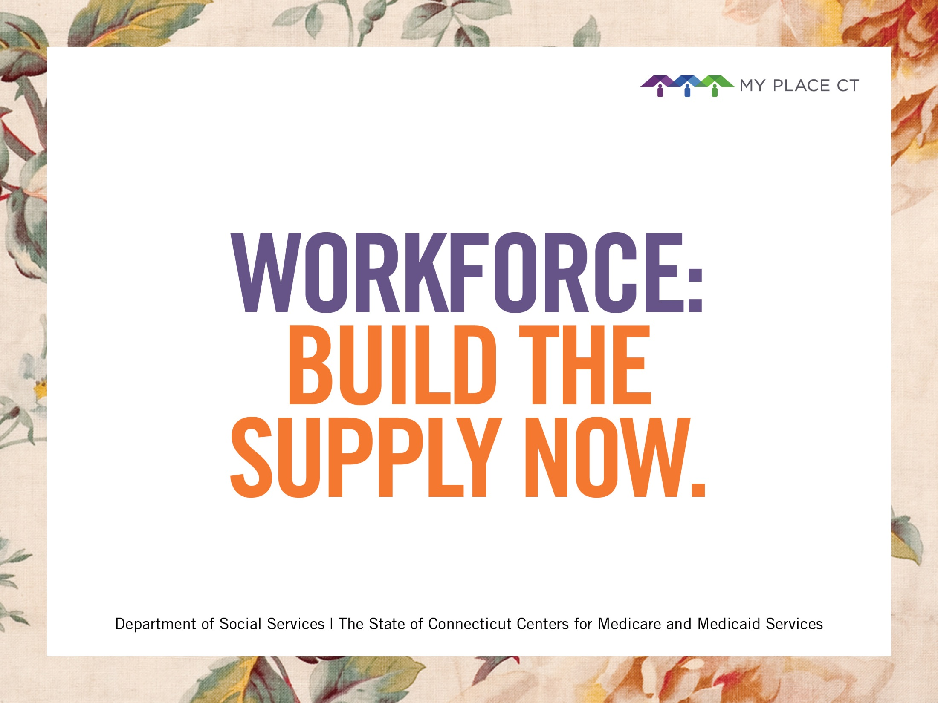
Notes:
The Workforce Stimulus program is designed to help boost the supply of personal care professionals in CT. We know there’s demand out there. Caregiver jobs represent the fastest growing employment segment. And if our goal is to match in-home personal care workers with older adults and people with disabilities, we need to take action to help ensure that the supply of people in the workforce is not outstripped by the demand. This program runs from now, through the end of the year.

Slide 19


Billboard
Notes:
The “theme line” we are using to alert people to the benefits of becoming an in-home care worker is “In-home is in demand.” You’ll find it on every piece in the program. There’s wordplay going on here, but it’s also designed to be a very clear message. Here you see a billboard that is currently being displayed throughout the state.

Slide 20

Strip Ad
Notes:
We are also running advertising in local papers. We opted for a smaller space ad with a consistent line.

Slide 21
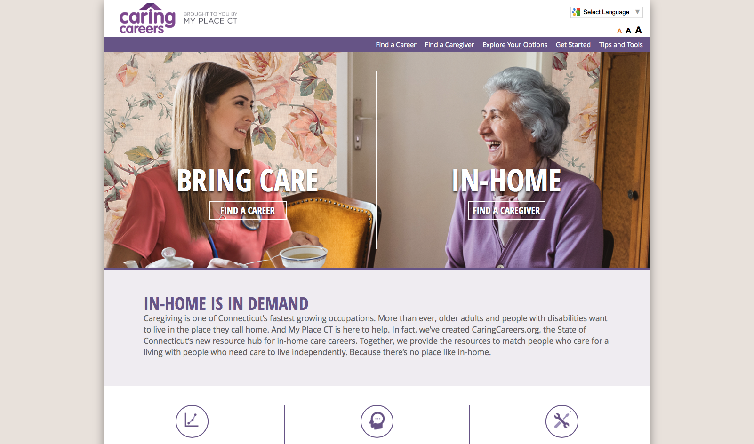
CaringCareers.org
Notes:
And we have created a microsite — at the URL, CaringCareers.org — that helps people navigate the process of finding a job and drives them to our sister site, CTHires.org where they can see a list of in-home care jobs by title and community.

Slide 22
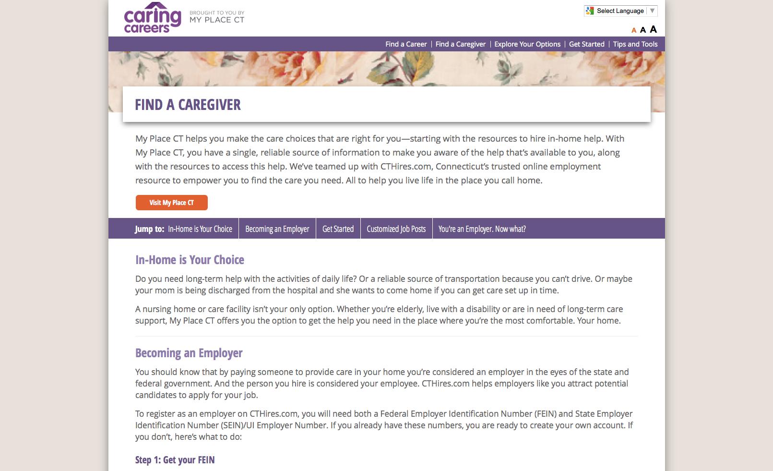
CaringCareers.org/find-a-caregiver
Notes:
We built a section into the microsite that helps consumers find a caregiver.

Slide 23

TV Spot
Notes:
We just completed production on a TV spot which I will play at the end of my remarks, so please stay tuned for that.

Slide 24
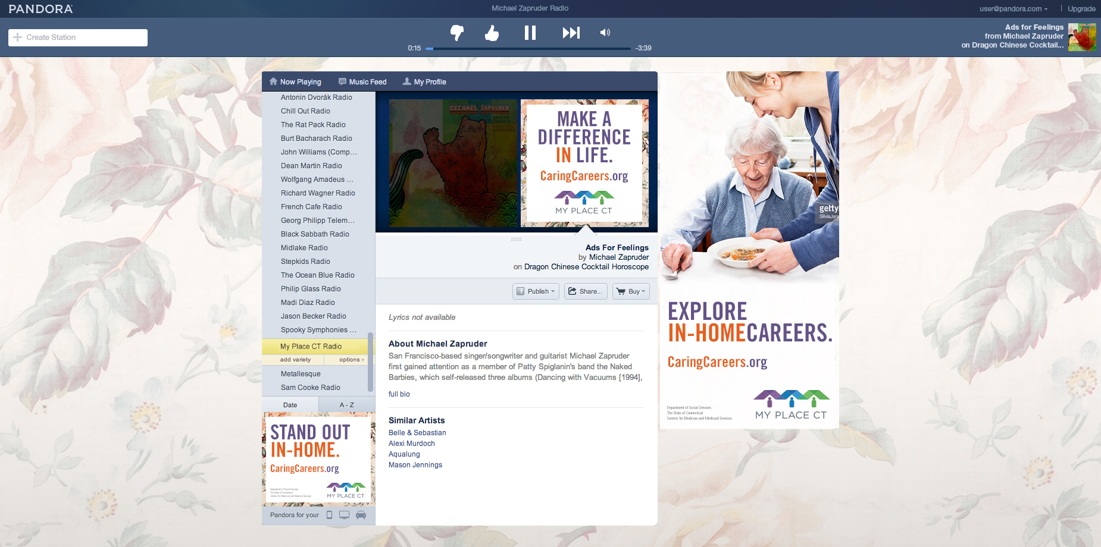
Pandora
Notes:
We are advertising on Pandora in three ways. With banners that drive people to our microsite. (More on the site in a minute…) With spot radio. And with spot video. Throughout the state Pandora reaches more people than any other radio outlet and it is especially good at reaching a younger demographic of people who have just entered the workforce and are looking to establish a career.

Slide 25
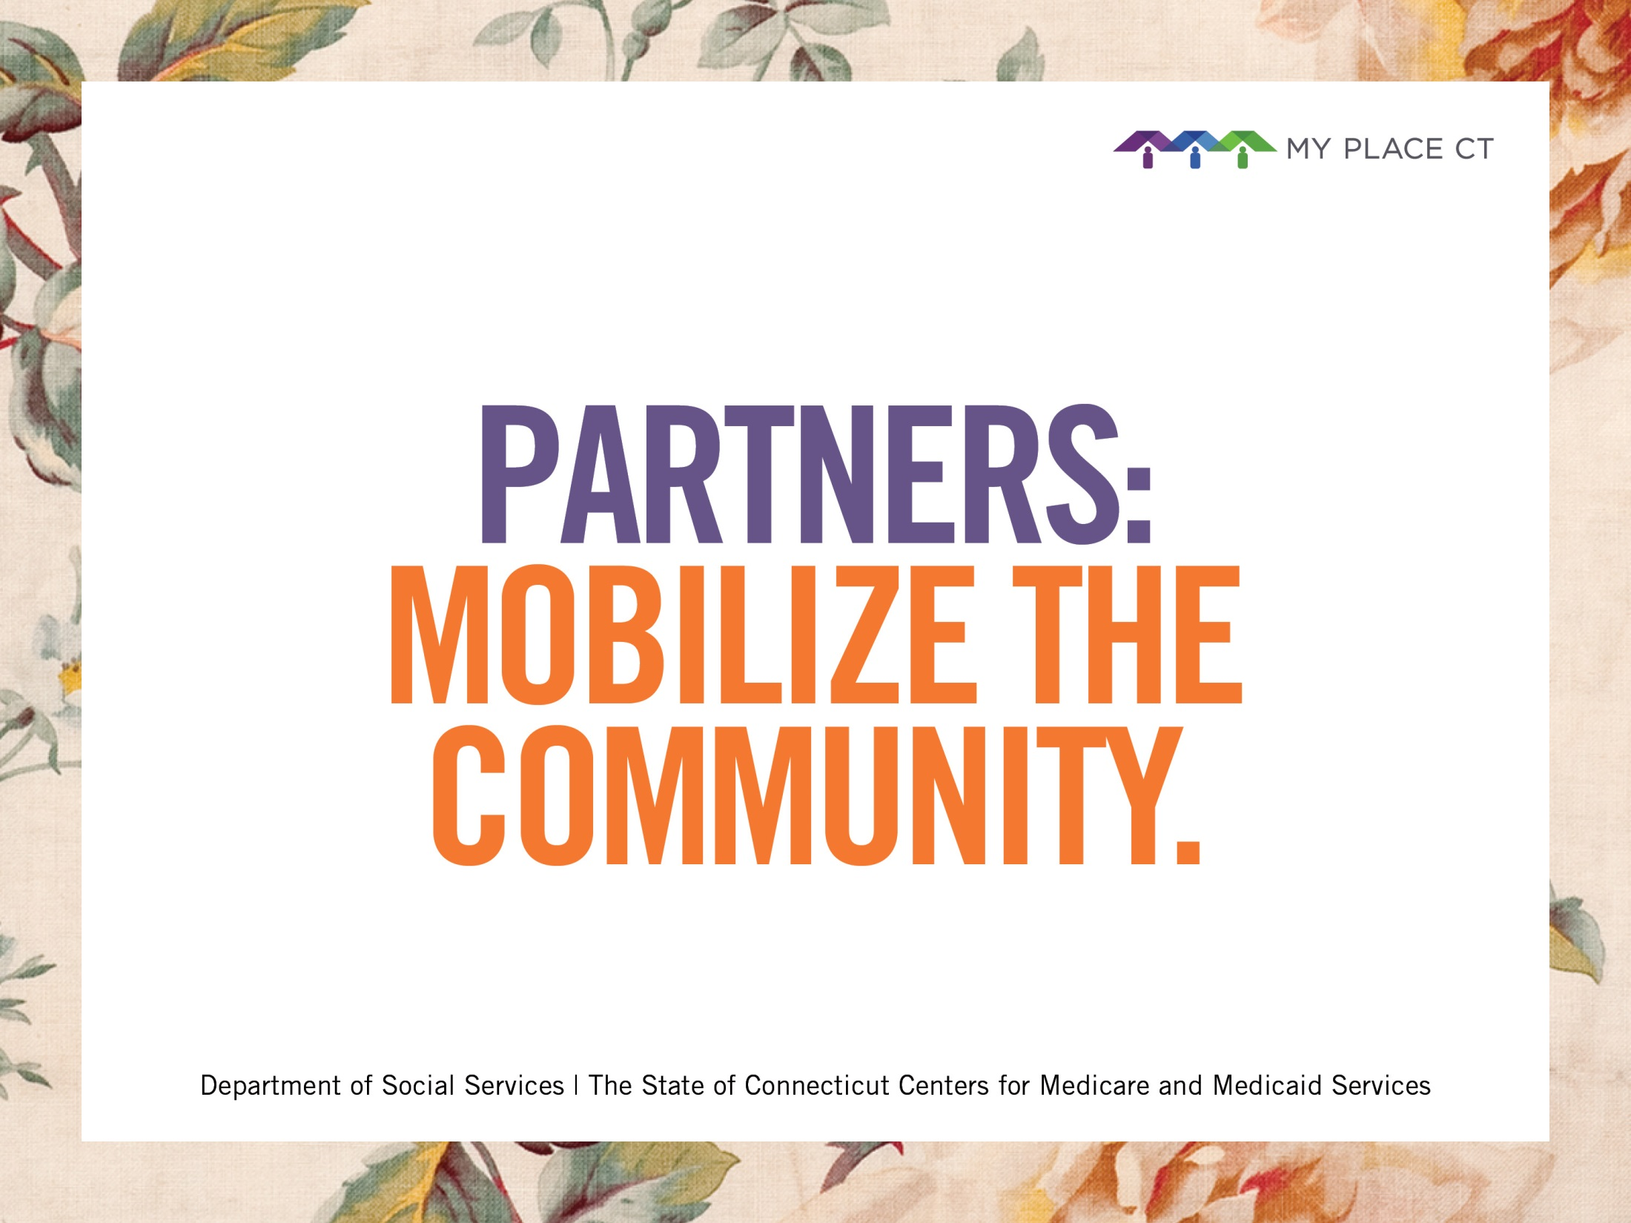
Notes:
Next up, let’s talk a little about the My Place CT “Care through Community Partner network.” This is where job seekers and consumers can get in-person help. There are really four kinds of partners in the Community network.

Slide 26
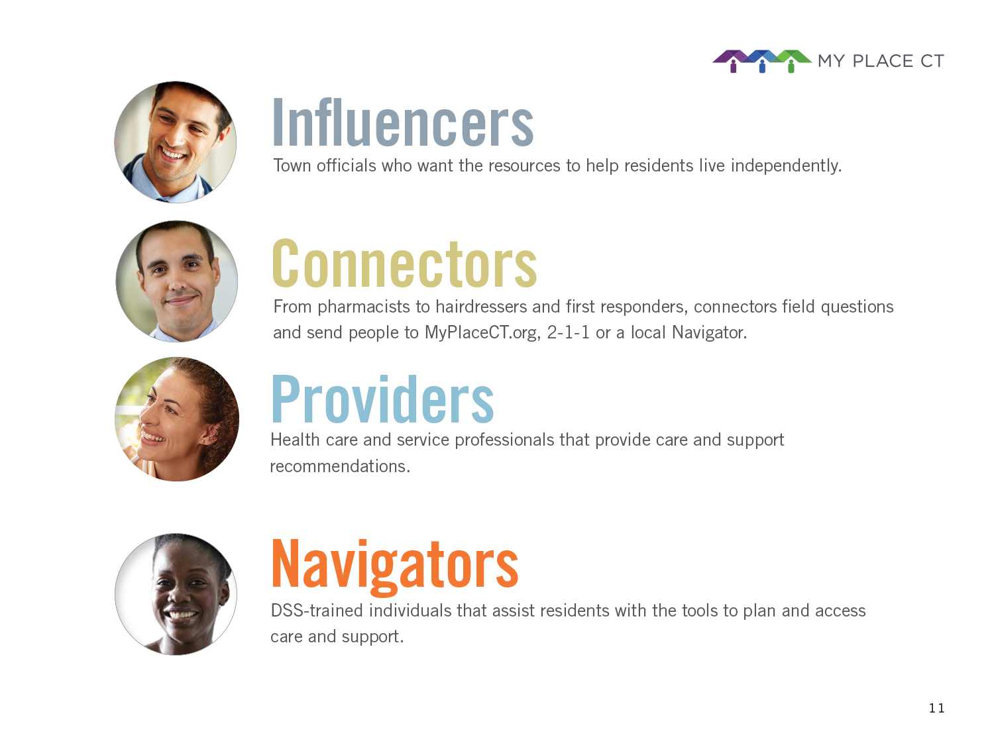

Town officials who want the resources to help residents live independently.
From pharmacists to hairdressers and first responders, connectors field questions
and send people to MyPlaceCT.org, 2-1-1 or a local Navigator.
Health care and service professionals that provide care and support
^{recommendations.}
DSS-trained individuals that assist residents with the tools to plan and
^{access care and support.}
Notes:
So what does a partner network look like? Influencers are town officials who want to see the people in their community live independently. Connectors may be folks like hairdressers, pharmacists and first responders who can point a client or family member in the right direction. Providers, obviously are healthcare professionals who offer care and support to their patients. And finally Navigators, who are DSS-trained people who help clients access the system.

Slide 27
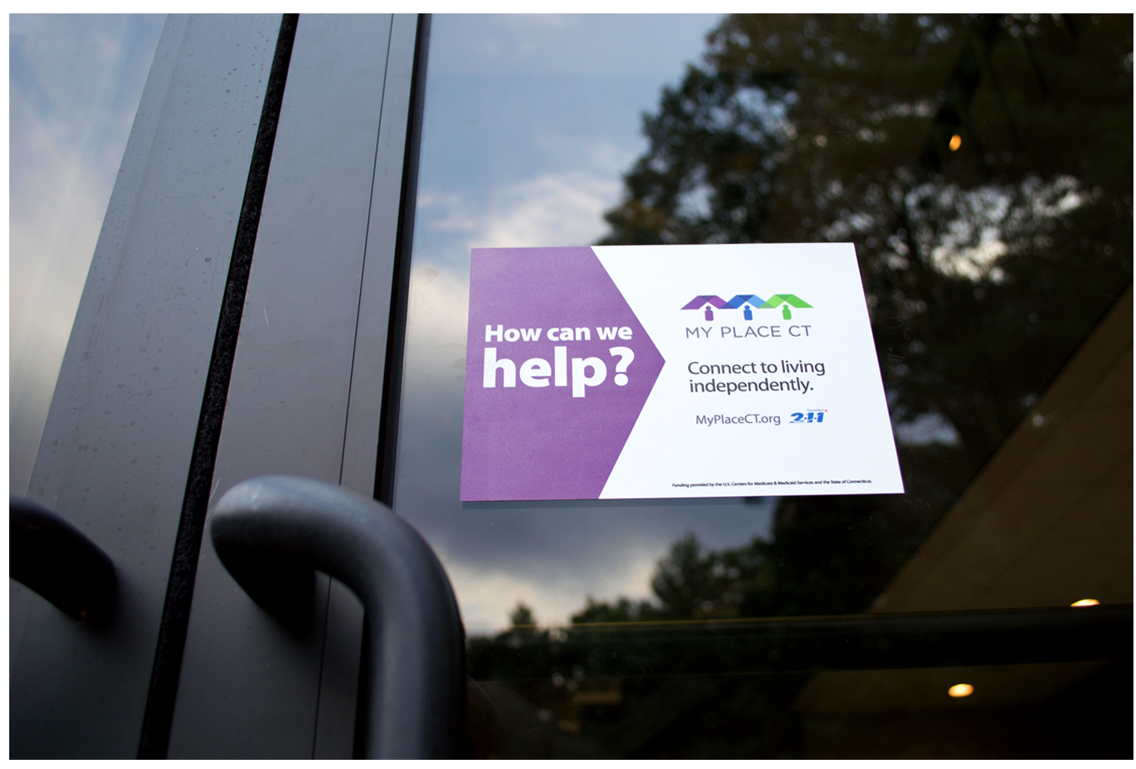
Window Cling
Notes:
The first component of the partner program was a simple sticker — it’s called a window cling. And it will help people throughout the community to identify a partner location. It asks the most important question our clients need to hear. How can we help?

Slide 28

Partner Materials
Notes:
We developed a range of materials that can be inexpensively printed and distributed to help people become a partner, from flyers to table tents to bookmarks and pins.

Slide 29
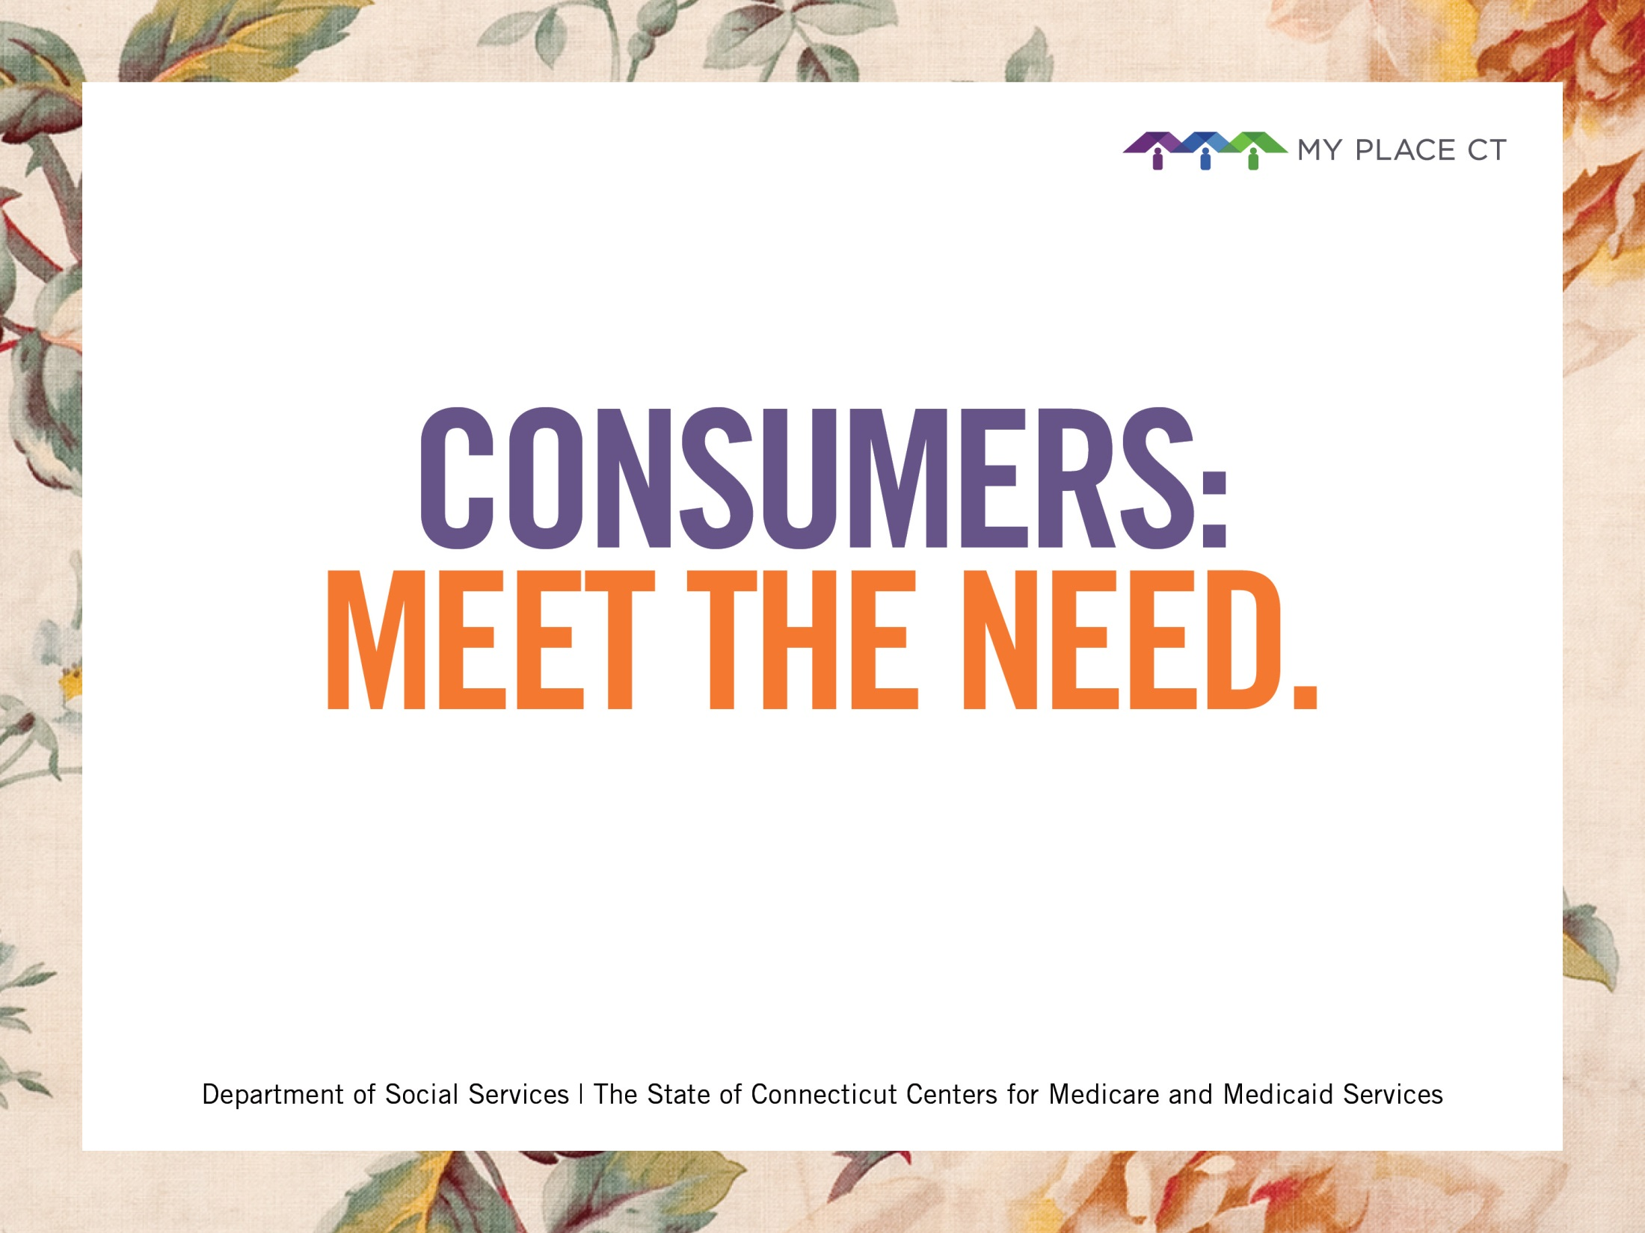
Notes:
We have just begun production of the consumer awareness campaign, which you will start seeing in the first quarter of 2017 throughout the community.

Slide 30

Billboard
Notes:
The consumer awareness program will include PR, television, print, outdoor, and a number of additional tactics. The idea of the campaign is to help consumers and families find resources and help so they can live independently.

Slide 31
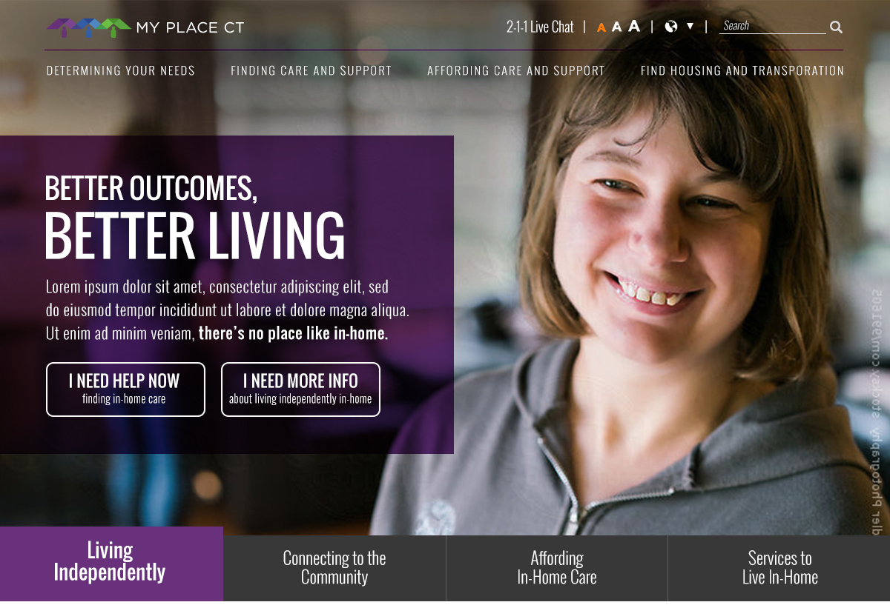
MyPlaceCT.org Homepage
Notes:
I’ve saved the web site for last because, for many people, the web site represents the last link in the chain before consumers find care and support. How many times have you needed answers and sat at your computer and typed something like…

Slide 32

“Is a nursing home my father’s
only option?”
“How can I hire a caregiver?”
“How can I afford my medicine?”
“How can I get help around
the house?”
“What is Medicaid?”
Notes:
“Is a nursing home my father’s only option?” “How can I hire a nurse?” “How can I afford my medicine?” “How can I get help around the house?” “What is Medicaid?”
Through good SEO practices, we plan to be able to bring people into the site and answer questions like these.

Slide 33
A direct link to help right now
Notes:
Features on the new web site will include: [List and explanations of each]

Slide 34
A direct link to help right now
Benefits Check-up

Slide 35
A direct link to help right now
Benefits Check-up
Benefits Pre-Screen

Slide 36
A direct link to help right now
Benefits Check-up
Benefits Pre-Screen
My Tool Kit

Slide 37
A direct link to help right now
Benefits Check-up
Benefits Pre-Screen
My Tool Kit
A Partner portal with unique log-in

Slide 38
A direct link to help right now
Benefits Check-up
Benefits Pre-Screen
My Tool Kit
A Partner portal with unique log-in
A Workforce section and landing page

Slide 39
A direct link to help right now
Benefits Check-up
Benefits Pre-Screen
My Tool Kit
A Partner portal with unique log-in
A Workforce section and landing page
Live support from 2-1-1

Slide 40
A direct link to help right now
Benefits Check-up
Benefits Pre-Screen
My Tool Kit
A Partner portal with unique log-in
A Workforce section and landing page
Live support from 2-1-1
More.

Slide 41

Partner Beta site: October
Live to the public: Early 2017
Notes:
This is planned for launch early 2017.

Slide 42
Partner Beta site: October
Live to the public: Early 2017
Notes:
This is planned for launch early 2017.

Slide 43
Thank you.
Notes:
Thank you.

Slide 44
Money Follows the Person
MFP Applications
*as of 8/31/2016 (n = 11,601)

Slide 45
Money Follows the Person
MFP Transitions by Program
as of 8/31/2016 (n = 3,959 transitions)

Slide 46
Money Follows the Person
MFP Transitions by Population
as of 8/31/2016

Slide 47
Money Follows the Person
Focus for MFP’s Final Years
In April 2016, CMS awarded Connecticut $129,920,175 extending the MFP Demonstration into 2020.
Housing Initiatives
  811 Grant
  Homelessness
Continue to demonstrate LTSS services
  Demo Addiction Services and Supports
  Informal Caregiver Supports
Community Options Unit – an integrated unit of the former
HCBS and MFP Units at DSS

Slide 48
Benchmarks
CT Medicaid LTSS Expenditures
Increase dollars to home & community-based services
Source: Center on Aging, University of Connecticut

Slide 49
Benchmarks
Percentage of Hospital Discharges to Home & Community Care
vs. Skilled Nursing Facility
Increase hospital discharges to the community rather than to institutions
Data Source: Connecticut Office of Health Care Access

Slide 50
Benchmarks
Percent of SNF Admissions Returning to the Community within 6 Months
Increase probability of returning to the community during the 6 months following
nursing home admission
Source: Center on Aging, University of CT

Slide 51
Benchmarks
Percent Receiving LTSS in the Community vs. Institutions
Increase the percentage of long term care participants living in the community compared to an institution
Data Source: Office of Policy & Management, Trends in Long-Term Care Annual Report

Slide 52
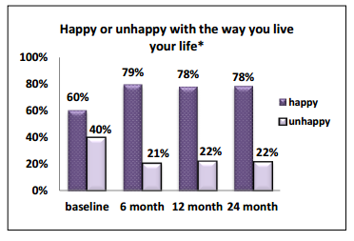

Benchmarks
Quality of Life
MFP Participant: Melanie Korotash
“It takes a village….”
1
Data: Center on Aging, UConn Health

Slide 53
Conclusion
Questions?

Slide 54
Conclusion
Resources
To apply for Community First Choice (CFC)
Dial 2-1-1, select Option #3; or
Apply online at ctmfp.com
For more information and to apply for Money Follows the Person (MFP)
Apply online at ctmfp.com
CT Testing Experience and Functional Assessment Tools (TEFT)
http://www.ct.gov/dss/cwp/view.asp?a=3922&q=562672
No Wrong Door Resources
MyPlaceCT
http://www.myplacect.org/
CaringCareers
www.CaringCareers.org

Slide 55
Conclusion
Contact Information
Deanna Clark
Health Program Assistant
Department of Social Services – Community Options Deanna.Clark@ct.gov
860-424-4984
Dawn Lambert
Project Director
Department of Social Services – Money Follows the Person
Dawn.Lambert@ct.gov
860-424-4897

