Slide 1
Medicaid Long Term Services & Supports
Rebalancing Updates
DSS Community Options
Money Follows the Person
Strategy Group

Slide 2
Topics
MFP Benchmarks
NH Closures
Litigation
Housing
Quality Improvement
CFC
UA
TEFT: PHR & eLTSS
NWD/MyPlaceCT
CaringCareers
Hospice
Informal Caregivers Initiative
Notes:
Guest Speaker

Slide 3
Presenters
Dawn Lambert, DSS
Christine Weston, DSS
Dane Lustila, DSS
Karri Filek, DSS
Talitha Coggins, DSS
Paul Ford, DSS
Tamara Lopez, DSS
Julia Evans Starr, Consultant
Deborah Migneault, UCONN

Slide 4
Benchmarks
Community First Choice

Slide 5
MFP Benchmarks
Transition 5200 people from qualified institutions to the community
Increase dollars to home and community based services
Increase hospital discharges to the community rather than to institutions
Increase probability of returning to the community during the six months following nursing home admission
Increase the percentage of long term care participants living in the community compared to an institution
(Based on latest data available at the end of the quarter)

Slide 6
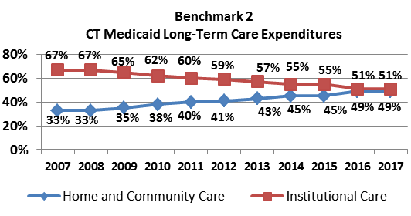
Benchmark 1: The number of demonstration consumers transitioned = 4,800
(non-demonstration transitions = 330)

Slide 7
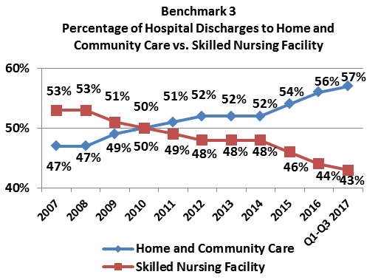
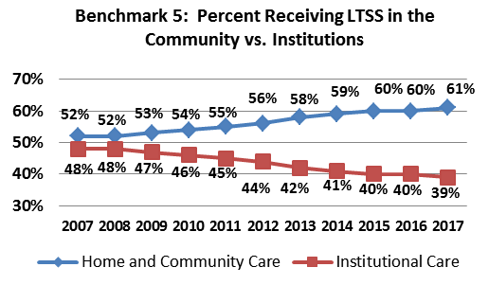
Source OPM and DPH data

Slide 8
Source OPM and DPH data

Slide 9
Source OPM and DPH data

Slide 10
Nursing Facility Closures
Community First Choice

Slide 11
Closure Procedures
Money Follows the Person Project Team (MFP) works collaboratively with the Nursing home staff, Ombudsman and Receiver, if applicable.
Identify preferences for setting and provide informed choice to all nursing home residents.
Assess and develop care plans for MFP eligible participants that meet their goals and needs.
Weekly meetings with the nursing home regarding MFP participants case status.
Collaborate with Nursing facility during the discharge process.
Support transition and ensure implementation of community care plan.

Slide 12
Current nursing home closures
Rosegarden
Bridgeport Manor
Census at start of closure: 41
Current census: 10
MFP involved residents: 9
Housing Units identified: 8
Declinations: 22
MFP to follow to next facility: 7
Transitions: 3
Projected community transition percentage: 20-25%
Closure is projected to meet the 60 days timeline on 9/16/18
Census at start of closure: 67
Current census: 33
MFP involved residents: 22
Housing units identified: 11
Declinations: 43
Transitions: 2
Projected community percentage: 25-30%
Timeline for closure is targeted for 9/26/18.

Slide 13
Nursing Home Closures and Anticipated Need: 2005 through 2025

Slide 14
Nursing Facility Closures SFY 2005-2018
Year | Nursing facility | Town | # of Beds closed
2005 | Hamilton | Norwich | 160
2006 | Mercyknowll | West Hartford | 59
2007 | Darien Health Care Center | Darien | 120
2007 | Oakcliff Convalescent | Waterbury | 60
2008 | New Coleman Park | Bridegport | 100
2008 | Haven Health Center of Waterford | Waterford | 90
2009 | Sterling Manor | East Hartford | 90
2009 | Griswold Health and Rehab | Griswold | 90
2009 | Cresent Manor | Waterbury | 115
2010 | Courtland | Stamford | 120
2010 | West Rock Health Care | New Haven | 87
2011 | Rocky Hill Skilled Nursing | Rocky Hill | 120
2011 | Soundview | West Haven | 102
2011 | Bishop's Coner Skilled Nursing | W. Hartford | 130
2011 | University Skilled Nursing | New Haven | 120
2012 | Richard Rosenthal Hospice | Stamford | 12
2012 | Tandet | Stamford | 130
2012 | Clintonville | North Haven | 112
2012 | Wethersfield Healthcare | Wethersfield | 210
2013 | Laurel Hill | Winstead | 75
2013 | Hilltop - Ansonia | Ansonia | 90
2015 | Marshall Lane Manor | Derby | 120
2015 | The Kent | Kent | 90
2016 | Holy Spitit Healthcare | Putnum | 40
2016 | Alexandria Manor | Bloomfield | 120
2016 | Astoria Park | Bridgeport | 135
2016 | Paradigm South Windsor | South Windsor | 100
2017 | Greensprings | East Hartford | 145
2018 | Ellis Manor | Hartford | 105
2018 | Blair Manor | Hartford | 98
2018 | Birmingham Health Center | Derby | 120

Slide 15
Litigation
Community First Choice

Slide 16
Litigation
Basis:
Federal Lawsuit involving Department of Social Services, Department of Mental Health and Addiction Services, Chelsea Place and Touchpoints of Manchester, alleging violations with the American Disability Act and Rehabilitation Act, concerning individuals with mental illness at risk of entering these nursing homes, but with appropriate services may live in community setting.

Slide 17
Extended Settlement Period
Following a joint motion to modify the settlement agreement in June 2018, the settlement was extended for a period of 6-18 months.
The extension agreement included 18 class members.
Since July 2018, 2 class members have been removed from the data tracking and 1 class member transitioned to the community.
There are currently 15 class members that the Departments’ continue to follow to satisfy the settlement obligations.
In-reach for informed choice has continued in the both skilled nursing facilities for the previously identified non-class members.

Slide 18
Housing
Community First Choice

Slide 19

Project Based Subsidy CT 811
COMMUNITY PARTNERSHIP
One component of the Frank Melville Supportive Housing Act of 2010 “creates a new emphasis on multifamily housing to encourage nonprofit sponsors to set aside up to 25% of units…”
PARTNERSHIP ACROSS AGENCIES
The Department of Housing and Urban Development (HUD), The Department of Housing (DOH), The Department of Developmental Services (DDS) Autism Spectrum waiver unit, The Department of Mental Health Coordinated Access Network (DMHAS-CANS), and The Department of Social Services Money Follows the Person (DSS-MFP) Demonstration are partnering in the project based subsidy program intended to serve very-low income consumers with disabilities.
PROCESS
CT is a 2013 awardee, to date two contracts have been executed.
Units become available based on turnover from each property.
Consumer access is limited to target populations of the partnered agencies listed above.

Slide 20
Project Based Subsidy
CT 811
Department of Housing Successes
4 properties under contract
1 is new construction
2nd Grantee of 2013 awardees to have units under contract and tenants leased.
36 units under contract
MFP : 5 leased units
CANS (DMHAS): 10 leased units
MFP CT has the fastest transition time for 811 units across all MFP states working with the 811 program.

Slide 21
Quality Improvement
Community First Choice

Slide 22
Overview of Quality Management Plan
Health and safety issues of consumers receiving HCBS
Training of providers, staff and other stakeholders
Consumer access to services
Provider qualifications
Consumer choice

Slide 23
Quality Management System Components
Quality Control
Quality Assurance
Quality Initiative

Slide 24
Quality Assurance Activities
Home and Community Visits
Critical Incidents
Site Reviews and Review of Consumer records

Slide 25
Quality Improvement Committee
The work of the committee is guided by essential questions as it relates to better health outcomes and higher participant satisfaction and the financial impact on the system.

Slide 26
Essential Areas of Focus
Assistive Technology
Community Integration
Social Determinants of Health
Self-Direction

Slide 27
Community First Choice
Community First Choice

Slide 28
Community First Choice
HUSKY Health Benefit
7019 unique applications (up 2300 since last year)
2416 active CFC participants
(this includes those participants using CFC with the PCA Waiver)
2611 cases recommended for closure/closed
207 pending care plan submission to DSS
2153 pending assignment to field

Slide 29
Community First Choice
Re-design and Re-assessment
On Jan 3, 2018, letters were sent to all applicants and active participants of CFC notifying them of a “design change” and informed everyone they would be reassessed for program eligibility and individual budget authorization.
CFC Access Agency staff began reassessments on all active CFC participants. This process is still 2/3 complete at this time.

Slide 30
Community First Choice
There is continued demand for the CFC Medicaid Option. As evidenced in the staggering number of applications over the last 3 years, CFC is serving an unmet need in CT.
Additional benefits of CFC is the growth of the workforce. Each additional participant accessing services, grows the workforce by a 2:1 ratio.

Slide 31
Universal Assessment v1.7

Slide 32
Universal Assessment (UA)
Over the last year the UA has been implemented across additional LTSS Programs.
  In March 2018 –Autism Waiver
  In June 2018 – PCA Waiver and ABI Waivers I & II
  In July 2018 – CHCPE Waiver
Focus has shifted to development of a quality training and quality assurance plan.
We currently have 300 assessors active in the system with 6,800 finalized assessments.

Slide 33
TEFT

Slide 34
TEFT had Four (4) Components
Awarded by CMS in 2014 to nine states to test HCBS tools
  Lewin conducted monitoring and evaluation
  Truven Health Analytics provided training and technical assistance
  Grants wrapped up in 2018
Why is TEFT unique?
  Focused on beneficiary experience within HCBS settings
  Focused on standardization, allowing for use of tools across HCBS populations
  Addresses the gap between HCBS populations and electronic exchange/health IT
  States tested four tools and these tools and lessons learned can be used by other state organizations (e.g., Medicaid agencies, AAAs, hospitals, providers)

Slide 35




TEFT Tools & Accomplishments
Experience of Care Survey (HCBS CAHPS® Survey)
  Obtained Consumer Assessment of Healthcare Providers and Systems (CAHPS®) trademark and National Quality Forum endorsement
  CT is using this with most waiver populations, with DDS and Mental Health to be added in the near future.
Functional Assessment Standardized Items (FASI)
  Developed a set of functional assessment measures for use with HCBS beneficiaries
Personal Health Record (PHR)
  To demonstrate use with HCBS beneficiaries – MFP Population to start and then expand to the entire CT Medicaid Population
  CT has a received an extension and anticipates launching the tool on September 20th
Electronic Long-Term Services and Supports (eLTSS) Plan
  Created eLTSS Dataset with 56 data elements
  Submitted data elements to standards development organization (goal eLTSS standard)
  CT developed an on-line tool for the Community First Population
    Allows participants to complete their tool-kit using an on-line automated tool that upon completion moves the kit through the approval process electronically and upon final authorization transmits the date directly to the fiscal intermediary and will transmit the plan into the participant’s PHR.

Slide 36

Coming Soon!

Slide 37
NWD/My Place CT
CaringCareers.org

Slide 38




No Wrong Door
MyPlace.org ~ Virtual hub
Helping people navigate
LTSS, Health & Well-being
Planning, End of Life
Caregiver Center (UConn)
Leverage Technology
Heighten Engagement
My Place Partners
In Communities Across CT
Navigators
Partner Portal
Training Hub
Empower – Plan for the Future – Access Key Services & Supports - Connect

Slide 39

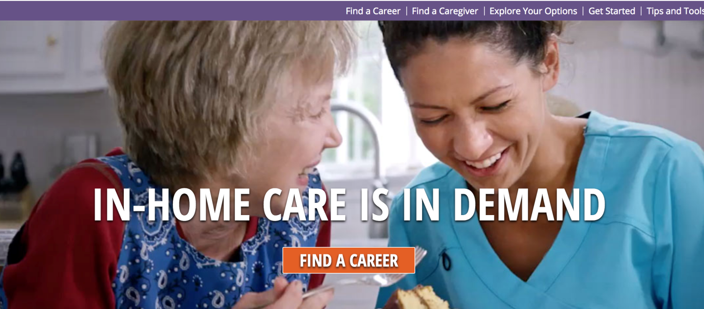
CTDOL occupational projections between 2016-2026
Home Health Aides
to increase by 34%
PCAs by 25%
CaringCareers.org
Now: hand-off to help PCA’s find jobs on CTHires.com
Next: Promote health & LTSS job opportunities
make connections & show ladder/lattice
Create an on-line platform for learning for job seekers & employers
~ Develop videos on select job types (eg: care coordinator)
~ Develop educational content on skills
~ Develop dynamic tools for the employers of PCAs
CTHires.com
Partner w/
CT Dept. of Labor
& GeoSolutions
Next: Create a CT
Portal to streamline, simplify and guide

Slide 40
Hospice

Slide 41
Baseline Analysis of Hospice Utilization in CT Medicaid Only and Dually Eligible Decedents
Overall Objective:
To identify the barriers to hospice care for State of CT Medicare/Medicaid participants with Chronic Medical Conditions.
Initial Baseline Data Analysis
UConn Center on Aging and Westat (formerly JEN Associates) in partnership with Yale School of Medicine conducted a baseline analysis of Medicare and Medicaid hospice claims from 2014 and 2016 of Medicaid-only and dually eligible decedents.

Slide 42
Hospice Utilization in Connecticut
Dually Eligible and Medicaid-Only Decedents

Slide 43
Type of Length of Hospice Utilization Among Hospice Users
Categories of Type of Length
  Appropriate Use: >7 days, <180 days
  Potentially Concerning Use:
    Hospice disenrollment or very long hospice enrollment (>=180 days) in 12 months prior to death
    Very short hospice enrollment (<=7 days) among hospice users prior to death
Notes:
¹ Patients with appropriate hospice used died under hospice care and had a single hospice episode the was >7 days and <180 days
² Patients with potentially concerning hospice use were hierarchically categorized into one of the three categories.
³ Patients in the disenrollment category either had multiple episodes and may or may not have died under hospice care, or they had a single episode that ended prior to death.
⁴ Patients with very short hospice use died under hospice care and had a single episode that was <=7 days.
⁵ Patients with very long hospice use died under hospice care and had a single episode that was >=180 days.

Slide 44
Type of Hospice Length
Dually Eligible Decedents
Dually eligible decedents that used hospice (n=5321)
52% with potentially concerning use (n=2,768)
48% with appropriate use (n=2553) defined as total days between 7 and 180 days
9.7% with disenrollment in 12 months prior to death (n=517)
36% with very short enrollment (≤7 days) prior to death (n=1913)
6.4% with very long enrollment(>180 days) prior to death (n=338)

Slide 45
Type of Hospice Length
Medicaid Only Decedents
Medicaid-only decedents that used hospice (n=541)
54% with potentially concerning use (n=292)
46% with appropriate use (n=249) defined as total days between 7 and 180 days
13.3% with disenrollment in 12 months prior to death (N=72)
40.7% with very short enrollment (≤7 days) prior to death (N=220)

Slide 46
Hospice Next Steps
Goals:
• Foster a conversation around how to discuss hospice care with Medicare/Medicaid participants and their families
• Increase public knowledge and awareness about hospice and the Medicare benefit.
Intervention:
Work with subject area experts and stakeholders to design an outreach/educational intervention targeting hospitals, physicians, and other practitioners to increase awareness and understanding of hospice benefits.

Slide 47
Informal Caregiver Initiatives

Slide 48
Informal Caregiver Initiative
Overall Objective:
Provide comprehensive information and resources to caregivers.
Focus Groups:
UConn Center on Aging conducted 2 focus groups (Hartford and Torrington) to gather qualitative data on caregivers’ needs. Focus groups were held in the last month; analysis in progress.

Slide 49
Informal Caregiver Initiative
Examples of Focus Group Questions
Please tell us how you have tried to find information or services, what methods or process have you used? Where do you look for information? How well has your search process worked?
What services or information have been the most helpful? What has worked well for you and your family member?
Does your family member get all the help or services that he/she needs? What additional help is needed? What prevents getting any needed help (probe: cost, not available in area, lack of information, language/culture differences)?
Do you get all the help you need? What additional help or services do you need, as a caregiver?

Slide 50
Informal Caregiver Initiative
Next Steps
Analyze focus group results and develop recommendations for informal caregiver supports, including the development of a technical assistance center.
Create online technical assistance center for caregivers through MyPlace.

Slide 51
Questions

Slide 52
Guest Speaker

