Slide 1
Trauma Activation Fee Patients
A Presentation to the Health Care Cabinet (Part II)
June 2021
Presented by: Alla Veyberman
Notes:
Laura

Slide 2
What is Trauma Activation Fee?
”Trauma Activation Fee” is the reimbursement associated with deployment of a hospital’s specialized trauma response team for a patient.
Reimbursement is based on special codes and related fee payment system.
The primary purpose of the fee is to help trauma centers remain financially viable, given the significant cost burden associated with professional and administrative resources needed to achieve and maintain the advanced level of readiness and capability of their critical care services.

Slide 3
Connecticut Designated Trauma Centers
Connecticut has 11 adult and 1 pediatric trauma centers designated and licensed by the Department of Public Health.
Connecticut Hospitals Designated as Trauma Centers
Trauma Level I | Trauma Level II |  | Trauma Level III
CT Children's Medical Center* | Bridgeport Hospital | Norwalk Hospital | The William W. Backus Hospital
Hartford Hospital | The Stamford Hospital | St. Mary's Hospital
St. Francis Hospital and Medical Center | The Waterbury Hospital | St. Vincent's Medical Center
Yale New Haven Hospital | The Danbury Hospital
*Pediatric

Slide 4
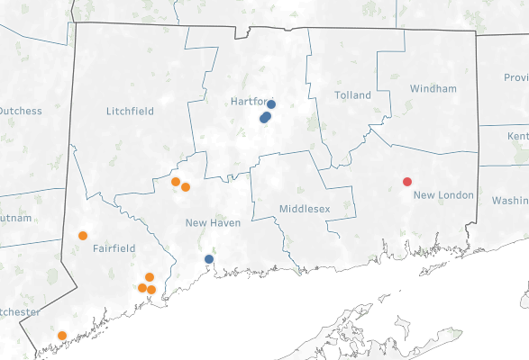
Connecticut Trauma Center Levels and Locations
Level I
Level II
Level III

Slide 5
FY 2015-2019 Statewide Trauma Discharges
Between 2015 and 2019, statewide trauma discharges increased by 62% from 2,308 to 3,733.

Slide 6
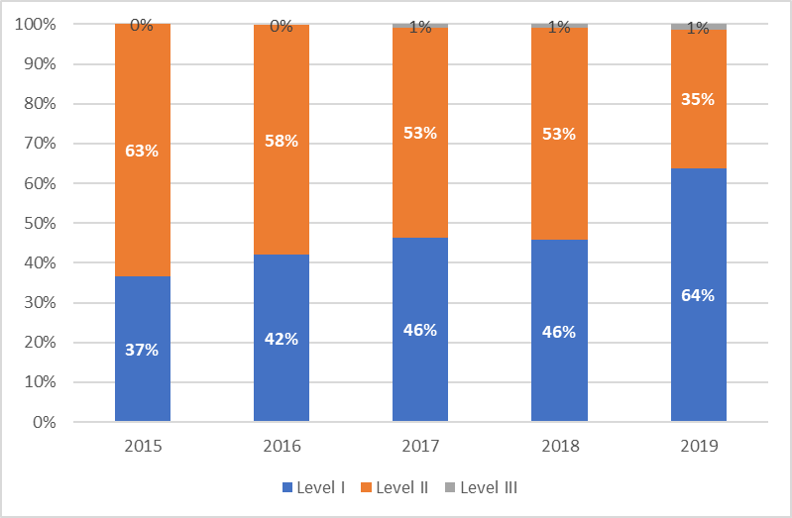
FY 2015-2019 Statewide Trauma Discharges
The share of Level I trauma patients has increased overtime.

Slide 7
FY 2019 Trauma Fee Statistics
7,115 patients were billed a trauma activation fee.
$32 million - Trauma activation fee charges billed.
2% of emergency department patients admitted to inpatient care had trauma team activated and fee billed.
0.4% emergency department patients treated and discharged without an overnight stay were billed a trauma activation fee.

Slide 8
FY2019 patient demographics*
* INPATIENT DISCHARGES ONLY

Slide 9
FY 2019 Trauma Patients by Gender and Average Hospital Stay
Trauma patients were nearly twice more likely to be males than females.
Male trauma patients also tended to have longer average hospital stays than their female cohorts, i.e., 6.8 days vs 5.2 days.

Slide 10
FY 2019 Trauma Patients by Age & Average Hospital Stay
Working age adults (18 – 64 years) made up over one-half of trauma patients followed by seniors (43%).
Working age adult trauma patients had longer average hospital stays (6.0+ days) compared to children (4.0 days) and seniors (6.0 days).

Slide 11
FY 2019 Trauma Patients by Race/Ethnicity and Average Hospital Stay
Over two-thirds of trauma patients were White Non-Hispanics.
Hispanic had shorter average hospital stays compared to White non-Hispanics and Black non-Hispanics, i.e., 4.5 days vs. 6.0 days.

Slide 12
FY 2019 Trauma Patients by Primary Payer Type
Most (72%) trauma patients had Medicare (42%) or Medicaid (26%) coverage.
Trauma patients were least likely (5%) to be uninsured.

Slide 13
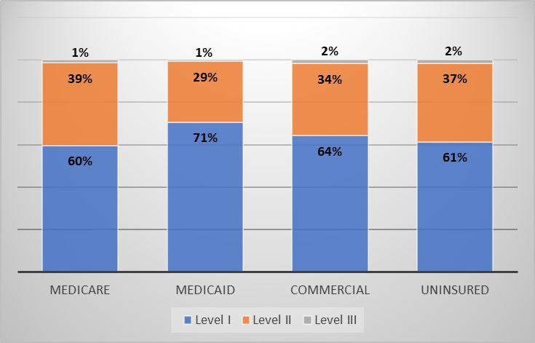
FY 2019 Trauma Level by Payer
Medicare patients were the biggest group of trauma patients across all three levels of trauma
Commercial patients were the second largest group for Level II and III hospitals
Level I patients were the majority for all payers

Slide 14
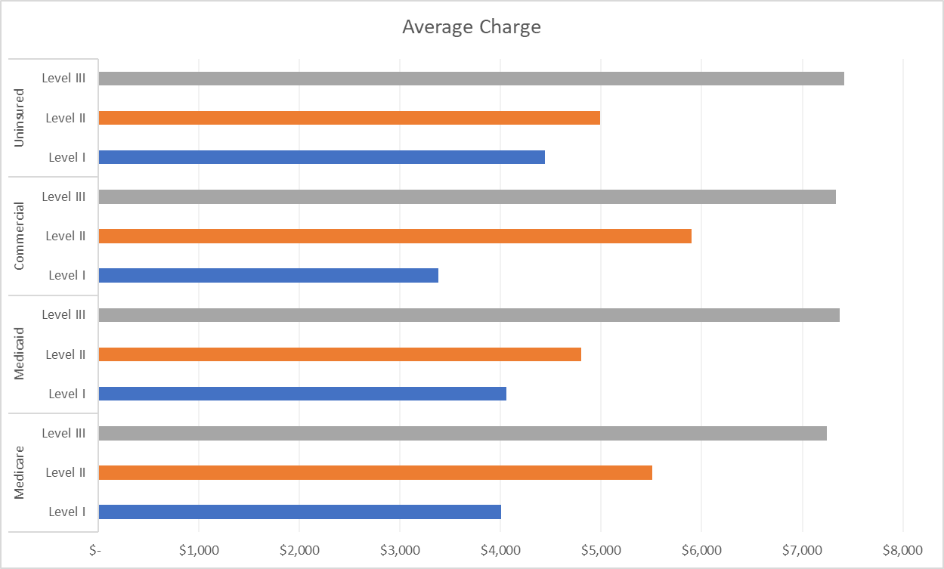
FY 2019 Trauma Charges by Payer
The average charge among all payers paid for Trauma activation fee was $4,461.
On average, Medicaid patients were charged $4,295 and Uninsured patients were charged $4,692.

Slide 15
FY 2019 Trauma Charges by Level of Trauma
The average charge among all levels of Trauma activation fee was $4,461.

Slide 16
FY 2019 Trauma Patients by County
79% of all trauma patients were from New Haven, Fairfield and Hartford counties.
Almost every third trauma patient was from New Haven county.

Slide 17
FY 2019 Trauma Patients by Town
Nearly one in four trauma patients (25%) came from Hartford, New Haven, Bridgeport, Stamford or Waterbury cities.
The remaining 75% came from over 100 other towns in CT.

Slide 18
Top Five Diagnosis for Trauma Patients
Nearly one in five patients who had trauma fee activation had these diagnoses:
23% MEDICAL BACK PROBLEMS W/O MCC
20% OTHER O.R. PROCEDURES FOR MULTIPLE SIGNIFICANT TRAUMA W/MCC
20% TRAUMATIC STUPOR AND COMA, COMA>1 HOUR W/CC
20% TRAUMATIC STUPOR AND COMA, COMA<1 HOUR W/CC
18% OTHER MULTIPLE SIGNIFICANT TRAUMA WITH CC

Slide 19
For more information on trauma policy
https://portal.ct.gov/OHS/Pages/Trauma-Activation-Fee
To know more about OHS visit
https://portal.ct.gov/OHS

Slide 20
Questions
?

