Slide 1


Lunch & Learn with OHA
October 17, 2023
12:00-12:30p
State Healthcare Advocate
Sean King

Slide 2


Presented by
Caroline Butler, RN, BSN
www.ct.gov/oha

Slide 3
Screening VS Diagnostic Tests for Breast Cancer
Screening mammograms are annual preventive exams, while a doctor may order a diagnostic mammogram based on any signs of breast cancer symptoms.
A diagnostic mammogram is more detailed than a screening mammogram. For women experiencing symptoms or to follow up on an abnormal screening.
Ultrasound is not typically used as a routine screening test for breast cancer.
Ultrasound can be especially helpful in women with dense breast tissue, which can make it hard to see abnormal areas on mammograms. It also can be used to get a better look at a suspicious area that was seen on a mammogram.
Resources and information can be found on the American Cancer Society Website.

Slide 4
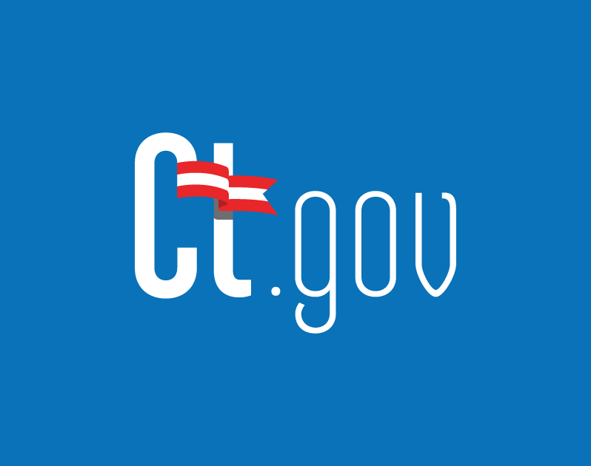
CT Insurance Laws Related to Breast Screening
Connecticut law requires certain health insurance policies to cover a baseline mammogram for a woman age 35 to 39 and one every year for a woman age 40 or older (CGS §§ 38a-503 and 38a-530, as amended by PA 16-82). Beginning January 1, 2017, it allows the covered mammogram to be provided by breast tomosynthesis (a three-dimensional mammogram) at the woman's option.
Policies must additionally cover a comprehensive ultrasound of a woman's entire breast(s) if (1) a mammogram shows heterogeneous or dense breast tissue based on the Breast Imaging Reporting and Data System (BI-RADS) established by the American College of Radiology or (2) the woman is at increased risk for breast cancer due to family history, her own history, genetic testing, or other indications determined by her physician or advanced-practice registered nurse (APRN). They must also cover magnetic resonance imaging (MRI) of a woman's breast(s) in accordance with American Cancer Society guidelines.

Slide 5
Current CT Insurance Law
State law applies to (1) individual or group health insurance policies delivered, renewed, amended, or continued in Connecticut that cover basic hospital expenses; basic medical-surgical expenses; major medical expenses; or hospital or medical services, including those provided under an HMO plan and (2) individual health insurance policies that provide limited benefit health coverage.
State law does NOT apply to:
  Employer-sponsored self-funded plans (also called “ERISA” plans)
  Medicare Advantage plans
  Plans written in other states (if for instance your coverage is through an out-of-state employer)

Slide 6
Current CT Law starting 2023, Breast and Ovarian Cancer Susceptibility Screening
This act expands coverage requirements under certain commercial health insurance policies for specified procedures used to treat or prevent breast or ovarian cancer. Specifically, it:
Expands health insurance coverage requirements for breast mammograms, ultrasounds, and magnetic resonance imaging (MRIs);
Requires coverage of certain procedures related to breast cancer treatment, including breast biopsies; certain prophylactic mastectomies; and breast reconstruction surgery, subject to certain conditions; and
Requires coverage for certain (a) genetic testing, including for breast cancer gene one (BRCA1) and breast cancer gene two (BRCA2), under certain circumstances; (b) post-treatment CA-125 monitoring (i.e., a test measuring the amount of the cancer antigen 125 protein); and (c) routine ovarian cancer screenings, including surveillance tests for certain insureds.

Slide 7
The act prohibits the policies from imposing cost sharing (i.e., coinsurance, copayments, deductibles, or other out-of-pocket expenses) for the above covered services. This cost-sharing prohibition applies to all affected policies, but it only applies to high deductible health plans (1) to the extent federal law permits and (2) so long as it does not disqualify a medical or health savings account from preferable tax treatment.
Lastly, the act makes minor changes, including adopting gender-neutral language (i.e., specifying that mammography, ultrasound, and certain other coverage requirements apply to any insured and not just women). The act’s requirements apply to fully insured individual and group health insurance policies delivered, issued, renewed, amended, or continued in Connecticut on or after January 1, 2023, that cover (1) basic hospital expenses; (2) basic medical-surgical expenses; (3) major medical expenses; (4) limited benefits; or (5) hospital or medical services, including those provided under an HMO plan.
Information on the current and new CT Law can be found on the CT.GOV website.

Slide 8
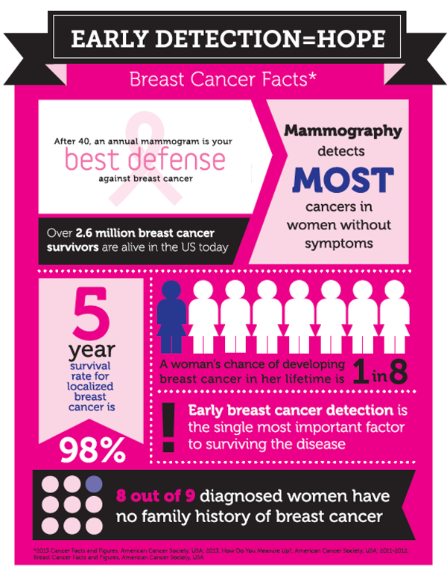
CT Breast Cancer Rates
According to CT Department of Public Health, CT has the second highest rate of breast cancer nationally.
Breast cancer is the most common cancer in CT women.
Incidence rates are higher in CT compared to the entire U.S.
In CT, breast cancer is the 2nd leading cause of cancer deaths in women.
A woman living in the United States has a 12.3 percent, or 1 in 8, lifetime risk of being diagnosed with breast cancer. In the 1970’s the lifetime risk of being diagnosed was 1 in 11.

Slide 9


How OHA CAN HELP
OHA can assist with insurance denials for cancer screening imaging, medications, chemotherapy, radiation treatment or any denial.
OHA can also help consumers understand their plans and what their plan covers. Based on if it is self-funded or fully insured plan.
OHA can assist with appeals for any breast or cancer related denials.

Slide 10

Thank you for joining us today.
Any Questions?
Email: Healthcare.Advocate@ct.gov
Phone: 866-466-4446
Web: www.ct.gov/oha

