Slide 1

Today: Insurance Options for Disabled Adult Children
October – Insurance Coverage for Breast Cancer Screenings
November – Understanding “Open Enrollment”
December – ERISA vs. Fully Insured Coverage & Consumer Rights
Lunch & Learn w/ OHA

Slide 2


TODAY’S TOPIC
Insurance Coverage for Disabled Adult Children brought to you by
Ted Doolittle
State Healthcare Advocate presented by
Jill Hall
OHA Nurse Consultant

Slide 3
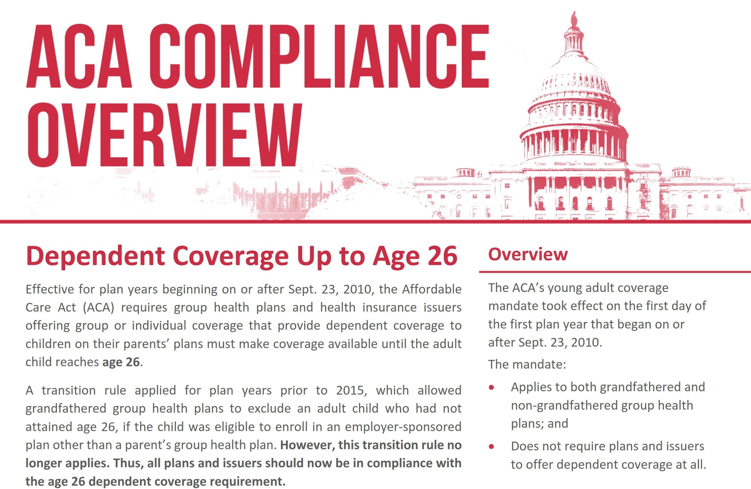

Slide 4


Slide 5
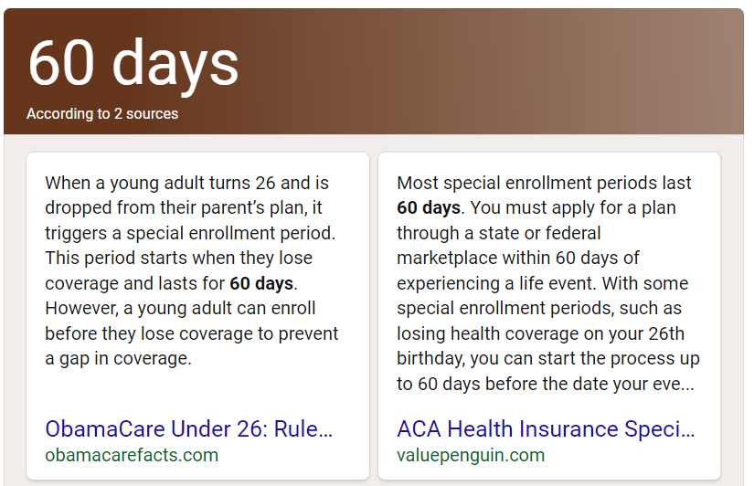

Slide 6

Insurance Options for Young Adults Coming Off Their Parent’s Health Insurance

Slide 7
Insurance Options for Young Adults
Commercial/Private Health Insurance
(individually purchased or provided by an employer)
Health Insurance Based on Financial Need
  Medicaid (HUSKY Health Plan)
  Government Subsidized Commercial/Private Health Insurance

Slide 8
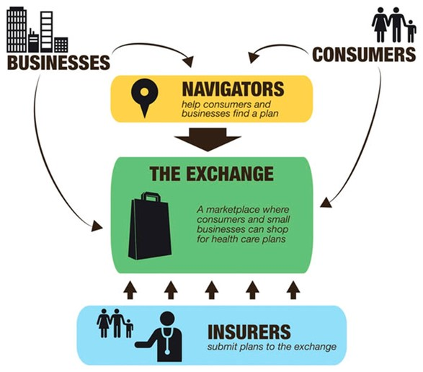
Insurance Marketplace

Slide 9


Slide 10

www.AccessHealthCT.com
Open enrollment : 11/01/2022 – 01/15/2023

Slide 11
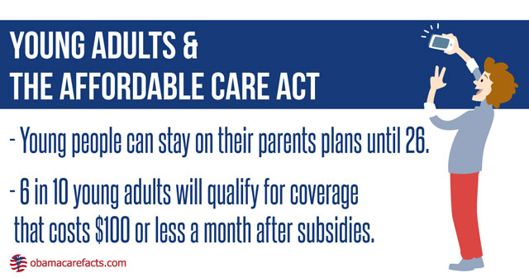

Slide 12


Options Young Adults with Disability

Slide 13


Slide 14

Navigating Disability Benefits

Slide 15
Healthcare
Benefits
Based
Upon
Disability
Social Security Administration (federal determinations)
Department of Social Services (state determinations)
Employer-Sponsor Health Insurance

Slide 16


Slide 17
Federal Disability
Determinations
Social Security Administration (SSA)

Slide 18
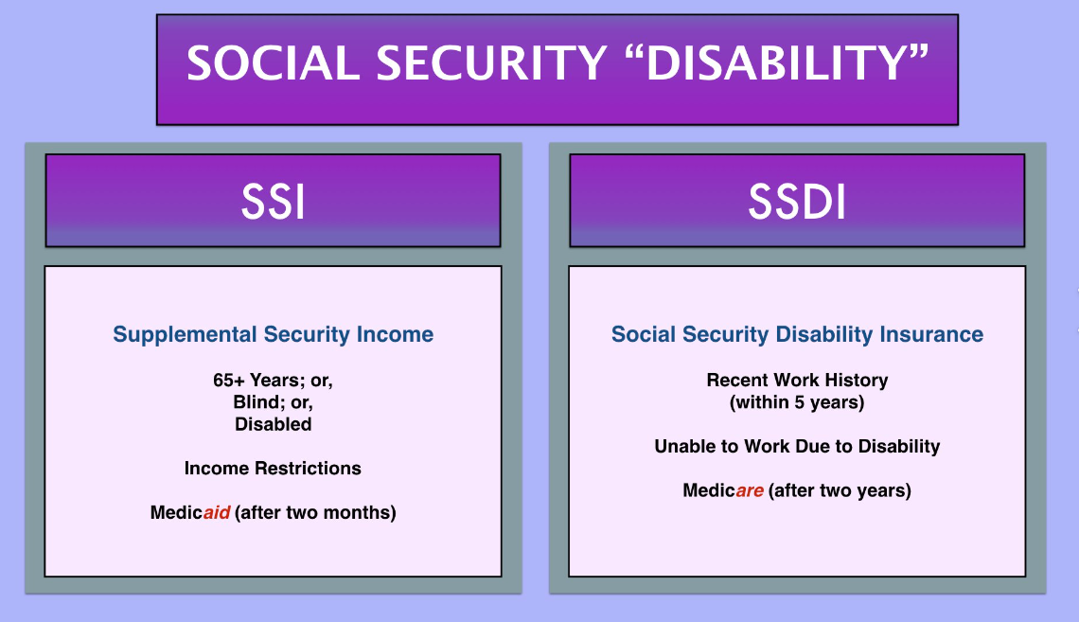

Slide 19
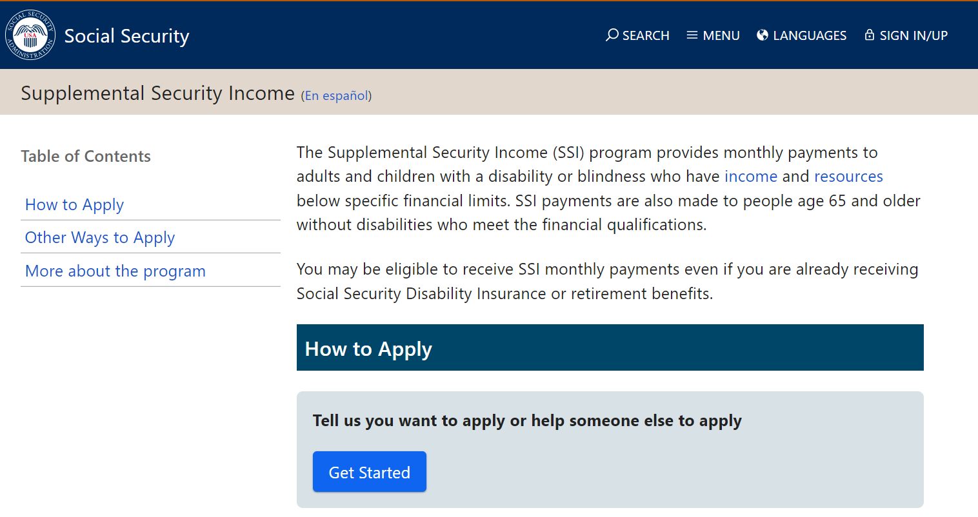

Slide 20


Social Security Disability Claims

Slide 21


Slide 22



Slide 23

Names for Medicaid in CT
HUSKY A
HUSKY B
HUSKY C (Title XIX)
HUSKY D

Slide 24
State Disability
Determinations
Department of Social Services (DSS)

Slide 25
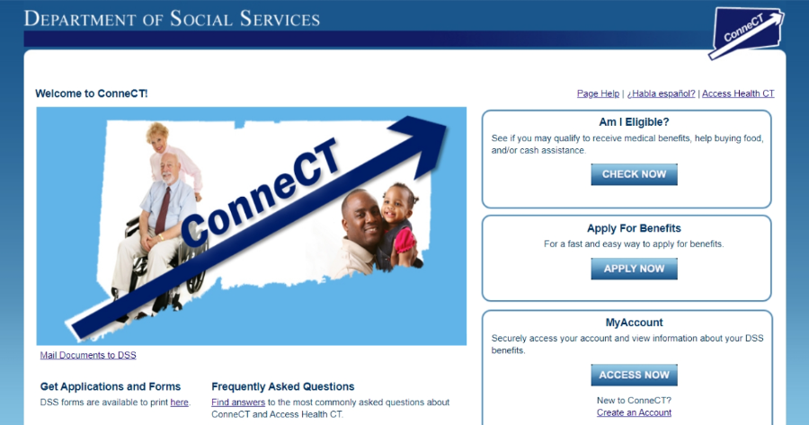

Slide 26

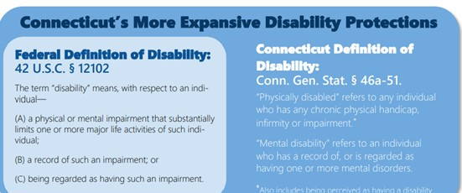
What is a Qualifying Disability?

Slide 27
Employer-Sponsored Health Insurance
Beyond Age 26

Slide 28


Slide 29
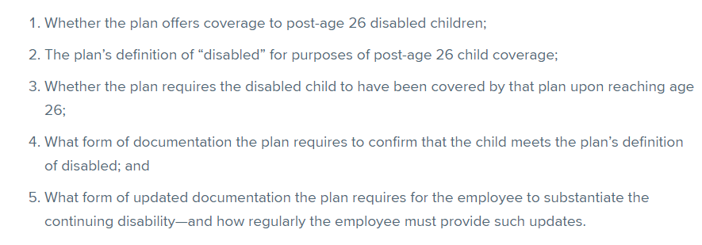
Factors that determine whether an employee may continue to cover a post-age 26 disabled child:

Slide 30

1. Federal disability and State disability determinations are two, separate processes.
2. Key ages 18 & 26 for insurance coverage action!
3. Some employers offer disabled child coverage beyond age 26, and dual private/public insurance is allowed.

Slide 31
Thank you for joining us today.
Any Questions?
Email: Healthcare.Advocate@ct.gov
Phone: 866-466-4446
Web: www.ct.gov/oha

Slide 32

Thank you for joining us today.
Any Questions?
Email: Healthcare.Advocate@ct.gov
Phone: 866-466-4446
Web: www.ct.gov/oha

