Slide 1


Lunch & Learn with OHA
March 22, 2022
12:00-12:30p
State Healthcare Advocate
Ted Doolittle

Slide 2
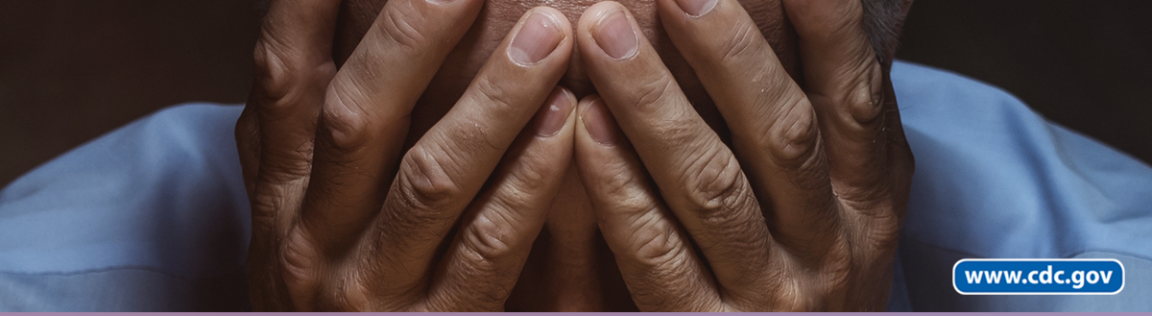
The Opioid Crisis: Getting Worse, Not Better!
Prepared by OHA Nurse Consultants: Annika Burney, Caroline Butler, Jill Hall, and Jackie Murillo
Presented by
Caroline Butler, RN
www.ct.gov/oha

Slide 3


28.5% National Increase in Drug Overdose Deaths
(Apr 2020 – Feb 2021)
CDC National Center for Health Statistics
  Cocaine
  Psychostimulants, such as methamphetamine
  Natural and semi-synthetic opioids, such as prescription pain medication
  Synthetic opioids (primarily fentanyl)

Slide 4
Fatal Overdoses, CT (2012-2020)
Source: CT Open data; CT Office of the Chief Medical Examiner., 2020

Slide 5
Fatal Overdoses by County, CT (2018-2020)
CT Open Data; CT Office of the Chief Medical Examiner., 2020

Slide 6
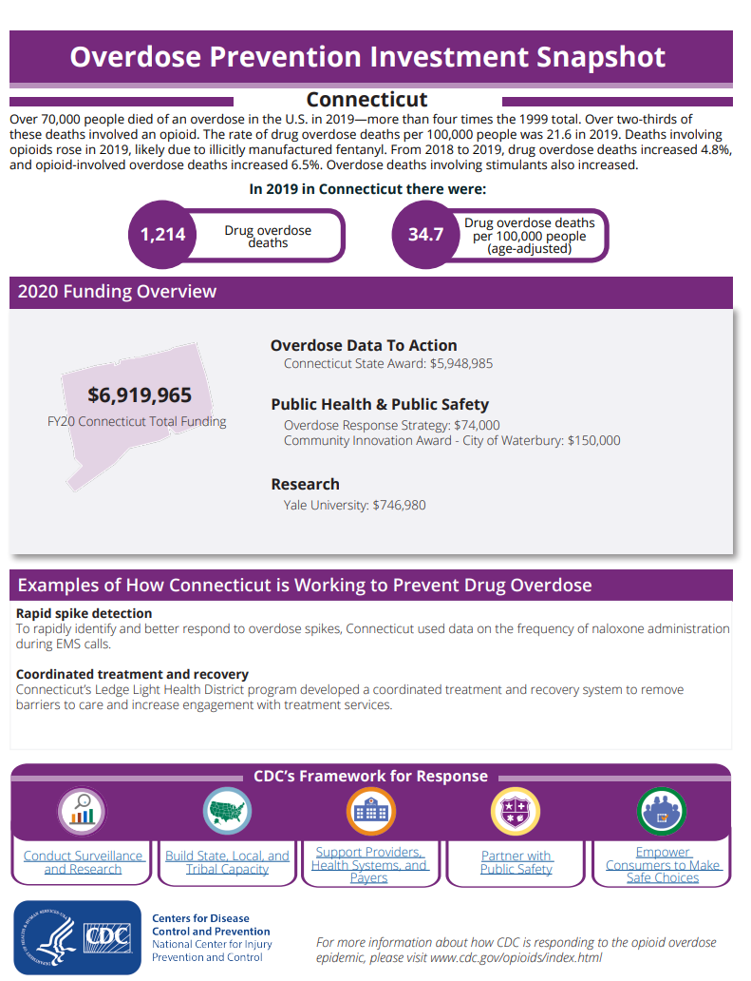
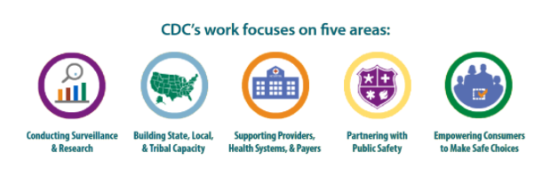
CDC Grant Period:
March 2016 – August 2019
Each of CT’s six Local Health Districts/Departments received $30,000/year from the CDC grant for the implementation of recommended evidence-based strategies identified in the Connecticut Opioid REsponse (CORE) Initiative

Slide 7
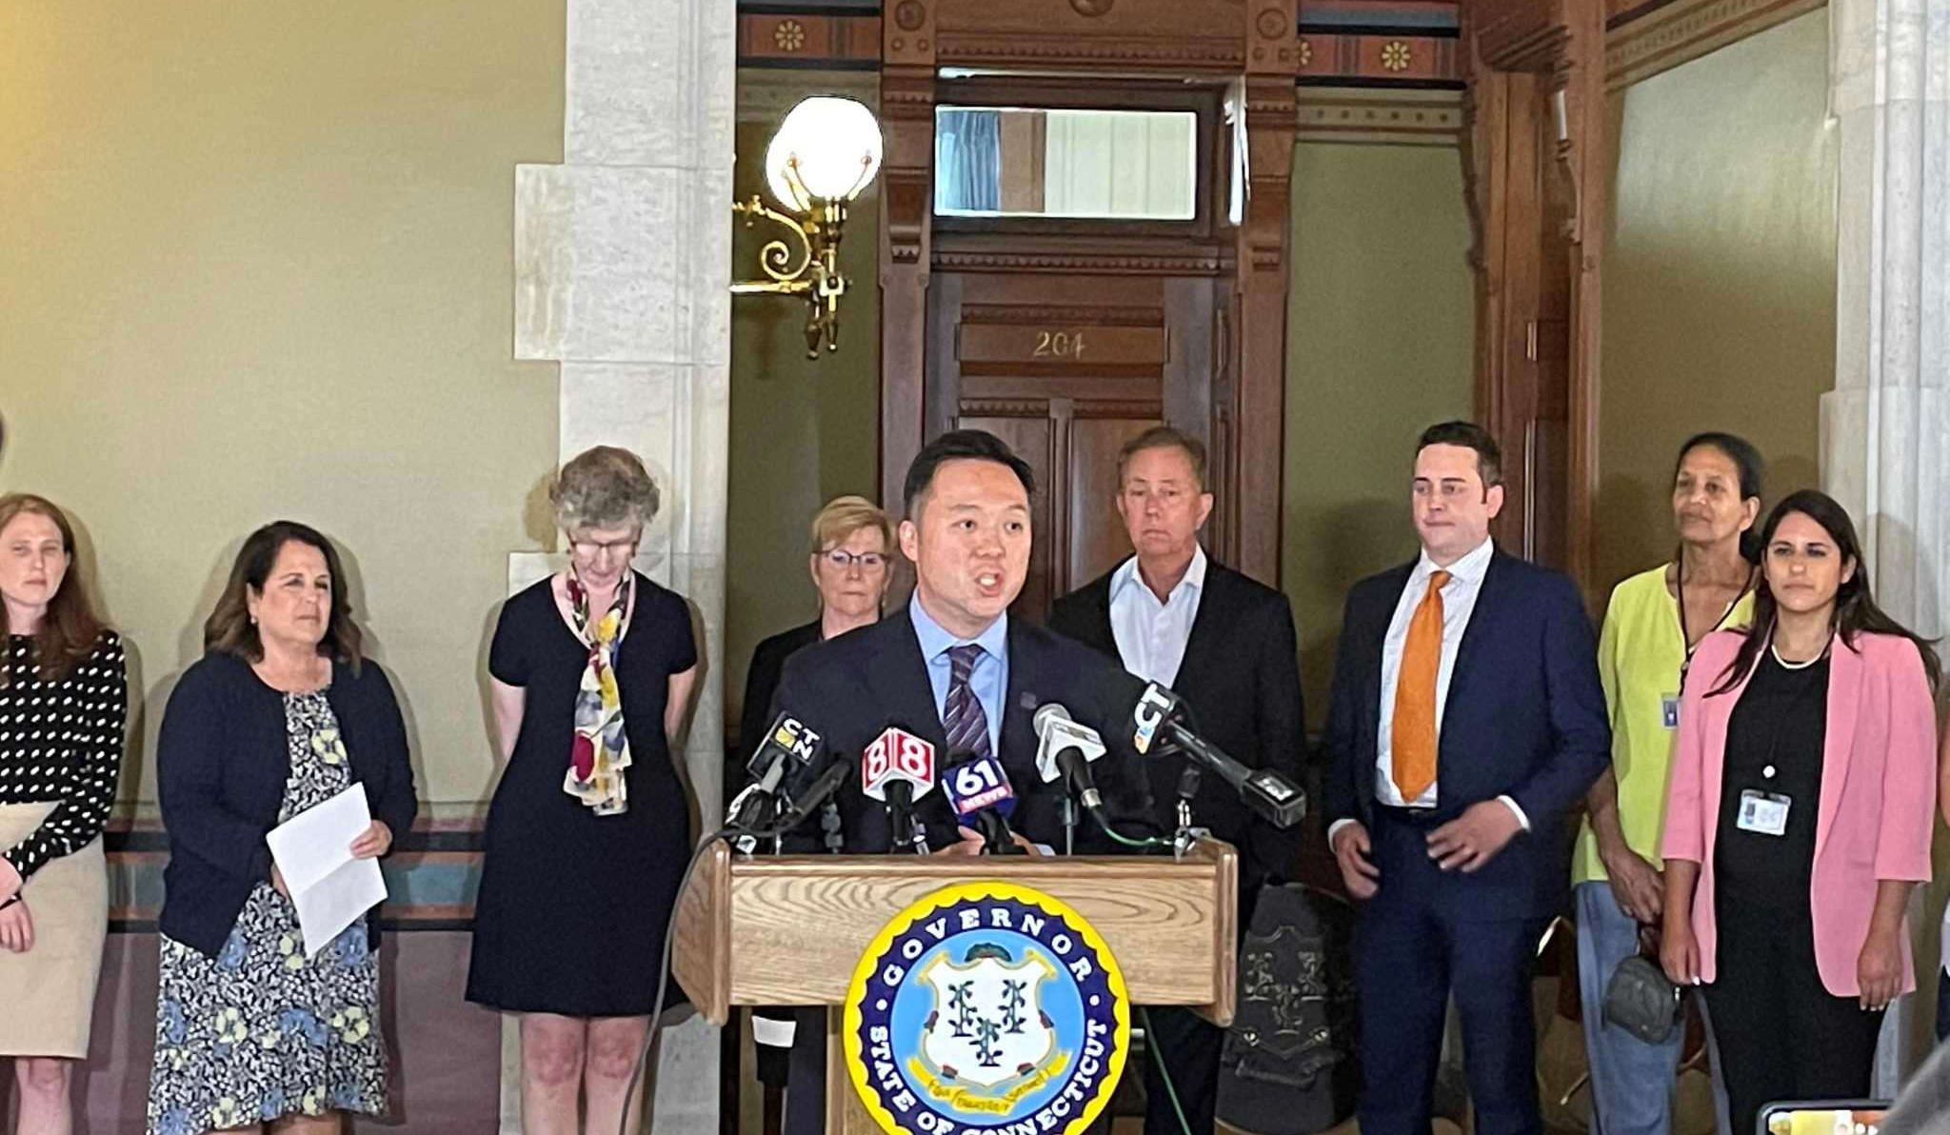
Connecticut to receive $300 million from national settlement with opioid distributors
State Attorney General, William Tong announcing Connecticut had participated in a $26 billion national settlement with AmerisourceBergen, Cardinal Health, McKesson and Johnson & Johnson related to their alleged roles in the opioid crisis.
Press Release, Office of the CT Attorney General. July 21, 2021

Slide 8

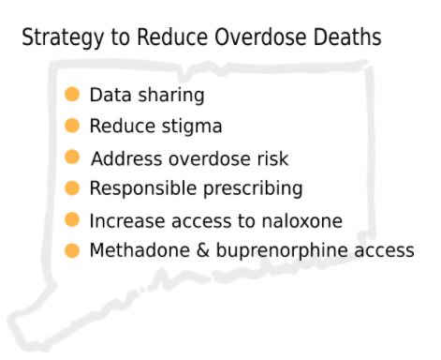
Notes:
Public Health / Public Safety Partnership.
Connecticut ORS Initiatives --Overdose Response Strategies—
Communication with local leaders, people/families at risk, resource providers
Mobile notifications
Radio / news PSAs
Mobilizing Resources
Harm reduction “rovers” and vans in hot spots
Harm reduction supplies (safer smoking kits)
Connection to treatment
Overdose education
Coordination with law enforcement- policing specific areas, drug take-backs
Safe stations
Post-Overdose outreachConnecticut ORS Initiatives
--Overdose Response Strategies—

Slide 9
Evidence-based Strategies for Overdose Prevention
Targeted Naloxone Distribution
Medication-Assisted Treatment (MAT)
Academic Detailing
Eliminating Prior-Authorization Requirements for Medications for Opioid Use Disorder
Screening for Fentanyl in Routine Clinical Toxicology Testing
911 Good Samaritan Laws
Naloxone Distribution in Treatment Centers and Criminal Justice Settings
MAT in Criminal Justice Settings and Upon Release
Initiating Buprenorphine-based MAT in Emergency Departments
Syringe Services Programs
Source: Safemeds.org
Notes:
Targeted Naloxone Distribution- to expand naloxone availability to include training and distribution to public bystanders, such as the families of opioid users.
Medication-Assisted Treatment (MAT)- the use of medications, in combination with counseling and behavioral therapies, to provide a “whole-patient” approach to the treatment of substance use disorders.
Academic Detailing- The process involves face-to-face education of prescribers by trained health care professionals, typically pharmacists, physicians, or nurses.
Eliminating Prior-Authorization Requirements for Medications for Opioid Use Disorder
Screening for Fentanyl in Routine Clinical Toxicology Testing- include in urine testing.
911 Good Samaritan Laws- was passed to protect people who call 911 seeking emergency medical services for an overdose from arrest for possession of drugs/paraphernalia.
Naloxone Distribution in Treatment Centers and Criminal Justice Settings- Naloxone Distribution (OEND). Programs in Jails and Prisons. People exiting jail or prison are at very high risk for opioid-related overdose ...
MAT in Criminal Justice Settings and Upon Release
Initiating Buprenorphine-based MAT in Emergency Departments- ED departments are now shifting to prescribe medications for the addictions to patients until thy are able to get into a program. Almost any amount of participation in opioid agonist MAT likely adds a meaningful chance of improving patient survival. At the very least, if a patient can be convinced to go into treatment for one week, that is one week their chance of death from overdose is reduced.
Syringe Services Programs- are community-based prevention programs that can provide a range of services, including linkage to substance use disorder treatment; access to and disposal of sterile syringes and injection equipment; and vaccination, testing, and linkage to care and treatment for infectious diseases.

Slide 10
CT Laws related to Opioids Overdose Prevention
In 2011, a Good Samaritan Law was passed to protect people who call 911 seeking emergency medical services for an overdose from arrest for possession of drugs/paraphernalia.
In 2012, a Narcan law was passed to allow prescribers (physicians, surgeons, Physicians’ Assistants, APRNs, dentists, and podiatrists) to prescribe, dispense or administer Narcan to any person to prevent or treat a drug overdose and the prescriber is protected from civil liability and criminal prosecution.
In 2014, protection from civil liability and criminal prosecution was extended to the person administering the Naloxone in response to an overdose.
In 2015, An act concerning substance abuse and opioid overdose prevention was passed to help curb heroin and prescription opioid abuse through more streamlined prescription reporting, continued education requirements for practitioners, and greater availability of the overdose reversing drug naloxone in case of emergency.
OLR Report 2017-R-0152. Connecticut’s opioid drug abuse laws.

Slide 11
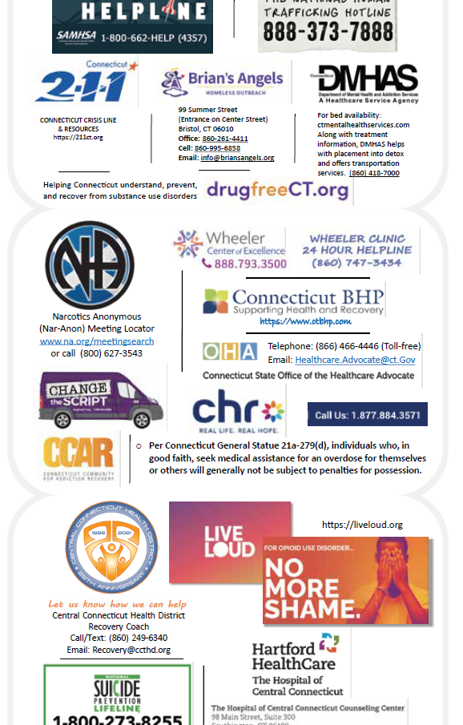
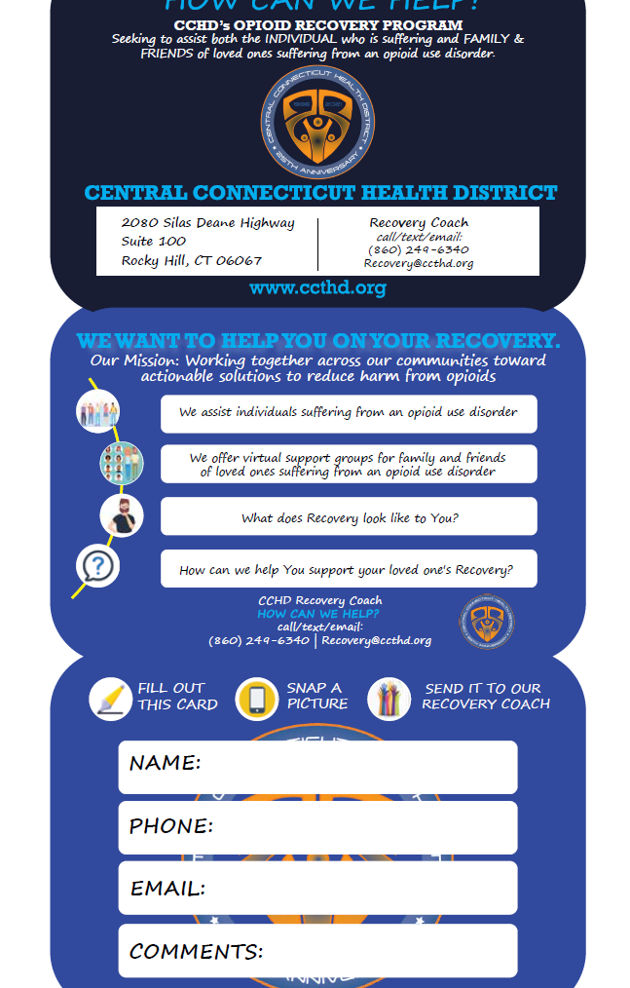
RESOURCES
Where to get additional Opioid & Prescription Drug Overdose Prevention Information:
Overdose Prevention Program (ct.gov)
Dept. of Public Health (DPH)
CT Office of Injury Prevention
(860) 509-8251
Prevention and Treatment (ct.gov)
Dept. of Mental Health & Addiction Services (DMHAS)

Slide 12

Thank you for joining us today.
Any Questions?
Email: Healthcare.Advocate@ct.gov
Phone: 866-466-4446
Web: www.ct.gov/oha

