Slide 1

Lunch & Learn with OHA
November 23, 2021
12:00-12:30p
Presenters: Ted Doolittle – CT Healthcare Advocate & Sean King – OHA Staff Attorney

Slide 2



Introduction
State Healthcare Advocate
Ted Doolittle

Slide 3

Important Changes in Health Care Coverage
New Connecticut Mandates
Cost Share Accumulator Programs
Formulary Stability
Dependent Child Dental and Vision Coverage
External Review Filing Fees
Insurance ID Cards
No Surprises Act
Sean King, Staff Attorney, Office of the Healthcare Advocate
****All the following information can be found on the OHA website: www.ct.gov/oha****
Notes:
Today’s Lunch & Learn will provide an overview of some of the most notable changes in health insurance coverage that will begin on January 1, 2022. Most of these changes are the result of new mandates passed by the CT General Assembly and will be applicable only to fully insured health plans such as those sold on the Access Health exchange. In addition, new federal rules addressing surprise billing by out-of-network providers will take effect at the start of the new year as well.

Slide 4
New Connecticut Mandates for Fully Insured Plans
Cost Share Accumulator Programs – Public Act 21-14
Formulary Stability – Public Act 21-96
Dependent Child Dental & Vision Coverage – Public Act 21-149
External Review Filing Fees – Public Act 21-157
Insurance ID Cards – Public Act 21-2 (June Special Session)

Slide 5
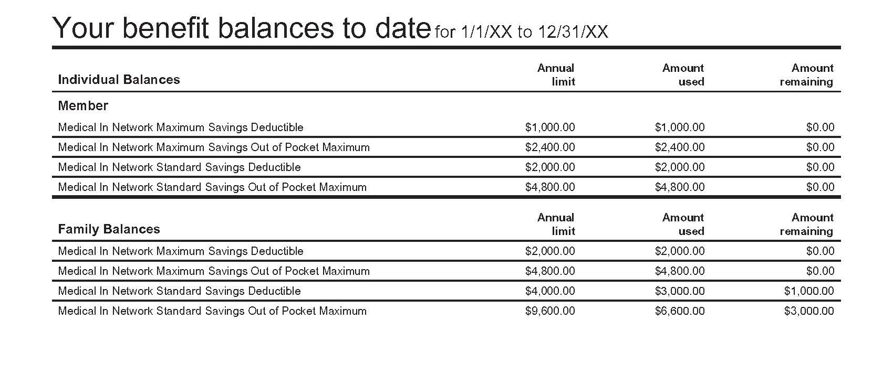
Cost Share Accumulator Programs
Public Act 21-14
Cost Share Accumulator Programs
  Insurer practice of refusing to give credit to patients for amounts contributed by third parties (e.g., drug manufacturer discounts) toward patient’s cost sharing (deductibles and out-of-pocket maximums)
  Result: higher out-of-pocket costs for patient & takes longer for patient to satisfy deductible
  Makes some expensive drugs more difficult or impossible to access

Slide 6
Cost Share Accumulator Programs
Public Act 21-14
Cost Share Accumulator Programs
  Insurer practice of refusing to give credit to patients for amounts contributed by third parties (e.g., drug manufacturer discounts) toward patient’s cost sharing (deductibles and out-of-pocket maximums)
  Result: higher out-of-pocket costs for members & takes longer for patient to satisfy deductible
  Makes some expensive drugs more difficult or impossible to access
Public Act 21-14
  Requires health insurers to give patient credit toward deductible for all third-party assistance
  Does not apply to self-insured employer sponsored health plans

Slide 7

Formulary Stability
Public Act 21-96
Drug Formularies
  List of all drugs covered by a health plan’s pharmacy benefits
  Drugs are divided among tiers that differentiate members’ cost sharing obligations
  Typically generics and other lower cost medications assigned to lowest cost tier

Slide 8
Formulary Stability
Public Act 21-96
Drug Formularies
  List of all drugs covered by a health plan’s pharmacy benefits
  Drugs are divided among tiers that differentiate members’ cost sharing obligations
  Typically generics and other lower cost medications assigned to lowest cost tier
Public Act 21-96
  Prohibits insurers from removing drugs from a formulary in the middle of a plan year
  Also prohibits insurers from moving drugs from lower to higher cost tier mid-year, unless patient’s cost remains below $40/month
  Insurers may still add drugs at any time
  Does not apply to self-insured employer sponsored health plans
Notes:
The following exceptions apply:
If the FDA raises an issue regarding the clinical safety of a drug, insurers may remove that drug with 90 days’ notice. Treating physician can override if medically necessary in spite of FDA notice.
With 90 days’ notice, insurers may remove a drug that is approved by the FDA for over-the-counter use.
Insurers may move a brand name drug from a lower tier to a higher tier if the FDA approves a therapeutic equivalent generic, and the insurer places the equivalent generic drug in a lower tier

Slide 9

Adult Child Dental and Vision Coverage
Public Act 21-149
Federal and State Rules Mandate Medical Benefits for Kids Until 26
But Dental/Vision Ended at Age 19
Public Act 21-149 Extends Adult Dependent (Child/Stepchild) Eligibility Through the End of the Plan Year During Which Dependent Turns 26
Will take effect for new plan years starting on or after January 1, 2022
Does not apply to Self-Insured Employer Sponsored Health Plans

Slide 10

External Review Filing Fees
Public Act 21-157
Prior to October 1, 2021, $25 fee was needed to access independent reviewer after exhausting internal insurance company appeals for denials based on lack of medical necessity.
Fee was refunded if denial was overturned
New law ends the fees, aligning Connecticut with most other states, which do not require consumer appeal filing fees

Slide 11
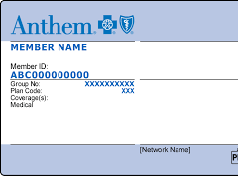
Insurance ID Cards
Public Act 21-2 (June Special Session)
Requires insurance cards to identify on the member’s card whether the health plan is “self-insured” (i.e. federally regulated) or “fully insured” (i.e., state-regulated)
Will assist consumers and advocates in identifying which laws and regulations apply, which will speed up resolution of disputes
Notes:
Difference between self-insurance and fully insured plans

Slide 12
No Surprises Act Rulemaking
July 1, 2021 Interim Final Rule – Part 1
  Defines requirements for health plan coverage of certain “surprise bills,” – which include charges for out-of-network emergency services, air ambulance services and non-emergency services at in-network facilities
  Limits cost sharing for such charges to in-network levels and applies cost sharing obligations to in-network deductibles and out-of-pocket maximums
  Prohibits out-of-network providers from “balance billing” the difference between their charges and the amount deemed to be payable under the health plan without a prescribed notice

Slide 13
No Surprises Act Rulemaking
July 1, 2021 Interim Final Rule – Part 1
  Defines requirements for health plan coverage of certain “surprise bills,” – which include charges for out-of-network emergency services, air ambulance services and non-emergency services at in-network facilities
  Limits cost sharing for such charges to in-network levels and applies cost sharing obligations to in-network deductibles and out-of-pocket maximums
  Prohibits out-of-network providers from “balance billing” the difference between their charges and the amount deemed to be payable under the health plan without a prescribed notice
September 30, 2021 Interim Final Rule – Part II
  Establishes independent dispute resolution process to settle payment disputes between out-of-network providers and health plans or uninsured patients

Slide 14
OHA SERVES ALL CONNECTICUT RESIDENTS AND/OR INSURANCE PLANS WRITTEN OUT OF CONNECTICUT
OHA DOES NOT WANT TO BE THE “BEST KEPT SECRET FOR CONNECTICUT”. HELP US CHANGE THAT.
PLEASE SHARE OUR CONTACT INFORMATION

Slide 15


Thank you questions?
OFFICE OF THE HEALTHCARE ADVOCATE
Healthcare.advocate@ct.gov
866-466-4446
www.ct.gov/oha

