Slide 1

Small Cities CDBG 2025
Virtual Application Workshop
Completing the e-Form
Accessing Bonus Points to increase the scope of work

Slide 2
Bonus points-phased projects only
Phase I
Phase II
CDBG Funds- up to $2.5M
Energy Conservation improvements e.g. roofs, thermal envelope insulation/siding, widows, doors, water heaters etc.
ADA upgrades to meet state 10% requirement
SSHiP Funds-Up to $5M- make property sustainable for 15-20 yrs.*
Community Room ADA improvements
Solar energy implementations

Slide 3

Bonus points-phased projects only
Phase II
SSHiP Funds-Up to $5M Plus Town Match
the remaining items e.g., interior renovations/updates.
Generators, whole-campus refrigeration, heating, cooling w/ a min of 3 powered outlets
Life safety systems- e.g. call for Aid, Campus Security
Notes:
Taking a closer look…..with

Slide 4


Town Match
Capping at 195 points
Capping at 137 points
Need and Impact
Capacity
How
Notes:
Need Impact-go for the max bonus of up to 100 pts
Capacity go for the maximum bonus

Slide 5


Need & Impact

Slide 6
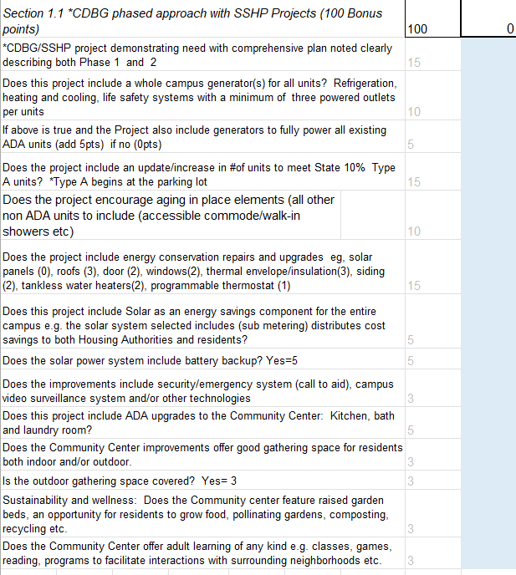
Get up to 100 Bonus pts
Section 1.1
include some of the following in your 1000-word project description
View the distribution in the Rating & Ranking workbook
Notes:
1. CDBG/SSHP project demonstrating need with comprehensive plan noted clearly describing both Phase 1 and 2
2. Does this project include a whole campus generator(s) for all units? Refrigeration, heating and cooling, life safety systems with a minimum of three powered outlets per units
3. Does the project include an update/increase in #of units to meet State 10% Type A units? *Type A begins at the parking lot ….
4. Does this project include Solar as an energy savings component for the entire campus e.g. the solar system selected should include (sub-metering) distributes cost savings to both Housing Authorities and residents?
5. Does the HA promote Sustainability and wellness: Raised garden beds, an opportunity for residents to grow food, pollinating gardens, composting, recycling etc.
6. How impactful is your HA? Does the Community Center offer adult learning of any kind e.g. classes, games, reading, programs to facilitate interactions with surrounding neighborhoods etc.

Slide 7

Capacity

Slide 8
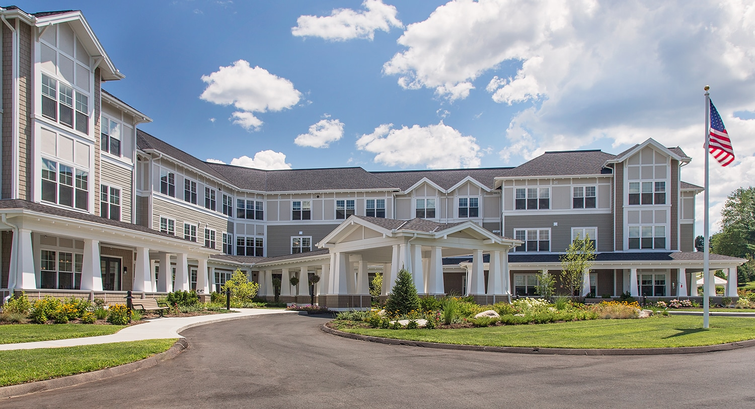
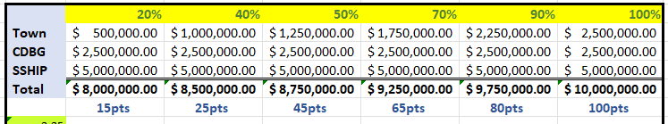
Town Match Funds-Get up to 100 Bonus points

Slide 9


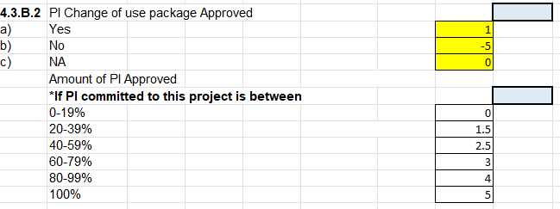
PI- Change of Use (approved and committed to this 2025 application)

Slide 10



Staff Capacity-Bonus Points
-15
+15
The members of the Applicant Team have experience with the CDBG program and have had excellent performance on open/closed grants (timely and accurate reporting, no citizen complaints, and effective and timely resolution with regards to any monitoring findings and/or concerns) in the last 5 years.
The members of the Applicant Team lack experience with the CDBG program OR are experienced but have had significant performance problems on open/closed grants untimely and inaccurate reporting, 4 or more citizen complaints, issues with complaint resolution, and repeated or prolonged monitoring findings and/or concerns in the last 5 years.

Slide 11

CGA Bonus-if you’ve followed along for the last 6 years
The members of the application administrative team are Certified Grant Administrators in good Standing. Teams must consist of municipal staff and consultants (both must be certified)- (3 pts.). One point for each additional member with a current CGA certificate in good standing (max of 3 additional points)

Slide 12
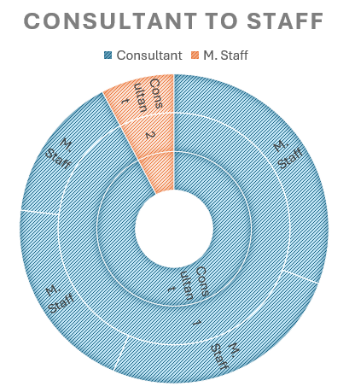
CGA-Bonus
One Consultant and 1 M. staff =3, (each additional certified staff 1pt up to 3 pts)
1 CGA Municipal staff w no Consultant =0; 1 consultant, 0 municipal CGA=-5; multiple Municipal staff with no consultant= 1.5

Slide 13
Bonus points for phase projects or even CDBG funds only.
June 7, 2025
For Phase projects, submit the CDBG (Phase I) application to DOH on June 7. In the project description Exhibit 1.1, fully describe both phases.
September 1, 2025
DOH will accept 40% D&S, but MUST complete the CONNAPP and submit to CHFA no later than September 1, 2025 with 90% D&S.
September 1, 2025
Failure to submit 90% D&S by September 1, automatically loose the bonus points earned and your application will be disqualified. Come back next year.

Slide 14

CDBG Funds only -
CDBG Funds with no SSHiP
still encourage these including other sources but NO SSHIP funds (Town should plan on absorbing the permit and fees, PI conversion, Eversource, Sustainable CT, Green Bank). MUST be submitted by
June 7, 2025 with 90% D&S
Notes:
Again this year, if you don’t complete this section accurately, your score will be negatively impacted.

Slide 15

Section 4
Project Feasibility & Merit
4.1 Budget Summary
4.2 Local leverage Funds
Notes:
4.2 local leverage. This is where we access your partnerships, your buying power and your level of firm/Conditional commitment at the time of application. We prefer to see firm commitments so put some skin in the game. Towns again this year are required to waive Permit & Fees
Our partners Eversource ,Sustainable CT and GreenBank this year will work again with applicants to prepare a firm commitment letter

Slide 16

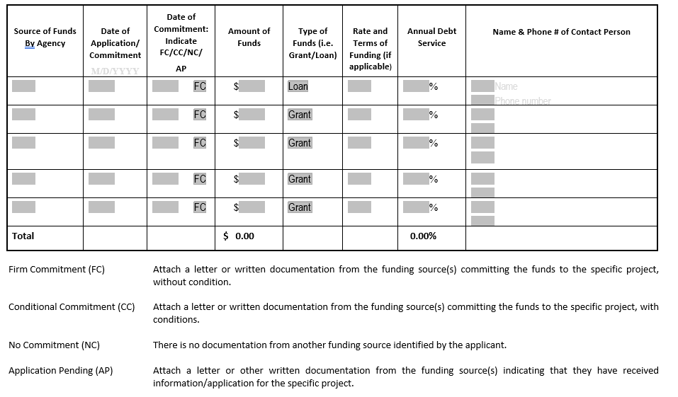
4.2 Local Leverage
List the sources of local match and leveraged funds. Amounts should be rounded to the nearest dollar.
Note. Sponsoring Municipalities are strongly encouraged to waive Permits and Fees applicable to this project (Firm Commitment).
Section 4.2
Local Leverage/Other Sources

Slide 17


