Slide 1



Slide 2
Small Cities CDBG 2025
Virtual Application Workshop
Completing the e-Form
Notes:
Since 2019 we have been promising that we will deliver a paperless/web-based application Well Guess what? Unfortunately, 2022 application season meets and greets everyone with this very effective “fantastic” word fillable form that we will continue to use until further notice.

Slide 3
Find These Forms on the DOH Website
Intent to Apply Form April 29, 2025
Application Handbook
Application Exhibits
Application Exhibit Checklist
Rating & Ranking
Documents requiring wet signatures
Application e-Form
Notes:
This is everything you’ll need to get your application done this year. Web based form email group will be posted online. Anything requiring signatures must be in blue ink. And clean copies check scans not twisted.
For Intent to Apply:
Indicate name and email of person responsible for submitting your grant.
All documents requiring wet signatures must be held and available upon request in your Application folder within your respective municipality.

Slide 4
File Naming Convention
General
Fair Housing
00.1 Town X FHO (Fair Housing Ordinance)
Other
00.4 Town X DFWP (Drug Free Workplace Policy)
00.3 Town X S3P (Section 3 plan)
00.5 Town X ERR (Environmental Review Record) Exempt, CENST and Broad level review for Housing Rehab.
000.3 Town X GCOC (General 3 Cert. of Compliance…)
000.2 Town X GALR (General 2 Adopted Local Resolution)
000.4 Town X GAC (General 4 Application Certification)….
00.2 Town X FHAO (Fair Housing Action Plan)
00.6 Town X CEPA (Connecticut Environmental Protection Act Checklist)
000.1 Town X GCA ( General 1 Corporation Agreement)
000.0 Portland SCAPP ( General 0 Small Cities Application)
Notes:
General Includes pages 1-6 of the application

Slide 5
File Naming Convention
Section 1
1.1 Portland PD (Project Description)
1.4 Portland GN (GIN Notice)
Section 2
Project Need
Section 3
3.1 R
3.1.A
1.4.A Portland RP (Relocation Plan)
3.1.B
Project Information
2.1 Portland PN (Project Need Narrative)
Capacity
2.1.A Portland WL (Waiting List)
Notes:
Very important to include the Town Name in the naming convention e.g. if your application is for Portland use Portland

Slide 6
Application
General Information Page
Make sure to complete this section accurately
Notes:
Again this year, if you don’t complete this section accurately, your score will be negatively impacted.

Slide 7
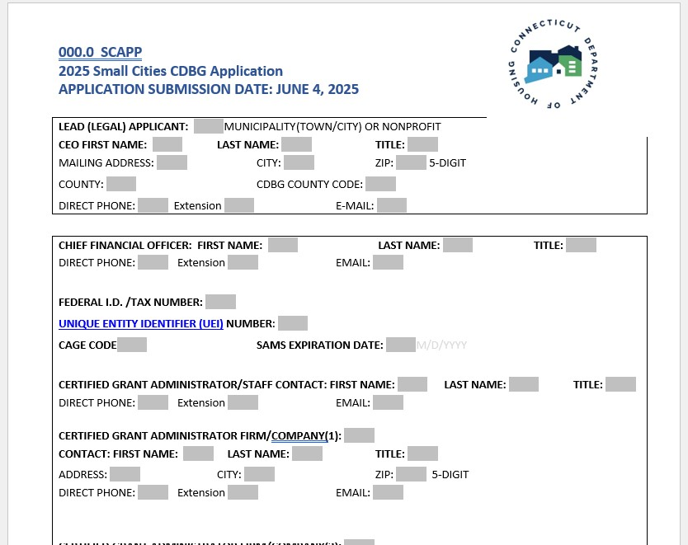
Notes:
So take the time to give us the real skinny…so e.g. if on this form you indicate your first selectman as Tom Boland, and you provide Kathy Y’s email and phone number or the Town’s general answer line…and we at DOH in order to review your application, must conduct detective work (i.e. speak with several different personnel in your offices before getting to the elected official), your application will be negatively scored appropriately so; Bad information there are deductions. DOH.Cdbgapps @ct.gov
We won’t hunt you down to get you the money you need.
Federal ID #
CAGE#/Cage Code (5 digit number the government assigns once you have been awarded a contract. if you get stuck not knowing the term or the question, you will have more help this year. There will be
hints provided by mousing over the word and an explanation should pop up. If not check the application handbook.
Project Name
Give the address…we know not to leave sensitive information lying around or to redact addresses for a Domestic Violence shelter in the event of a FOIA. If you refuse to include this information, the application score will be negatively impacted by a point deduction.
Indicate if your Consultant/Grant Administrator is CGA certified
Indicate if the local grant contact is CGA certified…

Slide 8
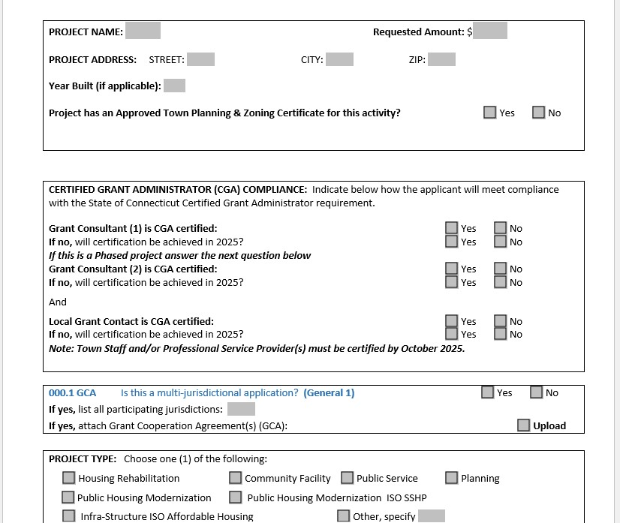
Notes:
Listen up folks
CGA certification is a requirement, you must get certified by October 2025 The State will offer another opportunity this year for certification on September 23-26/October 7-9 2025
If you have a current 2019, 2020, 2021, 2022, and 2023 grant and there is no CGA on staff/or not working with a Grant Administrator, your grant will be redlined for termination for non-compliance.
Say goodbye to the days when municipalities state, “we are just the pass-through organization, we’re doing a favor for the HA”

Slide 9
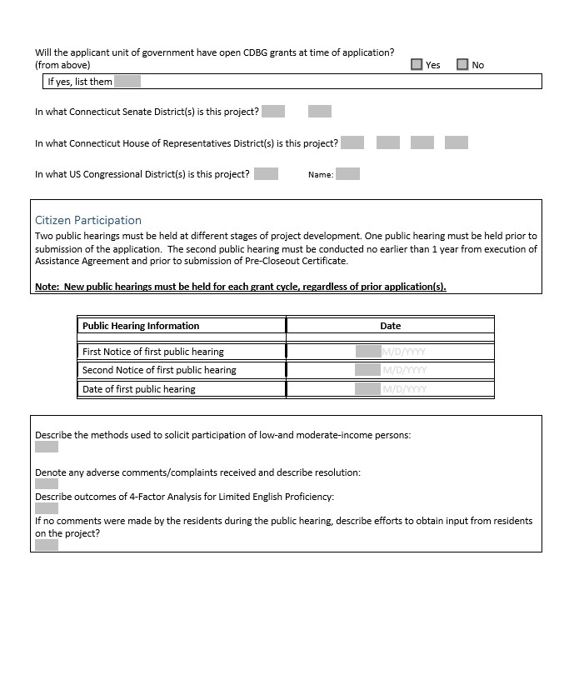

Slide 10
Citizen Participation
Fill in the table- answer the questions
Upload items..make certain the minutes ARE CERTIFIED and contain information about PI use/reuse (if applicable). Get the admin staff or a super detail- oriented person to accurately capture the discussions at the public hearing. Highlight the relevant paragraph. Make it easy for your reviewer.
If the meeting minutes don’t share specific points outlined in the PH Notice, you will not be scored. Minutes must be approved and certified.
We need to determine whether or not the applicant has completed the CIT PAT accurately.
Notes:
Lucille: We will check the public notice used. Do not use shortened versions
We will check the dates of notices, times hearings held,
We will read through the minutes…looking for the PI (if applicable) be sure to highlight that section.
“Jerome covered specific examples of good minutes”
Dominic: Finally, the minutes submitted MUST BE APPROVED AND CERTIFIED…that means (TC approval and minutes signed with a seal from the Town Clerk

Slide 11

Complete Beneficiary info
#of Asians, # American/Native Indians, #Africans, #Hispanic, #Whites
#Handicapped, #Elderly People, #Female-headed Households etc.
Notes:
Pretty straight forward. Who will you be serving?

Slide 12
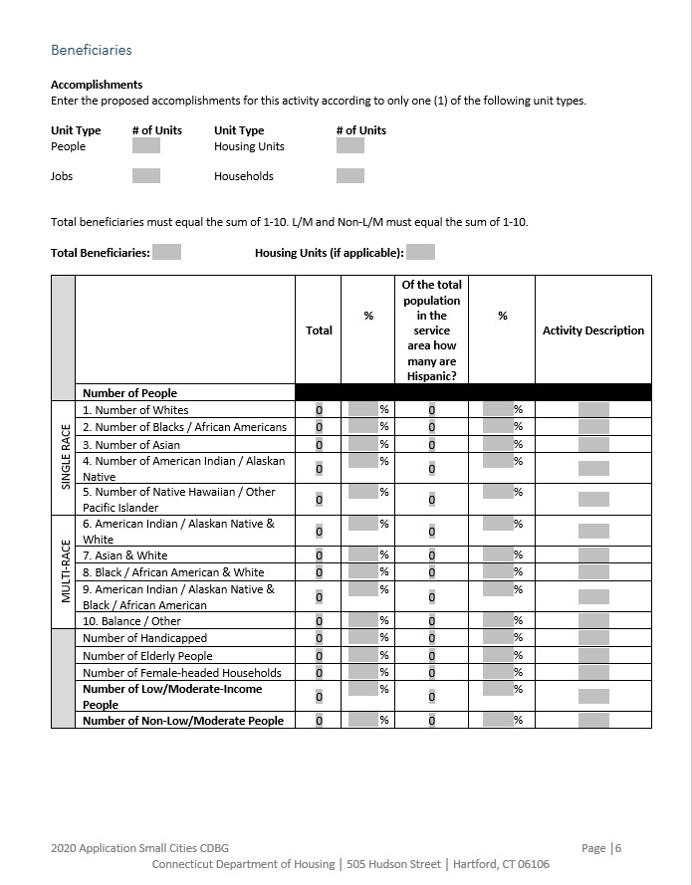
Notes:
Lucille: Fill the excel spreadsheet located in the exhibits!

Slide 13
Section 1.1
Project Description.
Describe the proposed project/program.
Limit 1000 words
  A detailed description of actual physical activities that would be undertaken; purpose of your project? The description should capture the results/comments/concerns raised at tenant meetings held with the residents…they can tell you what they truly need.
2. Is the project being completed in phases? If so, why?
3. What is the nature of the project?
4. Whom is it designed to benefit?
5. What is the impact of the problem on Low/ Mod income persons?
Notes:
What do I do? How do I fill 1000 words DOH will deem important and necessary…..what do you do? Reach for the handbook

Slide 14
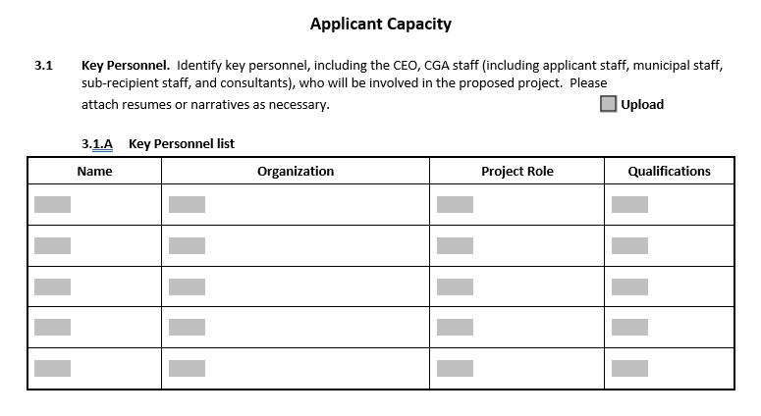
3.1
Applicant
Capacity
Notes:
Who’s on your staff?
What are their qualifications?
Are there experienced folks on your team to help deliver a fantastic product?
How many years have they been practicing? Do they hold a current/valid CGA certificate?
Are they capable of guiding your project successfully?
Do they have design people on staff?

Slide 15

Section 4
Project Feasibility & Merit
4.1 Budget Summary
4.2 Local leverage Funds
Notes:
4.2 local leverage. This is where we access your partnerships, your buying power and your level of firm/Conditional commitment at the time of application. We prefer to see firm commitments so put some skin in the game. Towns again this year are required to waive Permit & Fees
Our partners Eversource ,Sustainable CT and GreenBank this year will work with applicants to prepare a firm commitment letter

Slide 16
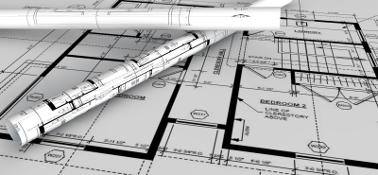
Section 4
Project Feasibility & Merit
Technical Compliance
4.4-4.7
4.5 and 4.5A Construction Documents- upload
(Provide 90% drawing and specs electronically)
Notes:
90% minimum for Non-phased or straight CDBG funds. D&S submitted at the time of application submission on June 7.
40% minimum for phased projects only, however the 90% D&S is required by September 1, 2025 with the CONNAPP application to CHFA

Slide 17

April 7,2025 https://portal.ct.gov/DOH/DOH/Programs/Small-Cities-Program
Check DOH’s Web site for application link
Notes:
All related documents will be available on our website

Slide 18
Important Points before you upload …..
√ Review the application, cross check it against the
Application Handbook.
√ Review and complete the Exhibit Checklist
√ If you’ve checked the upload box on the application, that means you have an exhibit to name e.g. 000.3 Portland GCOC and upload
√ Review the Rating and Ranking…see how you score
√ Complete and scan all required WET SIGNATURE Docs in BLUE INK;
DO NOT mail wet signature pages to DOH unless we request them …keep the original signature documents with the application.
√ Take a moment to congratulate all the folks around you for a great job pulling this all together.
Notes:
Include the R&R with your materials
Tweak it if you must in order to get that extra point here and there.

Slide 19
Good Luck &
Thank You
Lucille Vaughan
Lucille.Vaughan@ct.gov
Dominic Carew
Dominic.carew@ct.gov

