Slide 1
Radon Overview
April 1, 2025

Slide 2
What is radon?
How does it enter a home?
What are the health effects?
Radon measurement & mitigation basics
Notes:
Over the next several slides we will cover…

Slide 3
What is radon?

Slide 4
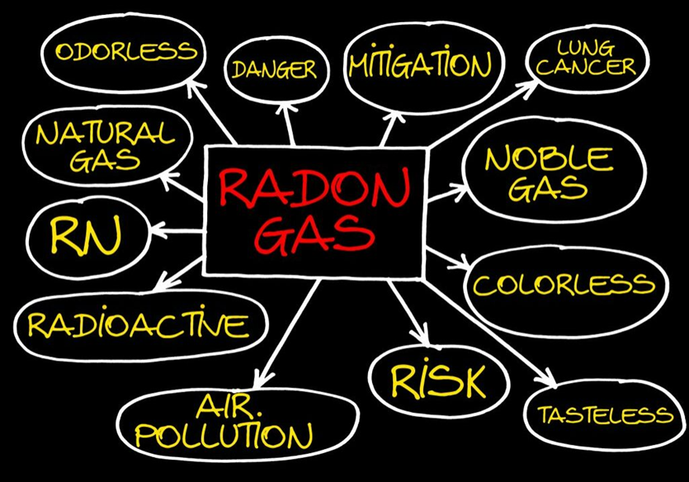
WHAT IS RADON?
Radon is a naturally-occurring, radioactive gas.
Radon is colorless, odorless, and tasteless.
Found all over the U.S. in all types of buildings:
Old and New
Drafty and Well-Sealed
With and Without Basements
Notes:
Radon is a naturally occurring, radioactive gas.
Radon cannot be detected by our senses. You can’t see, smell, or taste radon.
And it is found…
Radon is one of the nation’s most important environmental threats – one that places people at risk in their own homes. Radon is the leading environmental cause of cancer; the leading cause of lung cancer in non-smokers, and the second leading cause of lung cancer overall, after smoking.

Slide 5
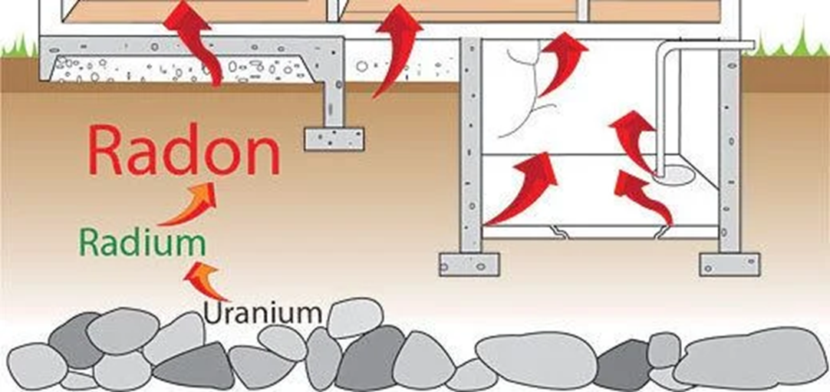
URANIUM DECAY CHART (simplified)
Notes:
Radon gas is formed by the natural decay of radium which is a decay product of uranium. Both radium and uranium are very common, solid elements present in soil and rock. Radon itself is not dangerous, but as it decays, the gas produces radiation in the form of microscopic particles that can cling to house dust or other airborne particles. Outdoor radon is diluted quickly and poses little threat, but when it migrates into a building and accumulates, it can become a health hazard.

Slide 6
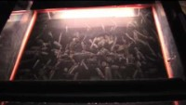
VISUALIZING RADON
Notes:
Click PLAY button on video (MUTE SELF to remove feedback)

Slide 7
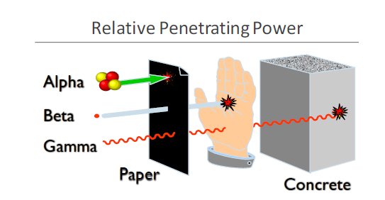
RADIATION TYPES
Image Source: https://aaaradontesting.com/where-does-radon-gas-come-from/
Notes:
During radon decay, gamma and alpha radiation result. Gamma is not the greatest concern in this scenario but rather the slow moving, bulky, alpha particles which pack quite a punch to sensitive lung tissue. Alpha particles can’t pass through your skin but can be inhaled and affect the bronchial cells in the upper airway of the lungs.

Slide 8
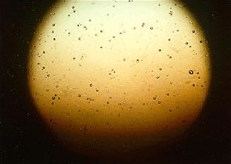
THE POWER OF ALPHA PARTICLES
Image Source: http://www.ilradon.com/what-is-radon/
Notes:
Pictured here, at 100x magnification, is the plastic chip from an alpha track detector. This detector was exposed to a radon level of 4 pCi/L for 3 months. A picocurie per liter is a unit of measure for radiation. The spots you see on this chip are pits created by the alpha particles as they contacted the plastic chip. Now, if they can do that kind of damage to a rigid plastic chip, imagine what happens to sensitive lung tissue…

Slide 9
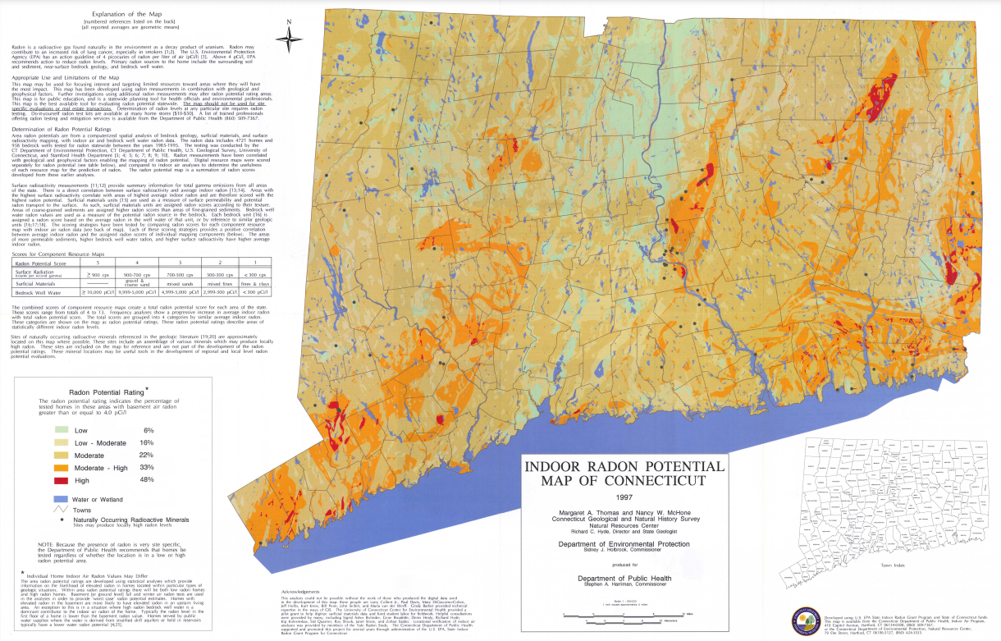
WHERE IS RADON FOUND GEOGRAPHICALLY?
Notes:
Radon levels vary for many reasons (weather (wind, temperature), geology, and building construction, to name a few), but a data mapping project that was completed in partnership with DEEP some years ago, helps to show an area’s potential for elevated results. It may be hard to see here, but most of the state is the dark yellow/tan color, indicating that about 22% of homes tested had an elevated radon level. This is very similar to the State average of 26% (or about 1 in 4 homes). Orange and red areas have higher potential at 33% and 48% respectively.

Slide 10
How does it enter a home?

Slide 11
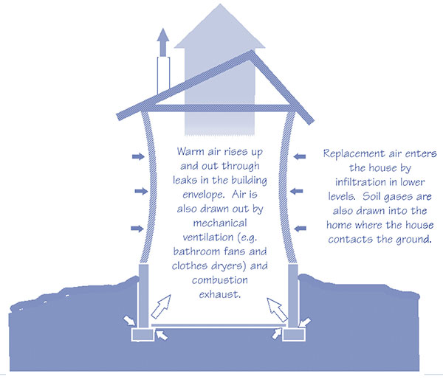
HOW RADON ENTERS A HOME
Source: USEPA https://www.epa.gov/sites/default/files/2014-08/documents/buildradonout.pdf
Notes:
The air pressure within a home is typically lower than in the surrounding air and soil, especially in the basement and foundation levels. As warm air rises it creates the need for makeup air, wherein soil gases are drawn into the home. In this way, a home acts like a vacuum via what’s referred to as the stack effect. The driving force is from negative pressure.

Slide 12
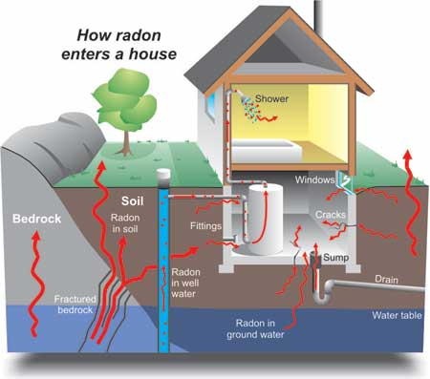
RADON ENTRANCE PATHWAYS
Cracks in solid floors
Construction joints
Cracks in walls
Gaps in suspended floors
Gaps around service pipes
Cavities inside walls
The water supply
Notes:
Routes for entry include:

Slide 13
What are the health effects?

Slide 14
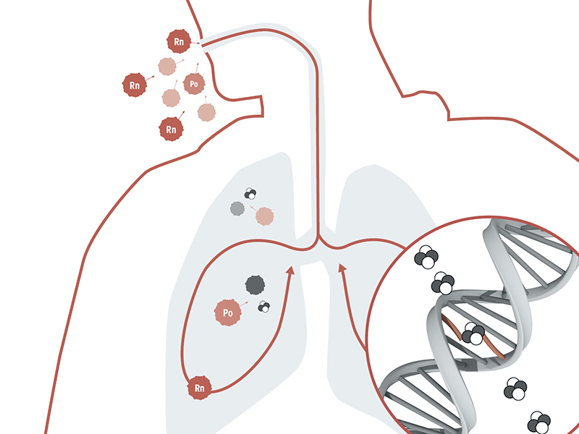
HEALTH EFFECTS OF RADON EXPOSURE
Prolonged exposure to elevated radon levels increases a person’s risk of developing LUNG CANCER.
There are NO immediate health effects from exposure and radon gas itself does not cause any symptoms.
The radiation created by the natural decay process damages lung cells and DNA.
Image Source: https://www.bfs.de/EN/topics/ion/environment/radon/effects/effects_node.html
Notes:
Radon is classified as a class-a carcinogen, as such prolonged…
Symptoms may only be seen once lung cancer has developed and progressed enough to cause shortness of breath, chest pain, wheezing, etc.
…AND DNA which can result in the development of lung cancer.

Slide 15
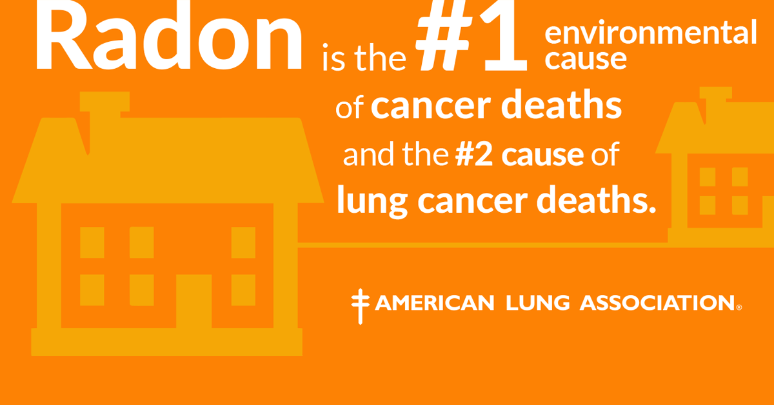
LUNG CANCER FACTS
Despite decreasing smoking rates, lung cancer remains the leading cause of cancer deaths*.
The CDC estimates that 80-90% of lung cancer deaths are linked to smoking, leaving 10-20% of lung cancers in those who have never smoked.
*2018 CDC data - https://gis.cdc.gov/Cancer/USCS/#/AtAGlance/
Notes:
About 35% of all cancer deaths – per 2018 CDC data
21,000/year is about 58/day

Slide 16
Radon measurement & mitigation basics

Slide 17
ACTION LEVEL FOR RADON IN AIR
The Environmental Protection Agency’s (EPA) established action level for radon in air is:​
4.0 pCi/L*​
*This is NOT a health-based value.​
​
The World Health Organization (WHO) has a more conservative action level of 2.7 pCi/L​
​
There is NO SAFE level of radon!​
​
At levels of 4.0 pCi/L or higher, the EPA recommends measures be taken to effectively reduce radon levels thereby decreasing the risk of developing lung cancer.
Notes:
US avg. indoor level is 1.3 pCi/L
US avg. outdoor level is 0.4 pCi/l
The EPA also recommends additional testing and/or mitigation for homes whose results are between 2.0 and 3.9 pCi/L

Slide 18

TESTING IS THE ONLY WAY TO KNOW
1.3 pCi/L
8.1 pCi/L
Notes:
Because radon originates from rock and soil and geologic formations are not uniform, and due to all the variables in house construction and occupancy patterns, one home can have elevated levels, while the house next door does not.

Slide 19

RADON MEASUREMENT
DPH recommends using a Nationally Certified Measurement Provider to test for radon.
For a single building (single or multi-family), DPH recommends testing the lowest occupied space.
A short-term testing device is placed for a minimum of 48 hours up to 7 days, depending on the device used – with 12 hour closed building conditions preceding the test.
Notes:
The current recommendations for percentage-based testing in multi-family housing likely do not comprehensively identify the risk for radon exposure in multi-family housing. Specifically, testing 10% or 25% of all ground-floor units results in a generally low probability of identifying units with radon levels at or above 4.0 pCi/L in structures with fewer than 30 ground-floor units. To fully characterize radon risk in multi-family buildings, it is recommended to test 100% of ground-contact units.

Slide 20

RADON MITIGATION
DPH recommends using a Nationally Certified Mitigation Professional to perform radon mitigation
Must be nationally certified through NRSB or NRPP
Must be a home improvement contractor registered with CT’s Department of Consumer Protection (DCP)

Slide 21

RADON MITIGATION
Radon mitigation systems are:
effective
relatively inexpensive
easy to install
Average cost ~ $1,200-$1,500
Notes:
Radon mitigation systems can reduce radon in air levels by up to 99%

Slide 22
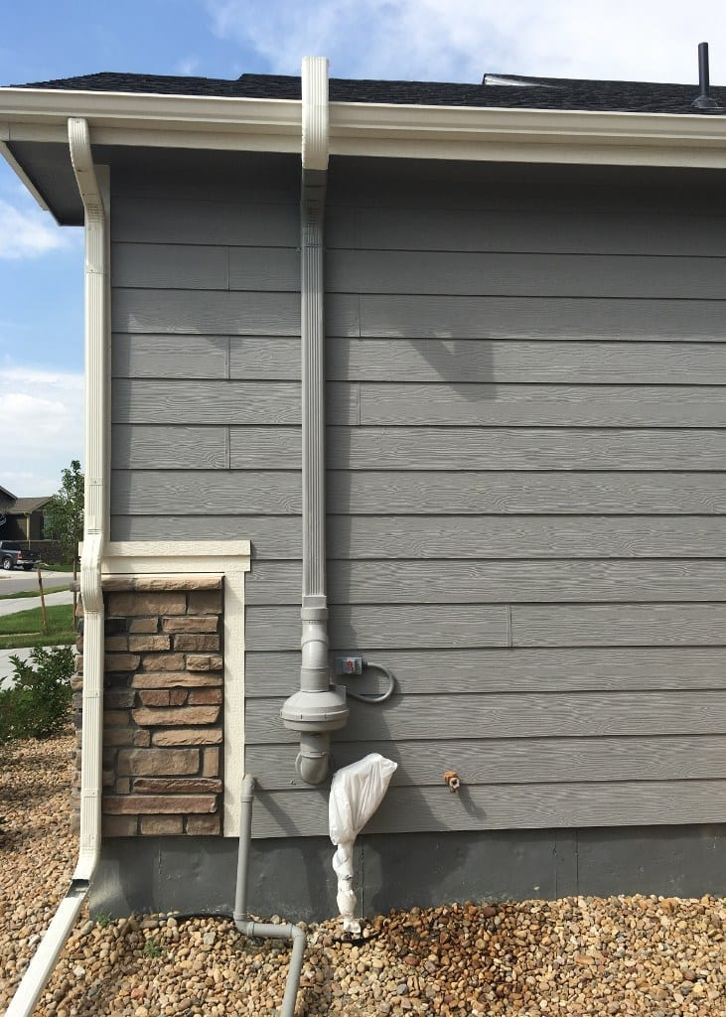
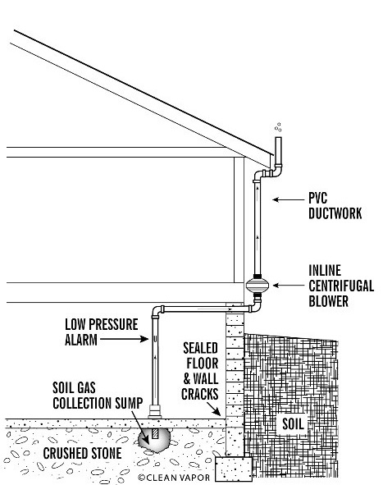
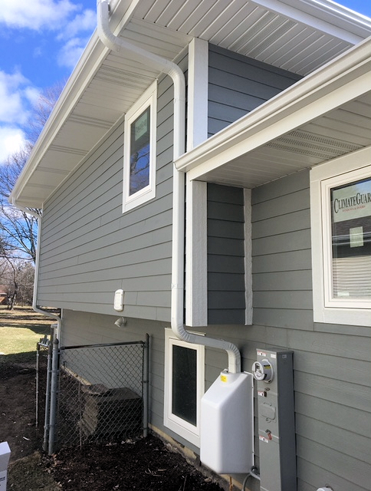
SUB-SLAB DEPRESSURIZATION (SSD) SYSTEM
Image Source: https://vim-1.itrcweb.org/sub-slab-depressurization-ssd-tech-sheet/
Notes:
A SSD is the most common type of system installed. The center image provides a diagram of such a system, where a small pit is excavated beneath the foundation, then piping is installed and run to the exterior of the home where a fan is mounted with an exhaust pipe above.
The image on the left shows how a system can be customized for the home via color-match painting. And the image on the right shows a fan cover box, which can make the system less obvious and more visually appealing.

Slide 23
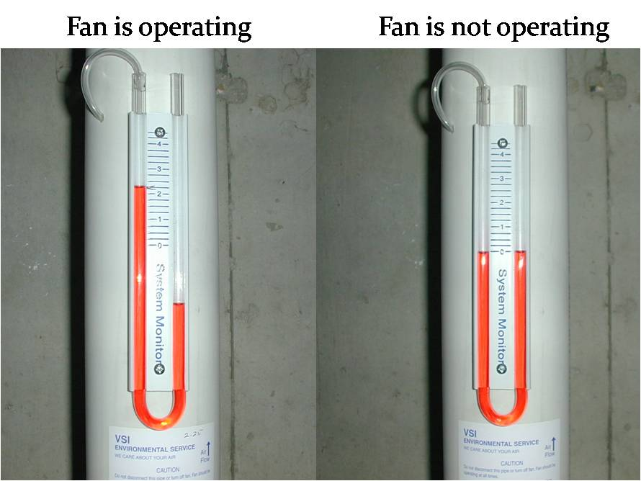
SUB-SLAB DEPRESSURIZATION (SSD) SYSTEM
Image Source: https://radongas.com/troubleshooting-your-system/
Notes:
The systems are easy to visually monitor with a manometer (pictured here). This device does not indicate the radon level. The manometer indicates the pressure difference between the inside air and that moving through the pipe. If the fluid level in the manometer is even on both sides, the system is not working.
Even after a mitigation system is installed periodic testing for radon in air is recommended (EPA suggests every 2 years).

Slide 24
Amanda Parkins
Epidemiologist 3
Coordinator, Indoor Environments Unit
amanda.parkins@ct.gov
(860) 936-1660
Questions?
Alessia Frasco
Epidemiologist 2
Radon Program
alessia.frasco@ct.gov
(860) 509-7474

