Slide 1
Key reminders for Community Development
Block Grant funded projects involving lead
Kimberly Ploszaj
Supervising Environmental Analyst
Lead Hazard Reduction and Control Section
April 1, 2025

Slide 2
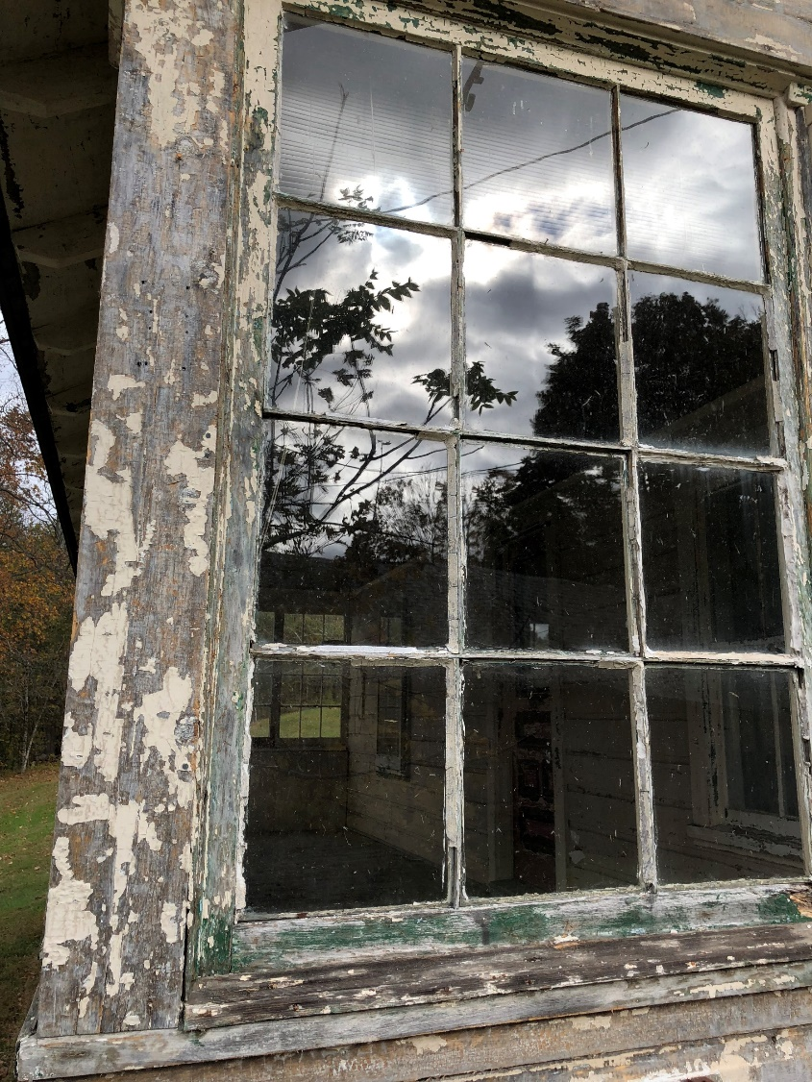
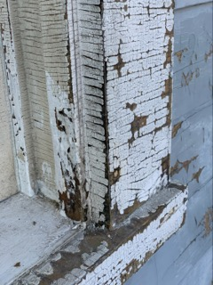
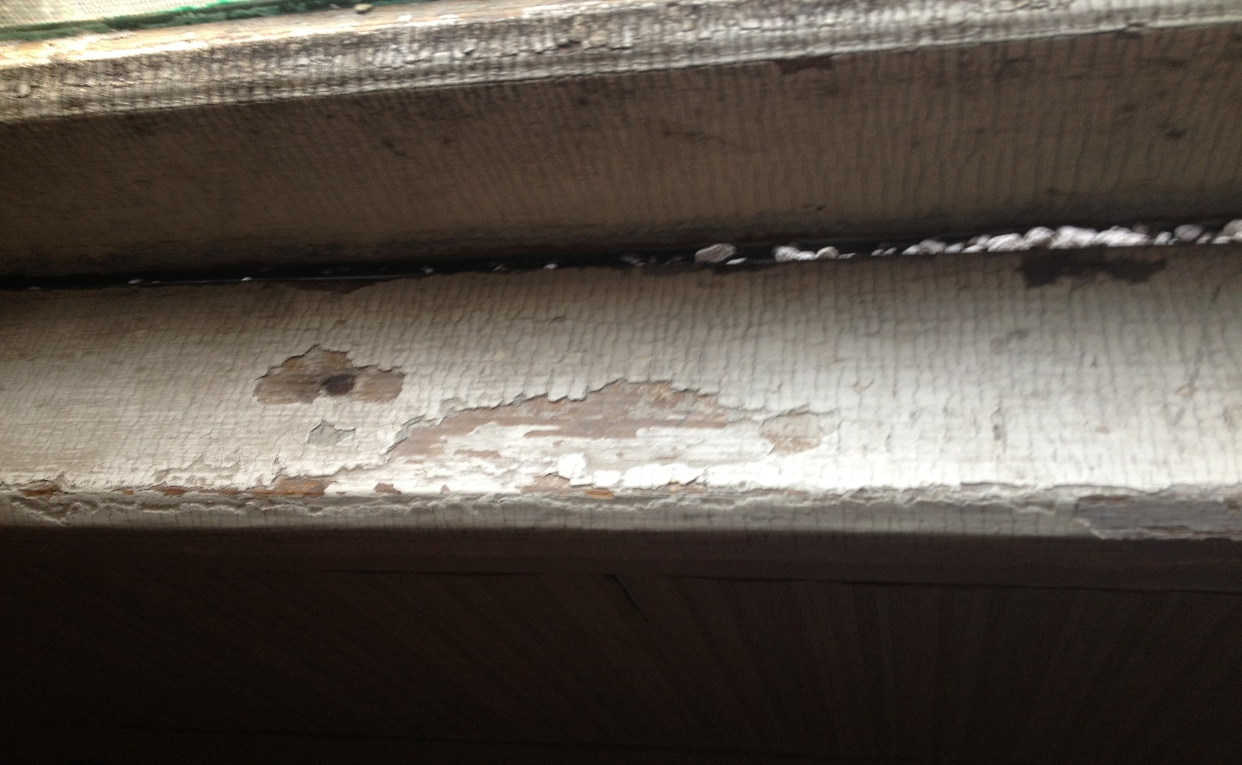

Slide 3
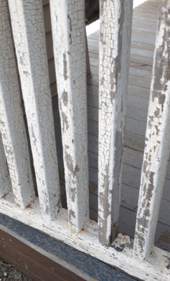
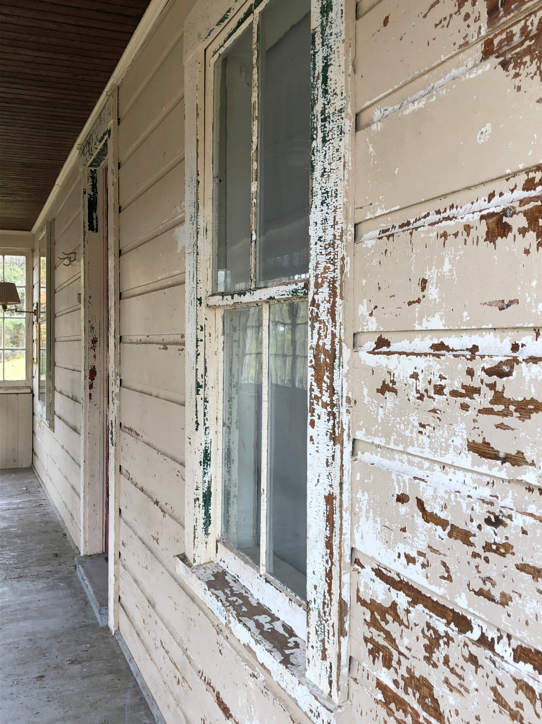

Slide 4


Slide 5
Phase in actions at lower blood lead levels
Time effective | Epidemiological Investigation
January 1, 2025 | ≥ 5 µg/dL

Slide 6
Updated Lead Dust Hazard Levels & Lead Dust Clearance Levels
 | Floor | Sill | Well
Risk Assessment Dust Hazards Standards | any reportable level (was 40 µg/ft²) | any reportable level (was 250 µg/ft²) | any reportable level
Post-Abatement Clearance Dust Standards | < 5 µg/ft² (was 10 µg/ft²) | < 40 µg/ft² (was 100 µg/ft²) | < 100 µg/ft² (was 400 µg/ft²)

Slide 7
Lead Remediation
vs.
Lead Abatement

Slide 8
Lead Remediation vs. Lead Abatement
Lead Remediation is the process of reducing lead-related hazards by using methods such as paint stabilization. These activities do not trigger CT lead-related regulations. The work must be performed by an EPA RRP certified firm, employing staff trained in lead-safe work practices. Clearance dust wipes must be conducted at the completion of the job – per HUD.
Lead Abatement is the process of permanently removing lead hazards. These activities trigger CT lead-related regulations. The work must by performed by a CT DPH-licensed lead abatement contractor, employing certified supervisors/workers. The process for lead abatement includes: a lead inspection, submission and approval of a lead abatement plan and lead management plan to a local health department and clearance dust wipes at the completion of the job.

Slide 9
Lead
Remediation

Slide 10
Reminders
Presence of defective paint
Testing of the painted surfaces is required
All defective surfaces shall be remediated by a certified EPA RRP firm
The RRP firm shall employ workers or supervisors who have completed a HUD approved lead-safe work practice course
A lead remediation plan shall be developed
At the completion of the job, a DPH-licensed lead consultant contractor must complete clearance dust wipes

Slide 11

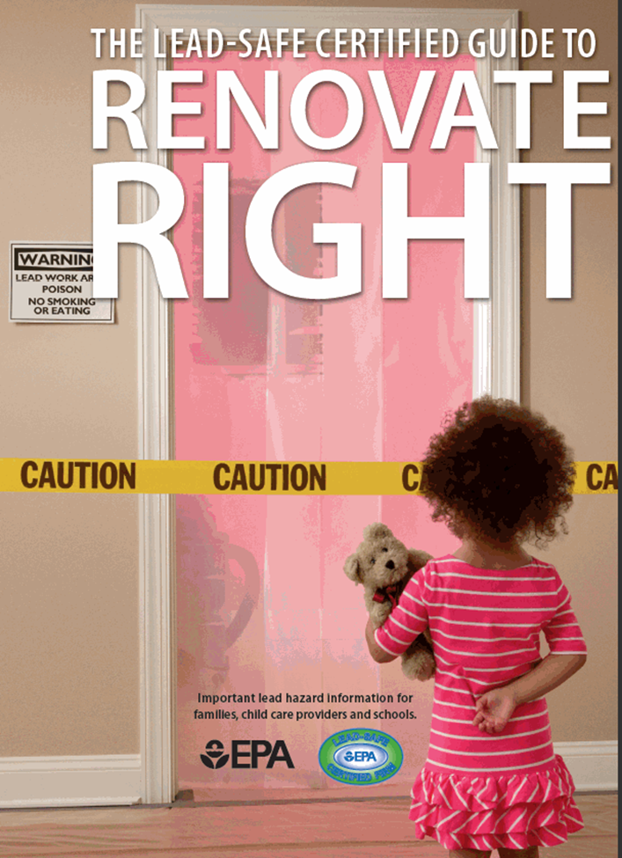

Slide 12
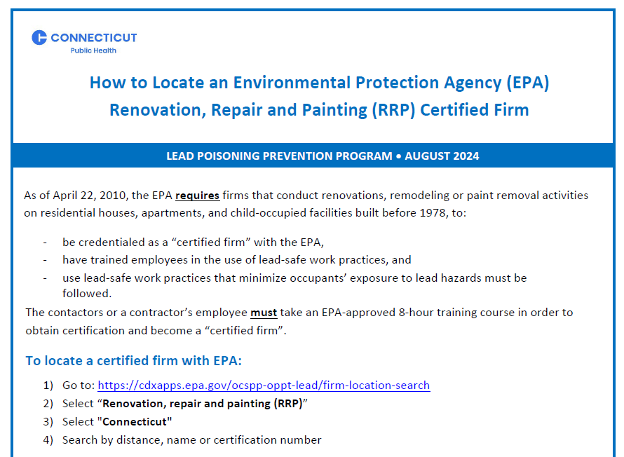

Slide 13
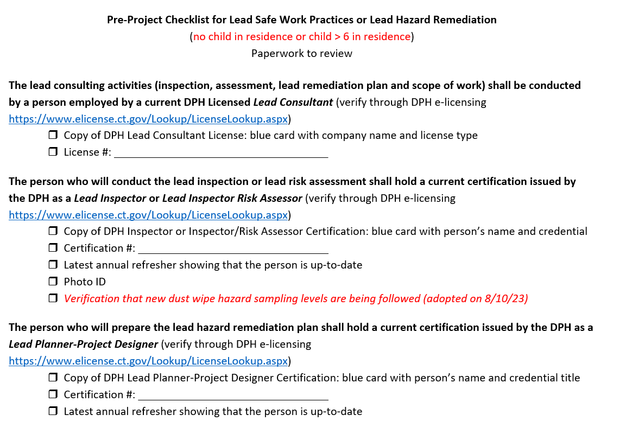

Slide 14
Lead
Abatement

Slide 15
Reminders
A child < 6 years of age resides at the property and there is defective lead paint = a comprehensive lead inspection is required.
The comprehensive lead inspection will identify all lead hazards in paint, dust, water and soil
All lead hazards shall be abated
All intact leaded surfaces shall be placed on a management plan
A lead abatement plan or a lead management plan shall be developed by a DPH-licensed lead consultant contractor

Slide 16
Reminders
A lead abatement plan shall be approved by the local health department before any work can begin.
All abatement work shall be performed by a DPH-licensed lead abatement contractor that employs certified lead abatement supervisors and workers.
At the completion of the job, a DPH-licensed lead consultant shall complete clearance dust wipes.

Slide 17
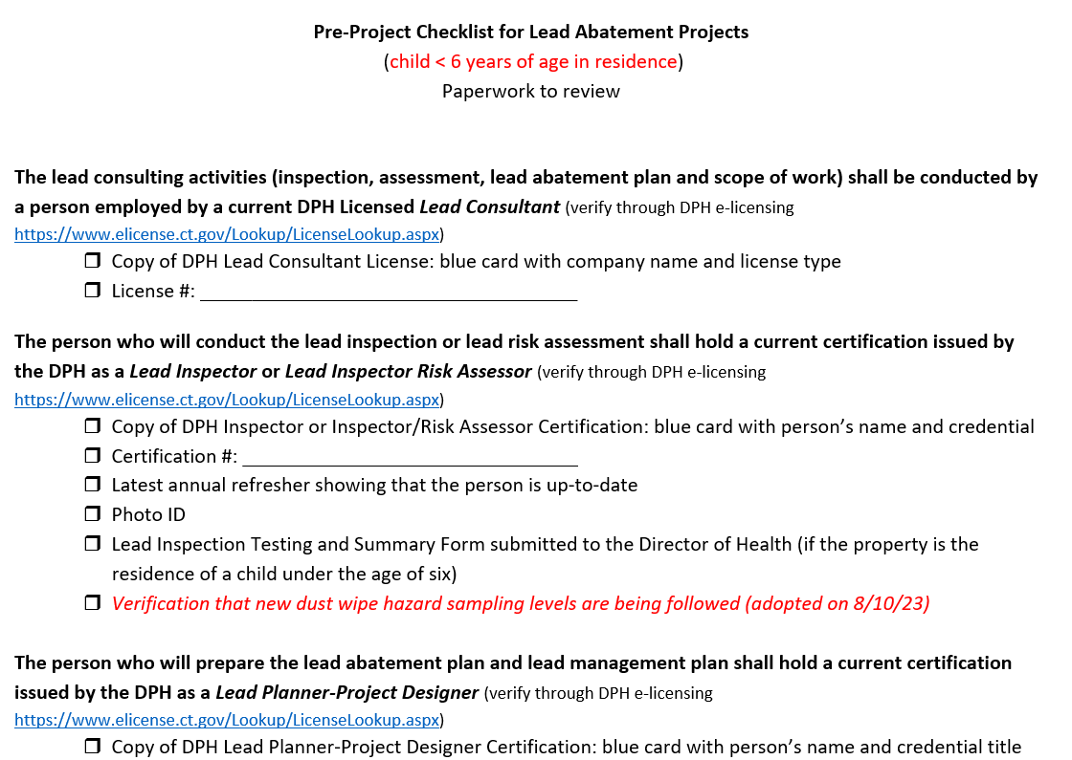

Slide 18
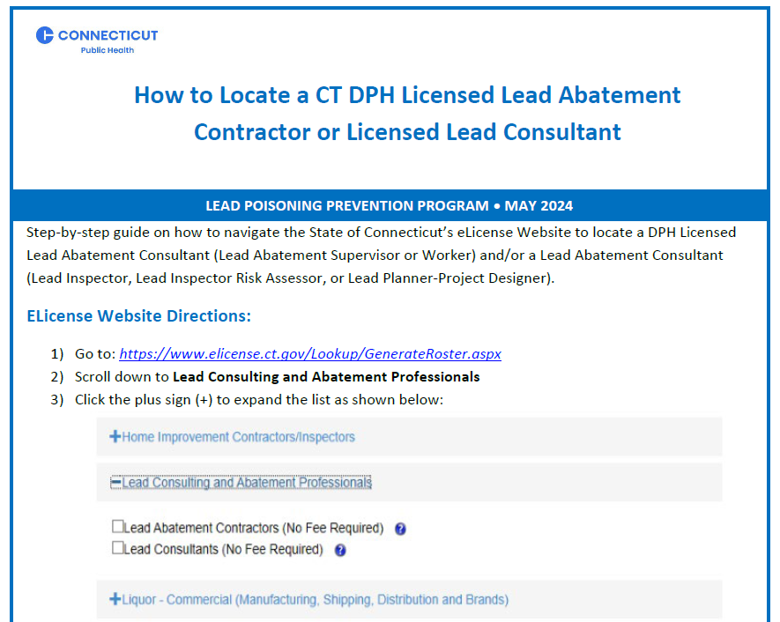

Slide 19
Remember to…
Use the pre-checklists.
Know the difference between lead remediation and lead abatement.
Involved DPH-licensed practitioners and the local health department when lead abatement is required.
Seek approval for work order changes, for lead abatement projects, from the local health department.
Ensure clearance dust wipes are collected at the end of lead remediation and abatement work.

Slide 20
When in doubt…
DPH has authority to take action for any lead abatement violations, 860-509-7299
EPA has authority to take action for any lead RRP violation, 617-918-1111

Slide 21

Questions

Slide 22

Lead Hazard Control and Reduction Unit contact information:
For technical assistance please contact:
(860) 509-7299

