Slide 1
Energy Saving Solutions
4/1/2025

Slide 3
Multifamily Initiative
Residential New Construction
Electric Vehicle Charging Solutions

Slide 4
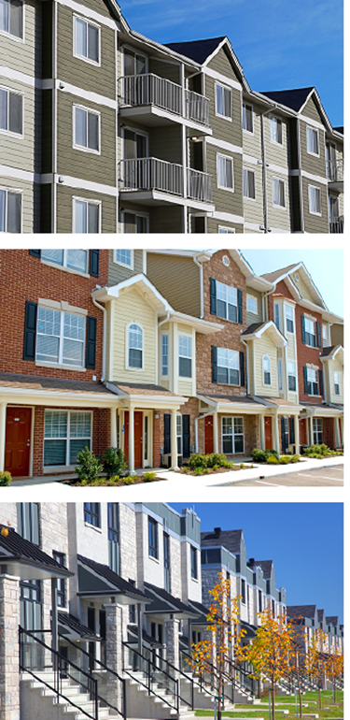
Multifamily Initiative
Incentives, financing, and technical assistance
Retrofit and moderate rehab projects
Comprehensive, whole building solutions
Apartments, condominiums, townhouses with 5+ units
Open-market
Past participating properties and multi-year projects
Income Eligible and Market Rate

Slide 5
Dwelling Unit Heat Pumps
Fuel Displaced
Electric Resistance | Oil/Propane | Natural Gas
$750/ ton | $750/ ton | $750/ ton
$1,875/ ton | $1,875/ ton | $750/ ton
Market Rate
Income Eligible
$250/ton (MR) or $500/ton (IE) for Heat Pump Equipment Upgrade
PTAC to PTHP: $500/unit MR and $750/unit IE
Notes:
$750 for ARRA heat pump to heat pump upgrade, plus $250 adder for integrated controls

Slide 6
Central Heat Pumps
ASHP | GSHP | VRF
$1,500/ ton | $4,000/ ton | $2,100/ ton
$1,750/ ton | $4,200/ ton | $2,400/ ton
Market Rate
Income Eligible
$250/ton (MR) or $500/ton (IE) for Heat Pump Equipment Upgrade
PTAC to PTHP: $500/unit MR and $750/unit IE

Slide 7
Heat Pump Water Heating
Dwelling Unit | Central
$650/unit | $1,000-1,400/unit
$750/unit | $1,200-1,600/unit
Market Rate
Income Eligible

Slide 8
Incentive Caps
Comprehensive Projects | Single End Use | Direct Install Measures
Up to 65% of Project Cost | Up to 50% of Measure Cost | Up to 100% of Installed Cost
Up to 90% of Project Cost | Up to 75% of Measure Cost | Up to 100% of Installed Cost
Market Rate
Income Eligible

Slide 9
Multifamily Initiative
multifamily@eversource.com

Slide 10
Moving to All-Electric Residential New Construction

Slide 11
All-Electric Home Standards
BUILDING ENVELOPE
Tiered performance structure
Based on % performance above energy code and/or ENERGY STAR™/Passive House
AIR OR GROUND-SOURCE HEAT PUMP
Required for all tiers
Increased incentive offerings/adders for Ground-Source technologies
VENTILATION
ERV/HRV required in all situations except for base tier in CT
WATER HEATING
Electric/Heat Pump water heater required in all cases except for multifamily in MA
ELECTRIC COOKING & APPLIANCES
Required in all tiers
SOLAR PV & EV READINESS
Required in all tiers

Slide 12
Passive House & Electrification: Resources
Incentives
Certification Incentives
Performance Incentives
Training
Exam Reimbursement
Seminar & Classroom
Lunch & Learns
Modeling Incentives

Slide 13
All-Electric Incentives
Tier Range | Incentive Structure
 | Single Family | Single Family Attached | Multi Family
Tier 1 | $7,500 | $3,000 | $1,500
Tier 2 | $10,000 | $4,000 | $2,500
Tier 3 | $12,500 | $5,000 | $3,500
CEE Tier/ ENERGY STAR® | Heat Pump Adders
 | Single Family Single Family Attached | Multi Family
CEE Tier 2 (Air-Source) | $125/Ton ($500 Cap/Unit) | $75/Ton ($300 Cap/Unit)
ENERGY STAR® (Ground Source) | $250/Ton ($1,000 Cap/Unit) | $125/Ton ($500 Cap/Unit)

Slide 14
Nick Jones
Senior Energy Efficiency Consultant
nicholas.jones@eversource.com

Slide 15
Funding Process
Project Initiation
Project Review
Incentive Commitment
EEM(s) Installation
Project Completion
Project Team Initiation
Proposal Review & Initial Submittal
Initial Review of Submittal
Letter of Participation
CHFA/DOH Funding Secured
LOA Issued
Measures installed by contractor(s)
Measure Verification
Incentive Payments Issued

Slide 16

CT Electric Vehicle
Charging Program
Public Utilities Regulatory Authority (PURA)

Slide 17
Charging Incentive Levels
Location | EV Charger Type | Per Site Maximum Rebate Amounts | Property Type | Port Installation Requirements
Baseline | Level 2 | Up to $20,000 | Multifamily | 2
 |  |  | Public | 2
 |  |  | Workplace | 2
 | DCFC | Up to $150,000 | Public | 2
Underserved | Level 2 | Up to $40,000 | Multifamily | 2
 |  |  | Public | 2
 |  |  | Workplace | 2
 | DCFC | Up to $250,000 | Public | 2
Level 2:
Baseline: $20,000
Underserved: $40,000
DCFC:
Baseline: $150,000
Underserved: $250,000
Underserved Communities Map

Slide 18


Eligibility
Eligible Costs
Rebate Capped At:
Chargers: up to 50%
Make-ready installation: up to 100%
Futureproofing costs: up to 100%
EV Charger
Qualified Product List (QPL)
Charger and Network Provider must be on list to qualify

Slide 19
Project process
2 – Submit application, sign Letter of Agreement & receive incentive reservation letter
1 – Plan a Project & Gather Proposals
3 – Install and activate your charger(s)
4 – Submit payment request & receive incentive check
Note: Rebates can be assigned to third party by applicant

Slide 20

More information
Eversource
United Illuminating
Program Support
This Photo by Unknown Author is licensed under CC BY-ND
United Illuminating
Program Support:
BusinessEV@uinet.com
(888) 722-5584
Eversource
Program Support:
EversourceCTCommercialEV@resource-innovations.com
(203) 350-3555

