Slide 1
2025 Small Cities CDBG Projects
Partnering with Sustainable CT’s Community Match Fund
April 1, 2025

Slide 2

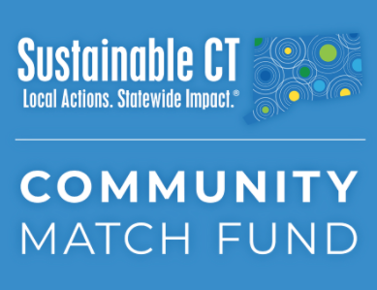
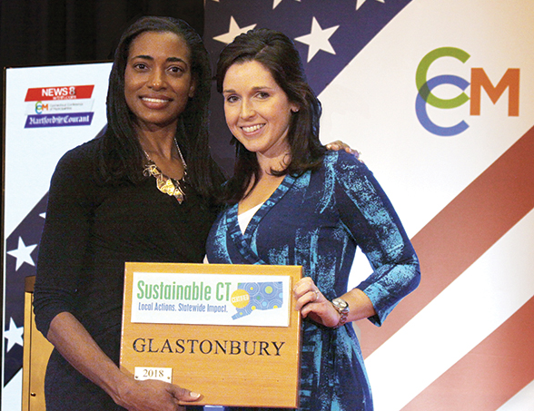
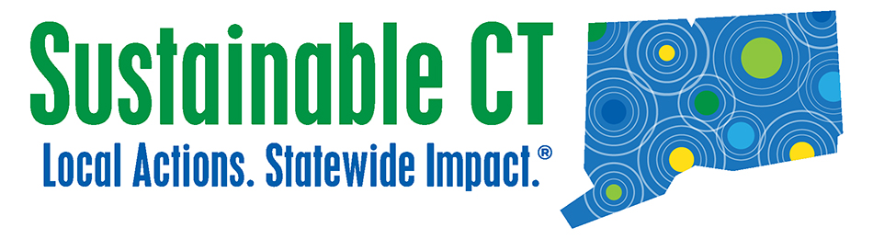
What is Sustainable CT?
Roadmap
Menu of sustainability actions
Resources
Technical assistance and funding
Certification
Recognition and celebration of achievements

Slide 3
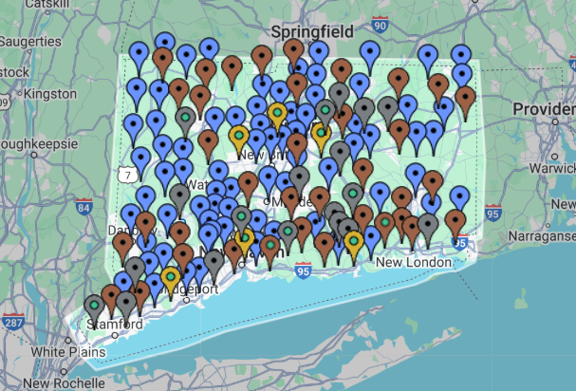
Participating Communities
138 registered CT towns
62 towns certified
More than 4,700 sustainability actions implemented
Strong civic engagement
Connected, inclusive, resilient communities

Slide 4
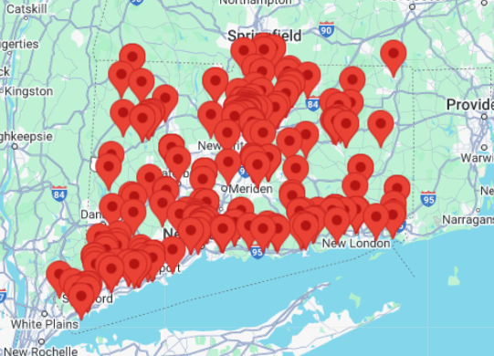
Community Match Fund: Resident Participation
  Fast, easy, flexible, no deadlines
  Anyone in a registered town with a free and publicly accessible idea to improve their community
  Crowdfunding doubled by $1-to-$1 matching grant from Sustainable CT
  Up to $7,500 for most projects; $15,000 for climate/energy projects
  30-to-60-day crowdfunding campaigns with coaching and support for project leaders
  Over $4.4 million invested in over 360 community-led projects statewide since 2019

Slide 5
What is a Sustainable Community?
Inclusive and equitable community impacts
Thriving local economies
Well-steward land and natural resources
Vibrant and creative cultural ecosystems
Dynamic and resilient planning
Clean and diverse transportation systems
Renewable and efficient energy infrastructure and operations
Inclusive engagement, communication and education
Strategic materials management
Optimal health and wellness opportunities
Healthy, efficient, and diverse housing
Effective, compassionate homelessness prevention

Slide 6
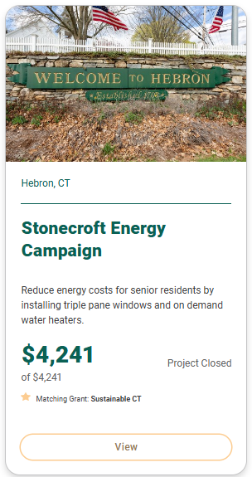
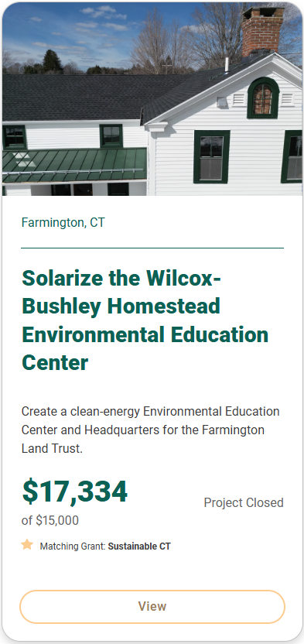
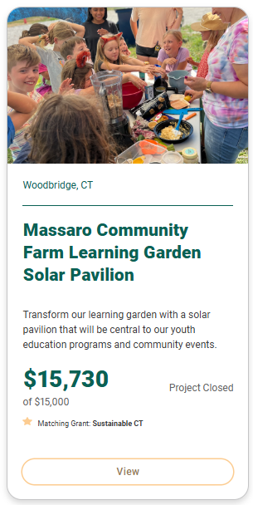
Project Examples: Climate/Energy ($15K match)
Notes:
Stonecraft = climate/energy project

Slide 7
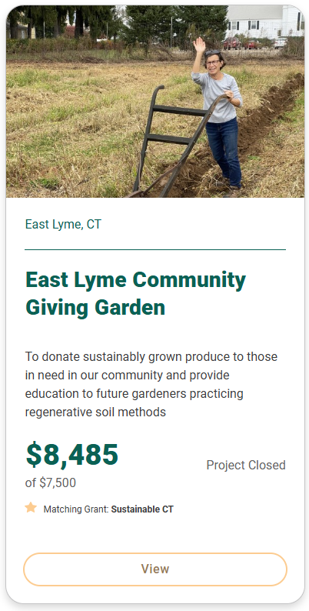
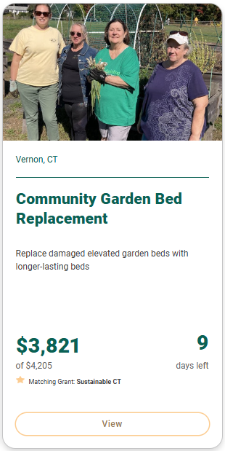
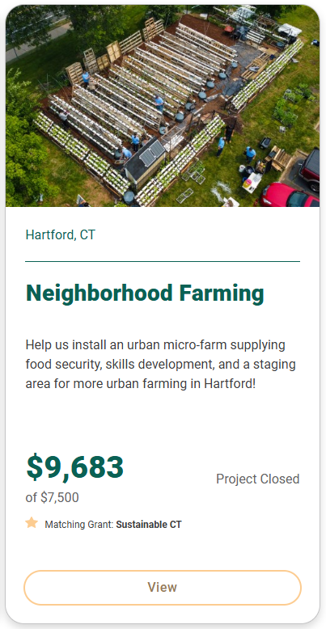
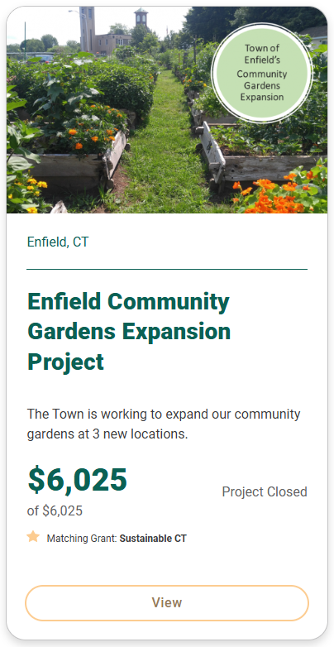
Project Examples: Food Gardens

Slide 8
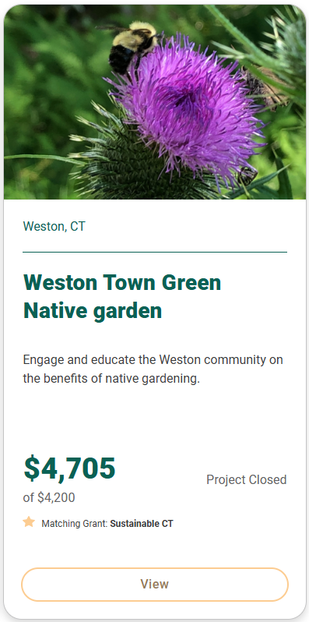
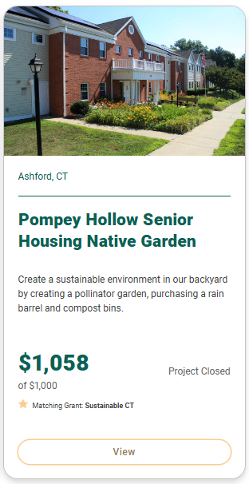
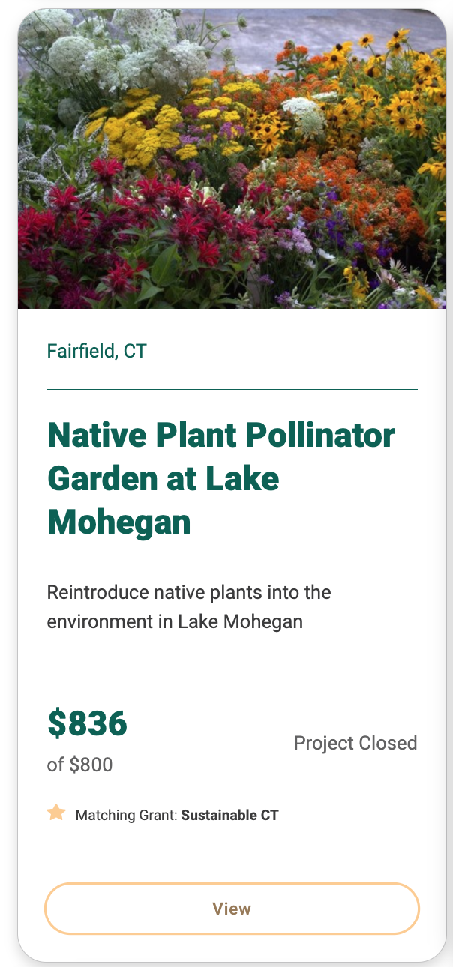
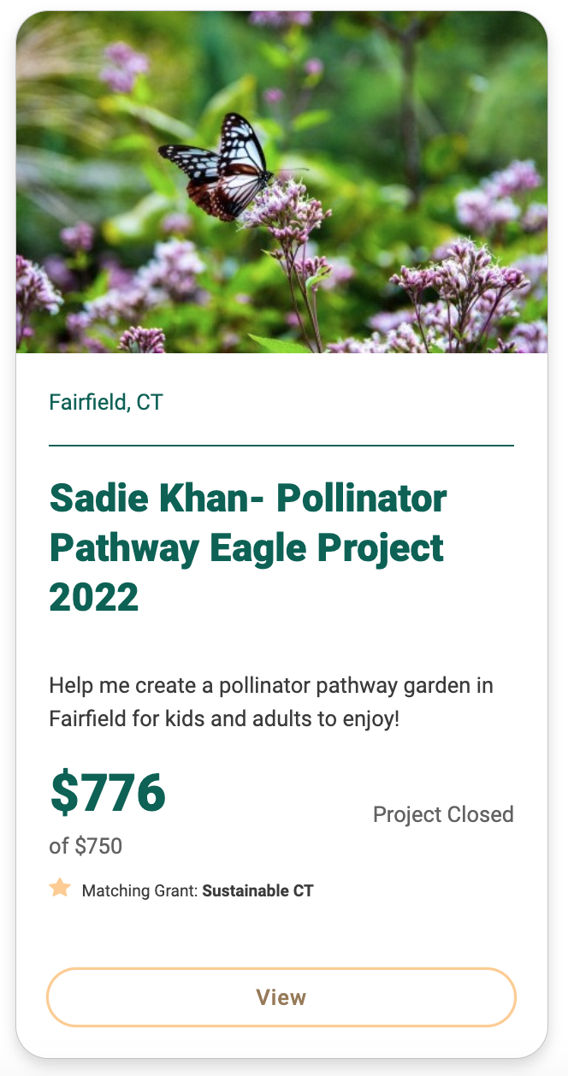
Project Examples: Pollinator Gardens

Slide 9
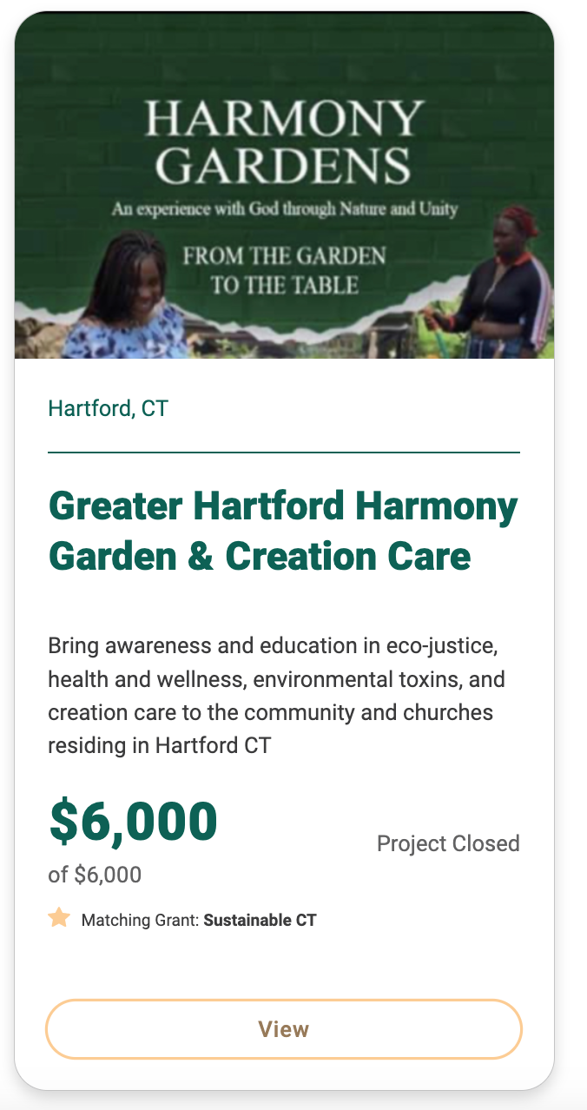
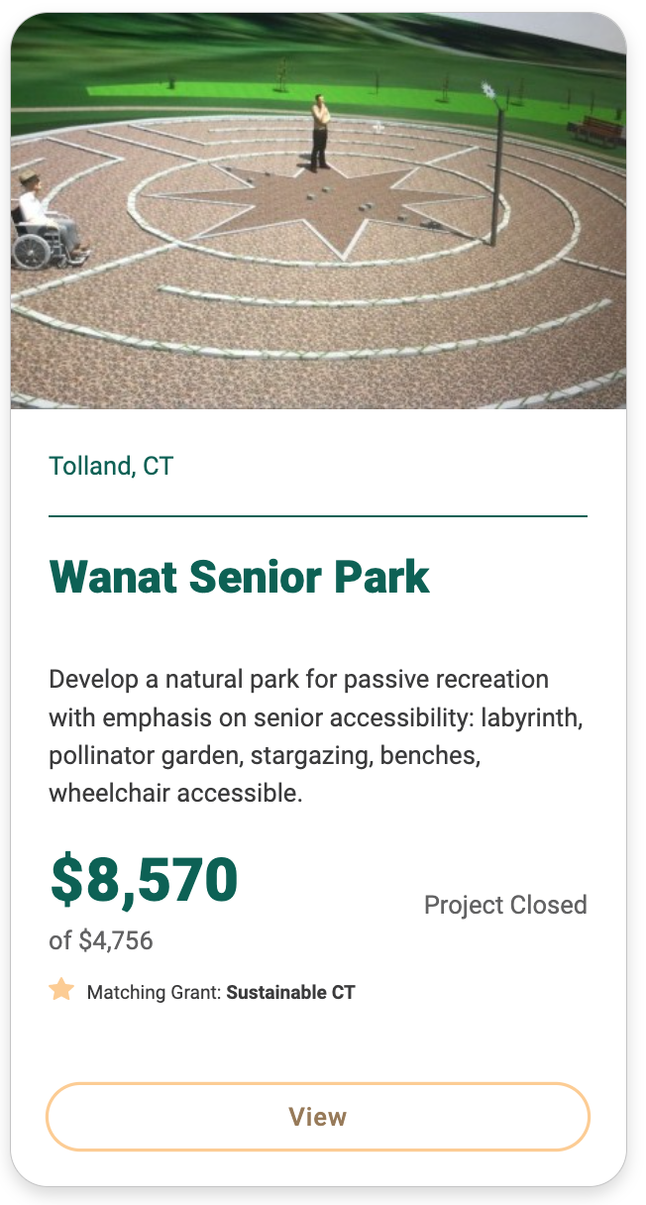
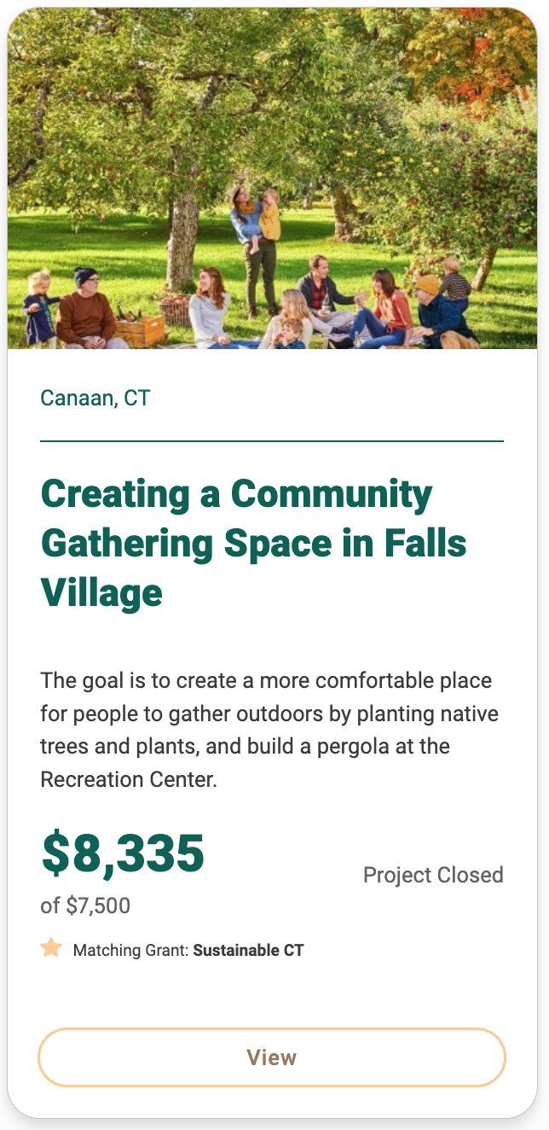
Project Examples: Community Spaces

Slide 10
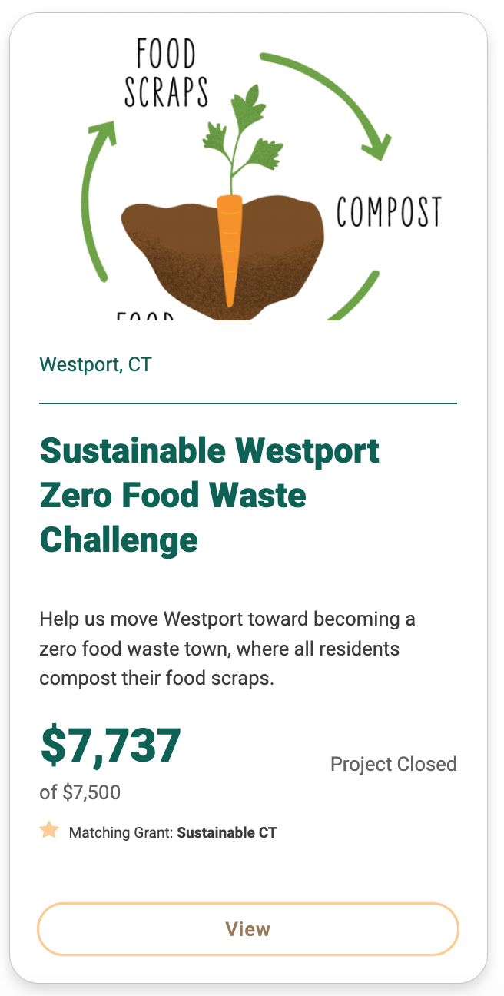
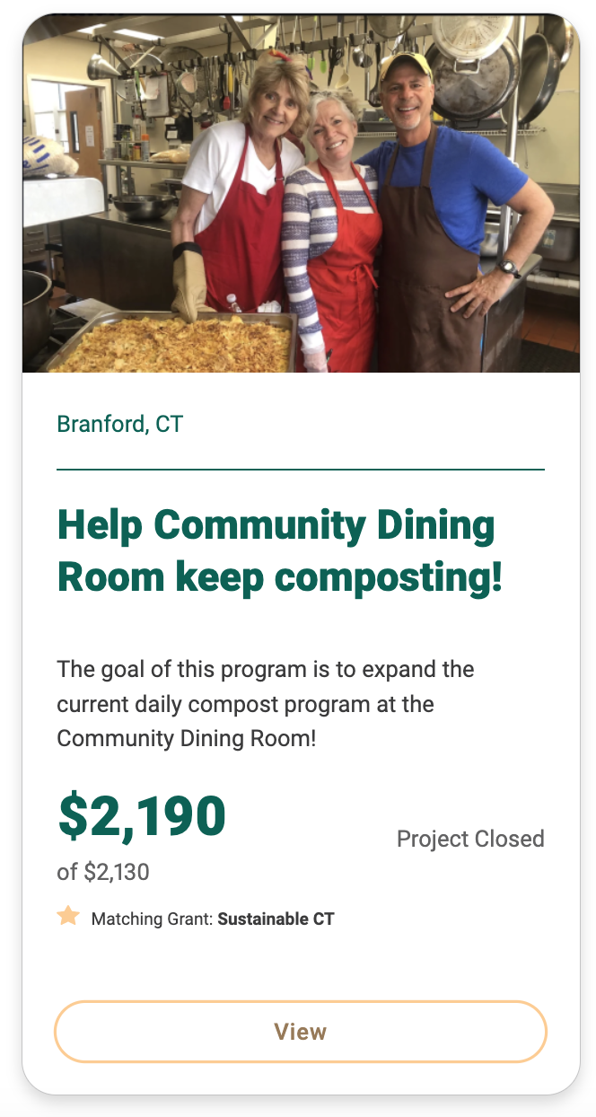
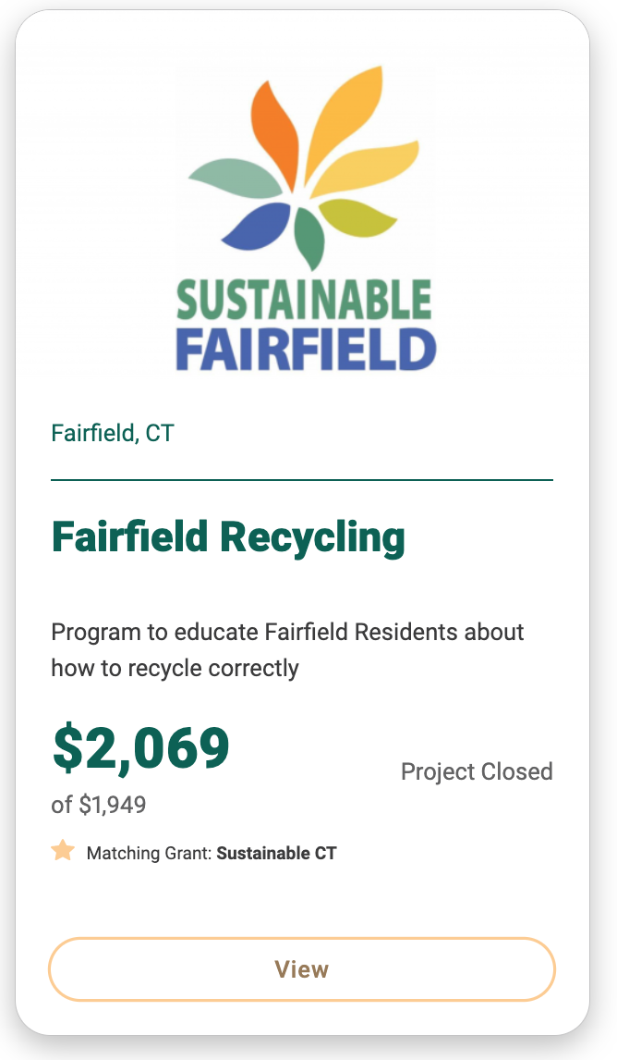
Project Examples: Recycling and Composting

Slide 11
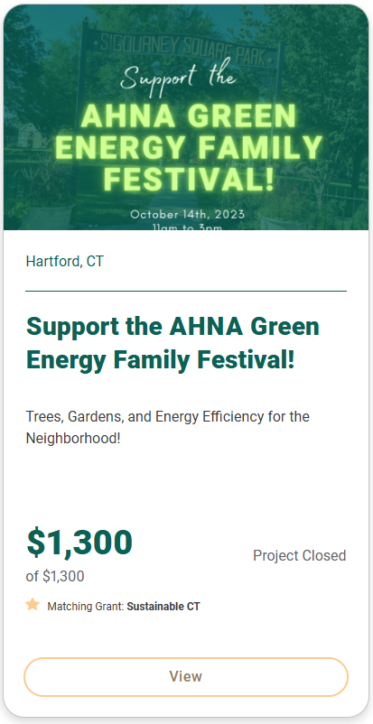
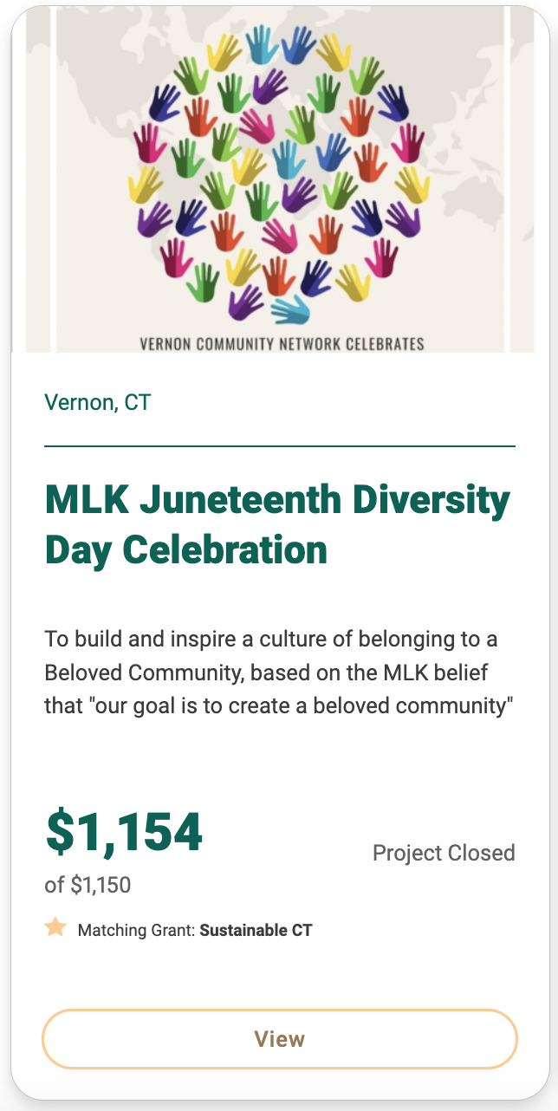
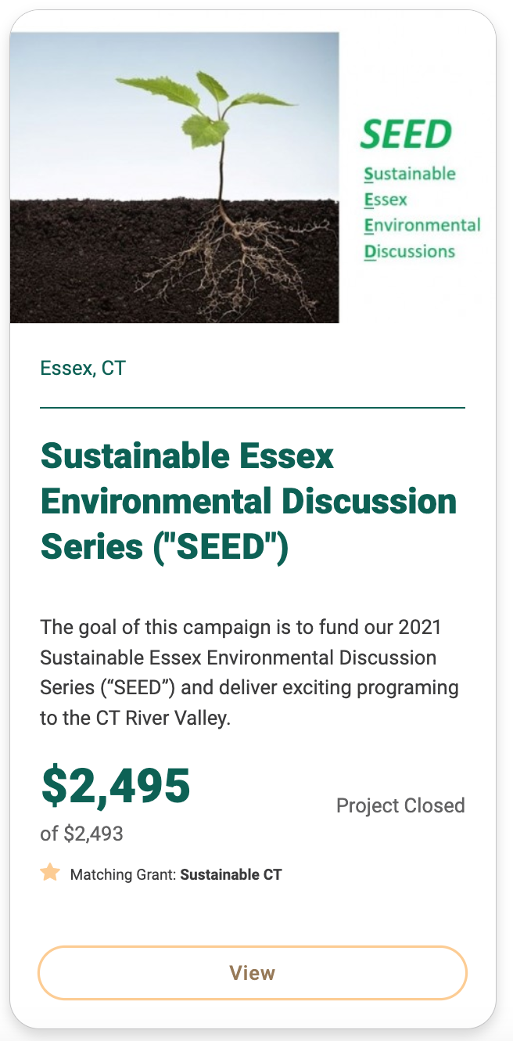
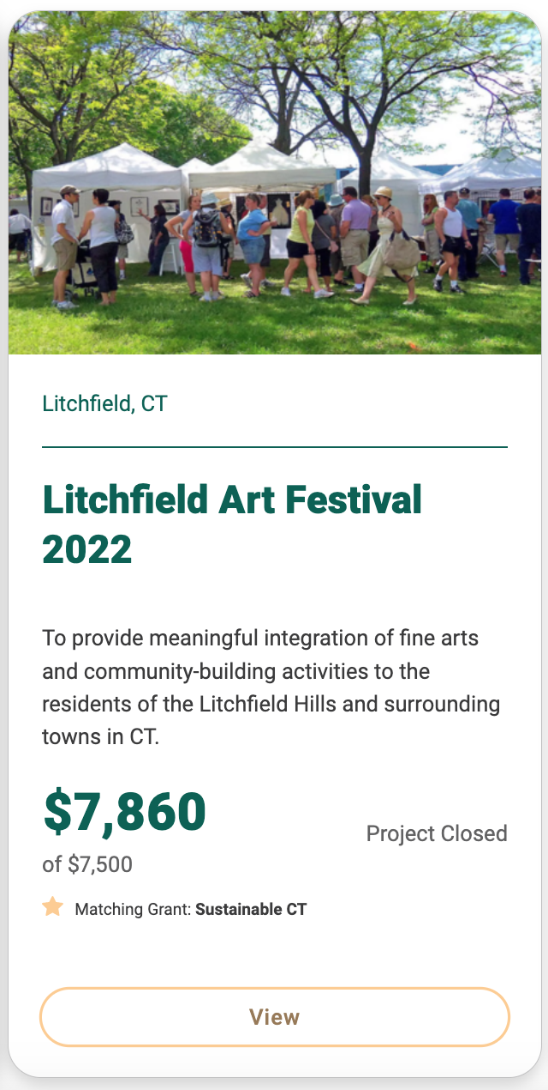
Project Examples: Celebrations,
Community Building

Slide 12
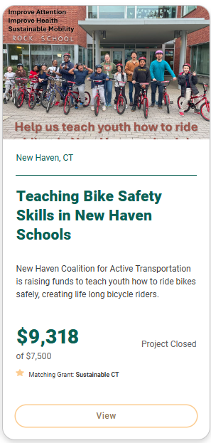
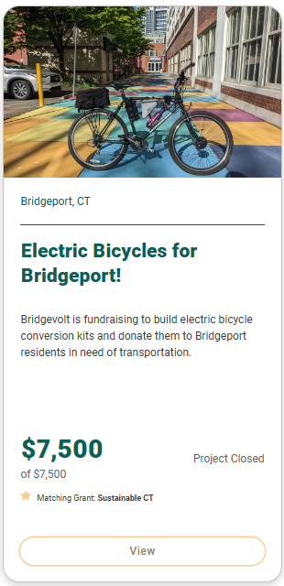
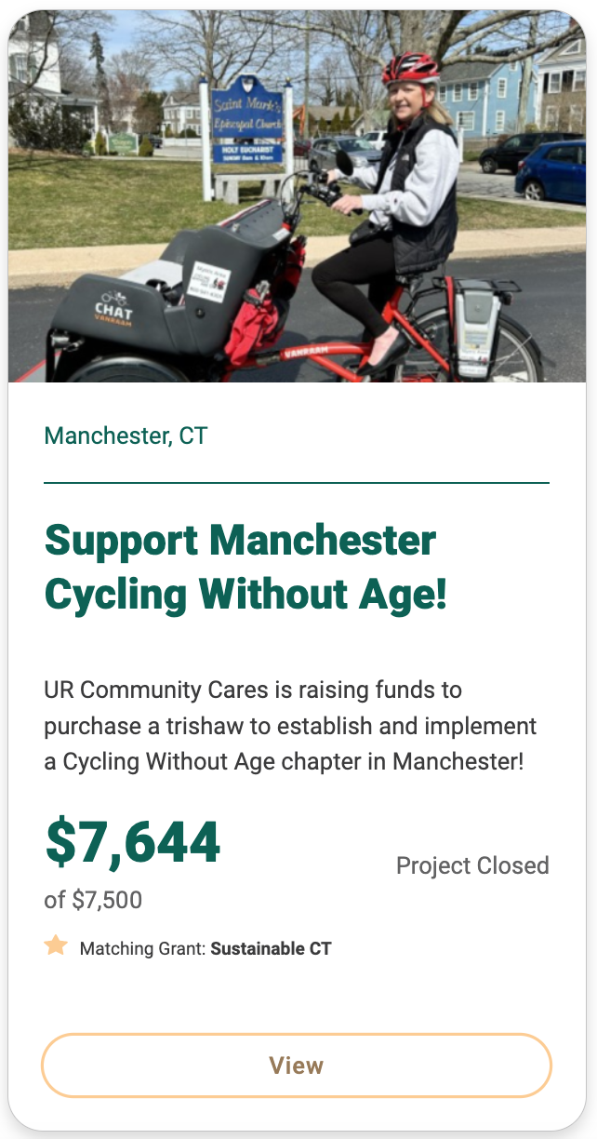
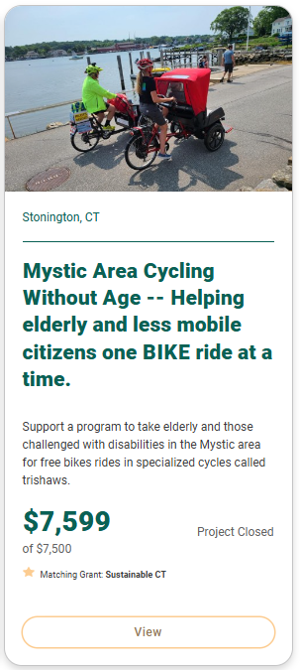
Project Examples: Transportation/Mobility
Notes:
Stonecraft = climate/energy project

Slide 13
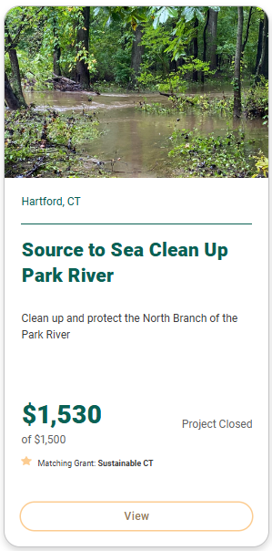
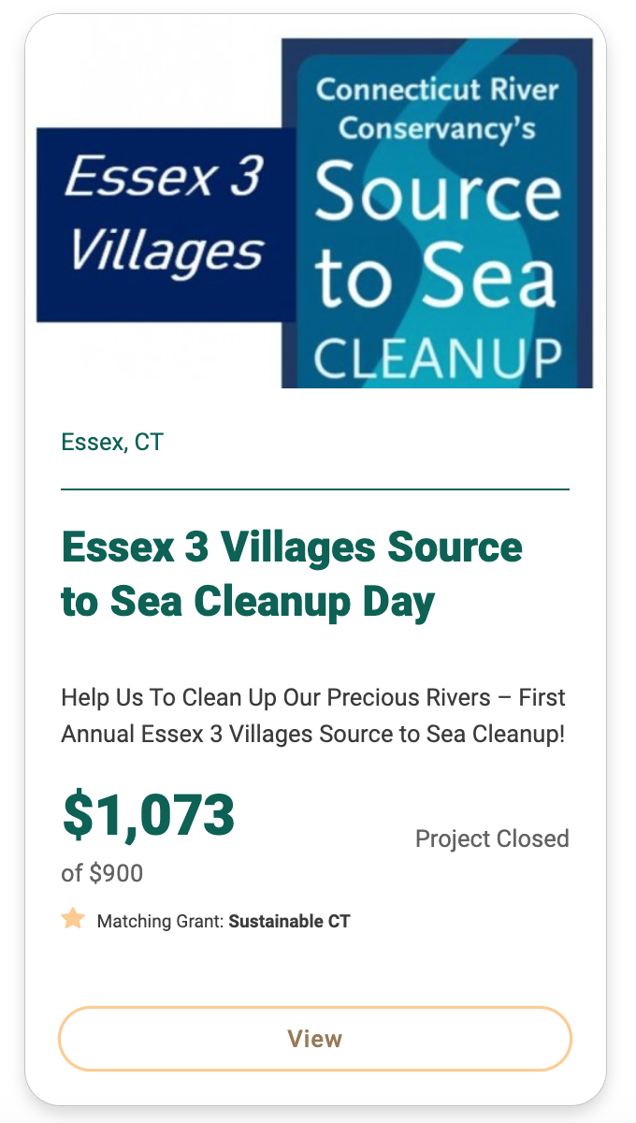
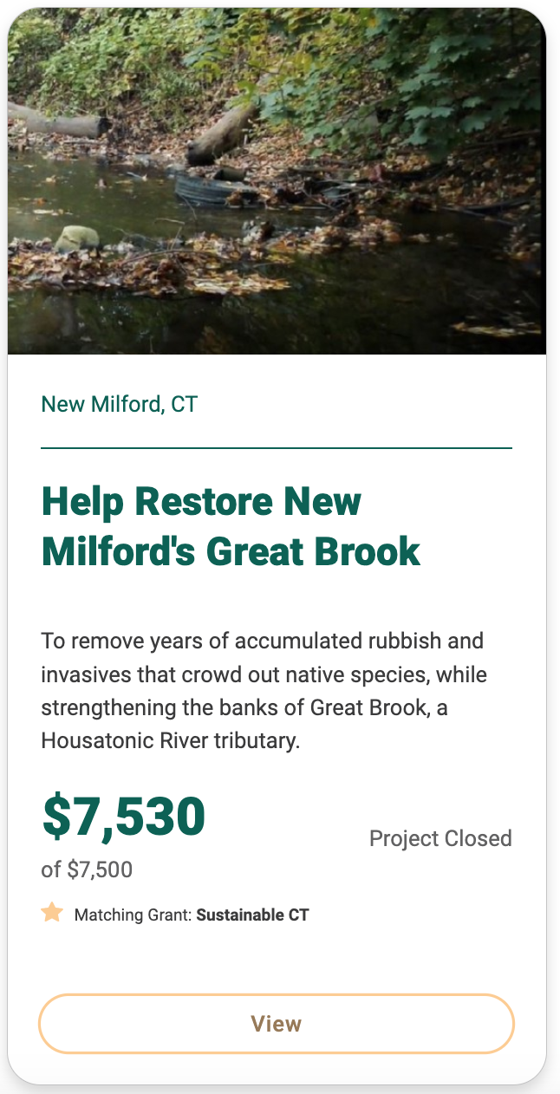
Project Examples: Natural Area Stewardship

Slide 14
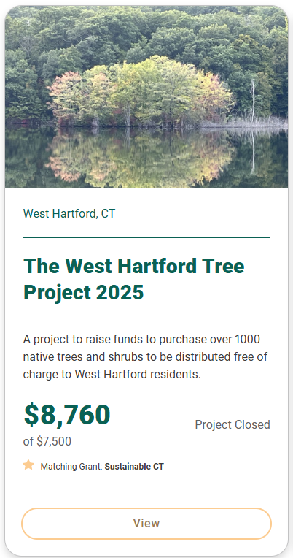
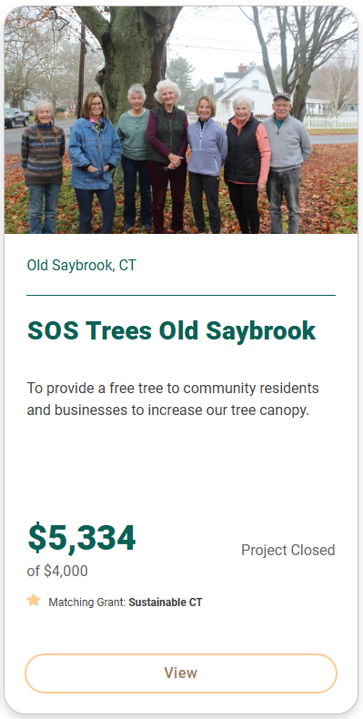
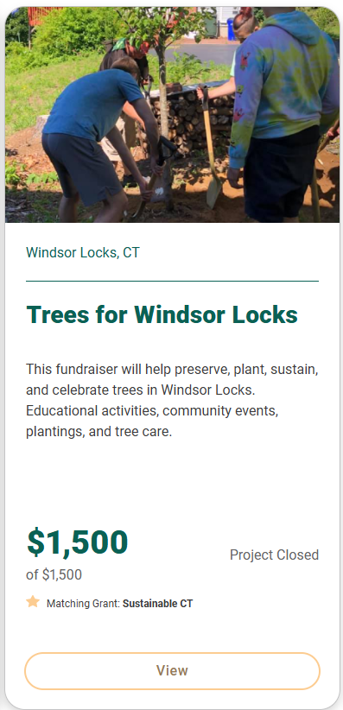
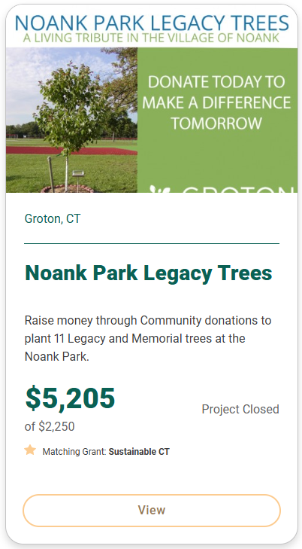
Project Examples: Tree Planting

Slide 15
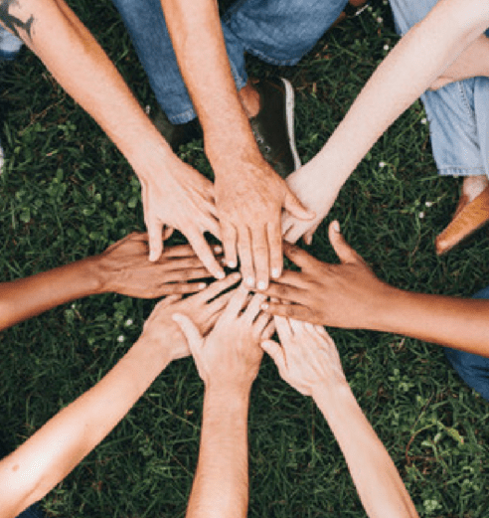
Let’s Partner on your CDBG Proposal
  Community Match Fund projects empower residents, connect people, and improve quality of life
  Process:
    Reach out to us to chat about resident participation and community engagement ideas to augment your project
    Rolling applications, 3-to-4-month process, project campaigns should be live by the June 7th deadline and completed by early August
    Sustainable CT will support community-led projects and provide the required letter for your CDBG grant application

Slide 16
Dorothy Piszczek, Program Manager
funding@sustainablect.org

