Slide 1


Solar MAP
Affordable Multifamily Housing Program
April 1, 2025
2025 Small Cities CDGB Workshop
Connecticut Department of Housing

Slide 2



Mission & Vision
Connecticut Green Bank is the nation’s first state level green bank. Established in 2011 as a quasi-public agency, the Green Bank uses limited public dollars to attract private capital investment and offers green solutions that help people, businesses and all of Connecticut thrive.
Our mission is to confront climate change by increasing and accelerating investment into Connecticut’s green economy to create more resilient, healthier, and equitable communities.
Our vision
Notes:
BG

Slide 3



Less work. More benefits.
Now even easier for property owners.
No-cost technical support and project development support for solar and storage
60+ Municipal and State Agency projects developed to date
Flexible financing with no upfront investment
Program has recently been expanded to include affordable multifamily housing

Slide 4




Program Steps
Site Analysis. The Solar MAP team works with stakeholders to perform an analysis of all eligible locations to identify opportunities for solar + storage projects​
Project Development. The Solar MAP team conducts site visits and develops system designs for each project to determine lease economics.
Execute. The Solar MAP team will present project specs and pricing to execute a project agreement.​
Competitive Partner. The Solar MAP team will solicit proposals from qualified contractors and select the best proposal, bundling participating projects together to achieve economies of scale. Once a contractor is selected, the development and construction phases will then commence. ​

Slide 5
Overview of CT’s
Affordable Multifamily Housing Program
Affordable multifamily properties will be allowed to access the Residential incentive program (RRES) ​
Residential Tariff is higher than the alternative commercial tariff​
$0.3745/kWh VS ~$0.20/kWh ​
There is no cap on the number of Residential Tariff projects​
One project to benefit all tenants and common space ​

Slide 6
Financial Benefit Must Be Shared With Tenants
Regulatory requirement of CT’s Affordable Multifamily Housing program
Housing with Tenant-paid utilities: Tenants receive portion of tariff via on-bill credits on their utility bill​
  Requirement that a portion of the financial benefit be shared with the tenants of the facility = 20% ​of the tariff

Slide 7
Financial Benefit Must Be Shared With Tenants
Master metered sites: the net present value of 25% of the tariff must be set aside for an eligible upgrade to the facility.
Measures include:
  Immediate Measures
    Energy Efficiency Measures
    Energy Storage
    Energy Efficiency Barrier Remediation
    Operational Reserve (this is a measure of last resort)
    EV Charging Stations
    Green Spaces and Community Amenities
    Security Enhancements
    Balanced Ventilation Systems
  Ongoing Measures
    Broadband Internet Access
    Onsite Mental Health & Supportive Services
    Residential Service Coordinator
    Bill Credits on Electrical Bills Covered By Landlords
  Other measures

Slide 8
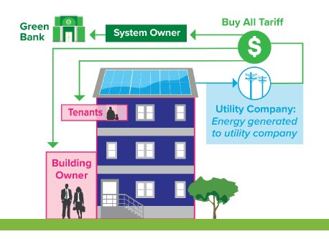
Multifamily Affordable Housing
Green Bank Solar Lease
No capital requirement from property owner​
Tenants receive credits on their electric bill from production (i.e., RRES)​
Green Bank owns and maintains asset, and bears risk​

Slide 9
What is Battery Storage?
Backup Power in Outages:
  Automatically islands from the grid to power critical loads.
No Emissions:
  Clean energy solution without pollutants.
Cost Savings:
  Can reduce electric bills for customers with demand charges
Works with Solar PV:
  Continues operation during outages if solar is available.
No Fuel Shortages:
  Stores energy directly, no reliance on fuel.
Service Continuity:
  Ensures reliable power for essential services.

Slide 10
Pairing Battery Storage
Receive no-cost technical assessment for solar + battery storage through Solar MAP
Incentives Makes Batteries more Affordable
Energy Storage Solutions lowers the cost of a battery by providing both upfront and performance incentives:
  Upfront Incentives reduce the cost to you before installation. Customers can qualify for up to $16,000 in exchange for allowing the battery to reduce their home’s demand from the electric grid on hot summer days for 10 years
  Performance incentives are paid twice a year for 10 years based on how to battery performs during peak summer and winter days
Affordable Multifamily Housing Projects qualify for Incentive Adders as Priority Customers

Slide 11
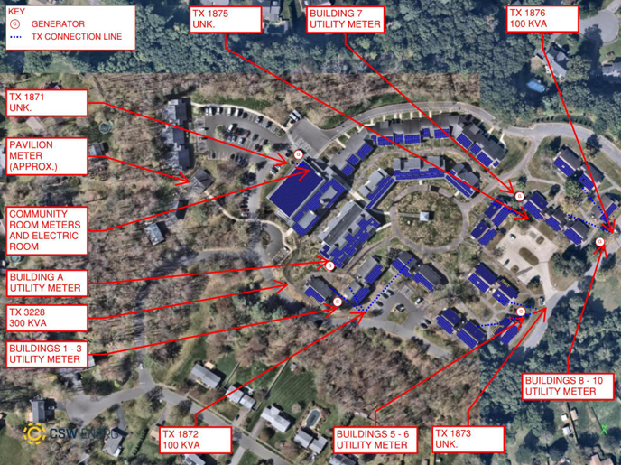
Sample Lease Modeling - 30% ITC Scenario
Sample Project
System Size (kW) | 1,073 kW DC
Year 1 Production (kWh) | 1,223,244 kWhs
ITC Assumption | 30% ITC
Cumulative Financial Benefit (Residents + Property Owner): $3,465,292 | Tenant $1,322,292 | Property Owner $2,143,000
Resident Share of Tariff | $1,322,292 (25% NPV of the tariff for eligible improvement)
Property Owner Share of Tariff | $113,714 (25.5% of the tariff)

Slide 12
How can Solar MAP be paired with CDBG Funds?
Connecticut Green Bank Provides:​
No Cost technical assistance through the Solar MAP program​
Solar Lease, which will allow public housing facilities to complete an energy related modernization project with zero capital outlay required​
CDBG Funds can be used to:​
Address barriers to completing a public housing solar project which include:​
  Roof restoration or replacement prior to solar​
  Structural upgrades​
  Interconnection costs or electrical upgrades​
  Administrative burdens, such as legal expenses when contracting a project​
  ​
Alternatively, public housing facilities may elect to submit for CDBG Funds to address other energy related upgrades to a facility (because there is an avenue to complete a solar project through solar MAP with zero capital outlay required). Projects may include: ​
Lighting Upgrades​
Energy Storage​
Insulation ​
Energy Efficient Windows or Doors

Slide 13
Round 1 Portfolio
Organization | Cheshire Housing Authority | Cheshire Housing Authority | Housing Authority of Town of Hamden | Housing Authority Town of Hamden | Housing Authority Town of Hamden | Elderly Housing Management | Access Housing | Vesta Corp | Simon Konover
Site | Foote Commons | Beachport Senior Housing | Hamden Village | Mount Carmel Village | Congregate | Juniper Hill | Parker Place | The Monarch | Federation Square
# of Units | 20 | 48 | 110 | 40 | 30 | 100 | 37 | 64 | 88
System Size | 94.8 | 281.1 | 336.2 | 93.1 | 182.3 | 401.5 | 224.4 | 117.7 | 310.2
Tenant + Property Owner Term Benefit 30% ITC assumption | $197,129 | $1,253,000 | $706,050 | $299,768 | $823,573 | $922,636 | $821,240 | $519,125 | $659,129

Slide 14
Round 2 Portfolio
Organization | Giordano Construction & The Green Footprint | Town of Glastonbury | Hamden Housing Authority | Portland Housing Authority | Enfield Housing Authority | East Hartford Housing Authority | Abacus Property Management
Site | West Ridge Apartments | Herbert T Clark | Centerville Village | Quarry Heights | Mark Twain Congregate Housing | Rochambeau Apartments | Highwood Gardens
# of Units | 64 | 45 | 40 | 70 | 82 | 50 | 16
System Size | 56.1 | 122.0 | 118.85 | 164.4 | 229.0 | 304.2 | 51.3
Tenant + Property Owner Term Benefit 30% ITC assumption | $227,371 | $331,899 | $477,713 | $323,000 | $905,388 | $1,199,000 | $398,319.80

Slide 15


Questions & Answers
Email us at info@ctgreenbank.com
Contact:
Katie Shelton, Senior Manager, CT Green Bank
Katie.Shelton@ctgreenbank.com
860-785-9625
https://www.ctgreenbank.com​
​Link to schedule a meeting:​
https://calendly.com/d/5j7-3jf-vyj/intro-call-solar-map-affordable-multifamily-solar

Slide 16


Thank you for attending!

