Slide 1

2023 Small Cities CDBG Projects
Partnering with Sustainable CT’s Community Match Fund

Slide 2

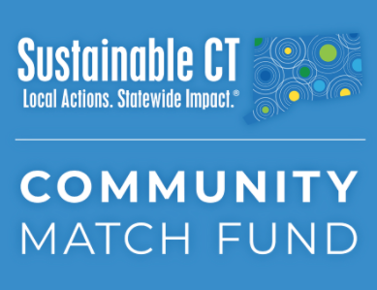
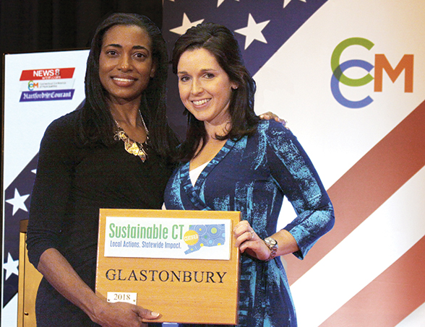
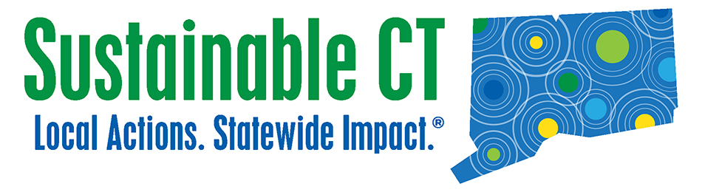
What is Sustainable CT?
Roadmap
Menu of sustainability actions
Resources
Technical assistance and funding
Certification
Recognition and celebration of achievements

Slide 3
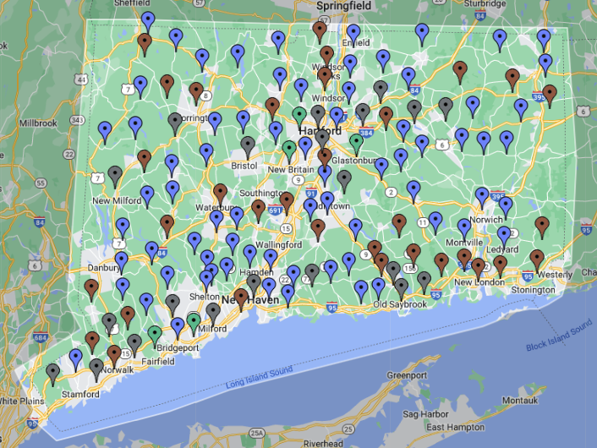
Participating Communities
131 CT towns participating (77%)
59 towns certified
More than 3,280 sustainability actions implemented
Strong civic engagement
Connected, inclusive, resilient communities

Slide 4
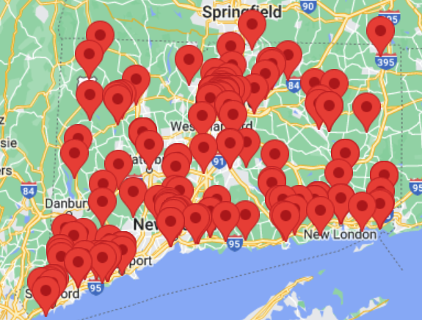
Community Match Fund: Citizen Participation
  Fast, easy, flexible, no deadlines
  Anyone with a good idea to improve their community
  Crowdfunding doubled by $1-to-$1 matching grant from Sustainable CT
  Up to $7,500 from matching grant
  Coaching and support for project leaders
  More than $2.96 million invested
  248 community-led projects statewide
  Supported by 13,600 crowdfunding donors

Slide 5
What is a Sustainable Community?
Inclusive and equitable community impacts
Thriving local economies
Well-steward land and natural resources
Vibrant and creative cultural ecosystems
Dynamic and resilient planning
Clean and diverse transportation systems
Renewable and efficient energy infrastructure and operations
Inclusive engagement, communication and education
Strategic materials management
Optimal health and wellness opportunities
Healthy, efficient, and diverse housing
Effective, compassionate homelessness prevention

Slide 6
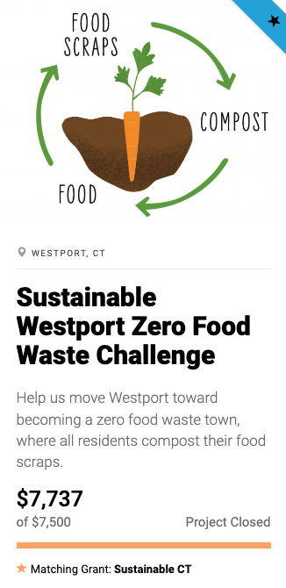
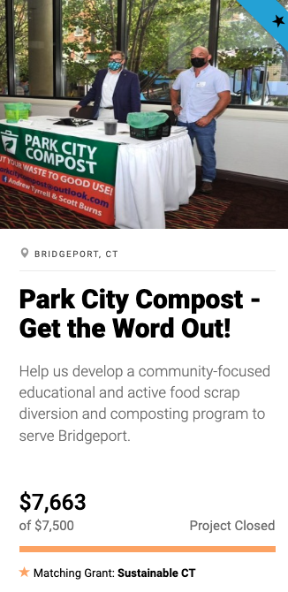
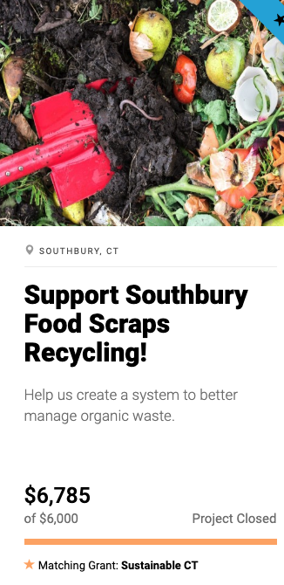
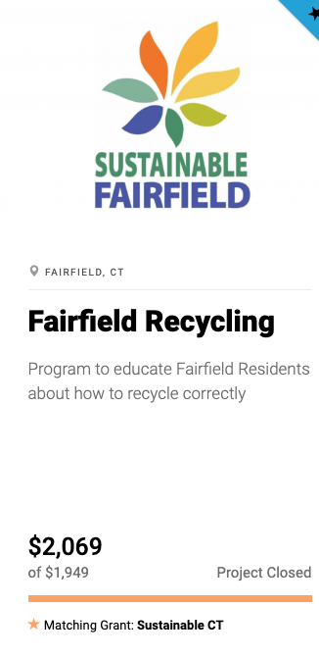
Project Examples: Recycling and Composting

Slide 7
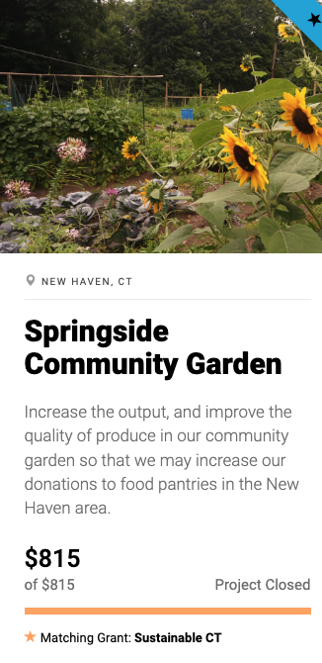
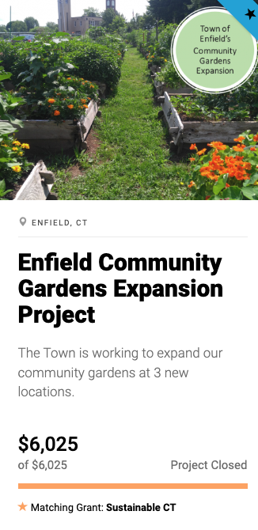
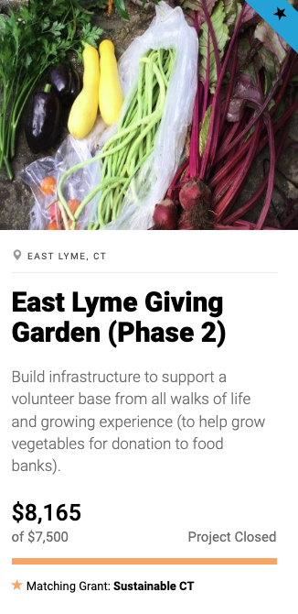
Project Examples: Community Gardens

Slide 8
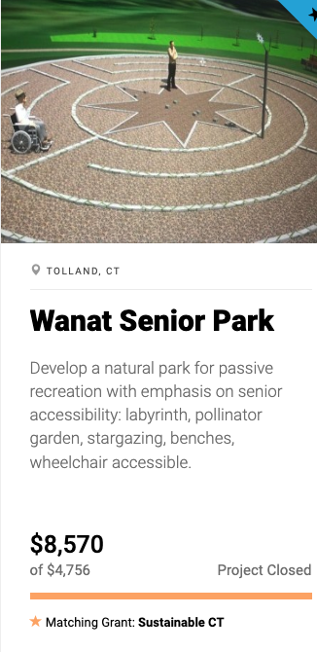
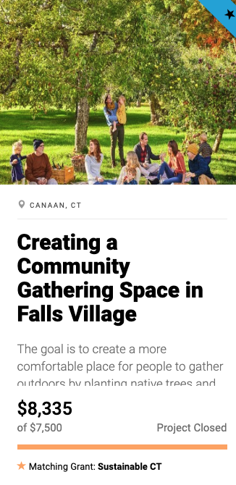
Project Examples: Creating Community Spaces

Slide 9
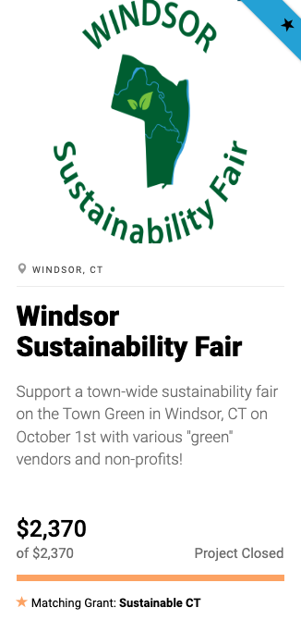
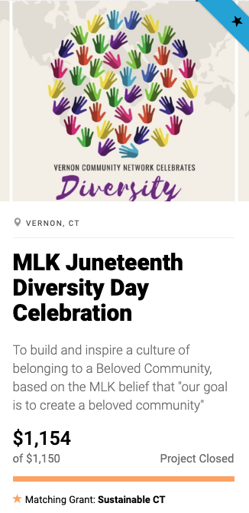
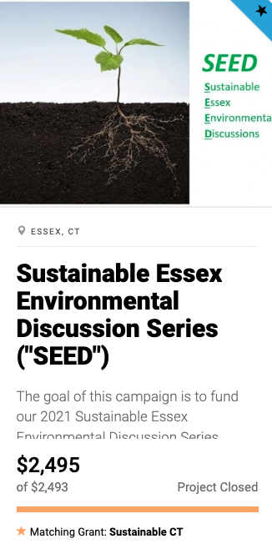
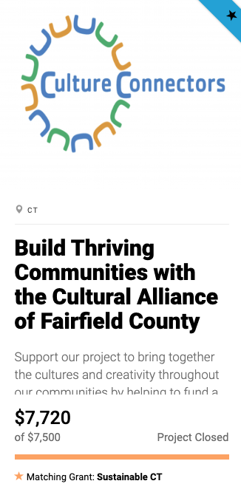
Project Examples: Celebrations, Community Building

Slide 10
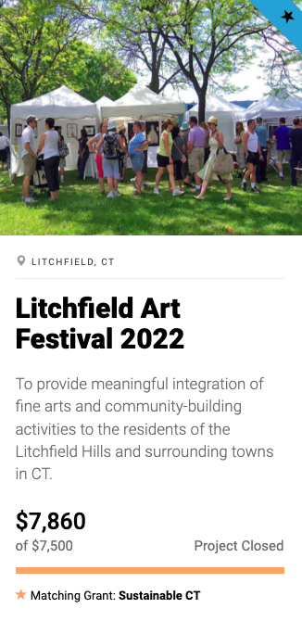
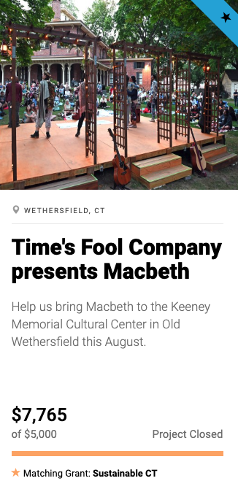
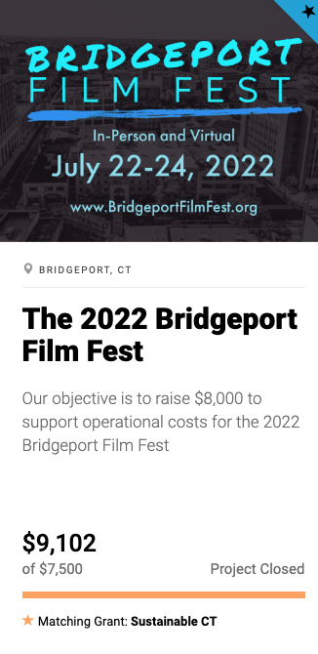
Project Examples: Arts Events

Slide 11
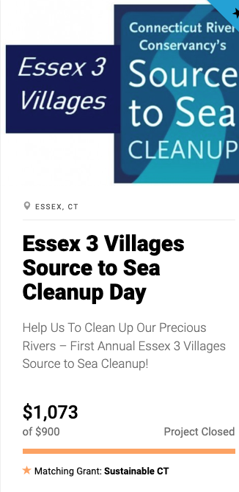
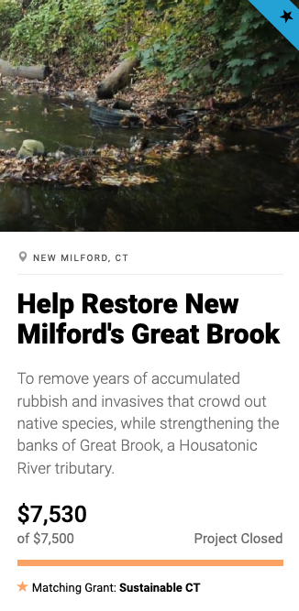
Project Examples: Clean Up Natural Areas

Slide 12
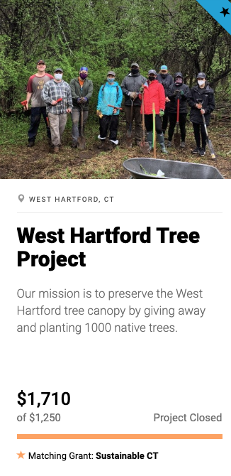
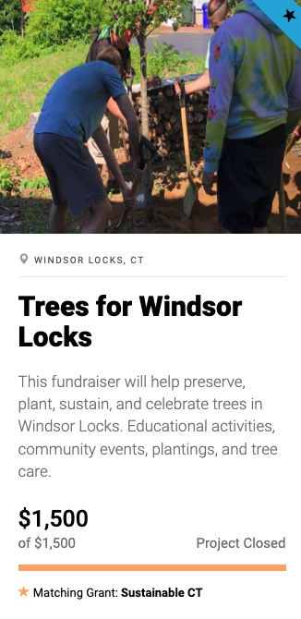
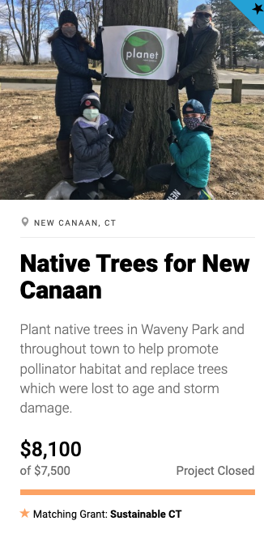
Project Examples: Tree Planting

Slide 13
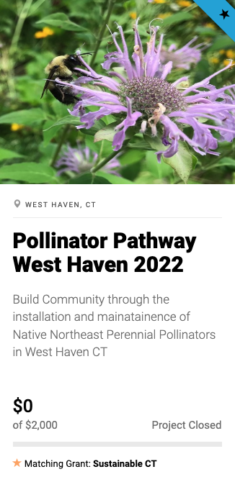
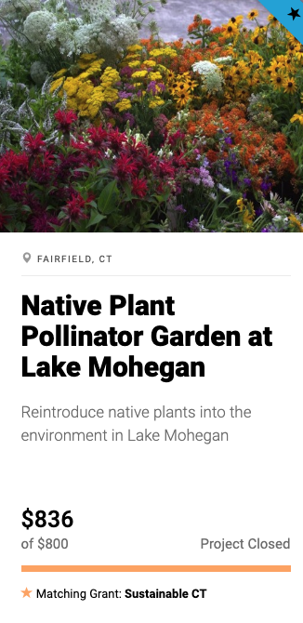
Project Examples: Pollinator Gardens

Slide 14
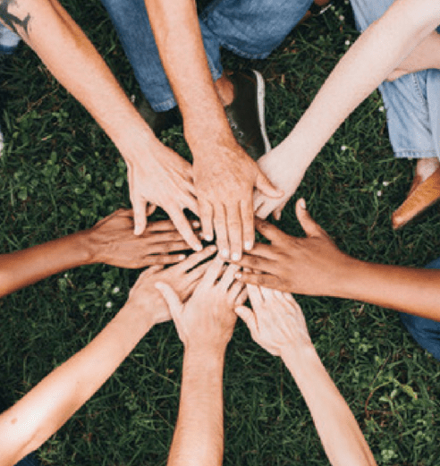
Let’s Partner on your CDBG Proposal
  Call us to chat about citizen participation and community engagement ideas to augment your project
  Empower residents
  Connect people
  Inspire fun, cool projects
  Improve quality of life
  Sustainable CT will support community-led projects and provide the required letter for your CDBG grant proposal

Slide 15
Lynn Stoddard, Executive Director
Joseph Dickerson, Community Partnership Manager
funding@sustainablect.org
860-259-4730

