Slide 1

Solar for Affordable Multifamily
Connecticut Department of Housing, CDGB Workshop
March 15, 2022
Notes:
Introduce us,
Who we are, what we do,
Who am I, my connection with nonprofits
Hear about your priorities around Energy, what you have done, open questions, what you want to do
Describe that we have financing programs for nonprofits and for muni/state owned buildings, -driven by the ownership structure.

Slide 2
Agenda
About us
The new solar tariff program
Solar financing solutions

Slide 3

Our mission is to confront climate change and provide all of society a healthier and more prosperous future by increasing and accelerating the flow of private capital into markets that energize the green economy.
Connecticut Green Bank is the nation’s first green bank. Established in 2011 as a quasi-public agency, the Green Bank uses limited public dollars to attract private capital investment and offers
green solutions that help people, businesses and all of Connecticut
thrive.
Guiding this mission is our vision for
“…a planet protected by the love of humanity.”
3

Slide 4




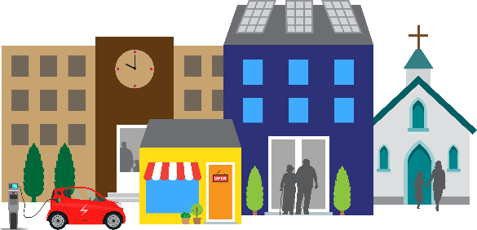
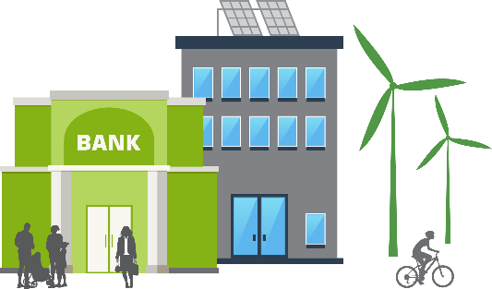
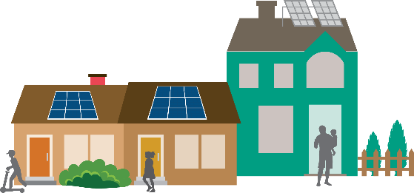



The Green Bank is helping Connecticut flourish by offering green solutions for homes and buildings and by creating innovative ways to invest in the green energy economy.
our solutions
our goals
Leverage limited public resources to scale-up and mobilize private capital investment in the green economy
of Connecticut.
Strengthen Connecticut’s communities by making
the benefits of the green economy inclusive and accessible to all individuals, families, and business – especially those in vulnerable communities
Pursue investment strategies that advance market transformation in green investing while supporting the organization’s financial sustainability goals.

Slide 5
New Solar Tariff Program
Successor to existing Low and Zero Emissions Renewable Energy Credit (LREC/ZREC) and net metering
Defines how solar system owners will be compensated for production
Solar system owners can receive 20-year revenue stream based on system kwh production
New program rules were published in September 2021. Program details for affordable housing are still being determined

Slide 6
Affordable Multifamily properties
Can access Residential Tariff rate, which is higher than Commercial
No cap on # of residential projects
Further guidance needed from PURA about
  benefit sharing with tenants,
  What is defined as affordable housing
Potential for tariff to have an adder (higher tariff) for Distressed Communities

Slide 7



What is a Power Purchase Agreement (“PPA”)?
System Owner: Green Bank
Building
$
Green Bank is Seller: Oversees development, construction, & asset management
Building is Buyer: Purchases electricity from solar installed on property
Contract between Seller (generates electricity) and Buyer (purchases electricity)
7

Slide 8
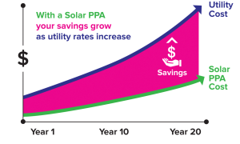
What are the Benefits of a PPA?
No upfront costs
Lock in low electricity rate
Positive cash flow
No operations & maintenance costs
Preserve capital & credit lines
Managed by a third-party solar system owner
Notes:
No upfront installation costs
No new debt to incur
Lock in low electricity costs and realize predictable energy production
Positive cash flow in year one
Preserve capital and credit lines for other investments
Managed by a third-party solar system owner

Slide 9
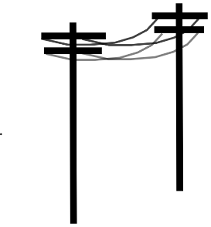
Roof Lease
System Owner: Green Bank
Utility
Energy Generated
$
Buy All Tariff
Building Owner
Annual Roof Lease Payment
$
Green Bank is owns the solar: Oversees development, construction, & asset management
Utility (under tariff): Purchases electricity from solar installed on property
Roof Lease between Green Bank and Property owner
9

Slide 10
Advantages for Affordable Housing Owners
Simple: third-party owner manages production revenue and renewable energy credits from the utility over 20 years
No payment obligation from property owner.
Property owner receives annual lease income instead of revenue from energy savings
Does not require credit risk assessment
Can work for newer properties that have limited operating history
Roof Lease is between Green Bank (or its affiliates) and property.
Note: if owner has tax liabilities, the C-PACE option may be preferable to either the roof lease or the PPA.

Slide 11
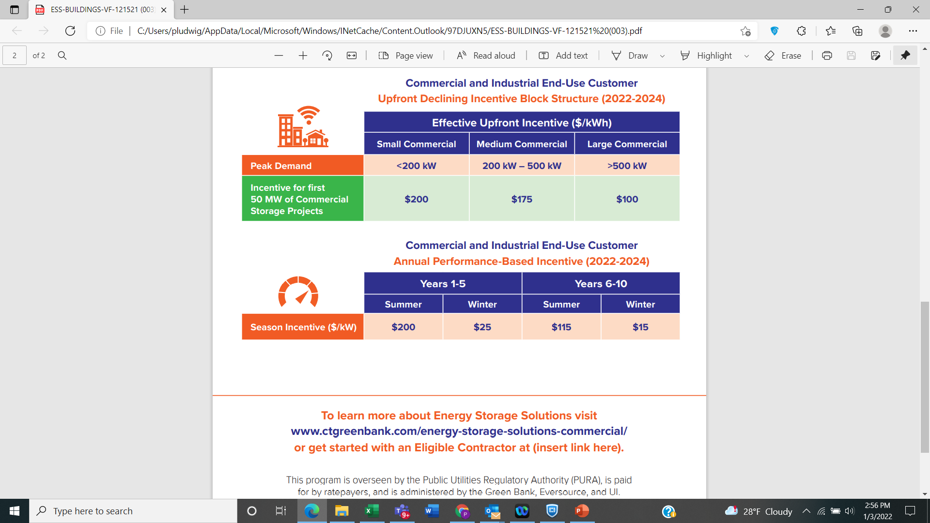
Building Solutions: Energy Storage Solutions
https://energystoragect.com/energy-storage-solutions-for-buildings-communities/

Slide 12
Stay Engaged
PURA, the utility regulator is still deciding on two matters
What should the definition of affordable housing be?
How should benefits of solar be shared with tenants?
You can stay engaged by
Email Rudy Sturk Rudy.Sturk@ctgreenbank.com to be added to the mailing list for the P2P Multifamily Network
https://www.ctgreenbank.com/mf-ptp-network/
Call or email us (see following page)
Notes:
There are three ways you can get involved in the proceeding

Slide 13
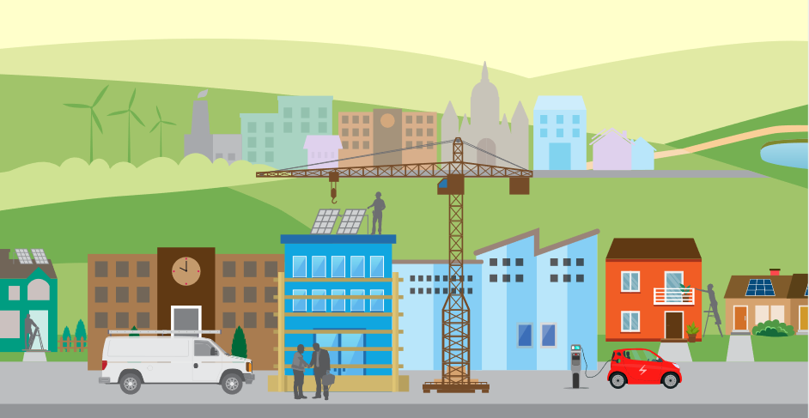
Thank you and Discussion
Peter Ludwig peter.ludwig@ctgreenbank.com
T 860-258-7806 https://calendly.com/peter-ludwig

