Slide 1


Photography Tips for Beginners
DSLR
Cellphone Photography
Composition
Quality
Photographing Architecture
Notes:
These are my notes.

Slide 2

Preparer
Kiara Ivelisse Rosario
BA in Fine Arts Candidate, Class of 2022
Pontifical Catholic University of Puerto Rico

Slide 3
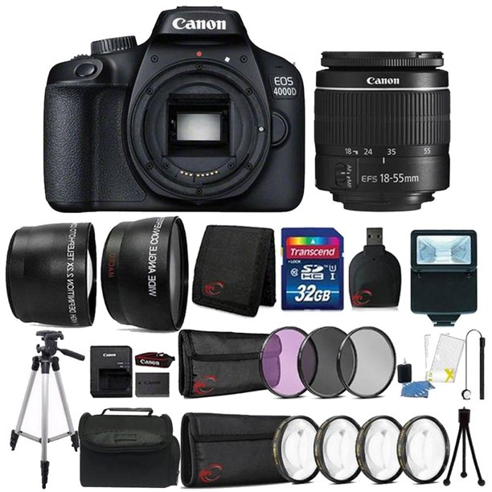
Using the Camera You Already Have
Having an expensive camera does not guarantee good pictures.
The basics of good composition can be done with any type of camera, including the one on your smartphone.

Slide 4
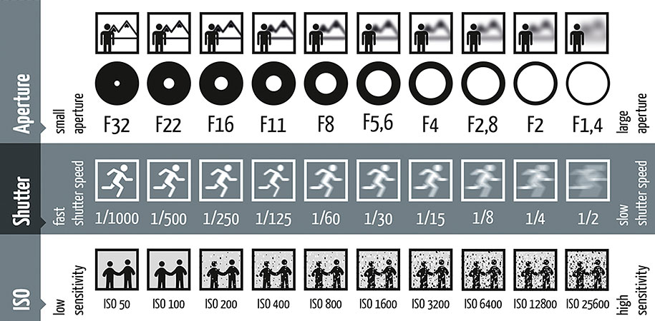
Learning the Basics
Familiarize yourself with the basic settings of your camera.
Digital cameras come with different modes, the most used are Auto and Manual modes.
Using manual mode on your camera will help put into practice the use of the most important settings: Aperture, Shutter Speed, and ISO also known as the “exposure triangle”
(Some smartphone cameras also come with a manual mode).

Slide 5
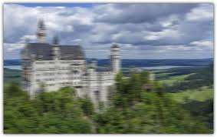
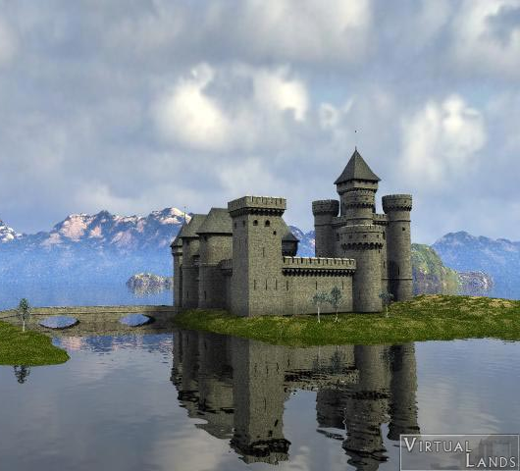
Focusing
Practicing how to focus on different elements (Close and Far) using the cameras lens and Aperture settings is also an important step for beginners.

Slide 6
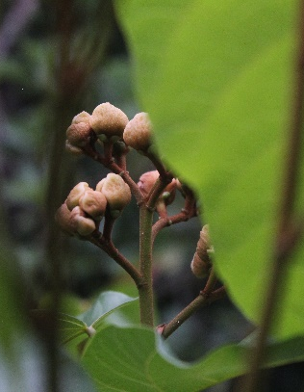

Focusing
Phone cameras allow focusing on a subject just by taping over it on the screen.
Focusing on one object more than another helps inform the viewer what the main subject of the image is.

Slide 7
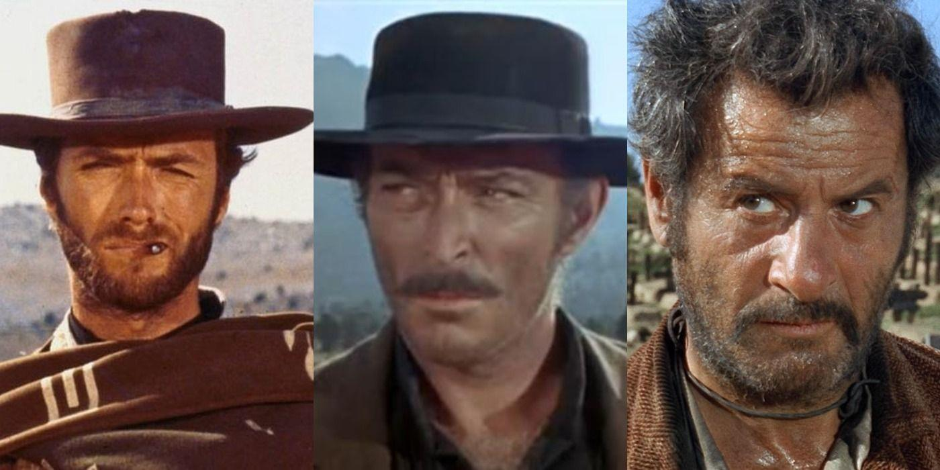
Take as Many Images as Possible
While on the field, it is important to snap as many pictures as we can. While you may believe that you have the desired image on the spot, it can become a very different story on the computer at home.
Having multiple images to choose from is never a bad option. Some photoshoots can take hours and hundreds of pictures, only to end up having one or two that work.
Do not be discouraged and do not hesitate to delete the images that do not work just because you have spent hours on them.
Good Bad Ugly

Slide 8
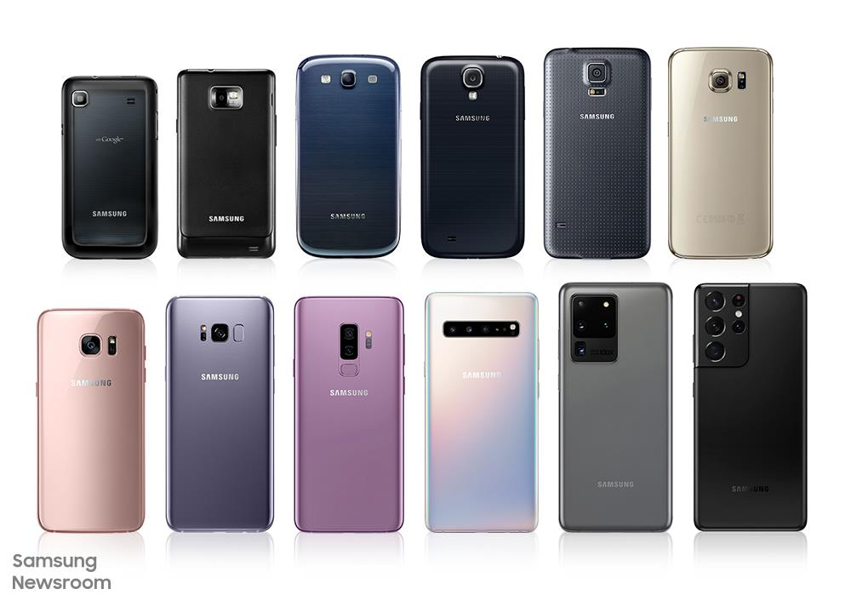
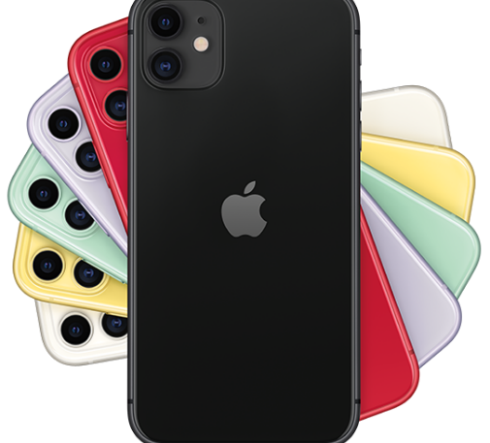
Cellphone Photography
Smartphones possess the capacity to create high quality images.
They are easier to carry around than all the equipment of a digital camera.
They also come with applications that can allow editing and sharing on the spot.
Learning how to properly use your phone’s camera to its full potential can drastically improve your images.

Slide 9
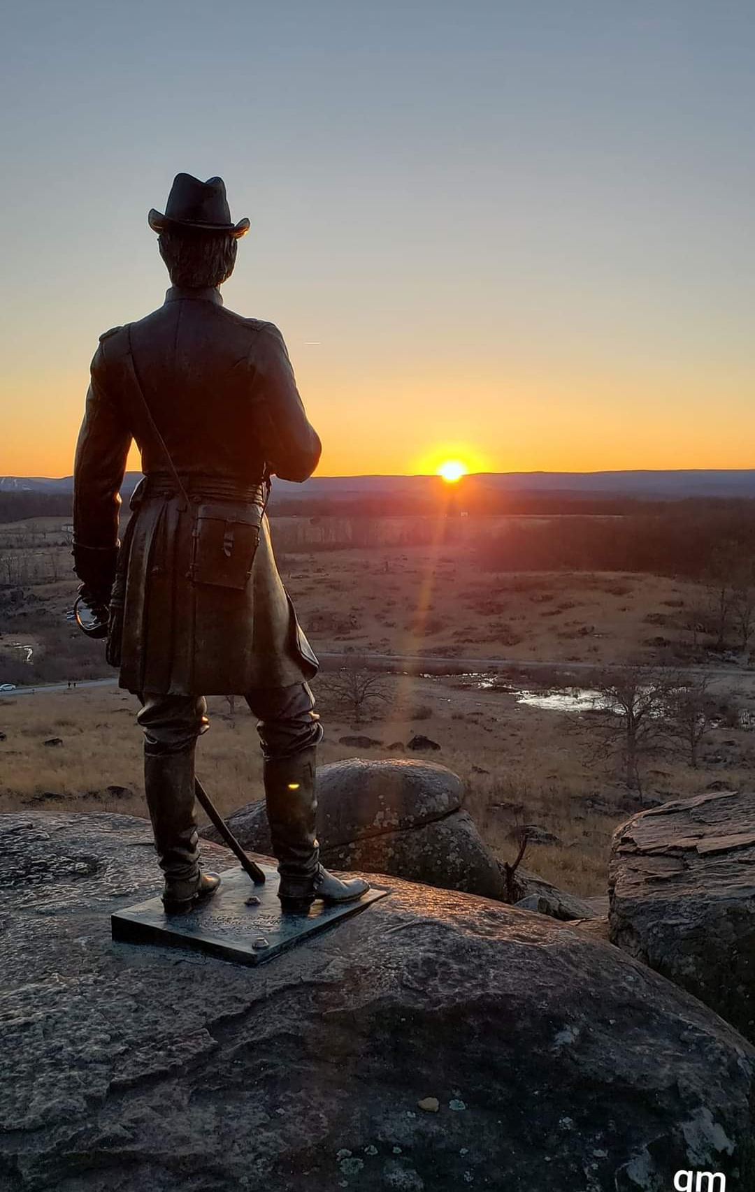
Adjusting Brightness
Making sure a picture is properly exposed before taking it can save many hours in postproduction, since overly exposed images loose details that may not be recovered even after hours of editing.
Adjusting the brightness level on an iPhone camera is simple, tap on the screen and swipe up or down to adjust.
To lock the focus and brightness settings you have chosen, long press on the screen and wait until the yellow square blinks twice. This will not allow the camera to automatically change the settings.
How much you reduce or increase the exposure of an image depends on the image you want to obtain.

Slide 10
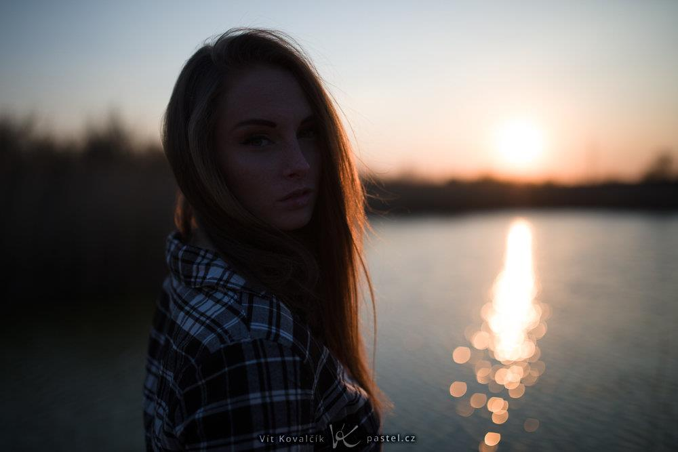
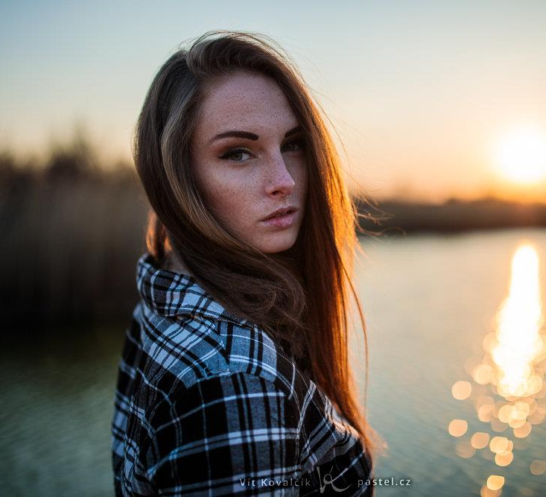
HDR: High Dynamic Range Imaging
High contrast images can be difficult to expose properly.
Either the highlights will be too bright or the shadows too dark, resulting in the loss of important details.
Take advantage of the HDR feature on an iPhone to obtain balanced exposure throughout the entire composition.

Slide 11
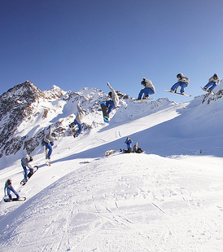
Use Burst Mode for Moving Subjects
Burst mode captures multiple pictures in seconds.
It allows to create dynamic pictures of moving and unpredictable objects, such as flying birds or waves crashing on the shore, allowing to capture movement.

Slide 12

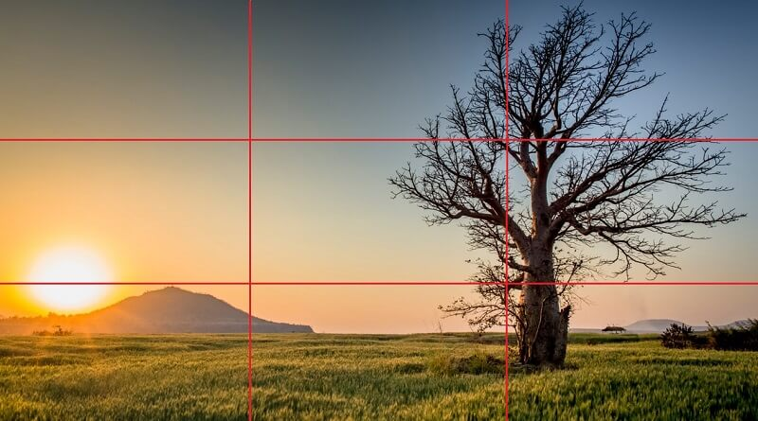
Using Gridlines
Turning on the gridline settings on a smartphone is a great way to practice creating great compositions. It helps easily visualize where to place our subject inside the frame to create a more pleasing image.
The Rule of Thirds is a basic concept in photography. Placing the main subject along the gridlines or on one or more of the four converging points creates a more balanced and engaging image.
Tip: When shooting horizon lines, avoid placing them in the middle. Instead, place them closer to the gridlines for a more dynamic result.

Slide 13
Composition
Composition in photography is the way elements are placed in relation to one another in a picture.
Arranging elements in a way that guide the viewer’s eyes around the image and towards the focal point is part of a good composition.
Every element that is present should be there for a reason. Think about the message you want to convey with your image.
What do you want to say?

Slide 14


Closed Composition
Used when there is a main subject that we want the viewer to focus on.
Elements such as “frames” lead the viewers eyes towards the main subject and away from the edges of the picture.

Slide 15

Open Composition
Several points of interest which keep viewer from focusing on only one subject resulting in a sense of movement within the photograph.
Elements run off the edges of the image.
Give sensation of space and depth.

Slide 16

Symmetrical Composition
Elements are similar or the exact same in shape, size, and color on both sides of the axis.

Slide 17

Central Composition
Emphasizes the elements that are center of the frame.

Slide 18
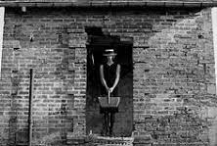

Frontal Composition
Image is taken directly from the front of the subject.

Slide 19
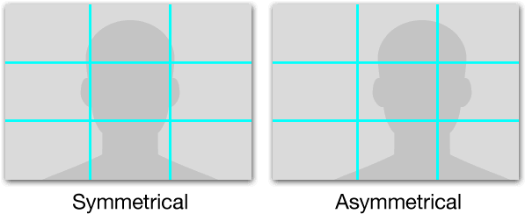
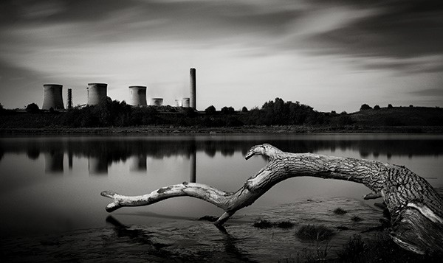
Asymmetrical Composition
Elements are different in shape, size, and color on both axis of the image.
Asymmetry does not equal imbalance in an image.

Slide 20
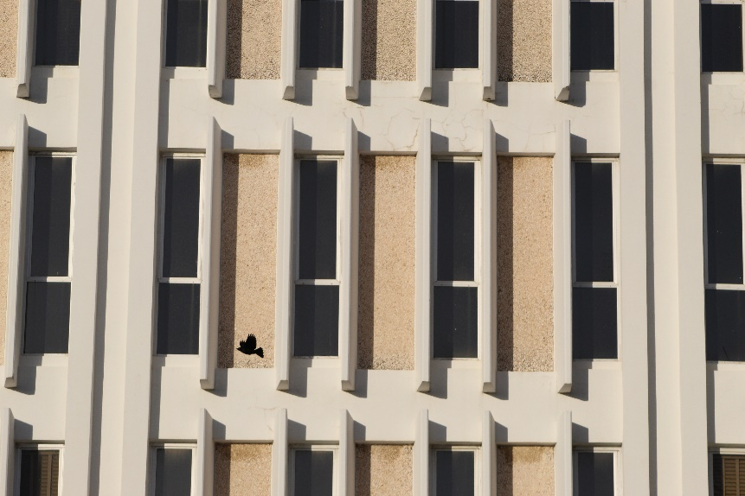

Vertical Composition
Elements are positioned along vertical lines.
A vertical composition does not necessarily mean a vertical format.

Slide 21
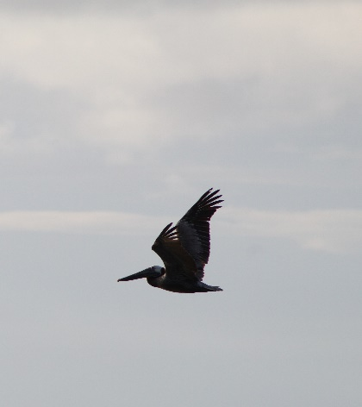
Positive and Negative Space
It is important to know what type of feeling you want to express.
Whether the images have more positive than negative space or vice versa, the emotion caused by either, is different.

Slide 22
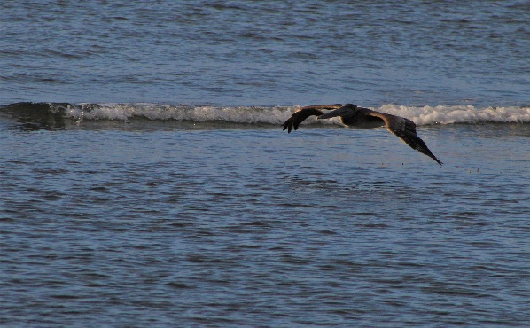
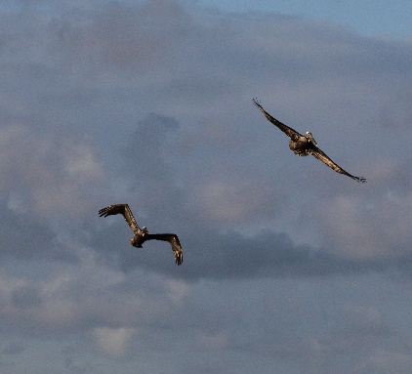
Breathing Space
Paying attention to how objects relate to one another is important for good composition.
Objects that interfere with others can be distracting and can ruin an image.
Avoid overwhelming the viewer with many details. Less is better.
The first image is hard to focus on since the waves in the background clash with the bird.
It is distracting and not pleasing to the eye.
The second image gives space between the elements making it easier on the eye.

Slide 23
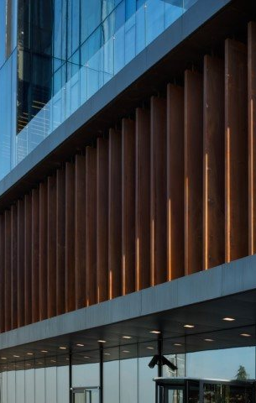
Composition and Photographing Buildings
Composition comes down to intention.
When it comes to architecture, rather than thinking of them as just buildings, think about the environment they are in, does it contribute to the main idea you want to convey?
How old is the building?
What is its purpose?
Pay attention to the details that could help answer these questions and carefully plan what composition suits best for the message you want to give.

Slide 24
Tips for Photographing Buildings
Always remember the message and intention for the image.
Placing it into context – Is the environment surrounding the building important to the message? If so, compose the image to include its surroundings. If it is not, avoid unnecessary elements that do not contribute to the intention. Everything in an image must have a reason for being there.
Human Element – Do you wish to inform about the functionality of the building? What is it used for? Including a human element in the composition can help tells us about its reason for being and how it is interacted with.

Slide 25
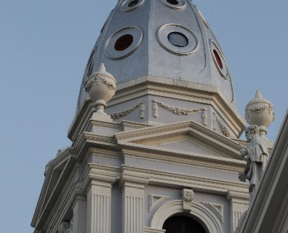


Lighting
When it comes to photographing buildings, lighting conditions can be tricky to manage as we mostly use natural light.
The best time to shoot is early in the morning and in the afternoon. Take advantage of the different colors in the sky and how they reflect on the buildings.
Weather can impact the mood of an image, which is a great way to express emotion and establish the message you want to convey.

Slide 26
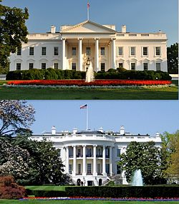
Move Around
Not being able to move the subject matter does not equal being unable to control the composition.
Change positions or the angle in which you are shooting at.
Explore all the sides of the building, experiment unique angles and use the lines of the buildings itself.

Slide 27


Look for Specific Details
Remove unwanted elements from the frame such as a parked car or a stop sign by zooming in on specific details of the building.
Look for geometric patterns or interesting shadows. Think to yourself, what can I say about this buildings structure?
Is it a historical building?
What details can you focus on to inform the viewer of this fact?

Slide 28
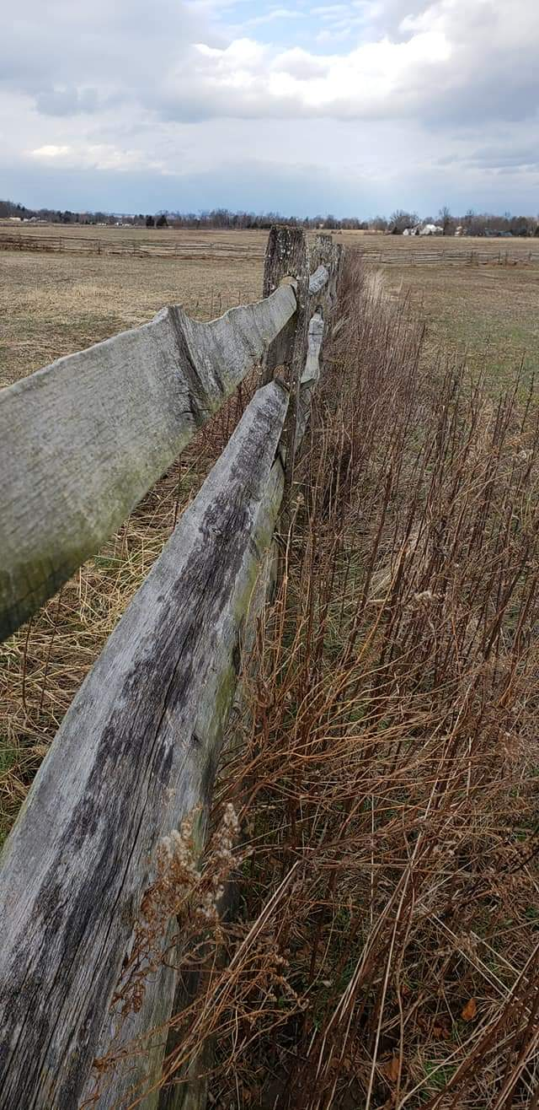
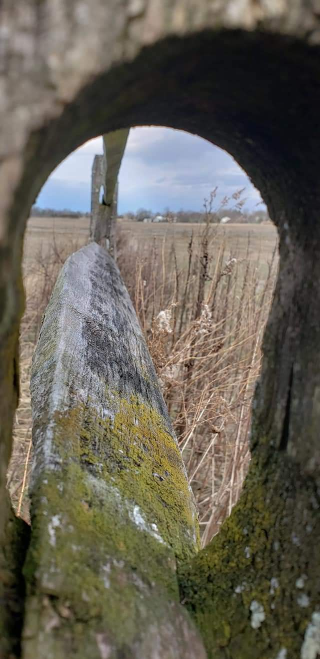
A Picture is Worth 1000 Words
5 Fences
What feelings are conveyed by each fence?
Positive or Negative?

Slide 29
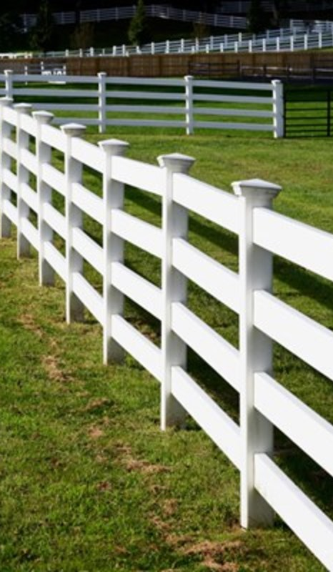
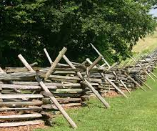
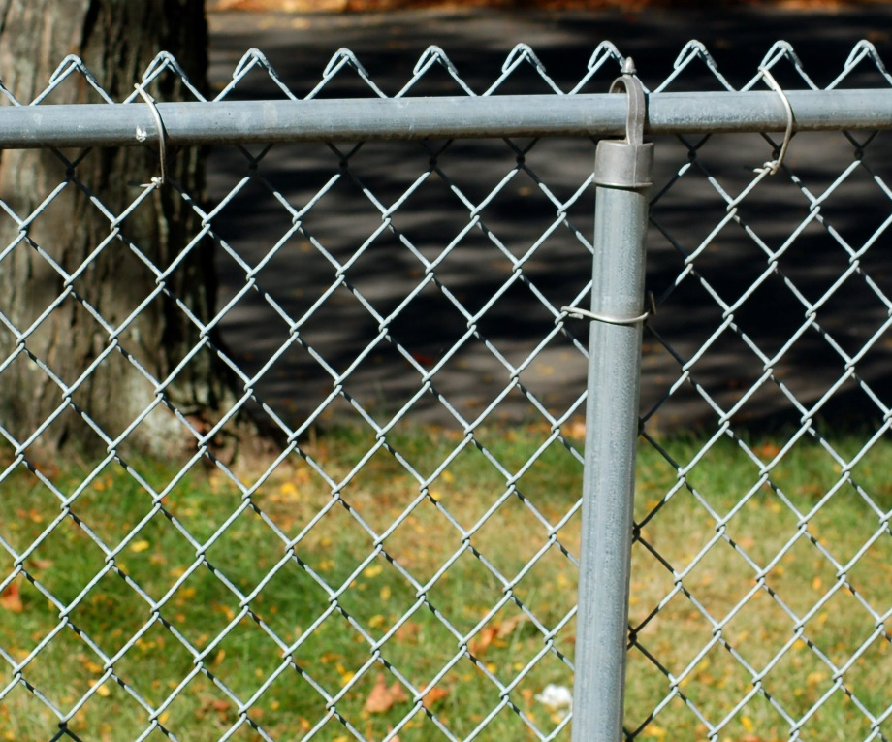
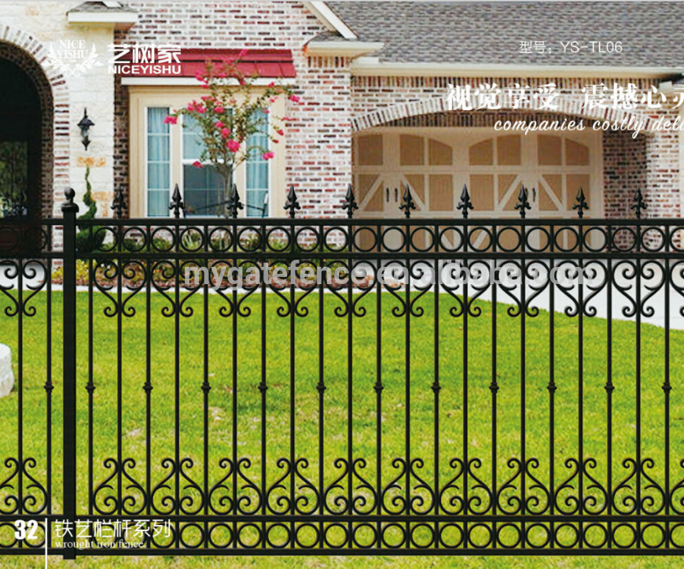


Slide 30
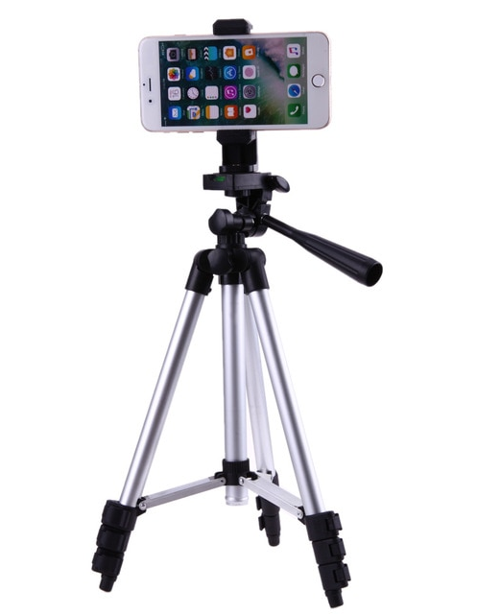
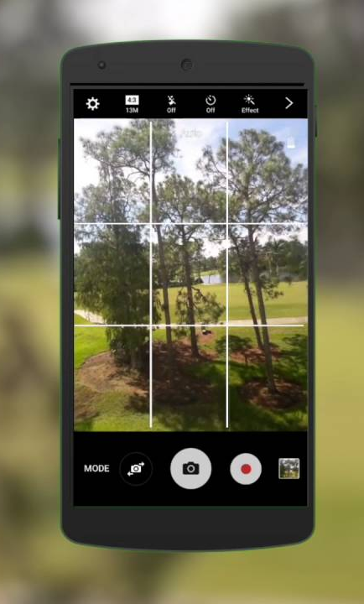

Final Words
Use the Gridlines in Your Cellphone – Helps with composition
Use a tripod – Allows more careful composing and framing of the subject
Hold Your Breathe – Less likely to result in blurred photos

Slide 31


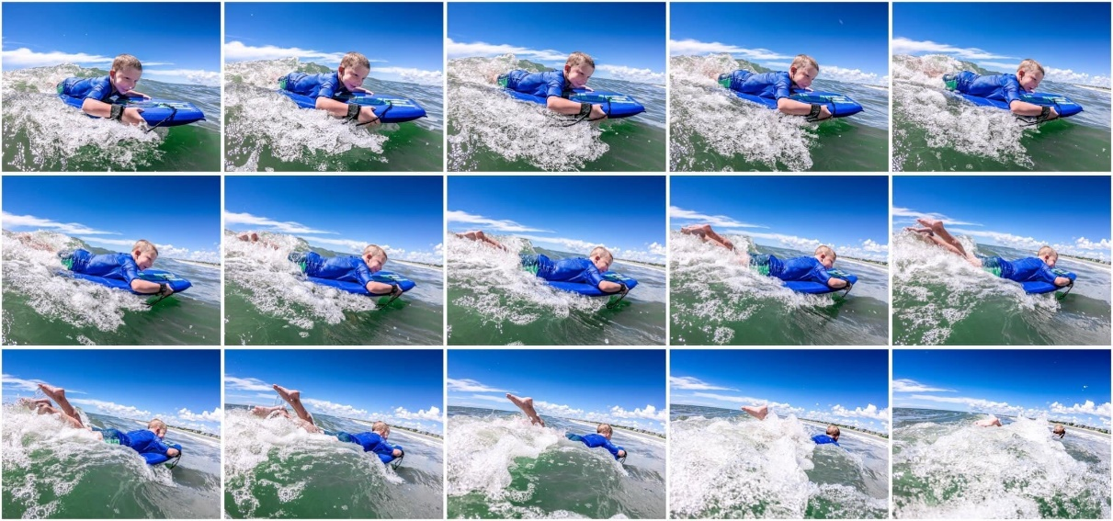
Final Words
Be Creative
Think Outside the Box
Do Not Be Discouraged
Remember – Even professionals take 1000 pictures and use only 5

Slide 32
THANK YOU
Remember, It’s OUR Project. Let’s be proud of our work!

