Slide 1


Slide 2
Small Cities CDBG 2022
Virtual Application Workshop
Completing the e-Form

Slide 3

Intent to Apply Form- Friday April 8, 2022
Application Handbook
Application Exhibits
Application Exhibit Checklist
Rating & Ranking
Documents requiring wet signatures
Application e-Form
Notes:
For Intent to Apply:
Indicate name and email of person responsible for submitting your grant.
All documents requiring wet signatures must be held and available upon request in your Application folder within your respective municipality.

Slide 4
Application
General Information Page
Make sure to complete this section accurately

Slide 5

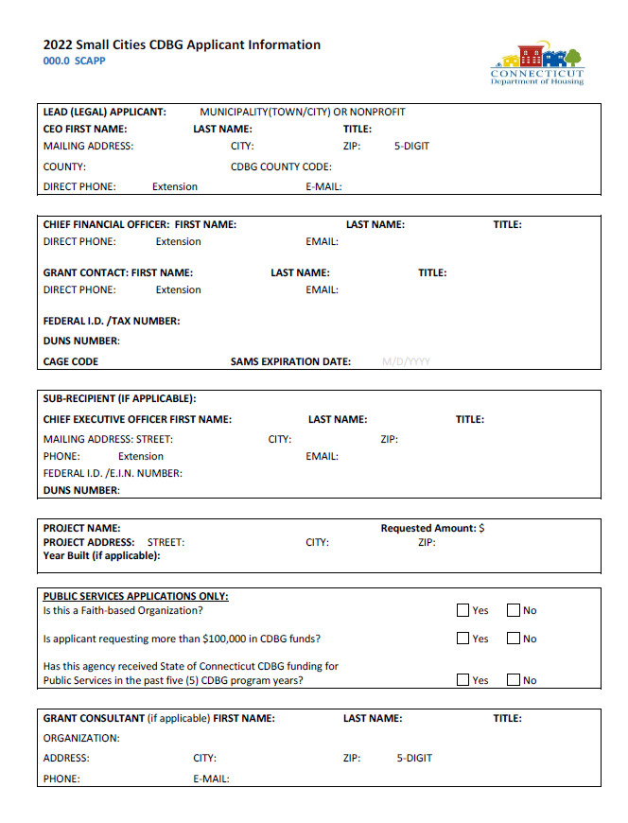

Slide 6
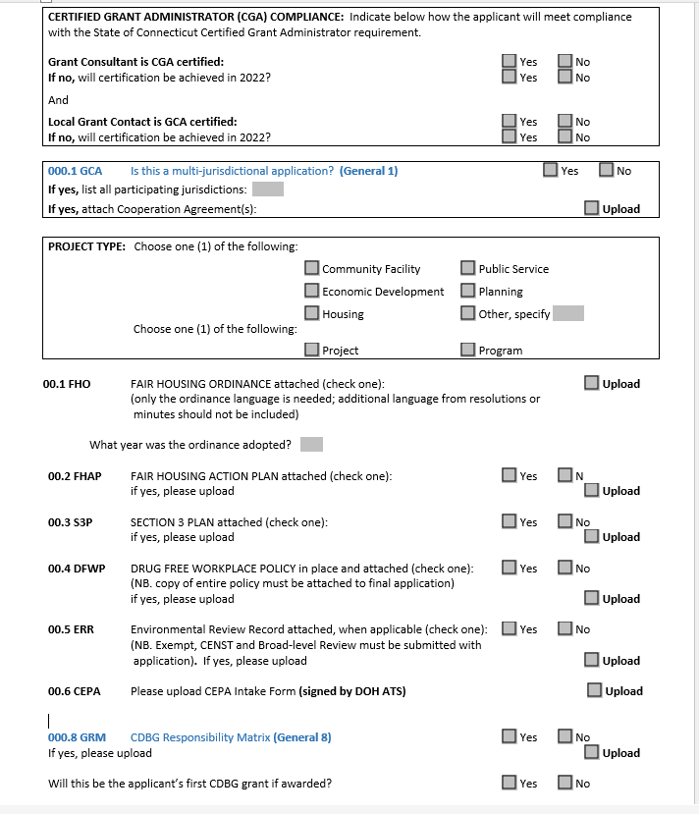
Notes:
Listen up folks
CGA certification is a requirement, you must get certified by October 2022. The State will offer another opportunity this year for certification in September/October 2022.
If you have a current 2018, 2019, or 2020 grant and there is no CGA on staff/or not working with a Grant Administrator, your grant will be redlined for termination for non-compliance.
Say goodbye to the days when municipalities state, “we are just the pass-through organization, we’re doing a favor for the HA”

Slide 7
Citizen Participation
Fill in the table- answer the questions
Upload items..make certain the minutes contain information about PI use/reuse (if applicable). Get the admin staff or a super detail- oriented person to accurately capture the discussions at the public hearing.
If the meeting minutes don’t share specific points, you will not be scored. Minutes must be approved and certified.
We need to determine whether or not you completed the CIT PAT accurately.

Slide 8
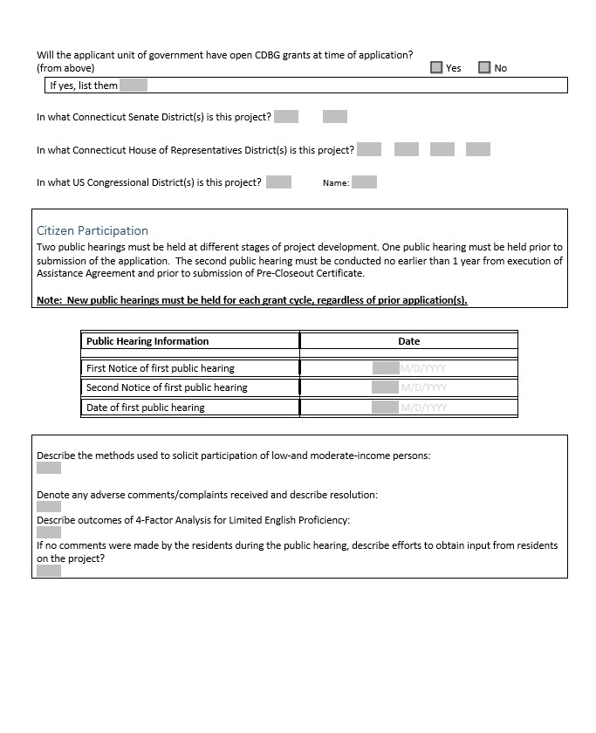

Slide 9
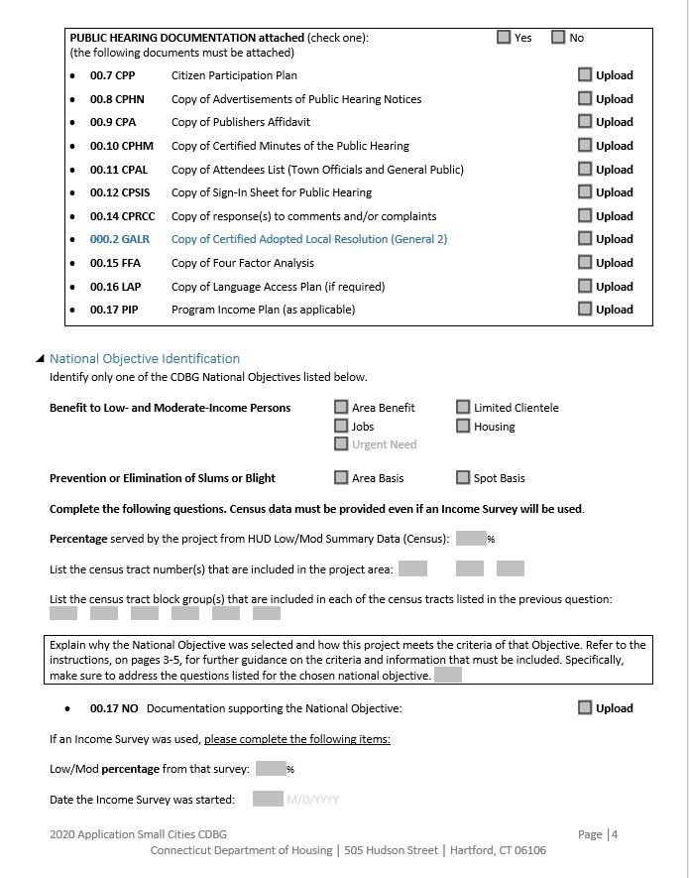

Slide 10
…Next National Objective
Jobs Housing
Urgent Need
Urgent Need
Select/check the appropriate box
Benefit Low/Mod
(Limited Clientele, Area Benefit, Housing)
Include census tract numbers if applicable
Notes:
Benefit Low Mod-
Is it Housing?
Limited Clientele
Area Benefit
Check one

Slide 11
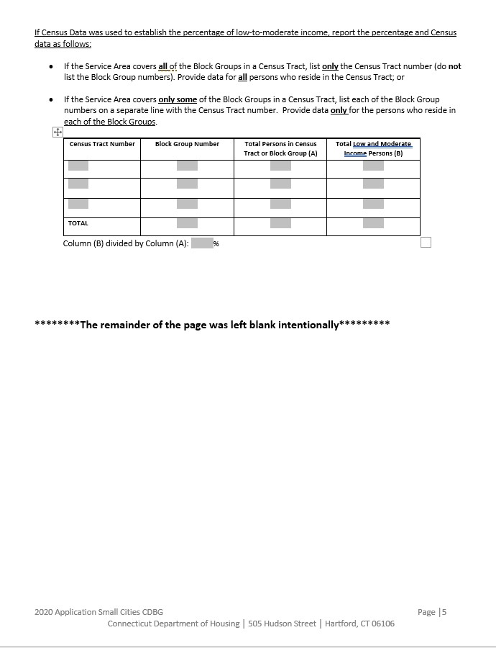

Slide 12

Complete Beneficiary info
#of Asians, # American/Native Indians, #Africans, #Hispanic, #Whites
#Handicapped, #Elderly People, #Female-headed Households etc.

Slide 13
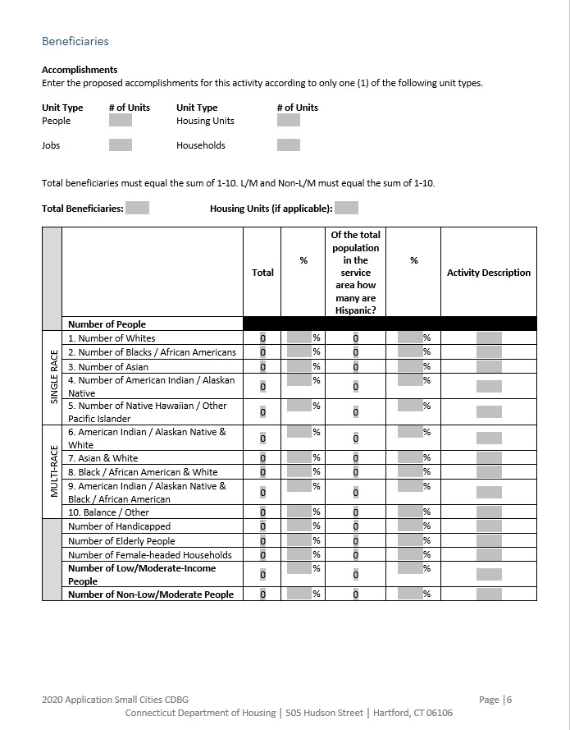

Slide 14

Sections 1.1
  A detailed description of actual physical activities or services that would be undertaken; purpose of your project?
2. Is the project being completed in phases? If so, why?
3. What is the nature of the project?
4. Whom is it designed to benefit?
5. What is the impact of the problem on Low/ Mod income persons?
Project Description.
Describe the proposed project/program.
Limit to 1000 words.

Slide 15
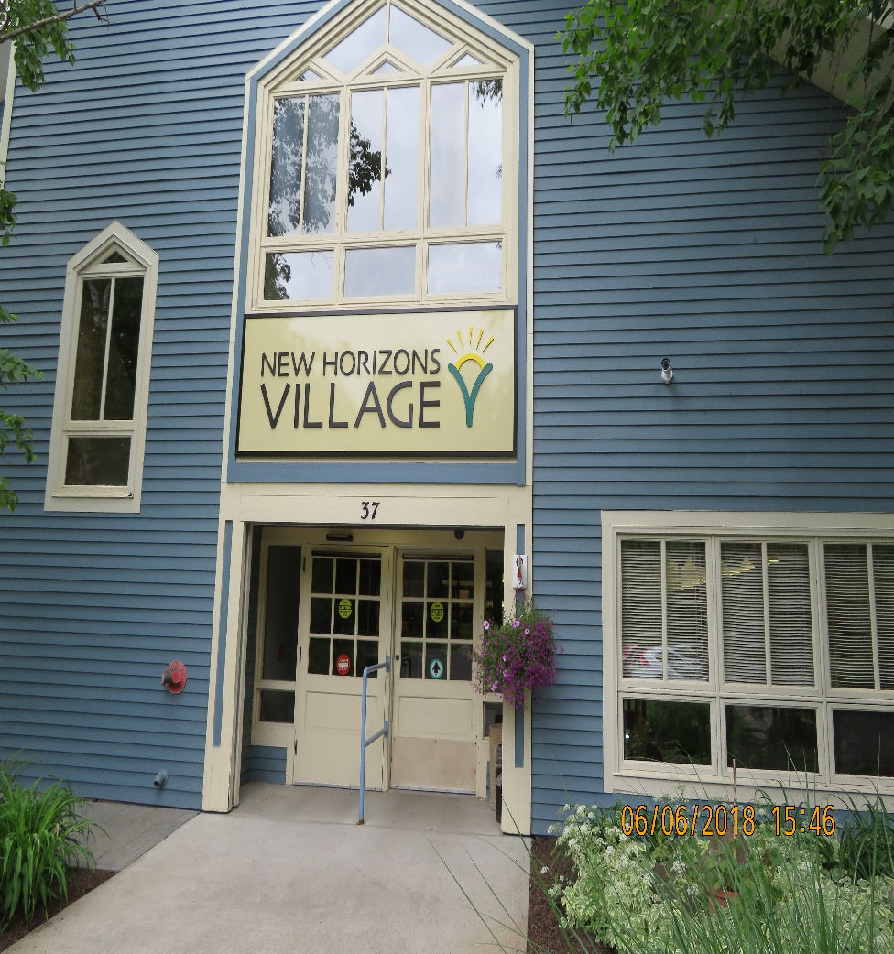
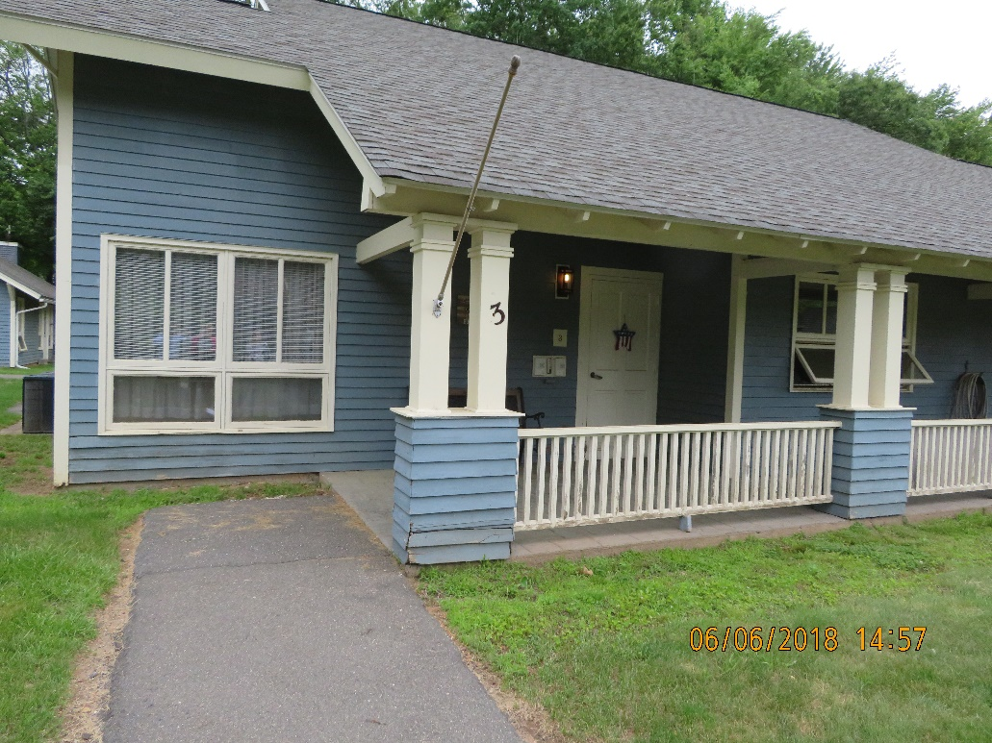
Section 2.1
Project Need

Slide 16
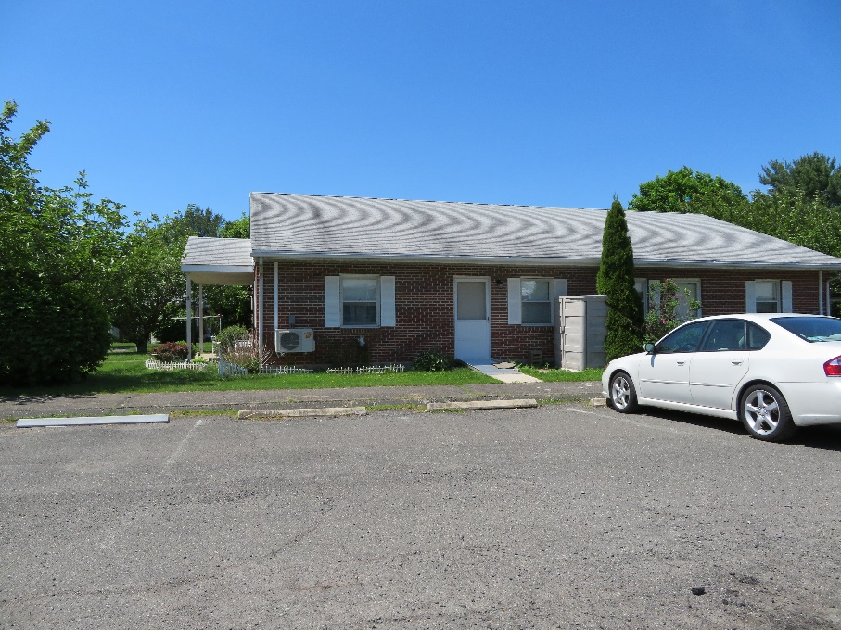
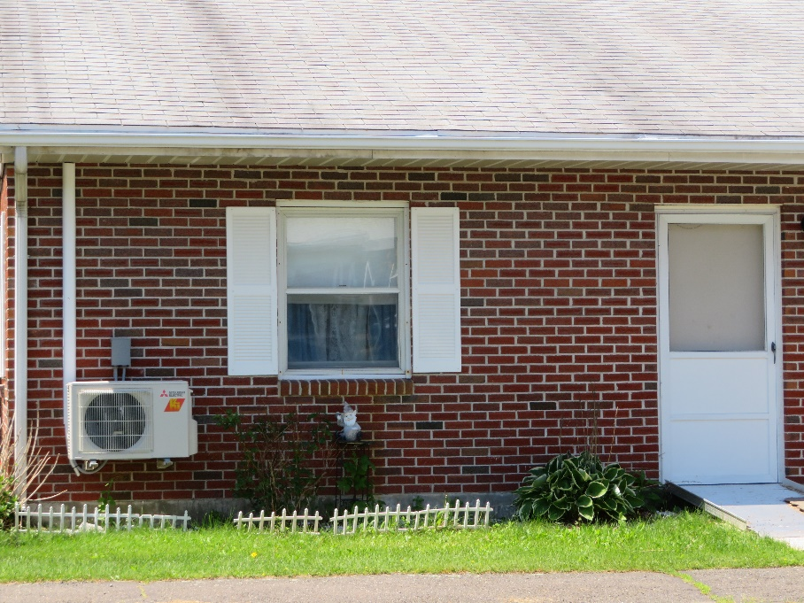
Campus Roofing, windows, entry doors

Slide 17
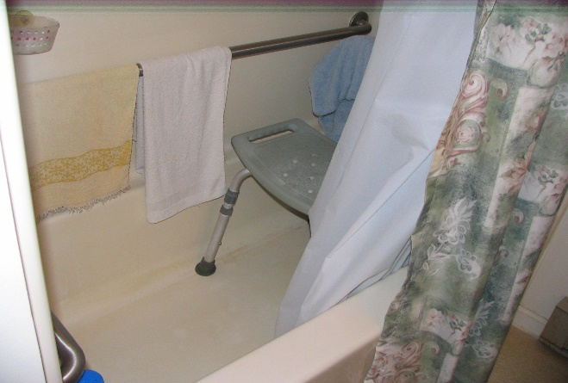
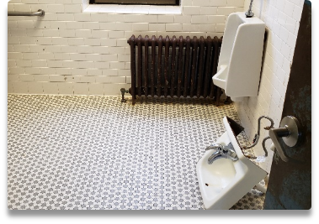
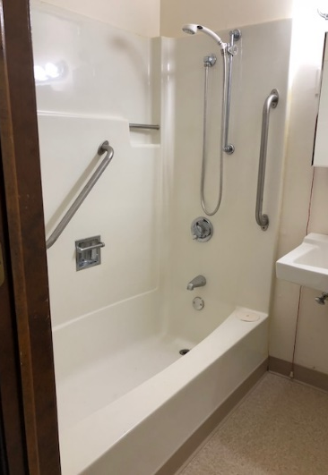

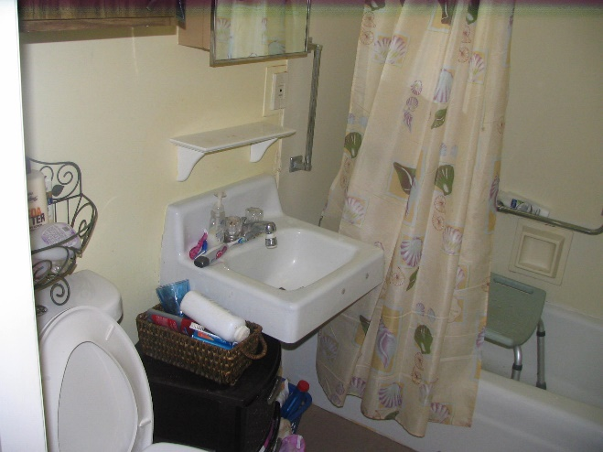
Do you have bathrooms that look like this and your residents are unable to age in place
trip hazards
Fixtures that look like this or are about to….
Bathrooms that look like this……

Slide 18
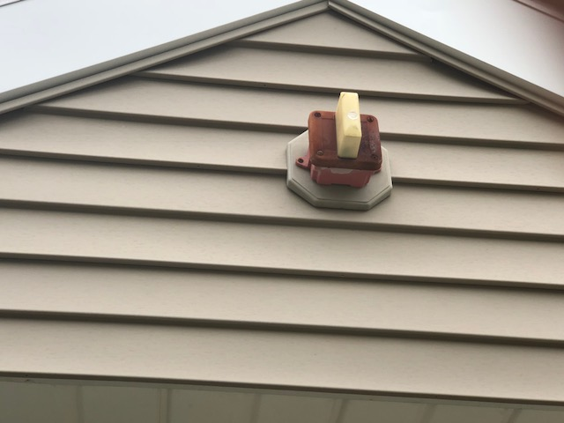
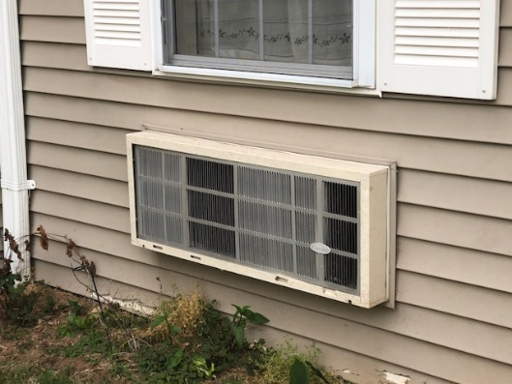
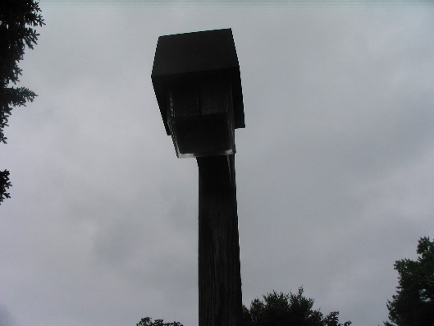
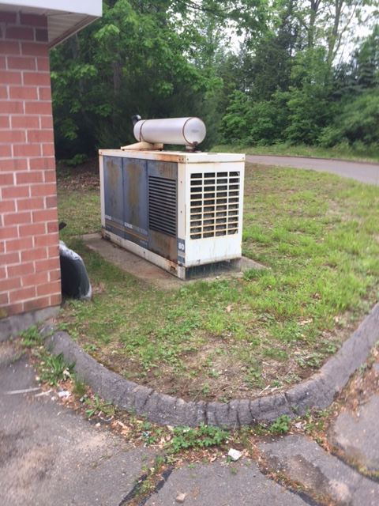
Campuses with ineffective health & safety fixtures that look like this
Inefficient/Retired AC Units
Poor Site Lighting/Unsafe for residents
Outdated Emergency Alarm Systems

Slide 19
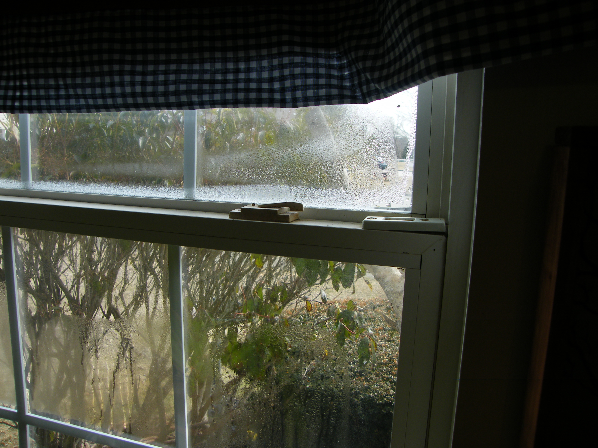
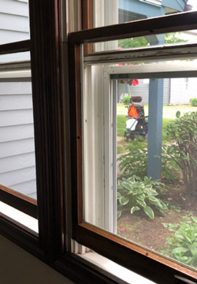
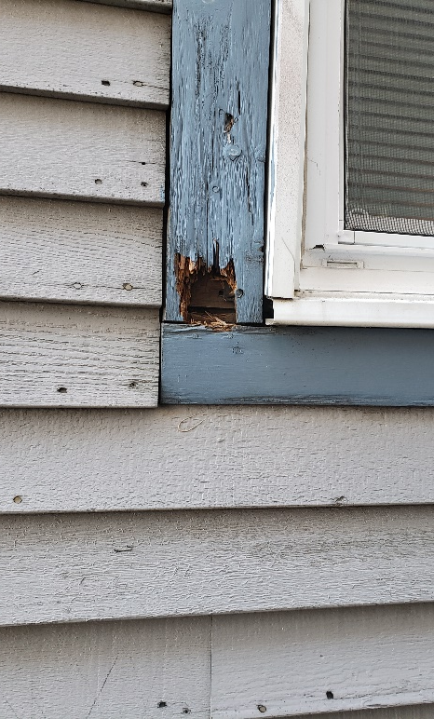

Rotten siding

Slide 20
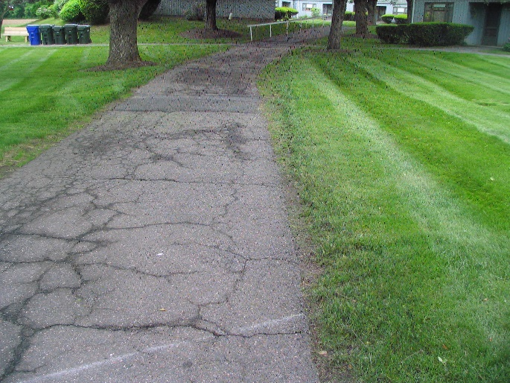
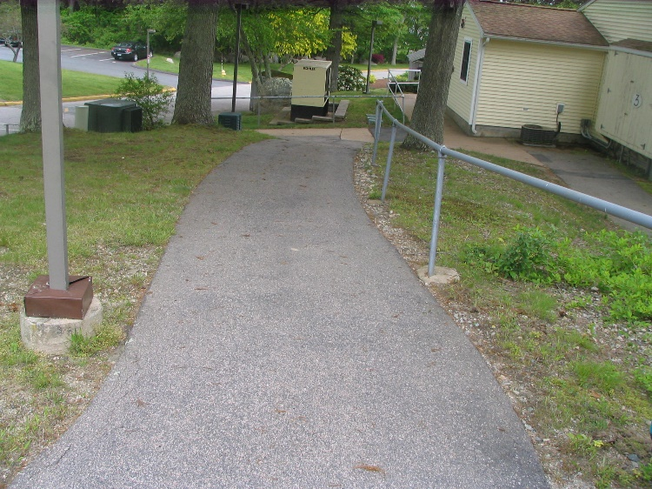
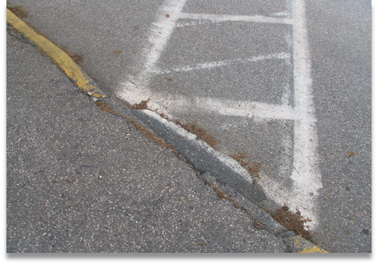
Dangerous steep sloping walkways (once upon a time considered safe)….
Curb cuts/walkways that look like this

Slide 21
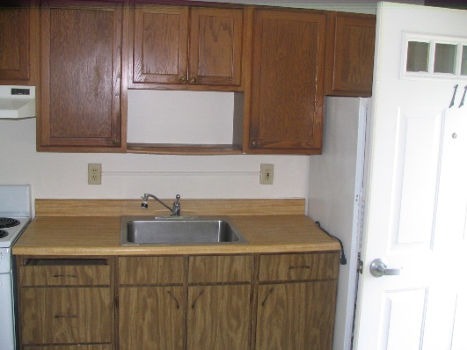
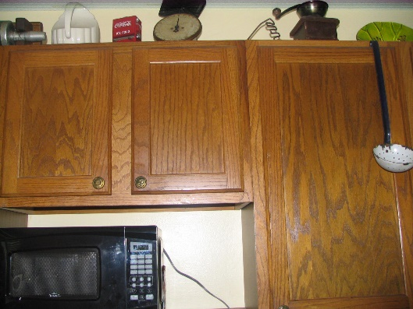
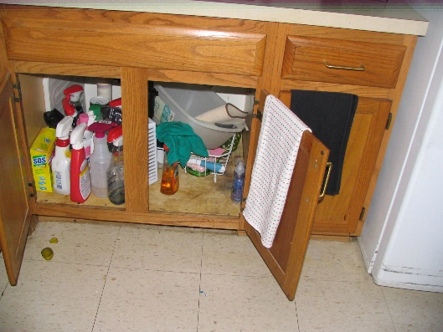
Cabinet drawers that no longer stay close
Cabinet doors that no longer stay close

Slide 22
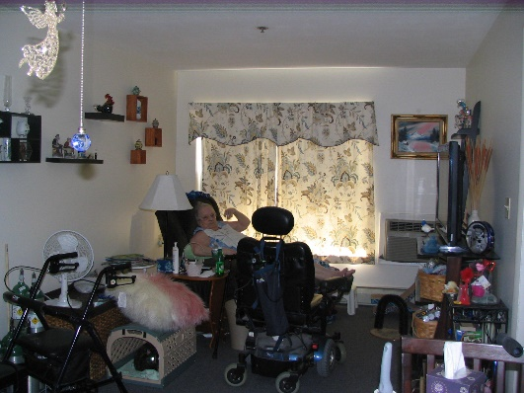
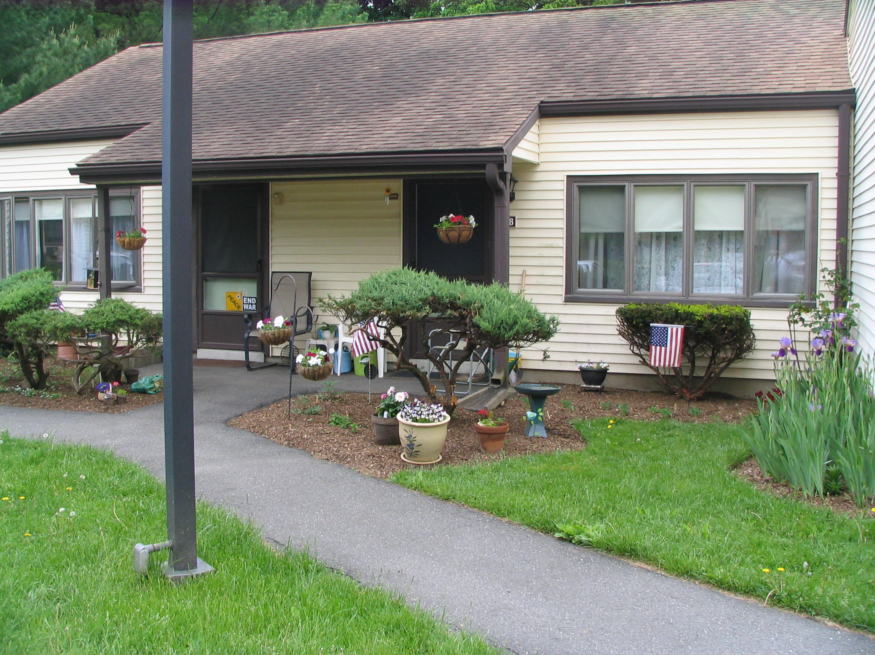
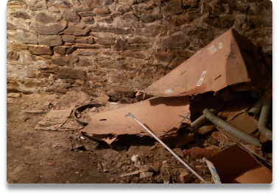
Insufficient turning radius to meet ADA requirements
Foundations that look like this…..

Slide 23



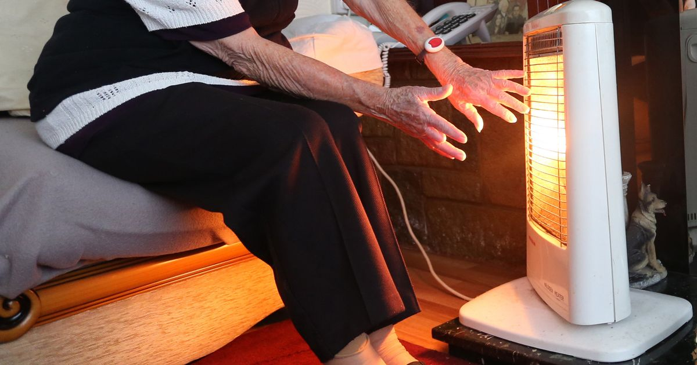
Residents complaining about

Slide 24
3.1
Applicant
Capacity

Slide 25

No thumb drive

Slide 26
File Naming Convention
General
Fair Housing
00.1 FHO (Fair Housing Ordinance)
Other
00.4 DFWP (Drug Free Workplace Policy)
00.3 S3P (Section 3 plan)
00.5 ERR (Environmental Review Record) Exempt, CENST and Broad level review for Housing Rehab.
000.3 GCOC (General 3 Cert. of Compliance…)
000.2 GALR (General 2 Adopted Local Resolution)
000.4 GAC (General 4 Application Certification)…..and so on
00.2 FHAO (Fair Housing Action Plan)
00.6 CEPA (Connecticut Environmental Protection Act Checklist)
000.1 GCA (General 1 Corporate Agreement)
000.0 SCAPP (General 0 CDBG Application)

Slide 27
File Naming Convention
Section 1
1.1 PD (Project Description)
1.4 GN (GIN Notice)
Section 2
Project Need
Section 3
3.1 R
3.1.A
1.4.A RP (Relocation Plan)
3.1.B
Project Information
2.1 PN (Project Need Narrative)
Capacity
2.1.A WL (Waiting List)

Slide 28

Section 4
Project Feasibility & Merit
4.1 Budget Summary
4.2 Local leverage

Slide 29
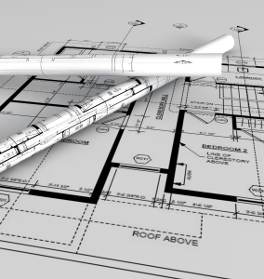
Section 4
Project Feasibility & Merit
Technical Compliance
4.4-4.7
4.5 and 4.5A Construction Documents- upload
(Provide drawing and specs electronically)

Slide 30
Community Impact
Section 5
5.1.A Community Impact Map
5.1.B Community Impact Map Narrative
5.2 Community Letters of Support
5.3 Resident Participation

Slide 31
Fair Housing and Equal Opportunity
Section 6
6.1 Local Fair Housing Action Steps- PAST GRANTEES ONLY
  6.2 Section 3 Past Performance – PAST GRANTEES ONLY
  6.6 -6.10- NEW GRANTEES ONLY
  Section 504/ADA Notice
  Section 504/ADA Grievance Procedure
  Section 504/ADA Checklist for Existing Facilities etc.

Slide 32
Other….
Sections 7-9
7.0 Fiscal and Grants Management
8.0 Consistency with State Consolidated Plan
9.0 DOH Training
9.1 List any non-required yet relevant Housing & Community Development trainings attended by municipal staff within the last 2 years

Slide 33

End of Week/ March 25,2022 https://portal.ct.gov/DOH/DOH/Programs/Small-Cities-Program
Check DOH’s Web site for application link

Slide 34


I’ll
Leave you with these parting words…….

Slide 35

Before you upload the 2022 application online
Have a Martini, Whiskey, Rum, Tea or maybe a large bowl of Ice Cream (if that’s your thing). We think you’ll need a few of whatever your poison is after this……

Slide 36
But on a serious note…..
√ Review the application, cross check it against the
Application Handbook.
√ Review and complete the Exhibit Checklist
√ If you’ve checked the upload box on the application, that means you have an exhibit to name e.g. 000.3 GCOC and upload
√ Review the Rating and Ranking…see how you score
√ Complete and scan all required WET SIGNATURE Docs in BLUE INK;
DO NOT mail wet signature pages to DOH unless we request them …keep the original signature documents with the application.
√ Take a moment to congratulate all the folks around you for a great job pulling this all together.
This is great feel good work!

Slide 37
Good Luck &
Thank You
Dominic Carew
Dominic.carew@ct.gov
860-270-8164

