Slide 1

CDBG
Technical Compliance
Environmental
Construction Documents
Project Development Budget
Accessibility
Procurement
Energy & Green Building

Slide 2
CDBG Technical Compliance
4.4 Site & Building
Location Maps, Zoning, Flood Plain Maps
Environmental Site Assessments Phase I/II, Hazardous Materials Survey
State Historic Preservation Office Determination Letter
Capital Needs Assessment Report, Interior & Exterior Photos
Planning & Zoning & Related Approvals
4.5 Construction
Construction Drawings, Specifications (CSI format)
Project Development Budget & Cost Estimate
Procurement Plans & Contracts
4.6 Energy Efficiency & Green Building
https://portal.ct.gov/DOH/DOH/Additional-program-pages/CDBG-SC-Grants-Management-Manual

Slide 3
CDBG Technical Compliance
4.4 Site & Building
Location Maps, Zoning, Flood Plain Maps
Environmental Site Assessments Phase I/II, Hazardous Materials Survey
State Historic Preservation Office Determination Letter
Capital Needs Assessment Report, Interior & Exterior Photos
Planning & Zoning & Related Approvals
4.5 Construction
Construction Drawings & Specifications – Accessibility
Project Development Budget & Cost Estimate
Procurement Plans & Contracts
4.6 Energy Efficiency & Green Building
https://portal.ct.gov/DOH/DOH/Additional-program-pages/CDBG-SC-Grants-Management-Manual

Slide 4
Environmental
Environmental Site Assessments Phase I/II
Records Review, Site Reconnaissance & Observations,
Summary of Findings, Areas of Concern, Recognized Environmental Conditions, Potential Release Areas
Hazardous Materials Survey
Lead-Based-Paint, Asbestos, Radon, Lead in Soil, Lead in Water, Polychlorinated Biphenyls (PCBs), Mercury, Universal Waste, Urea-Formaldehyde Foam Insulation (UFFI), Mold
findings may require Remedial Action Plans, Soil Management Plans, Remediation and Abatement Plans, Specifications, and Costs
CDBG Handbook. Basically CDBG State Chapter 13 Lead
CHFA Environmental & Hazardous Materials Review for joint funded projects

Slide 5
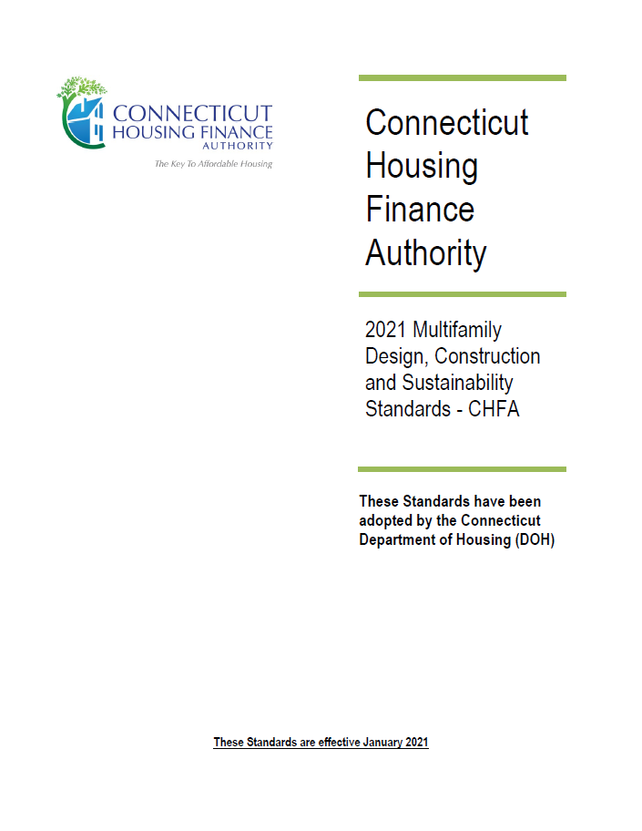
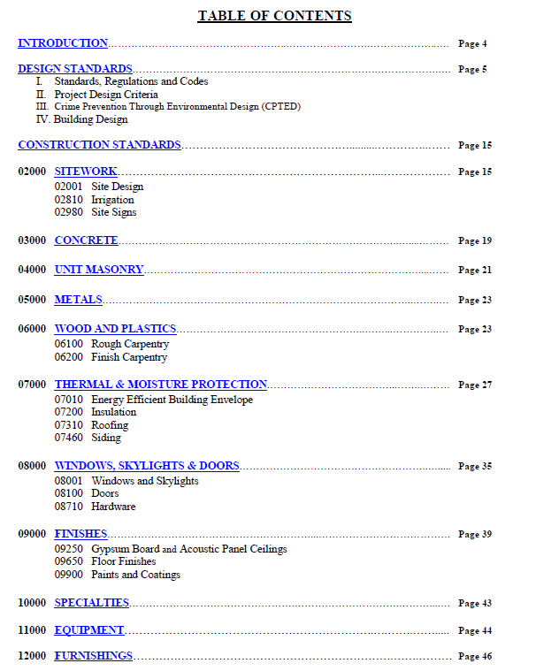
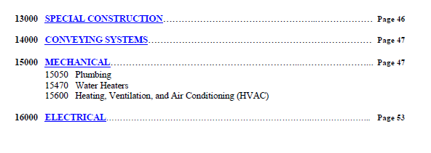
Construction Drawings & Specifications
https://portal.ct.gov/DOH/DOH/Additional-program-pages/CDBG-SC-Grants-Management-Manual

Slide 6
Accessibility/Adaptability
Requirements for Federally Assisted Housing
Section 504 Rehabilitation Act 1973
New construction - housing developments with 5 or more units must design and construct 5 percent of the dwelling units in accordance with the Uniform Federal Accessibility Standards (UFAS) or a stricter standard. An additional 2 percent of the dwelling units, or at least one unit, whichever is greater, must be accessible for persons with hearing or visual disabilities (HVI).
Substantial Renovation – If alterations are undertaken to a project .. that has 15 or more units and the cost of the alterations is 75 percent or more of the replacement cost of the completed facility, then the provisions of § 8.22 (new construction) shall apply.
Other Renovation - alterations to dwelling units in a multifamily housing project shall, to the maximum extent feasible, be made to be readily accessible to and usable by individuals with handicaps. If alterations of single elements or spaces of a dwelling unit, when considered together, amount to an alteration of a dwelling unit, the entire dwelling unit shall be made accessible…
www.hud.gov/program_offices/fair_housing_equal_opp/disabilities/accessibility
24 CFR Part 8.23 Alterations of existing housing
also review CT State Building Code, IBC, IEBC Model Codes, and ANSI ICC117-2009.

Slide 7
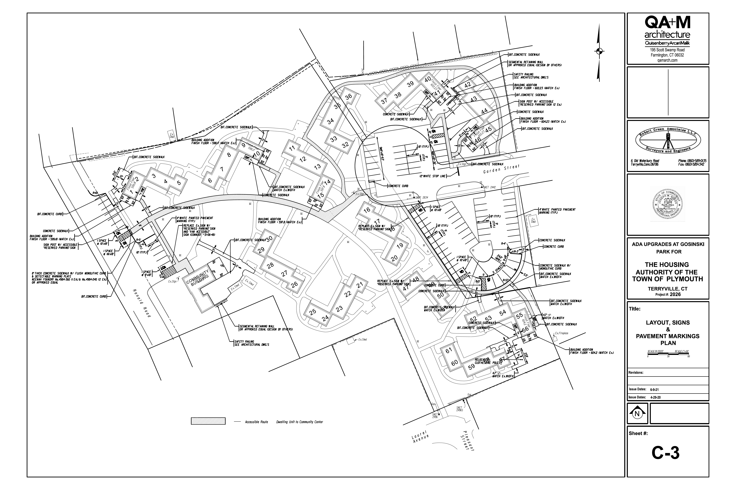
Accessible Routes
Thank you to QA+M Architecture

Slide 8
UFAS/TYPE A Adaptable Units
DOOR CLEARANCES
KITCHENS
BATHROOMS
UFAS (Section 504) Dwelling Units are similar to ANSI Chapter 10 - Type A – Adaptable Units

Slide 9
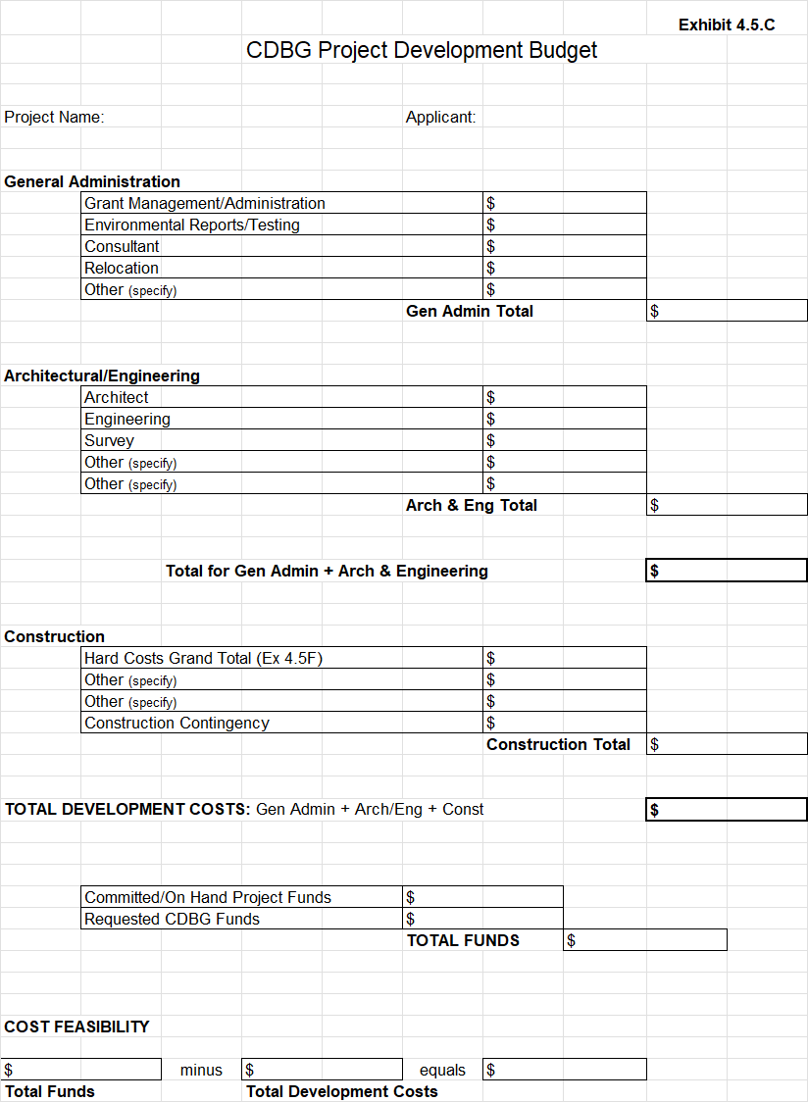
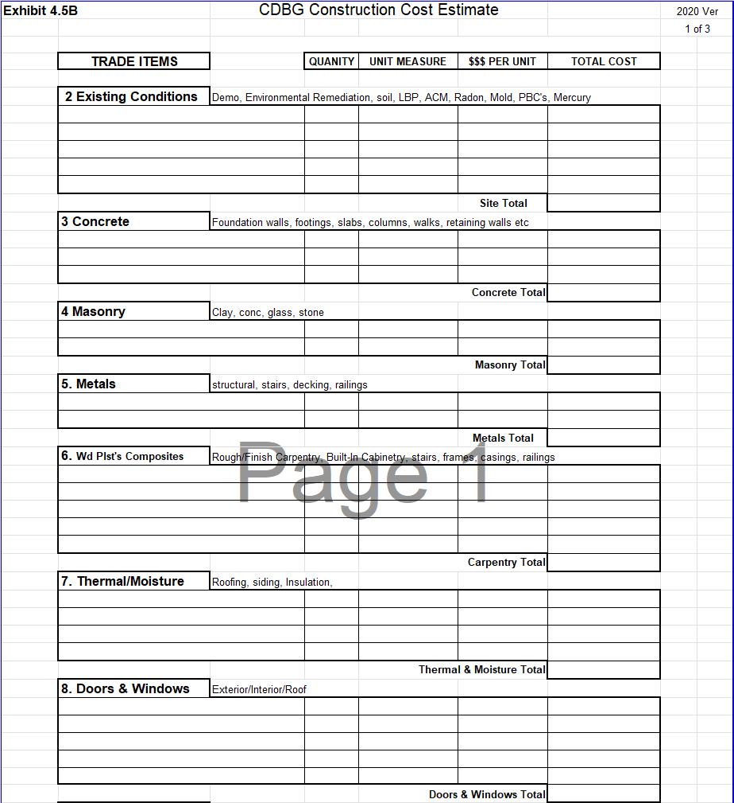
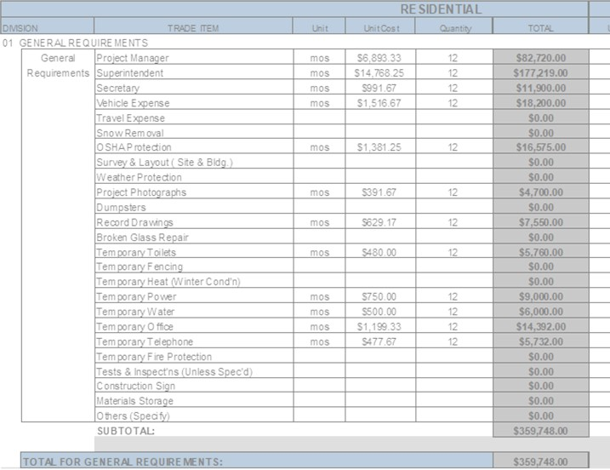
Project Development & Construction Cost
CDBG Exhibits 4.5C & 4.5B

Slide 10
Procurement
Consultants, Architectural, Engineering
Open – Publicly Advertised in Major Daily Newspaper
Competitive – Request for Qualifications or Request for Proposal
Complete – At least 2 bids, RFP is Fixed Fee or Hourly Not to Exceed
Outreach & Set-Asides - Section 3, MBE/WBE/SBE per CDBG Guidelines
Construction
Open – Invitation to Bid Publicly Advertised in Major Daily Newspaper
Competitive - Sealed Bid, At least 2 bids, 5% Bid Bond, Fixed Fee Contract
Provide Performance Specifications and at Least 3 Manufacturers
Outreach & Set-Asides - Section 3, MBE/WBE/SBE per CDBG Guidelines
Department of Housing – Procurement Requirements & Guidelines – November 2021
2 CFR Part 200 Methods of Procurement, CDBG Grants Management Manual Chapter 4
DOH CDBG website includes sample Invitation to Bids, RFP, RFQ, Evaluations, Bid Tabulation

Slide 11
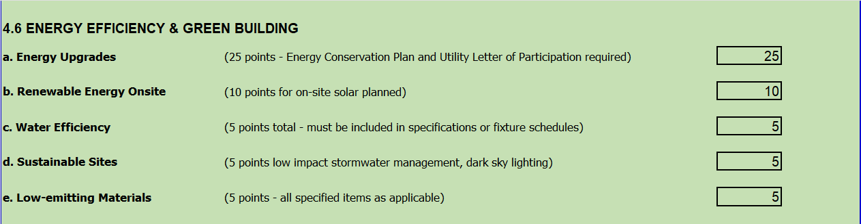
Energy & Green Building

Slide 12
Department of Housing
Architectural Technical Support
JC Frazier, Architectural Design Reviewer 2
Michele Helou, Architectural Design Reviewer 1
John Mesner, Building Construction Specialist

