Slide 1
Lead Overview
Kimberly Ploszaj
Supervising Environmental Analyst
March 15, 2022
Environmental Health and Drinking Water Branch

Slide 2
Does this look lead safe?
Let’s take a look……

Slide 3
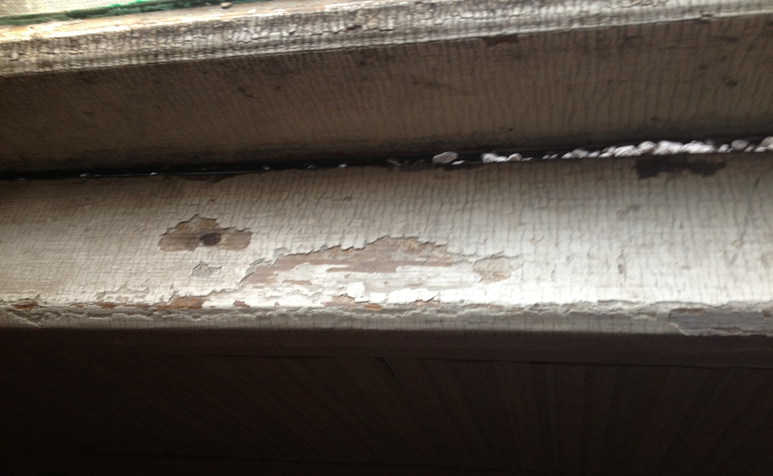
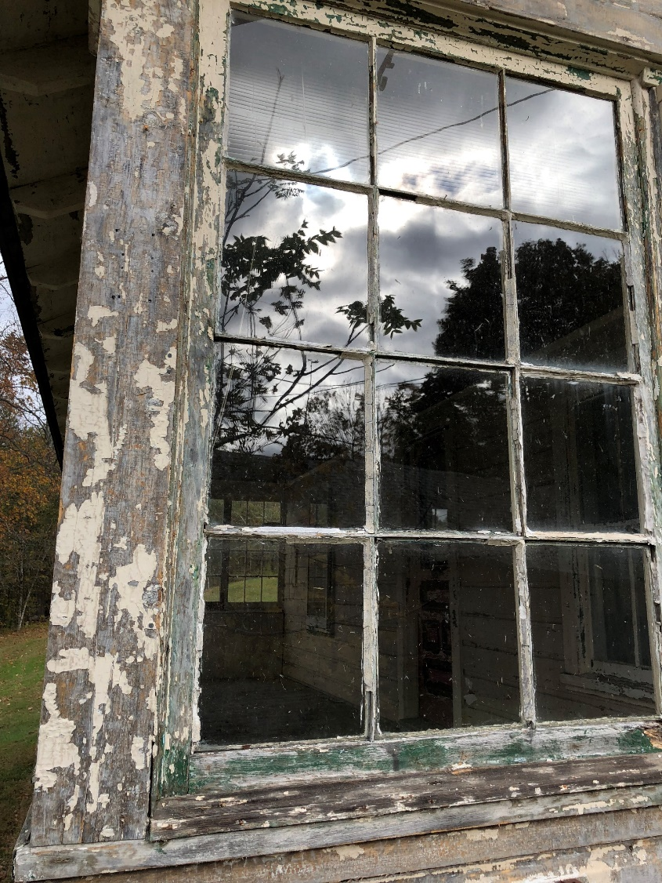
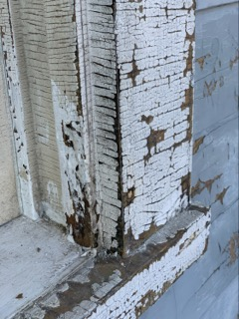

Slide 4
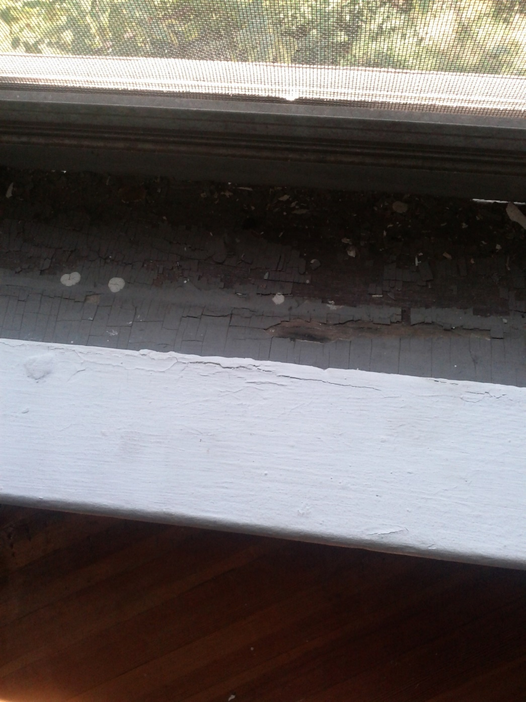
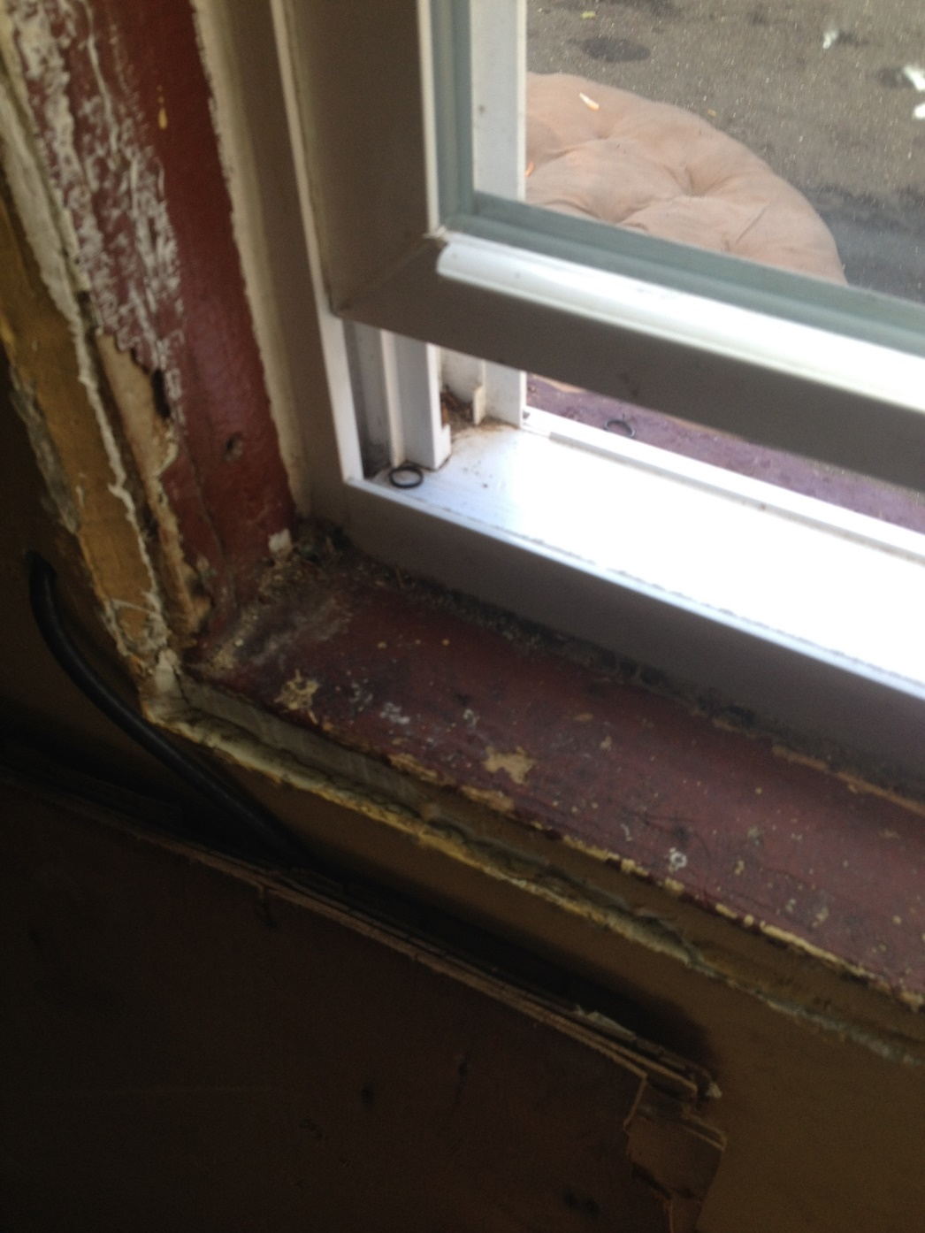

Slide 5
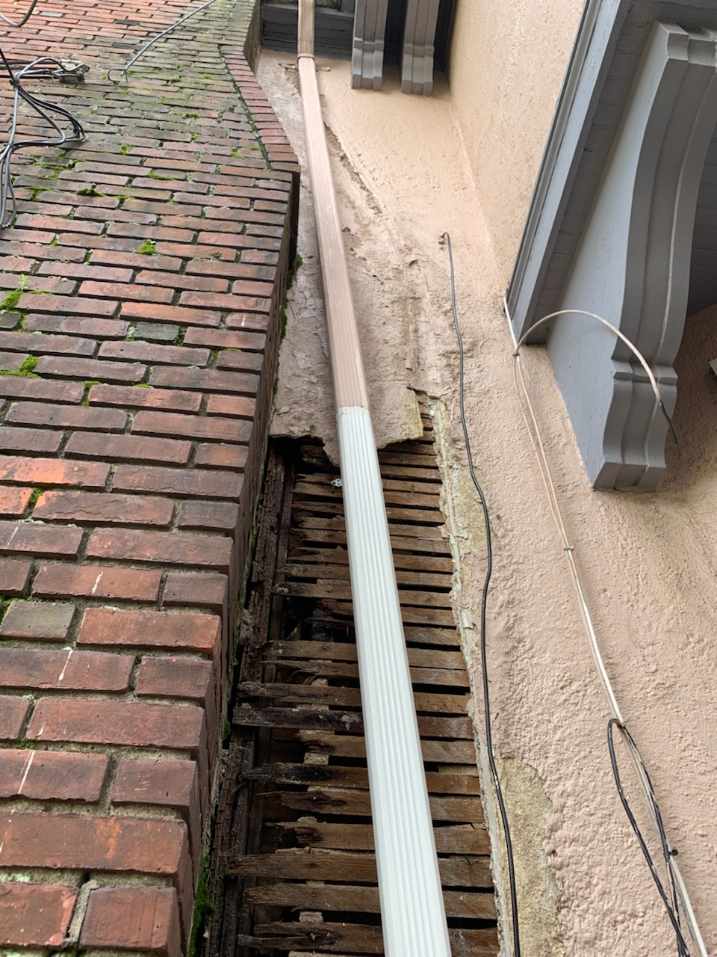
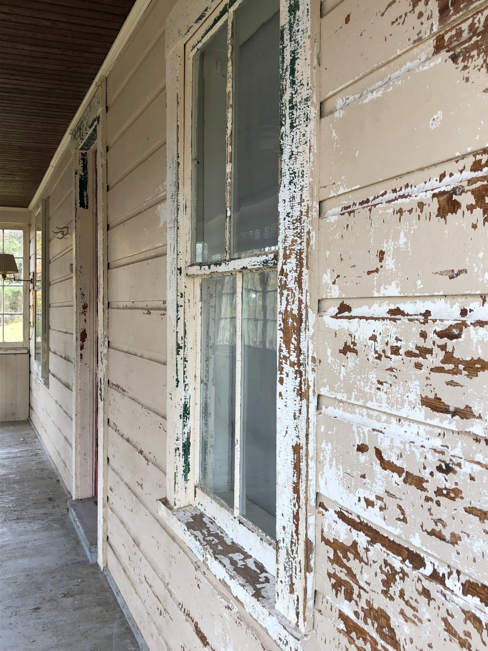

Slide 6
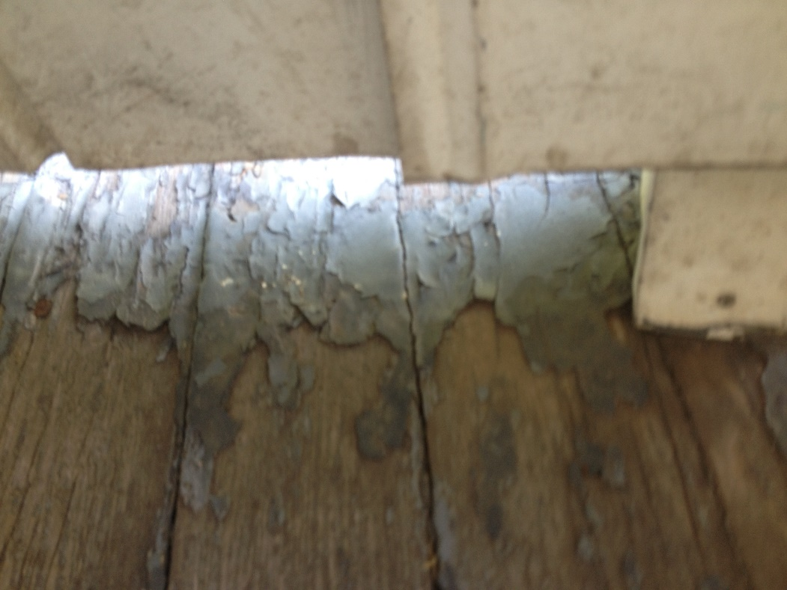
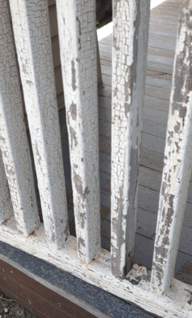
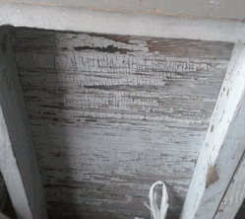

Slide 7

CDBG Small Cities Funding CHART

Slide 8
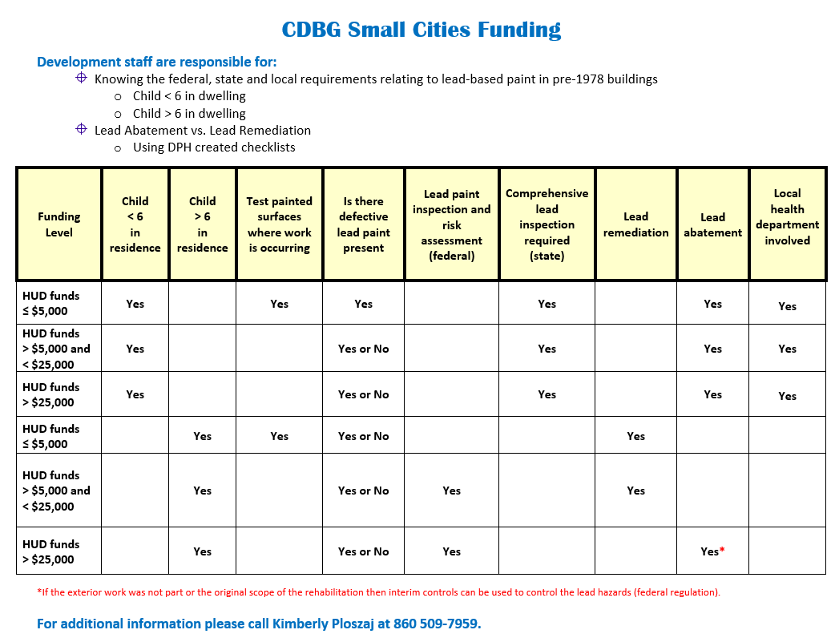

Slide 9
Scenario 1:
A project costs $17,500
There are three children ages 11, 8 and 7 in residence
The property has not been tested for lead paint
Many areas at the property have defective paint
What are your next steps?

Slide 10
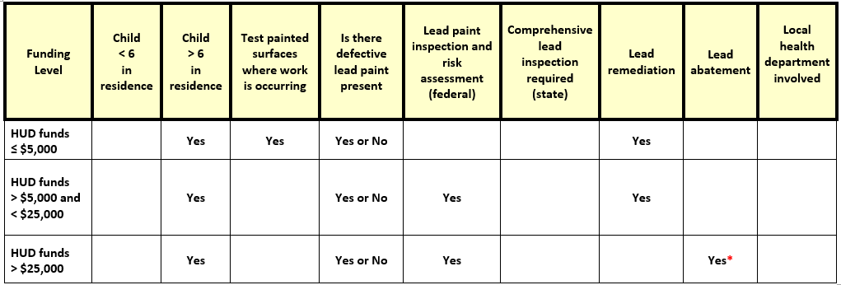

Child > 6 in residence

Slide 11

Answer:
Presence of defective paint
Testing of the painted surfaces for lead is required
All defective surfaces shall be remediated by a certified EPA RRP firm
The RRP firm shall employ workers/supervisor who have completed a HUD approved lead-safe work practice course
A lead remediation plan shall be developed
At the completion of the job, a DPH licensed lead consultant contractor must complete clearance dust wipes

Slide 12

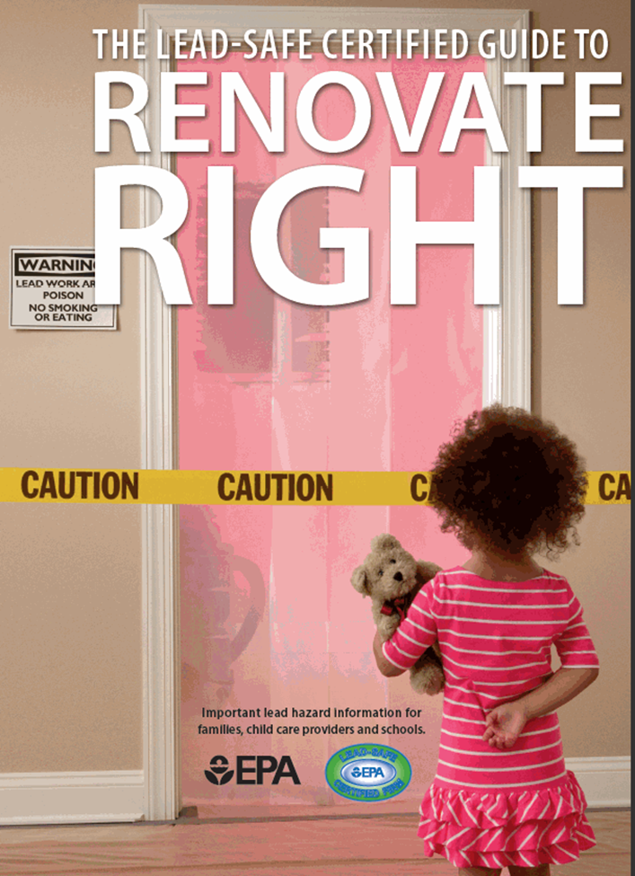
Protect Your Family
EPA Renovate Right

Slide 13
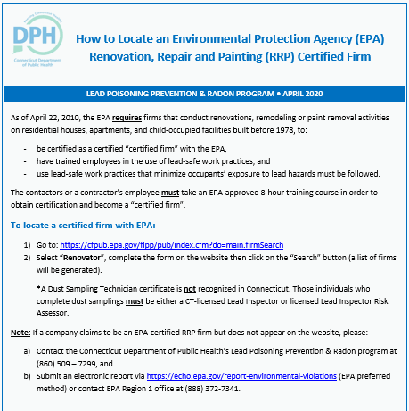

Slide 14
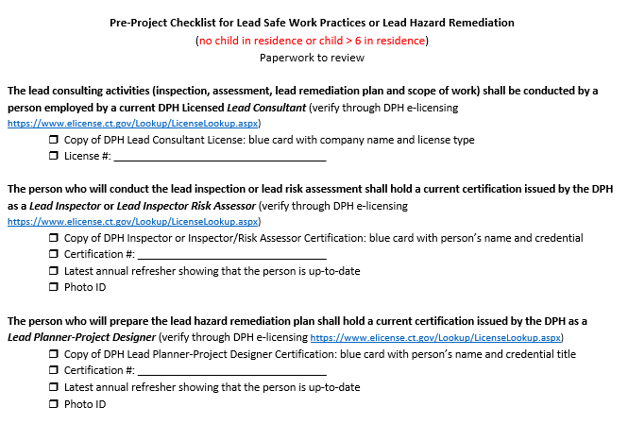

Slide 15
Scenario 2:
A project costs $33,000
There are two children ages 5 and 2 in residence
The defective paint has been tested for lead and is positive
What are your next steps?

Slide 16
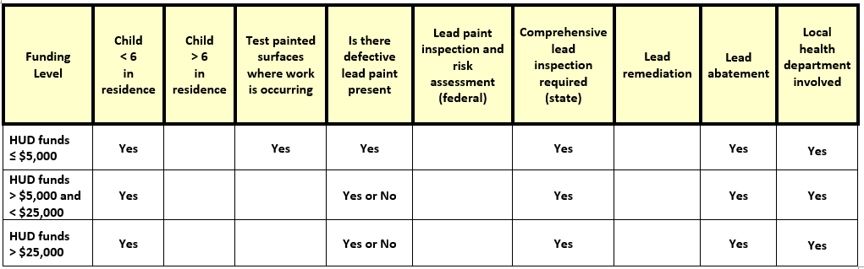
Child < 6 in residence

Slide 17

Answer:
A child <6 years of age resides at the property and there is defective lead paint = a comprehensive lead inspection is required
The comprehensive lead inspection will identify all lead hazards in paint, dust, water and soil
All lead hazards shall be abated
All intact leaded surfaces shall be placed on a management plan
A lead abatement plan or a lead management plan shall be developed by a licensed lead consultant contractor

Slide 18

Answer:
A lead abatement plan shall be approved by the local health department before any work can begin
All abatement work shall be performed by a DPH licensed lead abatement contractor that employs certified supervisors and workers
At the completion of the job, a DPH licensed lead consultant shall complete clearance dust wipes

Slide 19
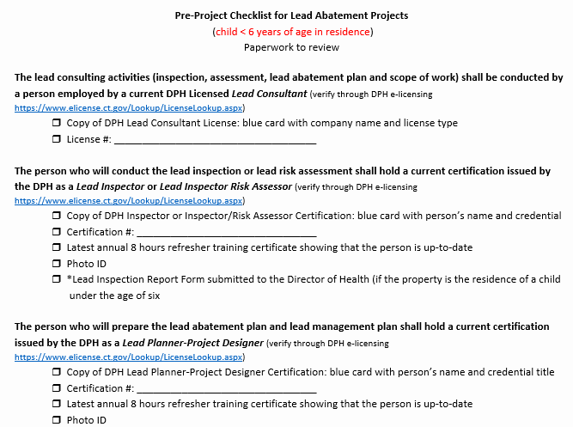

Slide 20
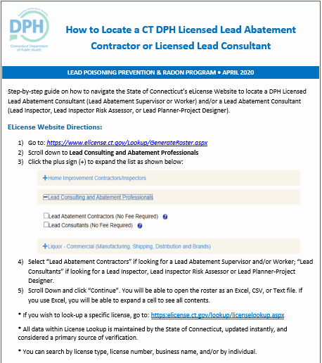

Slide 21

Challenges
Programs not……
using the pre-checklists
knowing the difference between lead remediation and lead abatement
involving licensed lead practitioners and the local health department when lead abatement is required
seeking approval for work order changes, for lead abatement projects, from the local health department
ensuring clearance dust wipes are required at the end of lead remediation and abatement work

Slide 22

When in doubt….
Call DPH
DPH has authority to take action for any lead abatement violations
EPA has authority to take action for any lead remediation violations

Slide 23

Questions

Slide 24
Contact Information
Kimberly Ploszaj
Supervising Environmental Analyst
State of Connecticut
Department of Public Health
(860) 509-7959
kimberly.ploszaj@ct.gov

