Slide 1

CDBG
Small Cities Workshop: Davis Bacon

Slide 2

We’ll Cover
Basics of Davis Bacon
When is Davis Bacon Triggered?
Enforcement Concepts
The Copeland Act

Slide 3
Basics of Davis Bacon
WHO? | What? | When? | HOW?
James Davis --DOL Secretary Under Harding, Coolidge, Hoover --US Senator (R-PA) 1930-45 | Requires workers be paid the local prevailing wage rate as determined by the Department of Labor. | Construction contract >/= $2000 | Contractors are required to submit certified payrolls
 | Requires weekly payment of wages. | Construction includes alteration, repair, painting, and decorating | Onsite interviews are conducted with workers in order to ensure compliance
Robert Bacon --World War 1 hero --U.S. Congressman (R-NY) 1923 TO 1938 | Applies to all laborers and mechanics. | For Davis Bacon to apply CDBG funds need to be spent specifically on construction costs vs “soft costs” | Wage Determinations must be posted at the construction site and visible to workers.

Slide 4

Housing and Community Development Act of 1974
Section 110 of the HCDA states:
“All laborers and mechanics employed by contractors of subcontractors in the performance of construction work financed in whole or in part with assistance received under this title shall be paid wages at rates not less than those prevailing on similar construction in the locality as determined by the Secretary of Labor in accordance with the Davis-Bacon Act as amended…Provided that this section shall apply to the rehabilitation of residential property only if such property contains not less than 8 units…”

Slide 5

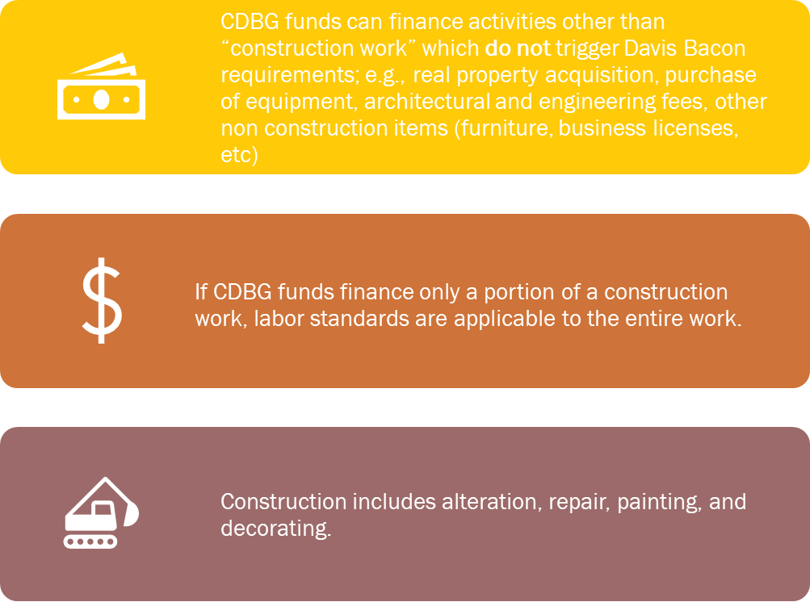
When is Davis Bacon Triggered?

Slide 6

What is Construction
Character of work: Does the project permanently change the character of a building or is it something that can be easily undone or removed?
Tools involved: Does the project involve power tools? Demolition? Permanent installation? Heavy machinery?
Workers involved: The term “laborer or mechanic” includes at least those workers whose duties are manual or physical in nature (including those workers who use tools or who are performing the work of a trade)

Slide 7
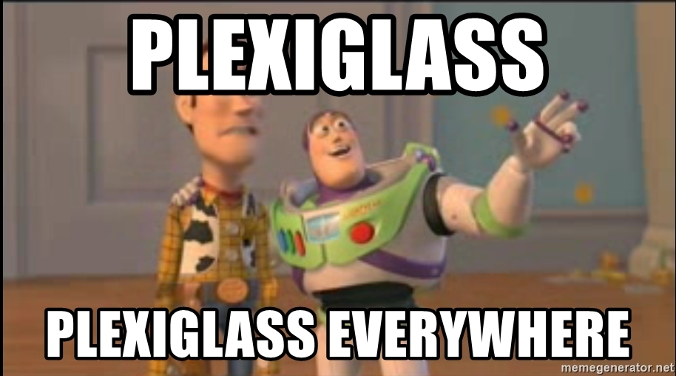
Plexiglass Installation
A CDBG grantee wants to install a dozen pieces of 8ft high, semipermanent plexiglass in their office. Costs of labor and material are estimated to be between $3000- $4000. This will require 2 people to fit it into place and a power tool to drill into the floor. Is Davis Bacon triggered?

Slide 8
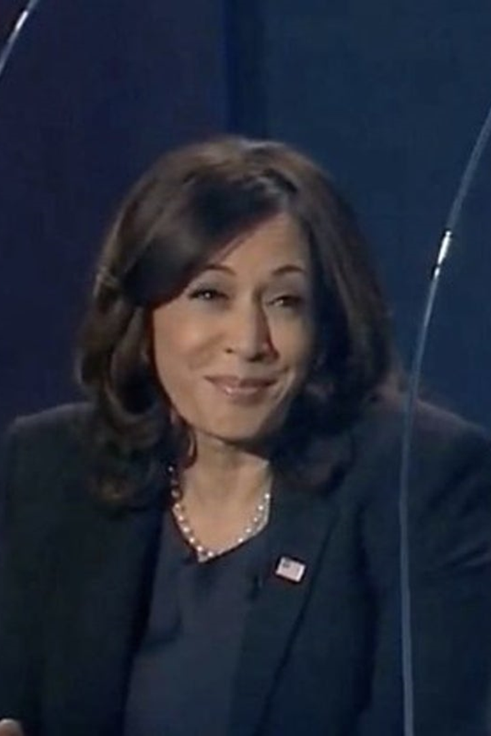
Plexiglass (2)
A CDBG grantee wants to purchase 100 portable pieces of plexiglass for their office. The estimated cost for the plexiglass is between $3-$4000. The plexiglass does not require drilling and can be moved in and out of the room. Is Davis Bacon triggered?

Slide 9
Bricks and Mortar vs. Independent Use
Brick and Mortar materials and equipment refers to materials used in construction such as lumber, cement, and fixtures.
The purchase of brick-and-mortar materials and equipment with CDBG funds will trigger Davis Bacon
The purchase of materials and equipment with an independent use, such as furniture, computers, and appliances, will not trigger Davis Bacon.

Slide 10
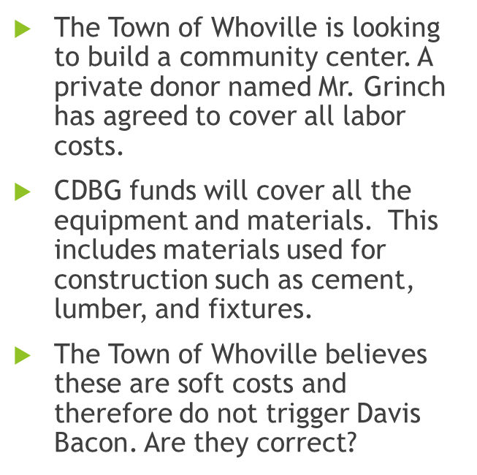

The Town of Whoville

Slide 11
National Affordable Housing Act of 1990; Section 286 (HOME)
“Any contract for the construction of affordable housing with 12 or more units assisted with funds made available under this subtitle shall contain a provision requiring that not less than the wages prevailing in the locality, as predetermined by the Secretary of Labor pursuant to the Davis Bacon Act…,shall be paid to all laborers and mechanics employed in the development of affordable housing involved…”

Slide 12
HOME: Factors of Applicability (1)
(Local Agency Guide, Page 26)
Affordable housing with 12 or more units assisted with funds made available under this subtitle…
Any contract for the construction of affordable housing with 12 or more units…
Sweat equity (is OK)
See also HOME Regulations: 24 CFR §92.354

Slide 13
HOME: Factors of Applicability (2)
Standard for applicability is construction assisted, not construction financed>>> this creates a broader application
Soft costs will trigger Davis-Bacon
HOME applicability “taints” all units of a development
Volunteers are exempt

Slide 14
Copeland Act (1)
Enacted in 1934
Prohibits “kickbacks”
Requires contractors to submit a certified payroll with a signed “statement of compliance” each week

Slide 15
Copeland Act (2)
Allowed payroll deductions from wages:
  FICA, federal, and state taxes
  Bona fide prepayment of wages
  Court ordered payments, fringe benefit plans, etc.

Slide 16

On-Site Interview
On HUD-11
Confidential (unless waived)
During working hours
Private location
Not disruptive
May be targeted

Slide 17

On-Site Interviews…
Targeting highly encouraged
Interviewer must:
  Complete all info on HUD-11
  Note each Laborer’s / Mechanic’s:
    Duties performed
    Tools used
  Note discrepancies between observations and Laborer’s / Mechanic’s statements
  Sign and date HUD-11

Slide 18


