Slide 1
CT DDS
Person Centered Planning
June 2018

Slide 2
Why are we making changes?
After over a decade of use DDS has chosen to revise the process and documentation for individual planning and replace it with this new format.
Moving Person Centered Planning tools and concepts into the documentation will help teams to increase the individuals participation in their planning.
This has always been an important part of the CT DDS mission plan and is also now a point in the CMS Settings Rule.

Slide 3
For Many Participants this is not ‘Business as Usual’.
Support teams need to assist the person they serve to voice their desires and dreams for their future. What does the person want to do in 5 years? 10 years? Where do they want to live or work? Who do they want in their lives?
This will be challenging for teams supporting people who have limited communication abilities. But it is important for those teams to make all attempts to get as much information as they can from the individual.
This is their plan.

Slide 4
What about people who cannot speak?
Teams need to know the person and their modes of communication. How can they tell now if a person likes or dislikes something? Who knows the person best? How do they communicate with the individual? What do their facial expressions, body language, amount of eye contact mean?
Teams should use or investigate use of communication boards, IPAD apps, Speech Talkers, etc.
Picture books can be useful with some people. Use colors like Red for No and Green for Yes. Faces for expressions, pictures of places, people, employment options…

Slide 5
Ideas for Communication
Happy/Yes
Sad/NO
I’m Tired and want to STOP!

Slide 6



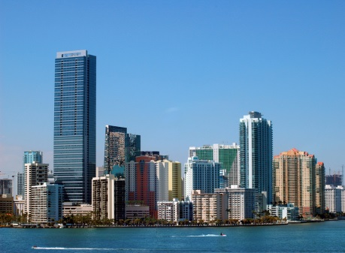
Ideas for Home Pictures. . .
Home
Country
Apartment
City

Slide 7


Ideas for Pictures - Employment
Post Secondary Education
Want a new job!
Desk Job
Helping Jobs
Notes:
Do you like your job? Would you like to work somewhere else or do something else?

Slide 8
Take Your Time
Teams need to give the person time to answer questions or come up with ideas. These may be new questions for many of the people we serve.
Be respectful and let the person know you value what they have to say.
Teams should try to avoid leading the person or giving their opinion when asking questions.

Slide 9
It is Understood…
That not all people are going to understand what is being asked of them and maximize their role in their planning the first year.
It is the team’s responsibility to make all attempts to assist them and to plan for the years to come.
How can they help the person to participate more each year?

Slide 10
Additional Resources…
Ideas on person centered planning and on working with people who have challenging intellectual and communication disabilities are available from many sources.
The DDS website has planning resources and tools on their Family Connections menu.
Youtube can be a good resource for videos from many different sources.
Examples:
“If You Listen, You Will Hear Us”
“Mikey’s Story”

Slide 11

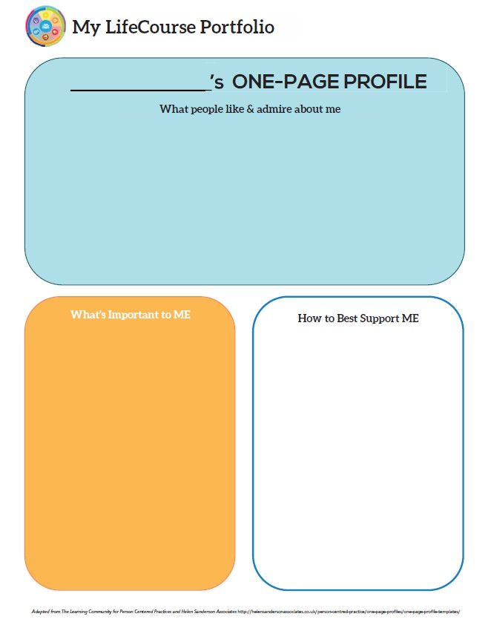
State of Connecticut Department of Developmental Services
http://ct.gov/dds
Person Centered Plan DDS# Meeting Date:
Ente r the Individual’s First Name & Last Name, Case Mana ger’s Name and the Meeting Date:
Full Name Person Centered Plan DDS # Case Manager: Meeting Date:
This information above only needs to get entered once. It will self-populate to each page after that. For any self- populating items you need to bring it up on the PRINT page before saving. That triggers the action.
Enter person's first or desired name above.
These first two pages are to be sent out to the individual and their guardian/PCG prior to the meeting. They should fill them out as much as they can. There are other areas (pg. 3-9) on the IP where team members can enter information.
These sections are for the individual, their opinion and feelings. It may be difficult for some to describe or communicate their ideas.
Teams should be aware of those with communication challenges and help to assist them in any way possible.
Try to get information directly from the individual.
What does the individual feel works best for them or how they would like to be supported?
These sections will have a scroll line pop up on the right side when the text reaches the end of the box. While you can
enter additional text it will only be assessable in the electronic document. If you are printing the IP it will only show what is viewable in the box in the print preview screen.
This may be challenging to do. How does the team communcate with the individual now? What do they do when they need information from them?
Simple Statements or lists are fine.
Page 1 of 19 Rev. 06-04-18

Slide 12
Technical Points…
Do Not Unprotect. This WORD document has several formulas built in it that will be affected by unprotecting. This will change both the format and abilities of the document.
On pages 1 and 2, the demographic information entered into the first box will become the heading for each of the following pages automatically. But to enable this function the document must be brought up on the PRINT screen prior to Saving once you have completed the IP. It does not have to be printed but will initiate the populating action in all areas of the document by going to that menu.

Slide 13
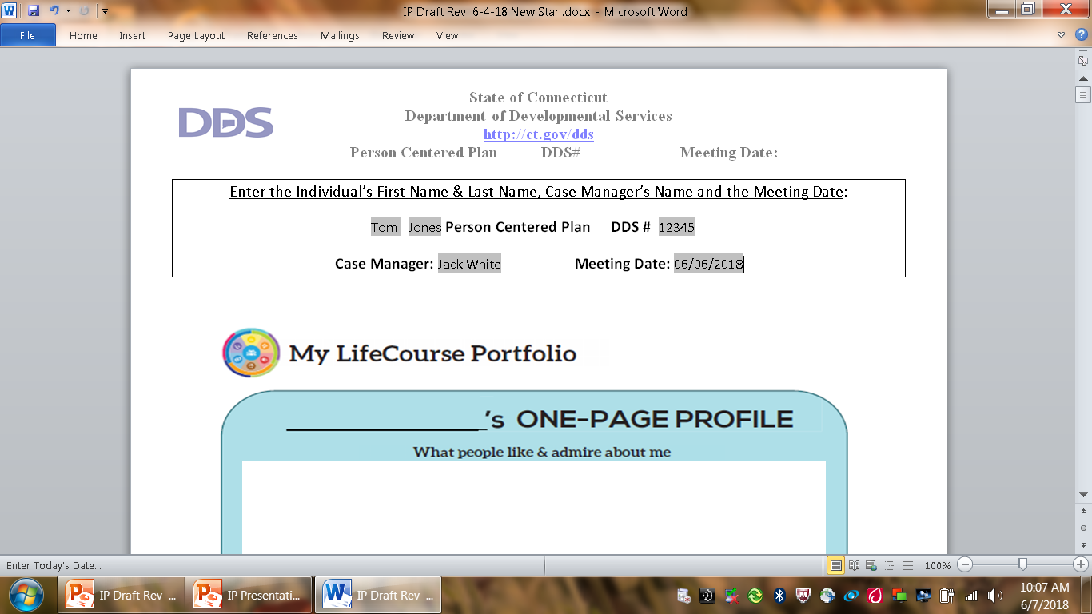

Slide 14
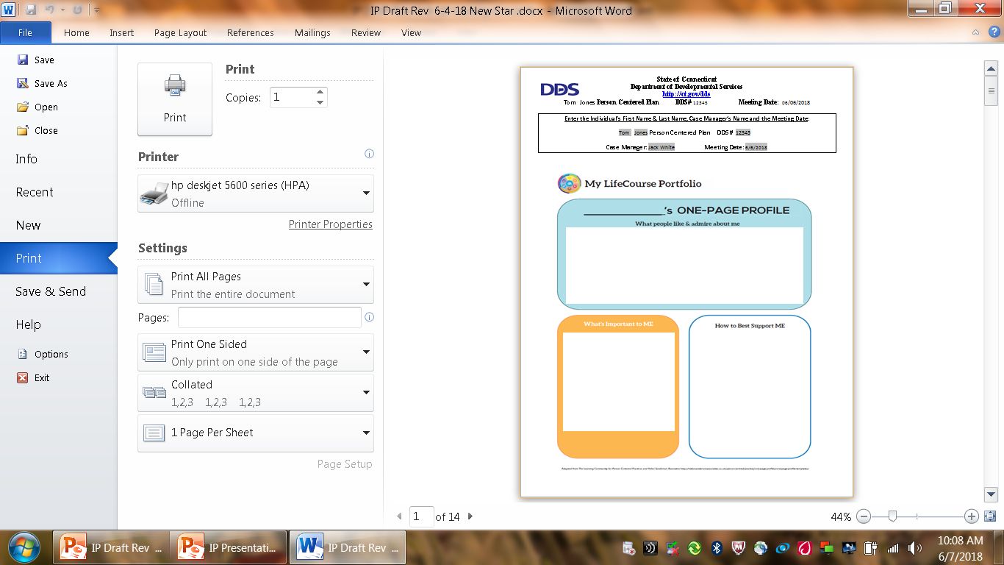

Slide 15
Other Points for Graphic Pages…
Each writing area contains a text box with a limited size. They are intended primarily for lists or simple sentences. When the entry reaches the boundary of the box a scroll icon will appear.
A person can enter more information that will remain in the electronic document but it will not print out on the page. The printed page will only contain what appears in the box at the time of printing.

Slide 16
Can you cut and paste?
You can cut and paste in this section between IPs when writing them year to year. But you are not able to use your mouse for this function.
To Copy: scroll over what you want to copy and press CTRL C
To Paste: choose spot and press CTRL V
To Copy and Delete between boxes: scroll over what you want to copy and delete and press CTRL X.
Paste is same as above.

Slide 17
Why the weird processes?
Moving graphics from other formats into a WORD 2010 document and enabling the writing and populating actions causes us to do ‘work arounds’. While we can get the document to do what we want, it just takes a different way than we are accustomed to .
What About Spell Check?
When you put formulas into a WORD document it prohibits Spell Check unless you unprotect the document. Unprotecting the document alters the formulas. We are not able utilize Spell Check in the IP.

Slide 18
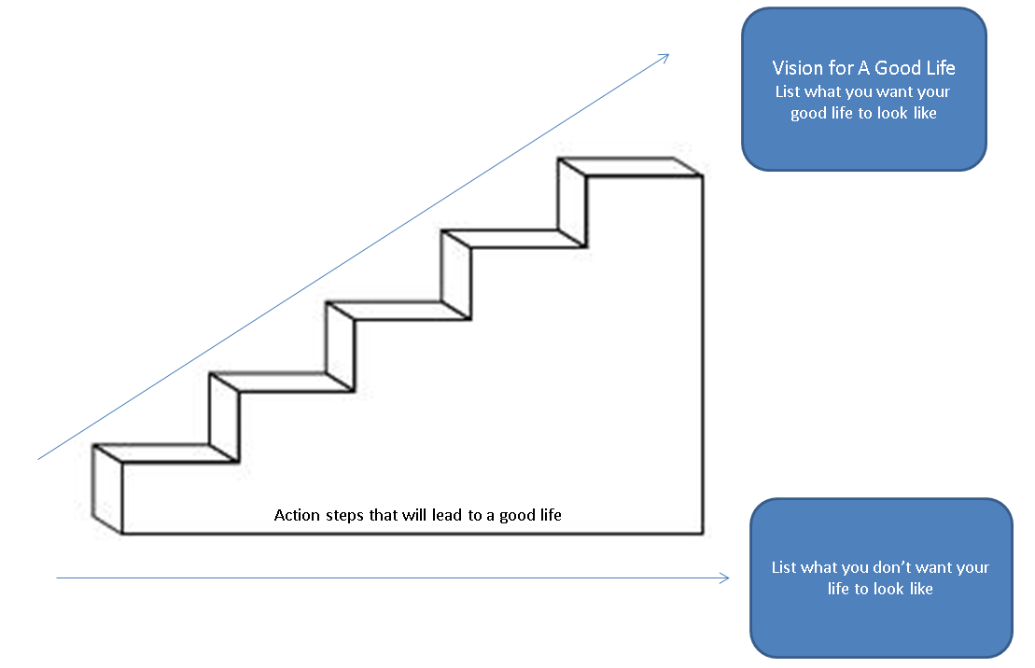
State of Connecticut Department of Developmental Services
http://ct.gov/dds
Person Centered Plan DDS# Meeting Date:
jjjjjjjjjjjjjjjjjjjjjjjjjjjjjjjjjjjjjjjjjjjjjjjjjjjjjjjjjjjjjjjjjjjjjjjjjjjjjjjjjjjjjjjjjjjjjjjjjjjjjjjjjjjjjjjjjjjjjjjjjjjjjjjjjjjjjjjjjjjjjjjjjjjjjjjjjjjjjjjjj jjjjjjjjjjjjjjjjjjjjjjjjjjjjjjjjjjjjjjjjjjjjjjjjjjjjjjjjjjjjjjjjjjjjjjjjjjjjjjjjjjjjjjjjjjjjjjjjjjjjjjjjjjjjjjjjjjjjjjjjjjjjjjjjjjjjjjjjjjjjjjjjjjjjjjjjjjjjjjjjj jjjjjjjjjjjjjjjjjjjjjjjjjjjjjjjjjjjjjjjjjjjjjjjjjjjjjjjjjjjjjjjjjjjjjjjjjjjjjj
This is a big question for many people.
This goes beyond just what they want to see this year but what they want their future to be like.
Teams should be helping the person to dream big. What would be their ideal for housing, relationships, health, careers, recreation, etc.?
 |  | Simple, direct, global items or activities
 | the individual feels would mark progress toward their "Good Life" desires.
This is NOT an area for detailed action planning or steps (see pg10) This is only for the individual to identify what would mean progress to them.
This may be easier for people. If at all possible it is recommended the individual do this before their individual planning meeting that would include their support providers. The focus is on what they don't want in their future, what they want to avoid and it may be difficult for some people to articulate that in a big meeting.
Examples: lonliness, poverty, living with many people...

Slide 19
The Trajectory Page…
Identifying their dreams or what they want their future to look like may be difficult for some people. Teams should be ready to spend some time in the first years of using this IP to help the person with thinking about their future. This is a process and not a finite thing. People may change their desires over the years but the important part is to start helping the individual to dream of what they want their future to look like. These dreams will help the teams in developing an action plan.

Slide 20




State of Connecticut Department of Developmental Services
http://ct.gov/dds
Person Centered Plan DDS# Meeting Date:
Home Life
Current Status Please include schedule, supports received, supervision needs, LON Risk areas, and accomplishments: Brief summary of present status, important points from reports, updates from family and providers, progress or accomplishments made this year, etc.. This is not an area to rewrite or insert full reports or data. Reports are due at intervals during the year and 2 weeks prior to the IP. Those documents can be discussed and attached to the plan.
1. What I want my Home to be like How do you like to spend your time at home: This question focuses on the person’s present living situation. What the person would like to see that would improve their satisfaction there? Teams can help the person identify things that they like about their home or what they like to do there and how to increase or improve those things.
2. Would you like to live anywhere else, what’s your vision? This should refer back to what the person identified in their vision for a Good Life. What was their vision for their home on the Trajectory page? Are there any more details the individual can add? How can the team help the person identify those things?
3. What Supports do you need to help with this? What does the individual feel they need for supports to move to their most desired setting? Do they need training in certain areas? Ongoing or intermittent supports. Teams can assist the individual to identify these supports but must be sure to include the individual in that discussion.
4. Do you need support with your finances? Providers please include financial assessment and report if applicable. Do you have a representative payee? Please list. Teams can assist the person to identify their needs in this area. Providers of residential supports should be completing a financial assessment and can include some information from that on the IP.
5. You are required to obtain and maintain Medicaid benefits. Do you require help maintaining
Medicaid?
a. If yes, who is responsible to help you? Is it the person themselves? Their family or guardian? Their residential provider? Be specific.
Financial Information: the intent here is to enter as much info as needed to assist the person. If this information is listed in a report from the provider it can refer to the report. Earned Income Benefits Income (list programs and amounts)
Bank Accounts Burial/Funeral Account? Total assets:
7. Are you satisfied with the supports you are receiving at home?
Describe: While this is a yes or no question, a person can choose to list the things they are satisfied with

Slide 21
The IP is written in
Person First language.
Any information or answers entered for direct questions that is not a person’s response must be identified as to who is speaking.
Example: “Team feels….” or Mrs. Jones said…”
Teams should assist the person to speak for themselves as much as possible and not speak for them. But teams can enter their information and feedback in the appropriate areas.

Slide 22
Technical Note…
The YES/NO boxes will hold the check once entered. You can moved them between the Yes or No as needed but you cannot remove them entirely from the document once entered.

Slide 23
State of Connecticut Department of Developmental Services
http://ct.gov/dds
Person Centered Plan DDS# Meeting Date:
in their home. If they reply No without an explanation the case manager must follow up with the person at a later time. It may be difficult for the person to discuss in a meeting.
Emergency contact: Who is the first person to contact in the case of an Emergency?
Emergency Back-Up Plan:
An Emergency Back-Up plan must be completed for individuals who receive waiver services and live in their own home, family home or other settings where staff might not be continuously available, and who receive personal care and/or supervision supports and the failure of those supports to be available would lead to an immediate risk to the individual’s health and/or safety.
Teams should note the explanation above as this pertains to those who would be in immediate
health or safety risk with the absence of the personal care or supervision supports.

Slide 24

State of Connecticut Department of Developmental Services
http://ct.gov/dds
Person Centered Plan DDS# Meeting Date:
Work, Day, Retirement or School
Current Status Description/schedule of what the individual is doing, level of support and supervision needed, identify any LON Risk areas, modes of transportation, accomplishments: Brief summary of present status, important points from reports, updates from family and providers, progress or accomplishments made this year, etc.. This is not an area to rewrite or insert full reports or data. Reports are due at intervals during the year and 2 weeks prior to the IP. Those documents can be discussed and attached to the plan.
1. Do you like the job you have or the activities you do during the day? This is essentially a yes or no question. It should be answered only by the individual as much as possible.
2. What do you like about it, what would you like to change? While this should be the individual’s opinion only, teams may need to assist the person if they are having difficulty in identifying specific items.
3. What new skills, education or activities would you like to learn or take part in this year? Were there items from the Trajectory page that can go here? Can the team help the person be more specific?
4. What are your career goals? Vision for the future? Was there any items related to work or daily activities in the person’s vision for their good life on the Trajectory page? There should be. Can any of those items be included in this year’s action plan? What are the first steps a person can make this year towards their vision?
What supports do you need during work or activities? What does the individual feel they need for supports to move to their most desired setting? Do they need training in certain areas? Ongoing or intermittent supports? Teams can assist the individual to identify these supports but must be sure to include the individual.
Do you have Transportation to get you to and from work on time?
Describe: Is the person frequently late to work due to transportation problems? Day providers have follow up needs for people with these issues. Teams need to discuss and address as needed.
Do you make minimum wage or better? Current minimum wage in CT is 10.10 (1/2017)

Slide 25
State of Connecticut Department of Developmental Services
http://ct.gov/dds
Person Centered Plan
DDS#
Meeting Date:
Are you satisfied with your wages?
Describe: This is more of a yes or no question but the person can enter anything they want for a comment here. The person may be assisted with this more in question #9 below.
Do you make enough money to do the things you want? Can the person pay their bills on time? Can they take part in desired recreational activities?
10. What can you do this year to make more money? If the individual desires to make more money the team can discuss with them what they may need to do to accomplish this. Examples: increasing hours on the job, seeking a higher paying job or finding an additional job. Ideas from this question will help to generate action steps for this year.
11. Are you satisfied with the supports you are receiving?
Describe: While this is a yes or no question, a person can choose to list the things they are satisfied with for this area of their life. If they reply No without an explanation the case manager must follow up with the person at a later time. It may be difficult for the person to discuss in a meeting.

Slide 26
Work, Day, Retirement….
Teams should be encouraging and assisting those who want to work to think about careers. Do they have a career objective? What’s their idea of a dream job?
For those who no longer want to work what do they want to do in the years ahead?

Slide 27
A Word About Satisfaction….
For all the service the person receives, the team needs to ask and document whether the person is satisfied or not and any information the person wants to add to their answer. This may be difficult for some people to answer at the team meeting or with the providers of those supports present. Case Managers should be considerate of this issue and follow up with the person as needed either before a meeting or after to get their opinions.

Slide 28

State of Connecticut Department of Developmental Services
http://ct.gov/dds
Person Centered Plan DDS# Meeting Date:
Health and Wellness
Current Status: How is your health? What supports are you receiving? What activities do you do to stay healthy? Please include current medications, diagnosis, doctor’s orders, dental, last physical, known allergies, adaptive equipment, brief overview of health history unless noted in Nursing Report, attach Nursing Report to plan if available. Is there a behavior plan in place? Please attach.
No need to copy entire nursing reports or behavioral reports in this section. Brief summary of present status, important points from reports, updates from family and providers, progress or accomplishments made this year, etc.. Reports are due at intervals during the year and 2 weeks prior to the IP. Reports are to be attached to the IP.
1. What’s Important to me about my health and safety Any areas you want or need to work on? This is entirely the person’s point of view. Teams may not agree with the person but it is important to hear what they think about their health. Some individuals may need some assistance in communicating their opinions to this question.
2. Are you up to date on routine medical tests and visits? Are you able to follow recommended health guidelines? List any deferrals.
Explain: Teams need to refer to DDS Health Standard 09-1 Attachment A, Minimal Preventative Care Guidelines for Persons with Intellectual/Developmental Disabilities
3. What supports do you need to improve your health and safety? Please include a plan to support any health risk identified in your LON. Individuals and teams should use this area to identify steps for the person’s action plan.
4. Are you satisfied with the supports you are receiving?
Describe: While this is a yes or no question, a person can choose to list the things they are satisfied with concerning the supports they receive for their health and safety. If they reply No without an explanation the case manager must follow up with the person at a later time. It may be difficult for the person to discuss in a meeting.

Slide 29
Health and Wellness…
While Health and Safety is important to us all it is not the only part of our lives that we focus on. Teams should not make this the singular focus of the person’s Planning Meeting. Reports should come to team members before the meeting so they can take the time to read them outside of the meeting. They can also be shared with individuals prior who may need more time to understand what they mean. Time at meetings should be spent with specific questions about the reported information or summaries of the key points.
The person’s opinion on what they feel is important to them about their health and safety must also be considered. We all have the right to make choices about our health and safety and the individuals we serve have the same right to do so. While the people we serve may require assistance and guidance in this area, their opinions need to be solicited.

Slide 30
State of Connecticut Department of Developmental Services
http://ct.gov/dds
Person Centered Plan DDS# Meeting Date:
Friendships, Relationships and Activities
1. Who do you enjoy spending time with? Family, friends, co-workers, acquaintances? Any special relationships? This should be a simple listing of people they enjoy being with. The intent of this page is to assist the person to identify, improve or increase friendships, relationships, and activities outside of their regular residential or work settings. Questions 2 and 3 are for helping to define some of the things that can help individuals find people with similar interests and potential friendships or fun activities.
2. What are your interests and hobbies?
3. Do you participate in any Groups?
4. Would you like to increase the time you spend with family, friends or doing hobbies or favorite activities? The answer should be specific about who or what they would like to increase time with, or something else the person may have brought up. This is not a simple yes or no. It should be explained and help to generate an action step.
5. What help do you need to accomplish this? This is directly related to the above question and will help to generate a specific action step on their plan for the year.

Slide 31
Loneliness…
Is an increasing issue for many Americans. It can especially be a problem for the people we serve who may live alone or with aging parents, etc.. How can the team assist the person to increase or improve their relationships if they desire? How can they help them build friendships?
Does the person have things to do in their lives besides work or home activities. Do they want to do more?

Slide 32
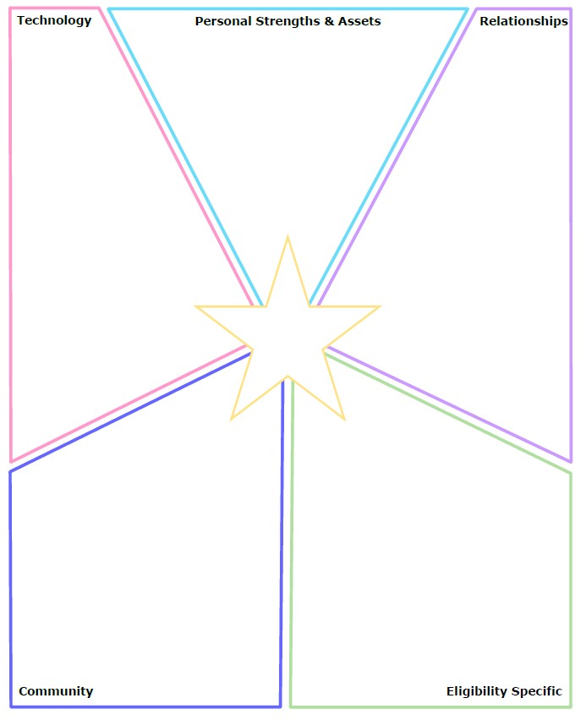
State of Connecticut Department of Developmental Services
http://ct.gov/dds
Person Centered Plan DDS# Meeting Date:
Like the f irst two pages containing graphics these sections have a l imited text box and are intended for l isting or short statements. This pa ge would contain information f ro m both the person and their team. Identified items here can help generate action steps in their pl an.
This area could contain both what the person identified in the One Page Profile and other things offerred by other team members.
Who are the important people in a person's life?
What people can assist the person on their path toward their vision?
This can be family, providers, community members, etc.
Is there someone the person or team can seek out?
Does the person use assistive technology now?
What technology is out there that can offer the person more independance or self relience?
Is the team aware of this technology or do they need to investigate?
Name
What are the Community supports or opportunities available to the person?
Community centers for recreation? Literacy Volunteers?
Meals on Wheels? Volunteer activities? Church?
Fire or Police? Best Buddies?
Are there entities that the person receives support from or may be eligible for?
DDS DSS DORS
ect.

Slide 33
The Integrated Support Star
The Integrated Support Star can help individuals and their teams to look beyond eligibility specific providers of support to other resources in their communities and social connections.

Slide 34

State of Connecticut Department of Developmental Services
http://ct.gov/dds
Person Centered Plan DDS# Meeting Date:
A c t i o n P l a n Global, general ideas, desires and recommendations have been identified in the f i rst pages of the IP. Now is the t ime to write those more specifically for this years support plan.
Desired Outcome (What Do You Hope to Accomplish?) | Why is this Important to you? | Actions and Steps These must be measurable. This could be either an Met/Unmet measurement or progress could be measured by data. | Responsible Person(s) | Date to be Completed or Time frame monitored
1. What does the person want or need? Avoid being too general as this will lead to general Action Steps. If it is a health outcome, what specifically is desired or needed? If it is work or residential desire or issue, what is it that you really are talking about? These Desired Outcomes will self-populate onto the Individual Progress Review. | 1. What does this mean to the person? Will it help them make more money? Will it help them develop more friendships? Will it improve their health? Will it help to live safely in the community? | 1A: List the Steps needed to accomplish the desired outcome. Depending on the Desired Outcome this could be detailed here or this could reference a written service plan, behavior plan, health protocol or guideline. Action Steps will self- populate onto the Individual Progress Review which needs to be submitted in 6 months from IP date and two weeks before the next scheduled IP. | What is the individual’s role in this Action Step? Who is providing the support? Who is accountable? | Does this step have a specific deadline? Ex: scheduling a doctor’s appointment? Is it something that needs to be done or monitored daily, weekly or monthly? Should not be an ambiguous “Ongoing”.
 |  | 1B:
 |  | 1C:
 |  | 1D:
2. | 2. | 2A:
 |  | 2B:
 |  | 2C:
 |  | 2D:
3. | 3. | 3A:
 |  | 3B:
 |  | 3C:
 |  | 3D:
4. | 4. | 4A:
 |  | 4B:
 |  | 4C:
 |  | 4D:
5. | 5. | 5A:
 |  | 5B:
 |  | 5C:
 |  | 5D:
6. | 6. | 6A:

Slide 35







State of Connecticut Department of Developmental Services
http://ct.gov/dds
Person Centered Plan
DDS#
Meeting Date:
6D:
7. | 7. | 7A:
 |  | 7B:
 |  | 7C:
 |  | 7D:

Slide 36
The Action Plan
It is important for the individual and team to identify what they really want to accomplish this year. Try not to use generic terms like “Maintain Health” or “Continue to live/work at…”. What are the real issues or desires behind these statements? Use those as the Desired Outcomes and build the plan to more specifically address them.

Slide 37



State of Connecticut Department of Developmental Services
http://ct.gov/dds
Person Centered Plan DDS# Meeting Date:
Summary of Supports and Services: Funded services must be listed but this summary should also include any support the person is receiving. This includes non-funded community or natural supports.
Agency/individual/Vendor | Type of Support/Service (identify all including HCBS Waiver Services, non-waiver services and any other supports) | Amount of Support/Service Hours per week/month/year This information must match the authorization for the service.
Name of the funded provider of service must match the person’s authorization for that service. | Each major service should have its own separate line even if provided by the same agency. Example Residential, Day services, Transportation.
If an agency provides the service the individual staff is not listed. Individual staff is only listed for self-hired or natural supports situations.
DDS | Case Management | Quarterly contact and as needed
For Extension Purposes Only
Plan remains appropriate and Team agreed to extend plan as per DDS extension procedure on:
Case Manager Signature: This section and page will replace the handwritten step for extension procedure

Slide 38
For Extension Purposes Only
Plan remains appropriate and Team agreed to extend plan as per DDS extension procedure on:
Case Manager Signature:
This page will become part of the extension process for any IPs that cannot be completed within the 12 month calendar year. It replaces the handwritten first page of the former IP in that process. Case Managers will fill this form out as needed, print this page only and send to team members to attach to the current IP.

Slide 39
State of Connecticut Department of Developmental Services
http://ct.gov/dds
Person Centered Plan DDS# Meeting Date:
Summary of Representation, Participation & Plan Monitoring
Choice and Decision Making
Would you like the assistance of a guardian (in some or many areas) or an advocate in making important decisions in your life? Does your team feel this assistance may be needed? Team should note steps to be taken in this area.
This should be an area the team discusses each year. What assistance do they need with decision making? Does the person want a guardian? Do they need one? Do they no longer need one?
Individual’s Participation in Planning Process
Were you part of the planning for your meeting and the development of this plan? How can the team assist you with improving your participation in the future? Please identify those steps for next year’s meeting.
All individuals should attend and take part in their planning as much as they want. It is the team’s responsibility to modify their time of meeting, place of meeting, mode or language to increase the person’s participation in their planning. The details of these actions or accommodations must be listed here.
What steps need to be taken to increase the person’s participation for next year? These should be discussed with the person and noted in the action plan.
Representative’s Participation in Planning Process
Did your family/guardian/advocate/legal or personal representative take part in the planning process and meeting? Are you satisfied with their level of participation? Team should note steps to be taken in this area for any increased participation.
What steps were taken to get optimal participation from the person’s guardian or family member? Note those steps and their level of participation in this year’s plan in this section. Were there scheduling problems? Was the meeting place a difficult one for the guardian to attend? Is teleconferencing something to consider? What steps need to be taken for next year to increase participation? Those steps must be noted here as well.
Monitoring and Evaluation of the Plan
Contact your case manager with any concerns or progress updates throughout the year. Providers will complete and distribute an Individual Progress Review every six months. Your case manager will conduct a Quality Service Review with you once a year.
Teams can note any additional steps for monitoring and evaluation different from those listed above.

Slide 40
Individual's Participation
This new Individual Planning process is designed to increase the person’s participation. It is required that their level of participation is documented. Some people are resistant to being at big meetings or will need assistance to take part. Teams need to help the person to their highest level of comfort with planning and make accommodations as needed.
How can they make it easier or increase the person’s comfort and participation next year? These should be noted here and become action steps in the plan.

Slide 41



State of Connecticut Department of Developmental Services
http://ct.gov/dds
Person Centered Plan DDS# Meeting Date:
Aquatic Activity Screening Individual Plan and Individual Short Plan Addendum
An individual’s aquatic activity screening* is effective for one year from the date on this form as part of the IP or for up to three years for an individual with an IP Short Form. Request for any changes or updates to this form shall be made through the Planning and Support Team process.
*For individuals without an IP and assigned case manager, this form shall be completed by the Helpline Case Manager and the individual’s family when access to aquatic activities at DDS-funded sites or with DDS-funded staff are planned (i.e., camp, respite centers, family support).
SECTION 1 SCREENING FOR PRESENCE AND PARTICIPATION IN AQUATIC ACTIVITIES
Definitions:
“Aquatic Activities” means all water-related activities including swimming, boating, fishing, hot tubs, water parks and those activities that take place near to water.
“Near To Water” means aquatic activities at any location where there is a body of water at the intended destination that is open and accessible to individuals. This means that there are no barriers to prevent access such
as secure fencing or padlocked gates. Contact with the water may, or may not be intended. Bodies of water include,
but are not limited to, streams, creeks, oceans, lakes, ponds, pools, hot tubs, wading pools, or natural or man-made water areas. Near to water activities include, but are not limited to, picnics in a park where there is water, feeding ducks at a pond, unrestricted access to backyard wading or swimming pools or hot tubs, or walks on the beach.
“Shallow Water” means water at or below the height of the individual’s chest.
“Deep Water” means water above the height of the individual’s chest.
The Planning and Support Team should assign an Aquatic Activity Code “0” to “6”for the individual Aquatic Activity Code
Name: | DDS#: | Date:
 | 0 = Individual does not swim or participate in any aquatic activities. If coded as “0”, Section 2 should have “NO” checked for all activities listed.
 | 1= Near to Water Activities Only and Must Be With Staff Individual participates only in activities near to water.
 | 2 = Shallow Water Only Individual has limited or no swimming skills and does not respond to verbal redirection and may not recognize dangerous situations.
 | 3 = Shallow Water Only Individual has limited or no swimming skills but usually responds to verbal redirection and may or may not recognize dangerous situations.
 | 4 = Deep Water Swimmer Individual can swim in deep water with staff supervision (Comments in Section 2 may define supervision type).
 | 5 = Aquatic Activity Level Not Known. Individual is approved only for aquatic activities as permitted in Section 2 and must be in a One-to-One enhanced staff-to-individual ratio at all of these activities until aquatic activity code is determined and approved.
 | 6 = Independently Accesses Aquatic Activities Individual requires no supervision for aquatic activities. Do not complete Section 2.
SECTION 2 AQUATIC ACTIVITIES - SUPERVISION NEEDS
Complete this section for individuals with an Aquatic Activity Code of “0” to “5”only.
NOTE: If you check off ‘yes’ for any of the activities below, there must be a “staff-to-individual” ratio included. These ratios are for staff to ensure they provide adequate supervision. Safe staff ratios cannot exceed 1 staff to 7 individuals for any of the activities listed. If supervision needs are unknown due to lack of previous participation, the individual must be in a 1:1 staff to individual ratio at all aquatic activities, until a safe appropriate ratio can be determined and approved.
AQUATIC ACTIVITY | ABLE TO PARTICIPATE | SUPERVISION NEEDS | COMMENTS (arms-length, line of sight, seizures, lifejacket, etc.)
Activities Near to Water |  | # staff to # individuals
Boating: follow site directions for life jacket use. |  | # staff to # individuals
Swimming |  | # staff to # individuals
Water Parks |  | # staff to # individuals

Slide 42
State of Connecticut Department of Developmental Services
http://ct.gov/dds
Person Centered Plan
DDS#
Meeting Date:
AQUATIC ACTIVITY | ABLE TO PARTICIPATE | SUPERVISION NEEDS | COMMENTS (arms-length, line of sight, seizures, lifejacket, etc.)
Hot Tub Use |  | # staff to # individuals

Slide 43
State of Connecticut Department of Developmental Services
http://ct.gov/dds
Person Centered Plan DDS# Meeting Date:
tt
Individual’s Name: will self populate DDS # will self populate Provider: Submitted By: Case Manager: Date: Period Covered: to Six Month Annual Other: Date of next Review Meeting :
Are there any significant updates or changes regarding the person’s status in any of the following areas? What’s important to me? Vision for a Good Life Home Life Finances Work, Day, Retirement or School Health and Wellness Friendships, Relationships and Activities Integrated Support Star Updates/Changes: this would be the area to update the team on any issues or changes that are not reflected in the Desired Outcomes or Action Steps. Copies should be sent to: Individual/Family/Guardian, Case Manager, Residential Provider, Day Provider
Waiver Service(s) (from Summary of Supports and Services): #1 Desired Outcome:. will self populate Progress made towards Actions and Steps Yes No Outcome not addressed (must comment below) Include information about progress, whether steps should continue or be modified. A: will self populate. Providers of service must submit an individual progress review the first 6 months after the IP and again two weeks prior to the next IP. They can use this form attached to the IP or cut and paste onto a separate individual progress review form. B: C: D: See Attached Concerns/Comments/Recommendations:
Waiver Service(s) (from Summary of Supports and Services): #2 Desired Outcome: Progress made towards Actions and Steps Yes No Outcome not addressed (must comment below) Include information about progress, whether steps should continue or be modified. A: B: C: D: See Attached Concerns/Comments/Recommendations:

Slide 44
Individual Progress Review…
The Individual Progress Review was added to the IP to be populated with the Desired Outcomes and Action Steps from the completed plan. This is to assist providers in their completion and submission of the 6 month reviews. Providers can enter progress on this form and then print this page only to send to team members. There will also be stand alone versions of this form that providers can cut and paste onto if they want.

Slide 45
That’s the end of the main body of the IP
The Signature Sheet is a separate document as it is the only part that requires hand written entry of information. It is designed to self populate with data from different sources prior to printing.
Case Managers need to review this information both before the meeting and with the team to ensure the information is correct.
This page is a report and entry of corrected data cannot be made from it. The case manager will need to go to the source of the information to change it. Example: CAMRIS, LON, PRAT, ect..
Unlike this example present, the Signature Sheet will have a place for many people who attend a meeting to sign in.

Slide 46

Individual Plan Signature Sheet
Date of meeting:
Name: | DOB: Sex: DDS#:
Provider Name: | Home: ( ) - Cell: ( ) -
Address: | PRRP Name:
City/State/Zip: , , | PRRP Email: @ .
Medicaid #: Medicare #: | Private Insurance:
All highlighted areas will self-populate from CAMRIS, LON, Medicaid and Wait List data.
Class member?
Annual Notifications - Given to individuals/guardians at IP or sent prior, Check box
Other Notifications (Maintained in individual’s DDS Case Management File. Check box to verify)
HIPAA Notification (at initial visit or change of guardian)
Legal Liability Notification (at initial visit or change of guardian)
Voter Registration Notification (annually, at initial visit, after 17th birthday or new address)
Notification of Regional Advisory Council
•
•
Medicaid (verified as current in MedOps Report/Waiver Maintenance screen)
type date implemented next redetermination date
Type of DDS Waiver:
LON Date | Residential LON Composite: | Behavior: Day LON Composite: | Behavior:
Residential WL: | Category: Service: | Day WL: Category: Service: | BSP:
Is this Accurate? Yes No Explain:
Case Managers must ensure the WL and other information is accurate. Any changes to WL info must be done thru a PRAT request and it needs to be an action step in the Individual Plan.
As an individual, family member, guardian, provider or advocate, please contact your Case Manager within two weeks of receipt if you do not agree with this plan as written.
As an individual, family member, guardian or advocate, you have the right to request a Programmatic Administrative Review pursuant to Policy DDS-7, if you disagree with any portion of the plan. Contact your Case Manager to assist you in your request. Case Manager: phone: email:
Name |  |  | Signature | Relationship | Attended Meeting (x) | Contact Number Email Address
 |  |  |  | SELF
 |  |  |  | DDS
 |  |  |  | Case Manager
3/26/18 rs

Slide 47
Individual Plan Signature Sheet
Date of meeting:
Name: | DOB: Sex: DDS#:
Provider Name: | Home: ( ) - Cell: ( ) -
Address: | PRRP Name:
City/State/Zip: , , | PRRP Email: @ .
Medicaid #: Medicare #: | Private Insurance:
All items marked in blue highlight must be filled out prior to or at the meeting.
Class member?
Annual Notifications - Given to individuals/guardians at IP or sent prior, Check box New 1 page form
Other Notifications (Maintained in individual’s DDS Case Management File. Check box to verify)
HIPAA Notification (at initial visit or change of guardian) is there one on file?
Legal Liability Notification (at initial visit or change of guardian) is there one on file?
Voter Registration Notification (annually, at initial visit, after 17th birthday or new address) An ED-682 must be done every year per federal law and kept in record. If person requests assistance to register CM must provide that assistance or ensure person gets help they need to register.
Notification of Regional Advisory Council This is contained within the 1 page notification form but must be marked on the Signature Sheet separately. Medicaid (verified as current in MedOps Report/Waiver Maintenance screen)
type date implemented next redetermination date
Type of DDS Waiver:
LON Date Residential LON Composite: Behavior: Day LON Composite: Behavior:
Residential WL: Category: Service: Day WL: Category: Service: BSP: Is this Accurate? Yes No Explain:
Case Managers must ensure the WL and other information is accurate. Any changes to WL info must be done thru a PRAT request and it needs to be an action step in the Individual Plan.
As an individual, family member, guardian, provider or advocate, please contact your Case Manager within two weeks of receipt if you do not agree with this plan as written.
As an individual, family member, guardian or advocate, you have the right to request a Programmatic Administrative Review pursuant to Policy DDS-7, if you disagree with any portion of the plan. Contact your Case Manager to assist you in your request. Case Manager: phone: email:
Name |  | Signature |  |  | Relationship |  |  | Attended Meeting (x) |  | Contact Number Email Address
 |  |  |  |  | SELF |  |  |  |  | Update as needed
 |  |  |  |  | DDS Case Manager

Slide 48
Name | Signature | Relationship |  |  | Attended |  |  | Contact Number Email Address
 |  |  |  | Meeting (x)

Slide 49
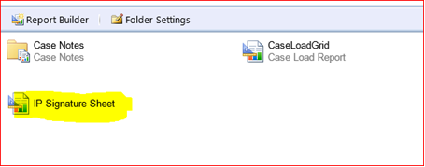

How to Get a Signature Sheet…
The link for the report will be posted and available for case managers.
To get a Signature Sheet the case manager will open the link:
https://apps-ext-ssrs2016.ct.gov:9443/Reports_2016/report/DDSDomainReports/1ConsumerServicePlanning/IP%20Signature%20Sheet
Please click on the highlighted report to access.
Step-1: After clicking on the report, you will be required to input DDS# into the report and then click view report.
Step-2: Exporting report to pdf: Click on the floppy box as highlighted below and select pdf option to export the report to pdf.

