Slide 1


Connecticut Core Standards for English Language Arts & Literacy
Systems of Professional Learning
Module 3 Grades K–5:
Supporting All Students in Writing and Research
Notes:
Slides 1-7 will take about 15 minutes.
Facilitator:
Introduce yourself. Welcome participants to Module 3.
Remind participants that regardless of which session they attended for Modules 1 and 2, they learned the same information, and had similar conversations. They are all part of the same community of coaches with a goal of deepening understanding of the CT Core Standards and instructional shifts across the entire state.
(Be sure that everyone is wearing a name tag. Since participants are now in their third module, it is likely that many of them will have met each other in earlier modules. There will be no full group introductions this time. They will have the opportunity to introduce themselves during various activities. However, as facilitator, you may want to read the room with regard to who is here from the same district so that you can plan to mix up groups; you may also want to ask if there is anyone who did not attend M1 and M2.)

Slide 2
You Are Here
Module 1: Focus on Instructional Shifts
Module 2: Supporting all Students in Close Reading, Academic Language, and Text-based Discussion
Module 3: Supporting All Students in Writing and Research
Module 4: Designing CCS ELA & Literacy-aligned Instruction and Assessment
Module 5: : Looking at Student Work and Engaging Students in Learning
Notes:
This slide provides a visual showing how the topics for the professional development modules fit together. Briefly explain to participants.

Slide 3
Today’s Agenda
Morning Session: CCS-ELA & Literacy
  Opening and Pre-Assessment
  Sharing our Successes and Challenges
  A Close Look at the Writing Standards
  Writing Grounded in Evidence from Text
Afternoon Session
  Research in CCS-aligned Units
  Supporting All Students in Writing
  Routine and Daily Writing
  Reflection and Planning
Post-Assessment, Session Evaluation, & Wrap Up
Notes:
Review the agenda, noting there will be a break for lunch as well as a short morning and afternoon break. You may want to add the importance of coming back from breaks on time to ensure enough time to complete all the work of the day.

Slide 4

Introductory Activities
Pre-Assessment
Module 2 Recap
Quick Write
Page 5
Notes:
Ask participants to complete the Pre-Assessment.

Slide 5
CCS-ELA & Literacy: Module 2 Recap
Backward design process and CCS-ELA & Literacy unit and lesson design
Deeper understanding of close reading, academic language, and text-based discussion
Practice with designing a sequence of text-dependent questions
Integration of close reading, academic language, discussion, and supports in unit and lesson design
Universal Design for Learning (UDL) and practices to support students in CCS ELA & Literacy
Notes:
The purpose of this slide is just to remind participants of the topics in Module 2. Be very brief with this slide, just naming the topics:
Unit and lesson design overview, close reading, text-dependent questions, academic language, discussion, and Universal Design for Learning

Slide 6

Quick Write
Jot down ideas to share with fellow Core Standards Coaches about activities or conversations you facilitated in your school or district relative to Module 2. If you encountered challenges, feel free to share those as well!
Use the Introductory Activity: Quick Write for Sharing section of the Notepad in your Participant Guide.
Page 61
Notes:
Facilitator: You will distribute cards from the deck in your supply box. Count the number of participants. Remove as many cards as needed to distribute evenly–or somewhat evenly–in matched fours among participants. For example, if you have 28 participants, you will remove all 8’s‒Kings from your deck and keep all Aces‒7’s to make 28 cards. If you have 32 participants, you would distribute Aces‒8’s to make 32 cards and so on. If you have an uneven number that would leave one or two participants alone, add a few more cards from the next number up. Shuffle well. As participants are writing in their Notepads, circulate among them, distributing cards. If you have a large district group, break them up for the first activity, by being deliberate in how you distribute the cards.

Slide 7
CCS-ELA & Literacy: Module 3 Outcomes
Review research base and rationale for CCS-ELA & Literacy Writing standards
Examine vertical progression of writing through student work samples
Learn how CCS model units teach research skills
Know how to support all students in writing
Trace writing instruction in CCS exemplar units and lessons
Plan support for educators in continuing the transition to the Core Standards and instructional shifts
Notes:
Review the expected outcomes briefly. This module will focus on the CC writing standards, writing instruction, and support.

Slide 8
Today’s Session
CCS Writing and Research
Successes and Challenges
Close Look at the Writing Standards
Research in CCS ELA & Literacy
Writing Grounded in Evidence
from Text
Supporting Students in Writing
Routine and Daily Writing
Notes:
The first thing we will do today is take a few minutes to share some of the discussions, plans, or activities that happened in your school or district between Modules 1 and 2.

Slide 9
Part 1
Sharing Our Successes and Challenges
Page 7
Notes:
15 minutes total including, directions.

Slide 10


Activity 1: Sharing about Modules 1 and 2
Activity 1: Sharing about Modules 1 and 2 (4 of a Kind)
Find three other coaches who have the same number card as you, to make 4 of a Kind. Introduce yourselves to each other. Have a brief discussion in which you reflect on any planning, discussion, or activities you did in your district, relative to Modules 1 or 2.
Page 7
Notes:
Part 1, including this activity, should take no more than 15 minutes. This slide gives directions for Activity 1. It is meant to be an informal “standing up” activity in which folks introduce themselves to others .

Slide 11
Today’s Session
CCS Writing and Research
Successes and Challenges
Close Look at the Writing Standards
Research in CCS ELA & Literacy
Writing Grounded in Evidence
from Text
Supporting Students in Writing
Routine and Daily Writing
Notes:
In Part 2 of Module 3, we’ll look at the organization of the writing standards and review the first three standards - text types - as they are explained in Appendix A of the CCSS. We’ll then examine the three types of writing by annotating student writing samples.

Slide 12
Writing Instruction in the US
“[…Since 2007] little has changed in how writing is taught in the majority of classrooms in the United States… This stands in stark contrast to the other members of the three R’s, reading and mathematics, subjects in which schools and teachers have devoted considerable effort to improving students’ performance.”
Graham, MacArthur, & Fitzgerald (2009)
Notes:
From Graham, S. & Harris, K. “Designing an Effective Writing Program,” in Graham, S., MacArthur, C. & Fitzgerald, J. Best Practices in Writing Instruction 2013. New York. Guilford Press.
The purpose of this slide is to bring provide context for this module.
Explain that the text, Best Practices in Writing Instruction, which provides evidence-based practices in writing instruction, was originally written in 2007, and has been revised and updated in 2013 to align with the CC standards. The authors and contributors are widely respected experts in the field of writing instruction.
Ask a participant to read the slide, then direct participants to turn and talk with a neighbor. “Do you agree with the authors’ statement? Why do you think less time is devoted to teaching writing than to teaching reading and math?
After several possible reasons have been offered, share the following information:
The authors make a point that the research behind writing instruction hasn’t changed. We know a lot about designing and teaching effective writing programs, and teachers and schools who regularly devote time to teaching writing, do a “phenomenal” job. Current research shows that beyond grade three, teachers devote little time to teaching writing and students do little writing in or out of school for academic purposes. With a new and rigorous set of standards that make writing a central element, learning to write is strongly emphasized. Students are expected to write for multiple purposes, and use writing to recall, organize, analyze, interpret, and build knowledge about content. With this strong emphasis on writing, it is important for all teachers to teach writing.

Slide 13
Why is Writing Important?
Versatile for accomplishing a variety of goals
Powerful for influencing others
Indispensable for learning and communicating
Improves reading skills
Graham, MacArthur, & Fitzgerald (2009)
Notes:
The purpose of this is to answer the question: Why is writing important? Versatile:
Maintain personal links with family and friends
Share information
Tell stories
Create imagined worlds
Chronicle experiences
Explore who we are
Powerful: Influencesothers, e.g. Uncle Tom’s Cabin, The Feminine Mystique
Indispensable for learning and communicating
Gather, preserve, and transmit information
Helps us understand what we read better by processing and organizing
Improves reading skills
Not identical processes, but research shows that instruction that improves writing skills and process also improves reading skills and processes
Writers gain insight about reading by writing for audiences
Quantity of writing improves reading comprehension
Graham (2013) pp. 4-6

Slide 14
What Determines “Best Practices” in Writing?
Examine successful methods that exceptional teachers of literacy commonly apply when teaching writing
Draw from scientific studies testing the effectiveness of specific writing practices
Notes:
Note that throughout this module we will look at both best practices and models

Slide 15
CCS-ELA & Literacy Writing Standards
3 Standards for Text Types and Purposes
  Argument/Opinion
  Explanation
  Narrative
3 Standards for Production and Distribution of Writing (writing process)
3 Standards for Research to Build and Present Knowledge
1 Standard for Evidence from Text
1 Standard for Range of Writing
Notes:
RE: Standard 10, Range of Writing: To build a foundation for college and career readiness, students need to learn to use writing as a way of offering and supporting opinions, demonstrating understanding of the subjects they are studying, and conveying real and imagined experiences and events. They learn to appreciate that a key purpose of writing is to communicate clearly to an external, sometimes unfamiliar audience, and they begin to adapt the form and content of their writing to accomplish a particular task and purpose. They develop the capacity to build knowledge on a subject through research projects and to respond analytically to literary and informational sources. To meet these goals, students must devote significant time and effort to writing, producing numerous pieces over short and extended time frames throughout the year.

Slide 16
CCS-ELA & Literacy Writing Standards
CCS.W.4 Produce clear and coherent writing in which the development, organization, and style are appropriate to task, purpose, and audience. (Begins in Grade 3)
CCS.W.9. Draw evidence from literary or informational texts to support analysis, reflection, and research. (Begins in Grade 4)
CCS.W.10. Write routinely over extended time frames (time for research, reflection, and revision) and shorter time frames (a single sitting or a day or two) for a range of tasks, purposes, and audiences. (Begins in Grade 3)
Notes:
Authors of Common Core Standards recognized the nature of writing for young children and were realistic in their expectations for assessing writing of young students on challenging or developmentally inappropriate tasks. Nonetheless, teachers of primary grades students can look to grades 3 and 4 for the missing standards and begin to build stamina and good writing habits for when these standards do begin.

Slide 17
Part 2
A Close Look at the Writing Standards
Page 9
Notes:
65 minutes for all of Part 2, including Activities 2 and 3. Introductory slides, 13-14, should take no more than 5 minutes, leaving 1 hour for the remaining activities.

Slide 18
Activity 2: Types of Writing in CCS-ELA & Literacy
Activity 2: Types of Writing in CCS-ELA & Literacy
Select a facilitator, timekeeper, recorder, and reporter. Read about one type of writing from the CCSS Appendix A (located in the Appendix of your Participant Guide). Read once to get the gist. Read a second time to focus on guiding questions and “render” the text. Share and explain. Answer questions and report out.
Pages 9-11
Notes:
Activity 2 will take 30 minutes.
For this activity, group participants in 4’s in any way that works for the groups you have. It’s OK for them to stay with their district if that works out. If there are an odd number, it is better to have a group of 3 than of 5. Direct them to the page in their Participant Guide, then briefly explain on the next slide. They will definitely need their Participant Guide for this.

Slide 19
Text Rendering Protocol
Read one section:
  Argument (p. 23)
  Informational/Explanatory (p. 23)
  Narrative [and Creative] (pp. 23‒24)
  Special Place of Argument (pp. 24‒25)
In your Notepad, record a significant sentence, a phrase, and a word related to:
  The purpose of this type of writing
  Important ideas from your section
Take turns sharing with your group, then together, answer the questions in the Participant Guide.
Page 61
Notes:
Remind participants that full directions, including the questions to answer, are in the Participant Guide.

Slide 20
Share Out
What is one significant or interesting point your group discussed?
How might you use the Text Rendering Protocol with colleagues or in the classroom?

Slide 21
A New Resource: In Common
Collection of K‒12 student writing samples from around the country
Organized by writing type and sub-divided by “On-demand Writing” and “Range of Writing”
Annotated with the language of the CCS
Intended to supplement Appendix C: Samples of Student Writing
Provides examples of Common Core-aligned writing for teachers and students
www.vermontwritingcollaborative.org
http://www.achievethecore.org/
Notes:
Slides 18-27, which include Activity 3, will take about 30 minutes.
The purpose of the next two slides is to introduce In Common as a resource. Most participants will have heard of In Common but may not have had an opportunity to explore it.
There are two types of writing in In Common. “On-demand Writing,” written to a common prompt and illustrates developmental spectrum. “Range of writing,” illustrates examples of writing for different tasks, audiences, and purposes over different time frames.
Created by Vermont Writing Collaborative and Student Achievement Partners.

Slide 22
Cautions from the Authors about Using In Common
Provides examples, not benchmarks
Should not be used as models for scoring student work
Chosen to illustrate text types and purposes of Common Core, not to illustrate mastery of conventions
May not illustrate grade-level language standards
Meant as a starting point, not a destination
Notes:
The authors make it clear that these are authentic writing samples to be used for a variety of purposes, but they are not intended to be models. They were intended to supplement Appendix C, which was not sufficient for its intended purpose. This is an ongoing project.

Slide 23
Activity 3: Examining the Grade Level Expectations of the Writing Types and Texts
Activity 3: Examining the Grade Level Expectations of the Writing Types and Texts
Choose one set of unannotated student writing K‒5: Opinion, Explanation, or Narrative. Annotate the set with the language of the applicable grade level standard: W.1, W.2, or W.3. Compare your annotations with those of the annotated versions of the same sample. Discuss first with your partner and then with your table, using guiding questions.
Page 12
Notes:
Approximately 25 minutes for this activity and discussion that follows.

Slide 24
Guiding Questions for In Common
With your partner
  What do you notice about the progression of student writing from grade level to grade level?
  Are these good examples of student writing for the grade level and type of writing? Why or why not?
With your table
  What are the similarities in student writing at the same grade level across types of writing?
  Are the CCS realistic in terms of their expectations for student writing?
With the whole group
  How might you use the In Common collection with teachers? With students?

Slide 25
How Does OPINION Grow?
Kindergarten
Grade 1
Grade 2
Grade 4
Grade 3
Grade 5
Draw, dictate, or write about topic or text
Supply a reason
Provide closure
Reasons support topic
Use linking words
Create organizational structure
Concluding statement
List reasons
Introduce clearly
Group related ideas to support purpose
Support reasons with facts and details
Relate conclusion to opinion
Ideas are logically grouped
Logically ordered reasons
Use words, phrases, and clauses to link opinions and reasons
Introduce topic
Notes:
The purpose of this slide and the next two is to reinforce the preceding conversations by looking at the patterns of writing. CC acknowledges the developmental nature of writing. Notice how 5th grade moves toward argument, which begins in Grade 6. Don’t spend a lot of time on these slides, but do point out the similarities across writing types in each grade. There is a lot of instruction that will be similar for each writing type.

Slide 26
How Does Explanation Grow?
Kindergarten
Grade 1
Grade 2
Grade 4
Grade 3
Grade 5
Draw, dictate, or write about topic or text
Supply facts
Provide closure
Introduce topic
Develop points with facts and definitions
Group related information
Paragraphs, sections, formatting, multimedia
Link ideas
Introduce with general observation and focus
Link ideas within and across categories
Develop with facts, illustrations and details
Concluding statement
Use linking words
Precise language and domain-specific vocabulary
Name topic or text
Quotations, examples
Notes:
Note that it is in grade 3 where students begin to create an organizational structure that leads the reader. This is true in all three kinds of writing. There is horizontal consistency.

Slide 27
How Does Narrative Grow?
Kindergarten
Grade 1
Grade 2
Grade 4
Grade 3
Grade 5
Draw, dictate, or write about single event or loosely linked events
Write about sequenced events
Well elaborated event or short sequence of events
Establish situation
Orient reader by providing a situation
Tell in order
Provide reaction
Include details
Use temporal words
Provide closure
Details for thoughts, actions, feelings
Introduce narrator and/or characters
Organize event sequence that unfolds naturally
(More sophisticated narrative techniques and transitions)
Notes:
Invite participants to comment: Why might there be no change in grade 5? What does this say about the decreased importance of narrative?

Slide 28
Quick Write
Use the Notepad section in your Participant Guide.
In the section labeled Activity 3: Examining the Grade Level Expectations of Writing Types and Texts, jot down notes about anything you think was significant from this activity that can be applied to CT Core Standards work in your school or district.
Page 61
Notes:
3 minutes.

Slide 29

Let’s Take A Break…
…Be back in 10 minutes
Notes:
The break should be 10 minutes. Remind participants to try to be timely in their return.

Slide 30
Today’s Session
CCS Writing and Research
Successes and Challenges
Close Look at the Writing Standards
Research in CCS ELA & Literacy
Writing Grounded in Evidence
from Text
Supporting Students in Writing
Routine and Daily Writing
Notes:
This part of the module will focus on Shift 2, writing, grounded in evidence from the text, and how that develops in elementary school.

Slide 31
Part 3
Writing Grounded in Evidence from Text
Page 18
Notes:
Part 3 is allotted 105 minutes in total. This includes introductory slides and Activities 4 and 5. Activity 4 is 50 minutes, and Activity 5 is 45 minutes. That leaves about 10 minutes for introduction and conclusion of this part.

Slide 32
#2 Shift in the Use of Evidence
Text-dependent answers
Writing from sources
Reading, writing, and speaking grounded in evidence from text
Notes:
Remind participants that in Module 1, we saw that one of three significant instructional shifts required by the CCS is “Reading, writing, and speaking, grounded in evidence from text.” With regard to writing, where in the standards do we find that?

Slide 33
Writing with Evidence from the CCS
CCSS.ELA-Literacy.CCRA.W.1
Write arguments to support claims in an analysis of substantive topics or texts…
CCSS.ELA-Literacy.CCRA.W.2
Write informative/explanatory texts to examine and convey…information… analysis of content.
CCSS.ELA-Literacy.CCRA.W.7
Conduct short as well as more sustained research…
CCSS.ELA-Literacy.CCRA.W.8
Gather…information from…print and digital sources…
CCSS.ELA-Literacy.CCRA.W.9
Draw evidence from literary or informational texts to support analysis, reflection, and research.
Notes:
The purpose of this slide is to show that writing from sources/writing with evidence is spread throughout the writing standards. Standard 9 also refers back explicitly to the reading standards at each grade level.

Slide 34
Writing with Evidence in the Primary Grades
CCSS.ELA-Literacy.W.K.7
Participate in shared research and writing projects (e.g., explore a number of books by a favorite author and express opinions about them).
CCSS.ELA-Literacy.W.K.8
With guidance and support from adults, recall information from experiences or gather information from provided sources to answer a question.
Notes:
These are the Kindergarten standards.
W.9 does not begin until Grade 4, primarily because of the independent and sophisticated nature of both reading and writing required to be successful.

Slide 35
Shift Toward Evidence in Writing Tasks
NAEP writing expectations are a key design consideration for CCS-ELA & Literacy-aligned assessments
  35% of evidence from narrative writing
  35% of evidence from explanatory/informational writing based on evidence from given sources
  30% of evidence from opinion writing based on evidence from given sources
Reflected in SBAC writing tasks related to Claim 2
Notes:
“It follows that writing assessments aligned with the Standards should adhere to the distribution of writing purposes across grades outlined by NAEP.” http://www.corestandards.org/ELA-Literacy/introduction/key-design-consideration/
This instructional shift is reflected on the Smarter Balanced assessments as well. Grade 3-5 Summative Assessment Targets, Claim #2
Students can produce effective writing for a range of purposes and audiences. 65% of grade 3-5 writing tasks related to Claim 2 on SBAC will include writing from sources.

Slide 36
Using Evidence in Selected and Constructed Assessment Tasks
What does Naomi learn about Grandma Ruth? Use details from the text to support your answer.
Revise the paragraph by adding details from the daily schedule that help support the reasons for having a longer school day.
http://www.smarterbalanced.org/sample-items-and-performance-tasks/
Notes:
The use of evidence is reflected in both writing tasks and revision tasks, and requires evidence from a variety of kinds of text, fiction and informational, graphic and video.

Slide 37
Sample Performance Task from SBAC Grades 3‒5
You will now examine two sources. Take notes on both sources…
Choose one animal from the article "Animal Roll-Ups" and one animal from the video "Animal Defenses."
In your article, identify your two animals, explain how each animal protects itself from its enemies, and explain how the two animals’ defenses are similar to or different from one another. Include details from your sources.
Notes:
Although the writing task does not use the word “evidence” which is associated with argument and explanation, beginning in grade 6, there is a clear expectation that information will be grounded in text.

Slide 38




What are “Best Practices” in Writing Instruction?
Notes:
Remind participants that earlier today we learned that “best practices” to teach writing from text are drawn from two sources: common practices of exemplary teachers of writing, and scientific studies.
Direct participants to turn and talk with a neighbor about practices they believe to be best practices in writing instruction. Then show the next slide and read the details in the facilitator’s notes. Ask participants to listen for the practices they named. Ask them if they are surprised by any, or if they named any they think should have been there and are not.

Slide 39
What are “Best Practices in Writing Instruction?”
Create a supportive environment where writing can flourish
Teach writing strategies
Teach foundational writing skills
Notes:
Create a supportive environment where writing can flourish
Clear, specific, and challenging goals
Arrangements in which students work together
Write often, and for a variety of purposes
Real audiences
Personal choices
Write for extended periods
Teach writing strategies
Strategies for writing process – planning, drafting, revising, and editing
Pre-writing activities
Graphic organizers
Characteristics of text types and genres
Teach foundational writing skills
Handwriting, typing, spelling
Syntax
Conventions
Graphic organizers
Sentence and paragraph structure

Slide 40
Activity 4: Writing about Text
Activity 4: Writing about Text
Your table group will be assigned one section of “Best Practices in Writing about Text.” Read individually and use sticky notes to highlight/annotate key ideas. Please do not write on the handout. Summarize together and decide how to share the information with others. Regroup so that each table has at least one member who has read each section. In turn, “teach” your section of the chapter. Discuss the types of supports students and teachers will need.
Page 18
Notes:
This activity will take 50 minutes. Directions for this activity are in the Participant Guide.
Say: “The purpose of this activity is to become familiar with four research-supported approaches to writing about text.”
Direct participants to turn to the correct page in their guide, then briefly review the directions. When step 6 is completed, move to the next slide.
Assign a number to each table group, reorganizing the tables as needed to even out the size of the groups.
Assign each table one section of “Best Practices in Writing about Text.”
Sections are as follows:
Intro - pp. 334–335
Writing to Text Models – pp 336–338
Summarizing Text – pp. 338–340
Writing about Text – bottom p. 340–343
Text Synthesis – pp. 343–347
Direct participants to read individually use sticky notes to highlight/annotate key ideas. (10 minutes) Remind participants to not write on the handout as these will collected and reused at future sessions.
Each table summarizes their section together, and decides how to best share the information with others in a 3-minute presentation. (10 minutes)
Regroup so that each table now has at least one member who has read each section.
In turn, “teach” your section of the chapter. (15 minutes – 3 minutes per group)
Discuss: How can these research-based practices be adapted for early elementary students? What support will students need in order to do the types of writing described in this chapter. What support will teachers need? (10 minutes)

Slide 41
Activity 4: Writing about Text
Activity 4: Discussion Questions
How can these activities be adapted for early elementary students? What types of support will students need? What types of support will teachers need? In your Notepad section titled Activity 4: Writing about Text, jot down any ideas from this activity that you might share with colleagues in your district.
Page 62
Notes:
Discuss: How can these research-based practices be adapted for early elementary students? What support will students need in order to do the types of writing described in this chapter. What support will teachers need? (10 minutes)

Slide 42
Activity 4: Writing about Text
Your table will be assigned to read the one section
of the chapter “Best Practices in Writing about Text.”
  Sections are as follows:
  Intro ‒ pp. 334–335
  Writing to Text Models – pp. 336–338
  Summarizing Text – pp. 338–340
  Writing about Text – bottom p. 340–p. 343
  Text Synthesis – pp. 343–347
  Do not write on the hard copy of article. Please return copies when this activity is completed.
  Shanahan, T. (2013). Best practices in Writing About Text, in S. Graham, C. A. MacArthur, & J. Fitzgerald (Eds.), Best Practices in Writing Instruction (2nd ed., ch. 14, pp. 334-350 ), New York, NY: Guilford Press.

Slide 43
Opinion and Argument
Everyday experience shows that youngsters have some skill in argumentation. Unfortunately, children…often ignore relevant information that is inconsistent with their perspective, are insensitive to potential criticisms of their opinion, lack standards for evaluating their argument, and fail to adapt their strategies to the communicative context…
These qualities are also evident in students’ written arguments.
Graham, MacArthur, and Fitzgerald (2013)
Notes:
The purpose of this slide is to address a particular kind of writing with evidence–argument. Although argument does not start until grade 6, it is really just a matter of semantics and formality. Students begin expressing opinions in Kindergarten and build toward formal argumentation.

Slide 44
How Does Opinion Grow into Argument?
Grade 3
Write opinion pieces on topics or texts supporting a point of view with reasons
Grade 5
Write opinion pieces on topics or texts supporting a point of view with reasons and information
Grade 6
Write arguments to support claims with clear reasons and relevant evidence
Organizational structure
Linking words
Organizational structure …ideas are logically grouped to support purpose
Link opinions and reasons
Introduce claim and organize reasons and evidence clearly
Clear reasons … relevant evidence… credible sources
Formal style
Notes:
This slide is reminiscent of an earlier slide when we were discussing text types. This one shows how opinion builds to argument, so that fifth graders are prepared to begin writing argument in sixth grade.

Slide 45
Activity 5a: Text Evidence to Support an Argument
Activity 5a: Viewing a Video and having a “Written Conversation”
View the video and take notes in your Notepad for this question: How does the teacher prepare students to write with evidence? (15 minutes) Identify a partner for a Written Conversation. Write simultaneous communications to one another about the video. At the facilitator’s signal, trade notes, for a total of 3 exchanges. This is done in silence. (10 minutes) When the facilitator gives the signal, you can talk out loud with your partner. (3 minutes) Be prepared to volunteer a highlight or thread of your conversation. Video: “Text Evidence to Support an Argument,” http://commoncore.americaachieves.org/module/17
Page 21
Page 62
Notes:
This activity will take about 45 minutes.
The purpose of this activity is to illustrate that young students can write well-developed arguments if given scaffolding and support. Briefly review the directions. Explain to participants that after they view the video and take individual notes, they will engage in a protocol, Written Conversation, that is a powerful discussion protocol to use with students. Direct participants to the appropriate pages in their Participant Guides. Have them review the directions for the activity.
Explain that they will be watching 3 clips from a longer video that are representative of the entire lesson. The video is called Text Evidence to Support an Argument. This teacher is actually focusing on Reading, Speaking and Listening, and Language standards, not W.1. She is teaching students about finding evidence in text. Participants are likely to notice that the teacher is using a basal anthology; since this realization may interfere with the lesson for some participants, it is better to acknowledge up front that they will notice she is using a piece of authentic literature from a reading series.
This is a fairly long video. Even with segments removed, it will be about 9 minutes.
http://commoncore.americaachieves.org/module/17
Minutes 1 – 3:50; 7:30 – 10:30; and 12 – 13:40
After the video, be certain that each participant has a partner. If there are odd numbers, there can be a trio. Be sure to watch the time and signal when partners should trade. After partners have had an opportunity to speak aloud, be sure to ask them why or how Written Conversation would be an effective strategy to use as a discussion protocol with students.

Slide 46
Activity 5b: Text Evidence to Support an Argument
Activity 5b: Looking at Student Work
Look at the samples of student work generated as a result of the lesson sequence in the video. Talk with your table: To what extent did the instructional activities prepare students to write with evidence from the text?
Page 23

Slide 47
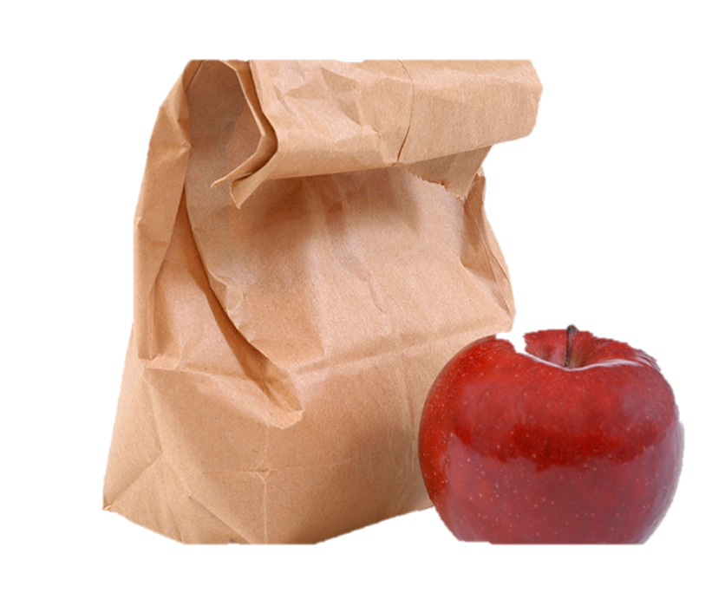
Bon Appétit
Notes:
Remind participants of the need to be timely. Allow 45 minutes. State time to return.

Slide 48
Today’s Session
CCS Writing and Research
Successes and Challenges
Close Look at the Writing Standards
Research in CCS ELA & Literacy
Writing Grounded in Evidence
from Text
Supporting Students in Writing
Routine and Daily Writing
Notes:
One group of writing standards is focused on research skills. However the CCS are explicit in pointing out that research is integrated throughout the standards.

Slide 49
Part 4
Research in CCS-ELA & Literacy
Page 25
Notes:
Part 4 is allotted 60 minutes.
In this section, we’ll look at the standards related to research and technology, and think about what that means for elementary students and teachers, especially at the earliest grades. One of the best ways to do this is to look at units that have been developed by teachers and writers who have worked closely with the authors of the CC.

Slide 50
CCS-ELA & Literacy Writing Standards for Research
CCS.W.7 Conduct short as well as more sustained research projects based on focused questions, demonstrating understanding of the subject under investigation.
CCS.W.8 Gather relevant information from multiple print and digital sources, assess the credibility and accuracy of each source, and integrate the information while avoiding plagiarism.
CCS.W.9 Draw evidence from literary or informational texts to support analysis, reflection, and research. (Starts in Grade 4)
Notes:
The purpose of this slide is to show the writing standards that focus on research skills.

Slide 51
How does Research Grow?
K-1
Shared research
Writing projects
With support from adults, recall experiences or gather information from provided sources
Grade 2
Recall experiences or gather information from provided sources
Grade 3
Conduct short research projects that build knowledge
Gather relevant information from print and digital sources
Grade 4
…short research projects that build knowledge through investigation of different aspects of a topic
Take notes…Sort evidence
Draw evidence from literary or informational texts to support analysis, reflection and research
Grade 5
…short research projects that use several sources
Print and digital sources
Summarize or paraphrase information
Notes:
Increased independence, more complex tasks, more complex sources, multiple sources. In grade 4, addition W.9, which links Grade 4 reading standards with writing standards.

Slide 52
Activity 6: Research in CCS-aligned Units
Activity 6: Research in CCS-Aligned Units
Your team will develop expertise on one research unit. Together, review your unit to see how it is organized. If it is long or complex, you may want to divide it. Read and use the “Developing Research” Organizer for notes. Be sure to notice and note how research skills are taught and what is missing in the unit! Create a poster with words and symbols to represent the way research skills are taught and developed in your unit. Prepare to “host” representatives from other teams at your poster on a gallery walk.
Page 25
Notes:
The review of the units and the hosted gallery walk are allotted 45 minutes. Allow 20 minutes to review the units, another 10 to create the poster, and 15 for the hosted gallery walk. It will be tight. Emphasize the importance of dividing up large units.
Facilitator: If you’d like, you can creatively use the cards that participants were dealt this morning to form research teams. Or if you’d like, you can just number off; for example a group of 30 can number be formed into 6 teams (2 teams for each unit). No team should be larger than 6 members.

Slide 53
Activity 6: Research in CCS-aligned Units
Activity 6: Links for Research Units
Grade 1: Informational Text, Research, and Inquiry Circles: Animals and Habitats Grade 2: Informational Text: Reading for Inquiry and Writing a Report Grade 4: Reading and Writing Informational Texts: Negro League Baseball http://www.doe.mass.edu/candi/model/files.html
Notes:
Facilitator: You do not have to do anything with this slide; it is for the convenience of participants who are following along with the PPT. There will be hard copies of each of the modules for the participants to choose. Since all three modules are located on the same web site there is only one web address for them to retrieve a copy of all three units.

Slide 54
Activity 6: Research in CCS-aligned Units
Activity 6: Hosted Gallery Walk
Join a group with representatives from each of the research teams. Each group starts at a different poster. Whoever in your group was a participant in making that poster will be the “host.” The host will explain the research process in his or her unit, including anything unique or noteworthy. At a given signal, each group moves to the next poster and the host changes.
Notes:
Re-group participants so that each new group has one member from each former team. There should be a representative from each unit in each group. So, if there were six teams working on the three units (2 teams per unit) they should make six new groups with representatives from the six research teams. These groups should be formed standing up, not seated. Although some participants reviewed the same unit, they will create different charts. They should be hung together in order to see the different areas that each team focused on as well as the “missed opportunities” for building research skills within the unit.
Tell groups what the signal will be (e.g. rhythmic clap, lights flicking, stopwatch on your cell phone, or on the computer). It can be an audible or visible signal. Depending on the number of groups, allow approximately 2 minutes at a poster, then move participants to the next poster. With movement, this activity should take about 15 minutes.
Hosted Gallery Walk adapted from Expeditionary Learning’s Protocols and Resources on EngageNY: http://www.engageny.org/sites/default/files/resource/attachments/appendix_protocols_and_resources.pdf
The hosted gallery walk involves small-group collaboration to create a product, yet makes individuals responsible for the learning and the teaching.

Slide 55
Research in CCS-aligned Units
To what extent did you see grade level research standards reflected in the units/modules you reviewed?
What types of instruction in the units will help students grow in their research skills?
How does instruction in research skills differ from (or mirror) other writing instruction?
Notes:
This slide provides closure to the Gallery Walk. Encourage volunteers to offer responses, based on their review of units and the Gallery Walk.

Slide 56
Writing and Research build Content Knowledge
“It is especially important that writing is included as an integral part of content instruction in the disciplines… When students write informative papers about the content they are learning, it forces them to make decisions about
  What information is most important
  What consequences were positive, negative, or both
  How findings should be organized and presented”
Graham (2013)
Notes:
This slide reminds coaches of the importance of research for building knowledge in the disciplines. It is especially important that writing is included as an integral part of content instruction in disciplines like science, social studies, and mathematics. This slide reminds coaches of the importance of research for building knowledge in the disciplines.
Full quote: “ It is especially important that writing is included as an integral part of content instruction in disciplines like science, social studies, and mathematics. For example, when students write informative papers about the content they are learning in social studies (the consequences of the westward movement in American history as illustrated through the Oregon Trail, for instance), it forces them to makes decisions about (1) what information is most important; (2) what consequences were positive, negative, or both; and (3) how their findings should be organized and presented. Such analyses and interpretation forces students to wrestle with the content, especially if they have to defend the choices they made (e.g., why were the consequences they presented important).”
Graham, S. (2013). Writing Standards. In Morrow, L.M., Wixson, K.K., & Shanahan, T. (Eds.), Teaching with the common core standards. (p. 102).

Slide 57
Where is Technology in the Writing Standards?
CCS.W.6 Use technology, including the Internet, to produce and publish writing and to interact and collaborate with others.
CCS.W.7 Conduct short as well as more sustained research projects based on focused questions, demonstrating understanding of the subject under investigation.
CCS.W.8 Gather relevant information from multiple print and digital sources, assess the credibility and accuracy of each source, and integrate the information while avoiding plagiarism.
Notes:
Technology is integrated throughout the standards. It is specifically embedded in the research standards. This could be considered a shift from former standards, which frequently isolated technology as an end in itself.

Slide 58
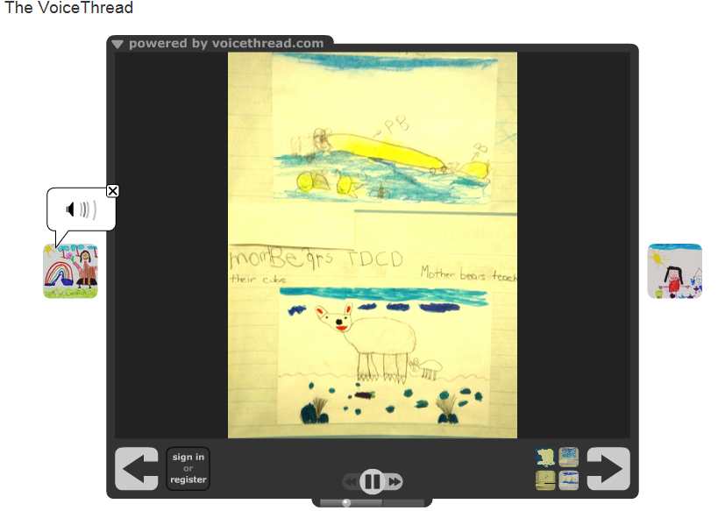
Digital Storytelling
https://voicethread.com/share/4215555/
Notes:
The next slides illustrate several technology applications that support the CCS.
This project illustrates the Kindergarten research standards as well as the use of technology. This VoiceThread, All About Polar Bears, Kindergarten ESL by Monica Schnee, won a PBS Teacher Innovator Award. The authors of the "book" are kindergartners who were learning English as a second language. Some of the children barely spoke English, as you can see by the short sentences, and some were advanced students. They had just started to learn how to read and write. This work is a great example of how children learn a second language, how they learn literacy, how they learn oral fluency and practice their oral skills and most importantly, how their parents were able to see and hear how their children are learning English.
The teacher: We spent a lot of time reading books, looking at websites, particularly National Geographic and Nature on PBS. We collected facts, a word that children learned in nonfiction. Then, each student chose a fact, wrote it and had to illustrate it like a true nonfiction illustrator. Therefore, the drawings had to be in "real colors". After we finished our "traditional hard copy" book. We read it to all the kindergartners, including their American peers. Then we practiced our lines and made it into a VoiceThread.

Slide 59
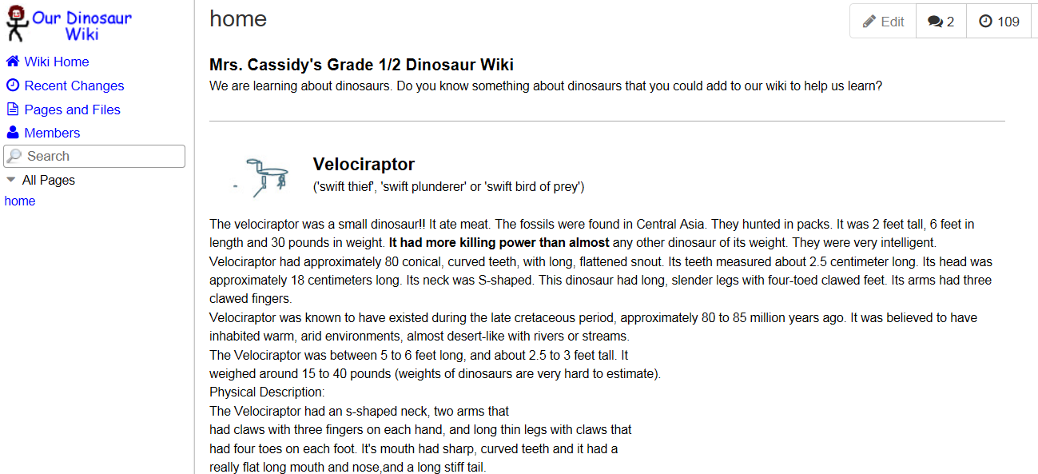
Shared Writing
http://room2-wiki6.wikispaces.com/
Notes:
http://www.wikispaces.com/content/classroom/about
Project-Based Learning
Project-Based Learning is a dynamic approach to teaching in which students explore real-world problems and challenges. With this type of active and engaged learning, students are inspired to obtain a deeper knowledge of the subjects they're studying.
Wikispaces Classroom provides a simple structure that allows you to create projects, define teams, assign students and manage them all through successful completion of their projects. Starting from pre-built templates, or a blank slate, students can work in private groups until their work is due. At the end of the project you can share the results with the rest of the class or even parents and other participants. In the project illustrated, the teacher asks students to contribute to the wiki.

Slide 60

Interactive Posters
http://hgaver.edu.glogster.com/native-american-tribes/?=glogpedia-source
Notes:
A Glog is an interactive visual platform in which users create a “poster or web page” containing multimedia elements including: text, audio, video, images, graphics, drawings, and data.
The teacher creates projects with templates and instructional guidelines, assigns them to the students, provides feedback throughout the assignment, and assesses their finished work.
Once projects are complete, the teacher can share students’ work in a variety of educational settings. Glogs can be embedded in a blog, wiki, or web page or shared with others using Glogster.

Slide 61

Virtual Field Trips
http://www.google.com/earth/explore/showcase/unesco.html
Notes:
With Google Earth, teachers can create customized field trips for shared research. This is great for primary classes.

Slide 62
Digital Literacy Skills Students Need
Refined search skills
Ability to evaluate the veracity of sources
Ability to synthesize information from multiple sources
Practice in sending clear, unambiguous messages in online environments
Skills for navigating social media and collaborative environments
Adapted from http://www.newliteracies.uconn.edu/events.html
Notes:
The New Literacies Research Lab at the University of Connecticut is the most widely recognized center in the world for conducting research on the new reading comprehension and learning skills required by the Internet and other emerging information and communication technologies. Their work develops research-based evidence to prepare students for their literacy and learning future. They are currently developing an online assessment to determine students digital literacy skills. They have determined areas in which students struggle with digital literacy. The list on this slide is derived from their research.

Slide 63
Today’s Session
CCS Writing and Research
Successes and Challenges
Close Look at the Writing Standards
Research in CCS ELA & Literacy
Writing Grounded in Evidence
from Text
Supporting Students in Writing
Routine and Daily Writing
Notes:
In Module 2, we considered ways to support students in reading closely and drawing evidence from text. Because of the integrated nature of the CCS, many of those supports address writing as well as reading.

Slide 64
Part 5
Supporting Students in Writing
Page 29
Notes:
Part 5 will take about 55 minutes:
Intro: 5
Activity 7: 10
Activity 8a: 20
Activity 8b: 20

Slide 65
Gradual Release of Responsibility
Focus Lesson
Guided Instruction
.
TEACHER
I do it.
.
Collaborative
Independent
We do it.
You do it together.
You do it alone.
STUDENT
Adapted from http://fisherandfrey.com/resources/
Notes:
Fisher & Frey. Literacy for Life http://fisherandfrey.com/resources/
Fisher and Frey have created a graphic to illustrate gradual release of responsibility. For most coaches, this is really a review, not new information. However, it is important to emphasize that given the rigor of the writing standards, it is important to model, guide, and provide practice for students before expecting individual mastery of writing.

Slide 66
Gradual Release of Responsibility for Elementary Writing
Modeled/Shared Writing
Interactive Writing
Independent Writing
Collaborative Writing
Notes:
Many coaches will be familiar with writing in a balanced literacy program. In modeled writing, the teacher thinks aloud and writes. In shared writing, the teacher and students compose together and the teacher scribes. In interactive writing, the pen is shared with students doing some of the writing. The CCS would add another step to this: Collaborative writing. There is a strong emphasis on collaboration in the CCS, and it aligns with with the Fisher and Frey model as well.

Slide 67
Activity 7: Viewing a Video
Activity 7: Viewing a Video
View the third segment of a video lesson begun in Module 2. Today’s segment is Putting Thoughts on Paper As you view, jot notes in your Notepad: What do you see and hear in this class? Be sure to look around the classroom as well as listening to and looking at the immediate activity on camera. Discuss with your table, using the prompts in your participant guide and on the next slide. https://www.teachingchannel.org/videos/analyzing-text-writing
Pages 29-30
Notes:
Remind participants that in Module 2, we saw a video of a fifth grade class (teacher Stacey Brewer). Ms. Brewer explained that she had a very diverse class and that she planned her lessons in such a way that all students could participate, contribute, and be prepared, regardless of their independent reading level. They read a text about Lewis and Clarke, took individual notes with post-its, discussed in a small group, and then as a whole class. Today we will see the last piece of that video, where Ms. Brewer supports students in preparing to respond in writing.
https://www.teachingchannel.org/videos/analyzing-text-writing
00:00 – 05:00

Slide 68
Discussion Prompts for Activity 7
What were some of the strategies and supports you saw and heard the teacher use?
What did you notice about student participation and responses?
To what extent did this teacher and the lesson sequence prepare students to be competent and confident in their writing?
What do teachers need to know and be able to do in order to be able to effectively prepare students to write?
Page 63
Notes:
After discussion, be sure to elicit responses from volunteers. Or, let tables know that you will be calling on someone to answer each question. The last question is particularly important for coaches.

Slide 69
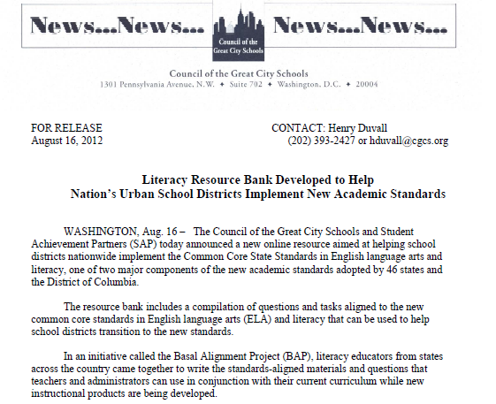
Resource: Basal Alignment Project
http://www.cgcs.org/Page/323
Notes:
The purpose of this slide is to introduce the Basal Alignment project. This project is led by Student Achievement Partners, but is carried out by teacher volunteers. The goal is to rewrite lessons from basal reading programs to align with the Common Core. It is an Edmodo site, which can be joined free of charge.

Slide 70
Introduction to Writing to Sources: Guided Instruction
Written by Student Achievement Partners and Council for Great City Schools
Framework for scaffolding writing after closely reading a text
Helps students build deeper meaning
Intended to accompany the Basal Alignment project lessons
Adaptable for any elementary literature writing task
Notes:
A recent addition to the Basal Alignment Project are Writing to Sources lessons, aligned with the BAP reading lessons.

Slide 71
Activity 8a: Examining a Framework
Activity 8a: Examining a Framework
Individually, review the framework, Writing to Sources: Guided Instruction. Working with a partner, choose one of the two sample lessons provided in your participant guide. As you read and discuss the sample lesson, annotate the parts of the lesson, using words from the Teachers’ Guide. Turn and talk to your partner: What are the benefits of using a framework like this to scaffold a writing task? Are there disadvantages as well?
Page 31
Notes:
Allow 20 minutes for this activity, about 8 to review the framework, and 10 to annotate the sample lesson, then another 2 for the turn and talk prompt.
The Writing to Sources framework is available on Edmodo, in the Basal Alignment Project https://www.edmodo.com/home#/group?id=1121902&sub_view=folders

Slide 72
Activity 8b: Scaffolding a Writing Task
Activity 8b: Scaffolding a Writing Task
Return to the text you used for your close reading lesson in Module 2. Using the scaffolded writing task you’ve just reviewed, create a prompt with a focusing question. If time allows, write a few examples on the evidence chart. Share your prompt and focusing question with a neighbor who is not your writing partner. Discuss: To what extent will a scaffolded writing assignment be effective with your chosen text and grade level?
Notes:
For this activity, explain that participants will be using the story or text for which they wrote a series of text-dependent questions in Module 2. If both partners are attending this session today, it would be good for them to work together on 8a and 8b.
If a participant did not attend Module 2, or does not have a text, he or she may work with a text from the box of books at the location, or with an Appendix B exemplar. However, he or she will need to choose quickly after 8a in order to have enough time to complete 8b.
Allow 20 minutes for 8b: 15 to create a prompt and 5 to debrief.

Slide 73
Resource: Literacy Design
Collaborative (LDC)
Instructional system for developing literacy skills.
Builds students’ literacy skills and understanding of content through reading and writing assignments aligned to the CCS.
Basic building block is a module, two to four weeks of instruction comprising a “teaching task,” standards, “mini-tasks,” and other instructional elements.
Working with LDC’s framework and tools, teachers develop a literacy-rich task and design instruction to help students complete that task.
http://ldc.org/
Notes:
The purpose of this slide is to briefly introduce a powerful resource.
LDC is a national community of educators providing a teacher-designed and research-proven framework, online tools, and resources for creating literacy-rich assignments and courses across content areas. They have developed an entire system of templates to create instruction leading to literacy performance tasks in every discipline. These templates and tasks have recently been extended to lower grades.

Slide 74
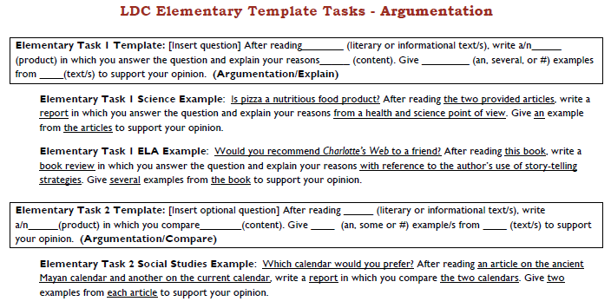
LDC Template Task
http://ldc.org/sites/default/files/LDC-Elementary-Template-Tasks-v1.pdf
Notes:
Facilitator, read a few examples to show the versatility of these templates. Encourage participants to explore this website if they have not done so. There are examples of full units of study leading to these types of performance tasks.

Slide 75
Today’s Session
CCS Writing and Research
Successes and Challenges
Close Look at the Writing Standards
Research in CCS ELA & Literacy
Writing Grounded in Evidence
from Text
Supporting Students in Writing
Routine and Daily Writing
Notes:
This part of the module will examine W.9.

Slide 76
Part 6
Routine and Daily Writing
Page 54

Slide 77
CCS ELA & Literacy Writing Standards for Research
CCS.W.10
Write Routinely over extended time frames (time for research, reflection, and revision) and shorter time frames (a single sitting or a day or two) for a range of tasks, purposes, and audiences. (Begins in Grade 3)
Notes:
The purpose of this slide is to set a CCS context for regular writing practice.

Slide 78
Activity 9: Writing Tasks in Exemplar Units
Activity 9: Writing Tasks in Exemplar Units
Choose and access one of the exemplar units (titles and links in participant guide), or use a unit you printed at home. Working with a partner, identify writing tasks and writing instruction embedded in the unit and write into graphic organizer (example on next slide). Record your writing tasks on large sticky notes and post as Opening, Work Time, or Closing on chart paper. Discuss with guiding questions.
Page 54
Notes:
Allow 15 minutes for looking at units and doing graphic organizer. Allow another 5 minutes for posting on charts and sharing out by volunteer. 5 minutes for table discussion and 5 minutes to share out with whole group.
Facilitator, be sure to post on one wall 3 chart papers, labeled, “Opening,” “Work Time,” and “Closing.”
The purpose of this activity is for participants to recognize the variety of ways in which routine writing and more formal writing is embedded in CCS-ELA & Literacy-aligned units, and discuss how daily writing supports learning and builds literacy skills, and how it scaffolds students to successfully meet the standards.
(If units printed for ELA Module 2 are available, they may be substituted for this activity. Please ask participants to take notes on the organizer in their participant guides, not on the printed units.)
Links to the units will be provided in the session materials on the CT core standards website:
Kindergarten: America the Beautiful http://www.readwritethink.org/classroom-resources/lesson-plans/america-beautiful-using-music-1147.html?tab=4#tabs
Grade 1: Creative Problem Solving with Ezra Jack Keats http://www.readwritethink.org/classroom-resources/lesson-plans/creative-problem-solving-with-1023.html
Grade 2: Author Study, Tomie DePaola http://www.doe.mass.edu/candi/model/files.html
Grade 3: Engage NY Grade 3, M.1, U.1 Seeking the Power of Education and Reading http://www.engageny.org/resource/grade-3-ela-module-1-unit-1
Grade 4: Using Literary Elements to Determine Theme http://www.doe.mass.edu/candi/model/files.html
http://www.doe.mass.edu/candi/model/files.html
Grade 5: Considering Perspectives and Supporting Opinions – Sports and Athletes’ Impact on Culture http://www.engageny.org/sites/default/files/resource/attachments/5m3a.1.pdf
They will record their tasks on a graphic organizer and on individual sticky notes. They may want to have one partner write on the organizer and one do the sticky notes. Go to next slide for example.

Slide 79
Activity 9: Writing Tasks in Exemplar Units
Activity 9: Links to Exemplar Units
Kindergarten: America the Beautiful http://www.readwritethink.org/classroom-resources/lesson-plans/america-beautiful-using-music-1147.html?tab=4#tabs Grade 1: Creative Problem Solving with Ezra Jack Keats http://www.readwritethink.org/classroom-resources/lesson-plans/creative-problem-solving-with-1023.html Grade 2: Author Study, Tomie DePaola http://www.doe.mass.edu/candi/model/files.html Grade 3: Seeking the Power of Education and Reading http://www.engageny.org/resource/grade-3-ela-module-1-unit-1 Grade 4: Using Literary Elements to Determine Theme http://www.doe.mass.edu/candi/model/files.html Grade 5: Considering Perspectives and Supporting Opinions – Sports and Athletes’ Impact on Culture http://www.engageny.org/sites/default/files/resource/attachments/5m3a.1.pdf
Notes:
Facilitator, you do not have to do anything with this slide. Its purpose is to allow participants who are following along with the PPT on their computers to copy and paste a link into their browser or to link directly from the PPT.

Slide 80
Activity 9: Writing Tasks in Exemplar Units
Example from Grade 4: Using Literary Elements
Day | Task | Purpose | Part O, W, C
1 | Notes for Think, Pair, Share | Prepare something to share | O
1 | Journal response | Reflect on author’s words, predict | C
2 | Journal response | Connect three chapters, predict | C
2 | Draw a picture of setting and write sentences describing scene | Formative assessment | C
Notes:
Let participants know that some of the units are far more complex than others and may have more writing tasks. A way to save time is, if there is a repeated writing task, e.g, journal writing, they can write it once and indicate that it is repeated. Explain to participants that at the earliest grades, much of the writing may be shared writing, and that’s OK to record.
The intent is not to get through the unit, but rather to see the variety of ways in which W.10 is reflected in CCS-aligned units.

Slide 81
Activity 9: Writing Tasks in Exemplar Units
Discuss: What did you notice about writing in CCS-aligned units?
  Types and purposes of writing
  Writing as a scaffold, model, or preparation for other tasks
  Writing instruction
  Writing as assessment
Record in your Notepad any ideas you have for how you might use this activity in your school or district.
Page 63
Notes:
Allow 5 minutes for this discussion and another 5 for sharing out.
Explain that this is intended to be an open discussion and these are just suggestions for where the conversation might go. At the end

Slide 82
Part 7
Reflection and Planning
Page 58

Slide 83
Activity 10: Reflection
Activity 10: Reflection
Individually review your notes and activities from today. List some key points that you think are important to share with colleagues in your school or district.
Page 58
Notes:
(Allow 10 minutes for this activity; adjust time as needed.)

Slide 84
Activity 11: Action Planning
Activity 11: Make an Action Plan
Work with your school team (or with a job-alike partner from another school) to review your Reflection notes. Develop a strategy for sharing Module 3’s key messages and resources (e.g., presentation, videos, resource links, and aligned instructional practices) with colleagues back at your schools.
Page 59
Notes:
(Allow 20 minutes for this activity; adjust time as needed.)

Slide 85
Sites for Educational Technology
Glogster:
  http://edu.glogster.com
  www.scoop.it/t/glogster-edu-inspiration
Google Earth:
  www.google.com/earth
  www.bridge.edu.au/verve/_resources/GoogleEarthHowToVFT.pdf
VoiceThread:
  http://ed.voicethread.com
  http://voicethread4education.wikispaces.com
Wikispaces Classroom
  http://www.wikispaces.com/
Notes:
The purpose of this slide is to provide links to resources described earlier. It is intended for those who will access the module online.

Slide 86

Resources for Writing
In Common Achievethecore.org | Basal Alignment Project Achievethecore.org
Literacy Design Collaborative LDC.org | Resources for Teachers on CT Core Standards
Notes:
Same as previous slide

Slide 87
Closing Activities
Post-Assessment
Session Evaluation
Page 60
Notes:
Adjusting for time, you may want to ask groups to share some of their ideas from Activity 10.

Slide 88

Post-Assessment
Where Are You
Now?
Assessing Your
Learning.
Notes:
The Post-Assessment will be the same as the Pre-Assessment they took in the beginning of the session
Ask for further thoughts, questions.

Slide 89
Session Evaluation
Thank you for attending today’s session. Your feedback is very important to us! Please fill out a short survey about today’s session.
The survey is located here: http://surveys.pcgus.com/s3/CT-ELA-Module-3-K-5
Notes:
Remind participants to complete the online Session Evaluation.
Ask for further thoughts, questions.

Slide 90





Some Key Resources
ctcorestandards.org
engageny.org
achievethecore.org
americaachieves.org

