Slide 1


Connecticut Core Standards for Mathematics
Systems of Professional Learning
Module 1 Grades K–5:
Focus on Practice Standards
Notes:
(Slides 1-5, including the Pre-Assessment, will take about 10 minutes total.)

Slide 2
Focus on Standards for Mathematical Practice Outcomes
By the end of this session you will have:
Gained an initial understanding of the CCS-Math and the embedded changes and instructional shifts.
Explored all eight of the Standards for Mathematical Practice and identified how they are related.
Explored how practices can be clustered and examine the reasons why Practice 1: Make sense of problems and persevere in solving them and Practice 6: Attend to precision are considered the two “umbrella” standards that describe the habits of mind of successful mathematical thinkers.
Notes:
Review the outcomes for the day, sharing what you hope to accomplish throughout the full day session.
There are the outcomes for this session. They are presented to the participants over two slides. Explain that the session will include an in-depth look at all eight Standards for Mathematical Practice but will provide specific insight and depth into Practices 1 and 6.

Slide 3
Focus on Standards for Mathematical Practice Outcomes (cont'd)
By the end of this session you will have:
Identified evidence of the practices in tasks.
Discussed and created grade-level descriptors for all eight practices.
Explored how specific instructional strategies can help students meet major learning goals.
Identified relevant resources for implementing the CCS-Math and created a peer support network.
Identified ways in which you will share information with and provide support for teachers as they make changes to their instructional practice.
Notes:
There are seven outcomes for this session. These are presented to the participants over two slides.

Slide 4
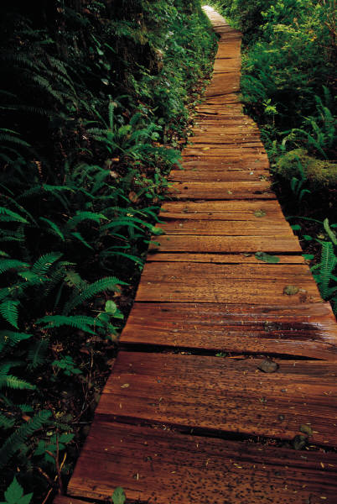
Today’s Agenda
Morning Session
Welcome and Introductions
Understanding the Foundations of the CCS
Supporting Change
Understanding the Standards for Mathematical
Practice: Developing Mathematical Expertise
Afternoon Session
Supporting Students to Make Sense of Problems
and Persevere in Solving Them
Attending to Precision in Every Lesson
Teaching the Standards for Mathematical Practice
Planning for Change
Next Steps
Post- Assessment, Session Evaluation, and Wrap Up
Notes:
Review the agenda letting participants know that this is the pathway they will travel in order accomplish the outcomes discussed earlier. Note that in addition to the 45 minute break for lunch there will also be a morning and afternoon break. Emphasize the importance of coming back from breaks on time to ensure enough time to complete all the work of the day.

Slide 5


Introductory Activity:
Pre-Assessment–CCS Math
Please complete the
Pre-Assessment
Page 5
Notes:
This will be a short self-assessment, which will be found in the Participant Guide on page 5. It will assess where the coaches are now with understanding the implementing the Standards for Mathematical Practice. The participants will complete the same assessment at the end of the session. Allow 3-4 minutes to complete.

Slide 6
Understanding the Foundations of the Connecticut Core Standards
Section 1
Page 7

Slide 7

What do we know?
Discuss: What do you know about the
CCS-Math?
Past
Present
Discuss: How is what you know about the CCS-Math different from what you know about past instruction in mathematics?
Notes:
What do we know? – Have participants take five minutes to answer the first question on the slide by talking with the people at their table. Space has been provided on page 7 for participants to make a list of everything they collectively know about the CCS-Math.
When time is called, debrief the small groups discussions as a large group and chart participants’ key understandings about the CCS-Math. After a list is generated, ask the question ‘how is what they know about the CCS-Math different from what they know about past instruction in mathematics’. Possible answers to listen for include: in the past mathematics focused on basic skills and the CCS require a focus on learning to solve problems and in the past mathematics was taught from perspective of repetitive calculations and now mathematics needs to focus more on solving problems. Use this quick comparison as you proceed to the next few slides that summarize shifts in the CCS. Refer back to participants answers and move quickly through those that the group clearly knows about and linger a bit more on the ones that present new information.
Explain to participants that as you go through the next slides that they can make additional notes in the What do we know about the CCS-Math? on page 7 in the Participant Guide.

Slide 8
What’s in the CCS-Math?
The Standards for Mathematical Content
The Standards for Mathematical Practice
What’s New About the CCS-Math?
Focus
Coherence
Rigor
Notes:
What’s in the CCS-Math? There are two parts to the Connecticut Core Standards for Mathematics, Standards for Mathematical Content and Standards for Mathematical Practice. Together they define what students should understand and be able to do in their study of mathematics in order to be College and Career Ready.
The Standards for Mathematical Content are very specific about concepts, procedures, and skills that are to be learned at each grade level, and contain a defined set of endpoints in the development of each. Explain to participants that while today’s focus is on the Standards for Mathematical Practice, we will be going in-depth into the Standards for Mathematical Content in the next a future session.
Focus participants back on the Standards for Mathematical Practice. Explain that these standards are often simply called the Practice Standards or the practices, and that is the way they will be referred to during the remainder of this session. The practices include the mathematical habits of mind and mathematical expertise that students should develop such as reasoning, communication, making arguments, and modeling.
What’s New About the CCS-Math?
In order to meet both the Content Standards and the Practice Standards, the writer’s of the Common Core explicitly based the standards on three very important fundamentals of mathematics that were missing from or were not as explicit in different versions of mathematics standards. Those are: Focus, Coherence, and Rigor. Explain to participants that we will now take a few moments using the next five slides to explore how these are embedded within the Common Core.

Slide 9
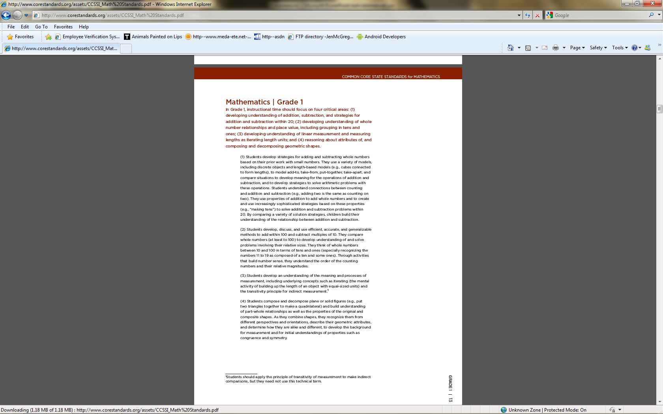
Focus
Fewer standards allow for focusing on the major work for each grade.
Notes:
Focus: The writers of the standards worked very hard to reduce the number of expectations at each grade level. This work was not done arbitrarily. They focused on the different domains of mathematics such as Operations and Algebraic Thinking, Number and Operations in Base Ten, Geometry, and Measurement and Data, and determined what work was critical for students at each grade level to address in order to develop the concepts in each domain over time. This reduction in the number of standards allows teachers to shift their instruction to focus on the major work at their grade and to spend more time in each of these critical areas in order for students to develop a deep understanding through investigation, inquiry, and problem solving.

Slide 10
Coherence
The standards are designed around coherent progressions and conceptual connections.
Grade 1
Grade 2
Grade 3
Use place value understanding and properties of operations
to add and subtract.
Use place value understanding and properties of operations
to add and subtract.
Use place value understanding and properties of operations to perform multi-digit arithmetic.
Notes:
Coherence: Coherence means ensuring that there is a clear sequence of concepts and skills that build on each other across the grades. In the example of Coherence in the Participant Guide on page 8, point out the grade 1 standard 4 and grade 2 standard 5. The connection between these is that in grade 1, students add within 100 using strategies, concrete models, etc. Then, in grade 2, students are expected to fluently add and subtract within 100. Then point out the grade 2 standard 7 and grade 3 standard 2 to show a similar progression for adding and subtracting within 1000.

Slide 11
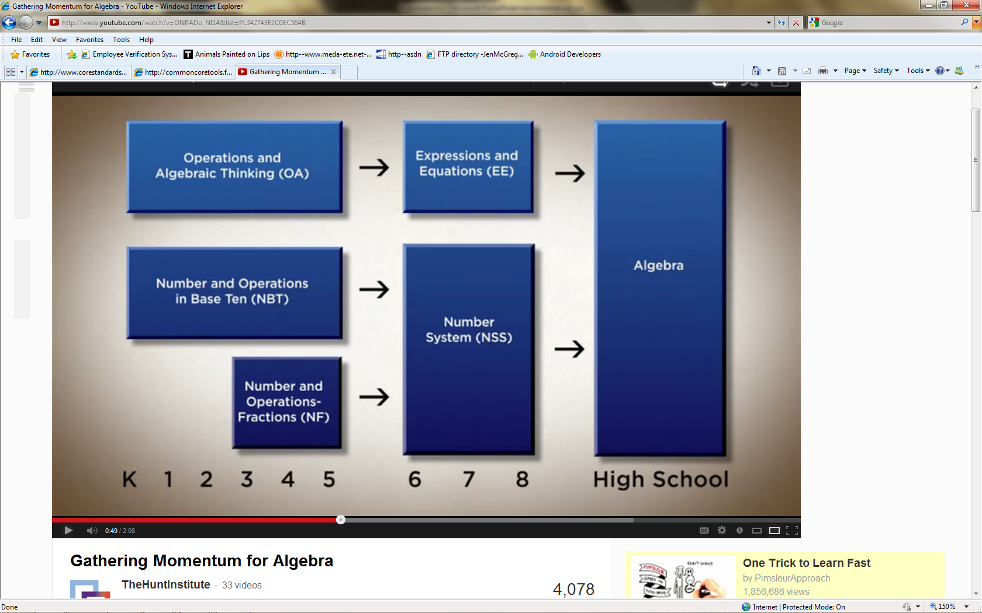
Coherence
The Standards are designed around coherent progressions and conceptual connections.
Notes:
Coherence: The chart on the slide shows one of the progression in the CCS-Math that builds up to algebra in high school. Note that the Operations and Algebraic Thinking standards in grades K–5 lead up to and are designed to help middle school students work with Expressions and Equations, which will then help students to be successful in high school algebra. This same progression takes place with the Number and Operations domains. In K–5 the Number and Operations standards are split over two domains, Base Ten and Fractions. This does not mean that the standards within the domains are not connected, but that there is a focus on each. Fractions are not explicitly focused on until 3rd grade, after students have formed a foundation for Base Ten. Deep work over time within these two Number and Operations domains will support middle school students to be able to work within the Number System, supporting further success as they progress into high school algebra.

Slide 12
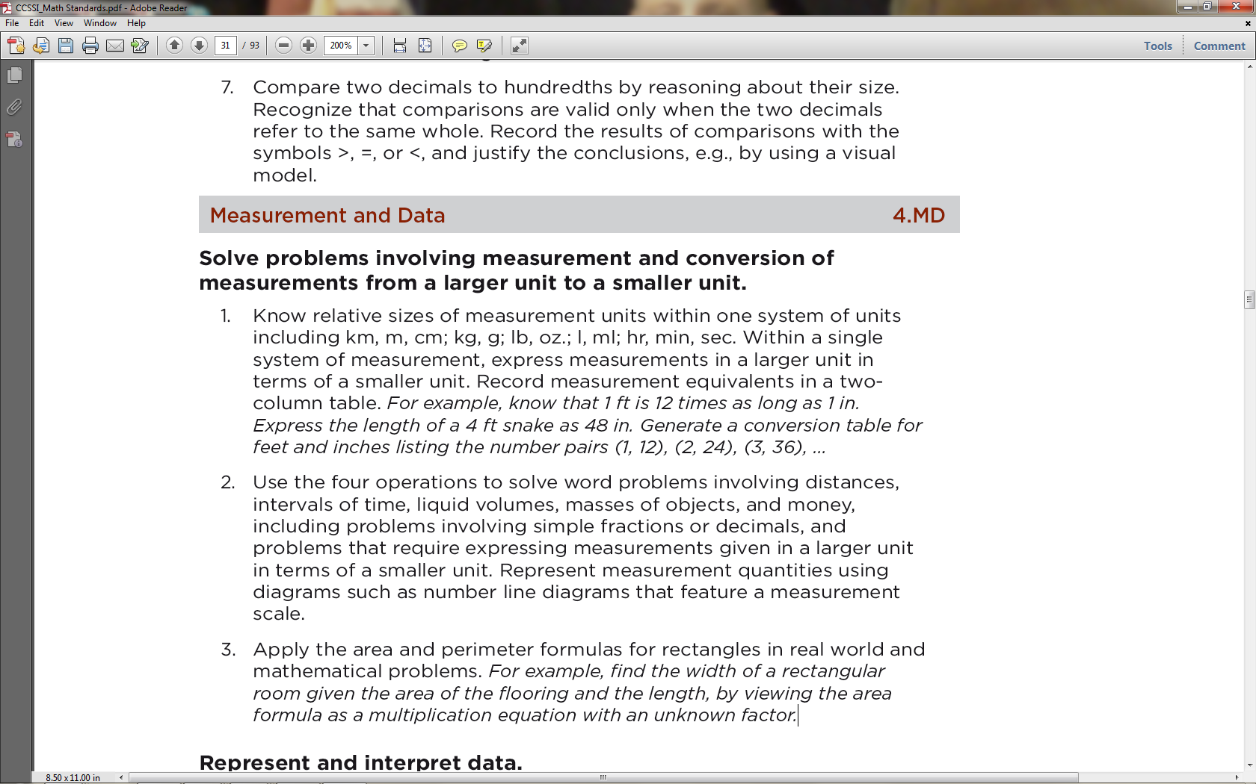
Coherence
The standards are designed around coherent progressions and conceptual connections.
Notes:
Coherence: Coherence also means ensuring that connections and relationships among ideas are highlighted and made clear. Students should see each standard as an extension of previous learning, not as a new and separate chunk. The arrows on the slide are pointing to examples of key pieces of learning from other domains being integrated into the standards in the Measurement and Data domain, such as using operations to solve word problems covering domain specific topics of time, distance, volume (etc.), using number lines to represent measurements, and using equations to solve domain specific mathematical problems. Each of these examples shows how learning gained in other domains such as Number and Operations in Base Ten and Operations and Algebraic Thinking crosses over into the domain of Measurement and Data.

Slide 13
Rigor
The major topics at each grade level focus equally on:
Conceptual Understanding
More than getting answers
Not just procedures
Accessing concepts to solve problems
Procedural Skill
and Fluency
Speed and accuracy
Used in solving more complex problems
Comes after conceptual understanding
Application of the Mathematics
Using math in real-world scenarios
Choosing concepts without prompting
Notes:
Rigor: Rigor means learning that is based in the deep understanding of ideas AND fluency with computational procedures AND the capacity to use both to solve a variety of real world and mathematical problems. Tell participants that conceptual understanding, procedural skill and fluency, and application of mathematics will be addressed in much more depth in future modules when we discuss planning lessons around specific content learning goals and when we discuss how to assess both the Practice and the Content Standards.

Slide 14
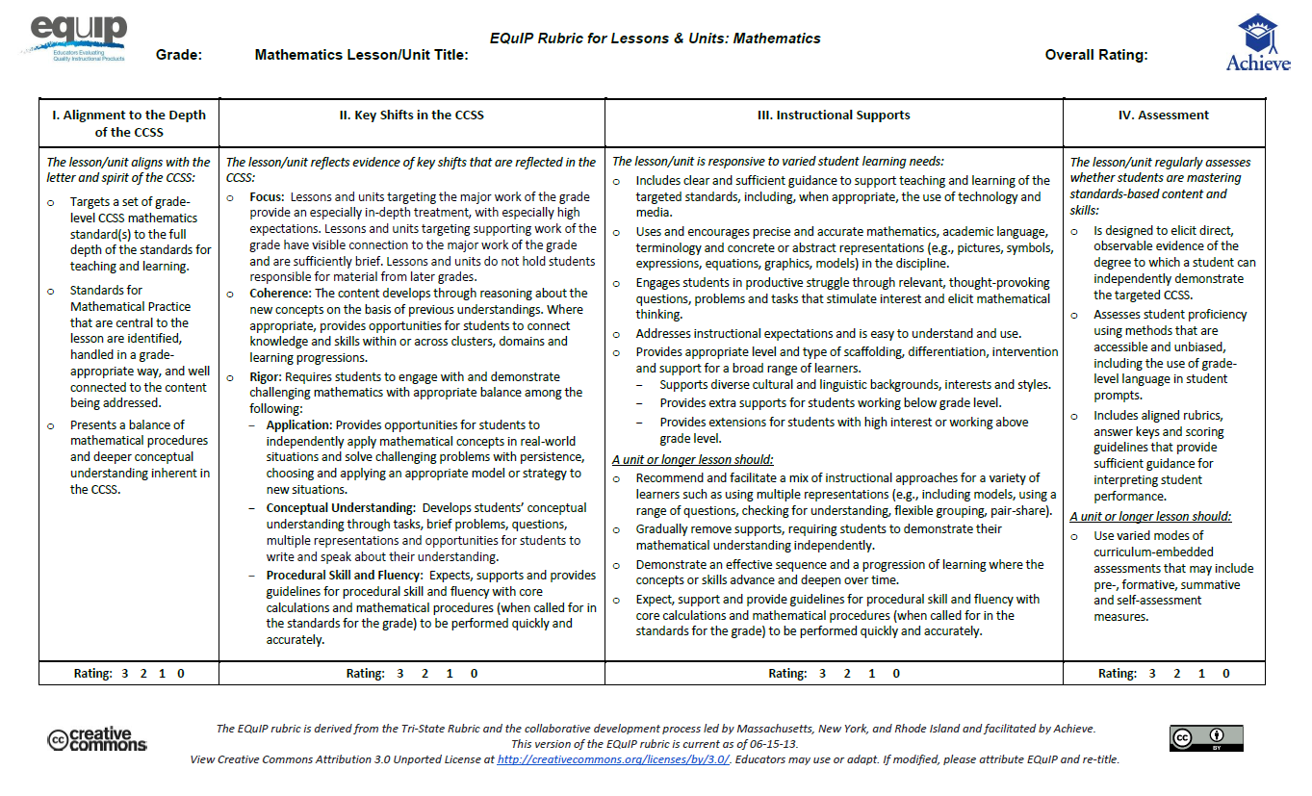
The Impact of the Shifts
Notes:
The Impact of the Shifts: Distribute copies of the EQuIP Rubric. Explain to participants that the EQuIP Rubric is a tool for evaluating CCS-Math lesson plans. Allow participants to review the rubric on their own and then as a group. As they discuss the rubric in their groups, ask them to think about their responses to the comparison of mathematics instruction in the past and in the present that were provided in the first activity of this section and to think now about how those changes will impact planning, teaching, and learning at the classroom level. Debrief the small group discussions by adding to the chart of what participants know about the CCS-Math.

Slide 15
The Personal Journey of the CCS
Questions | Answers
Notes:
The Personal Journey of the CCS: Explain to participants that before they move on the next section, you want them to take a moment to write down, in the Questions column in the chart on page 10, any questions that they personally have right now about the CCS-Math. Further explain that throughout this and future sessions they can refer back to their list of questions and document the answers as they are found.

Slide 16

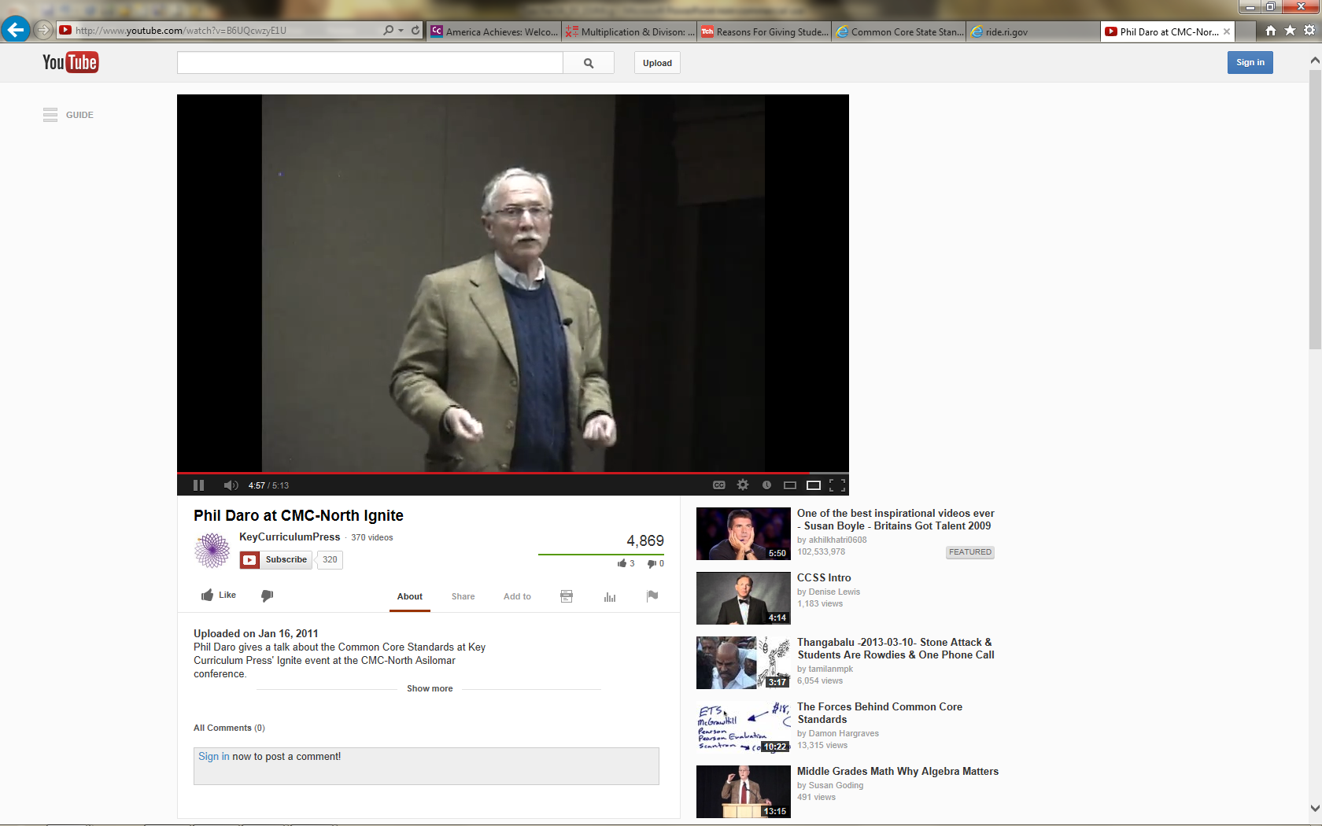
Phil Daro Co-Author
Common Core State Standards for Mathematics
Phil Daro at CMC-North Ignite
http://www.youtube.com/watch?v=B6UQcwzyE1U
Notes:
Phil Daro: Tell participants that to find answers to their questions they will now hear from Phil Daro, one of the major figures involved in writing the Common Core Standards and a professor at Stanford University, as he discusses what mathematics instruction should look like in the era of the Common Core and the need for change in mathematics teaching and learning. Play the video and then wrap-up Section 1 by debriefing the video with participants as a large group. Use the overarching topic of change to transition to Section 2, in which participants will begin to look at their role in helping teachers make the changes within their classroom that have been discussed.

Slide 17
Supporting Change
Section 2
Page 12
Notes:
Section 2: Supporting Change
Section 2 Training Objectives:
To understand the stages of change that teachers will go through as they work through their implementation of the CCS.
To practice the process for setting norms within a learning group in order to anticipate how they will support teachers through their stages of change.
Section 2 Outline:
Participants will first be introduced to the stages of change and will discuss the implications of working with teachers through these stages. A focus will be placed on creating a professional learning environment in which teachers feel comfortable in expressing their ideas, strengths, and challenges on their personal implementations of the CCS.
Participants will then go through the process of setting norms for working within their professional groups in this session as a way to model the types of considerations that will need to be made back at their school. As they engage in this process, participants will work in their group to answer questions such as: In a conversation what is something that encourages you to speak your mind? What is something that deters you from expressing your ideas? Responses will be recorded on chart paper. Later, in Section 4, when perseverance is addressed, these norms will be referenced as a way to look at creating a classroom environment in which the Standards for Mathematical Practice can be developed.
Supporting Documents
Stages of Change
Creating an Environment for Personal Change
Materials
Chart paper, markers

Slide 18
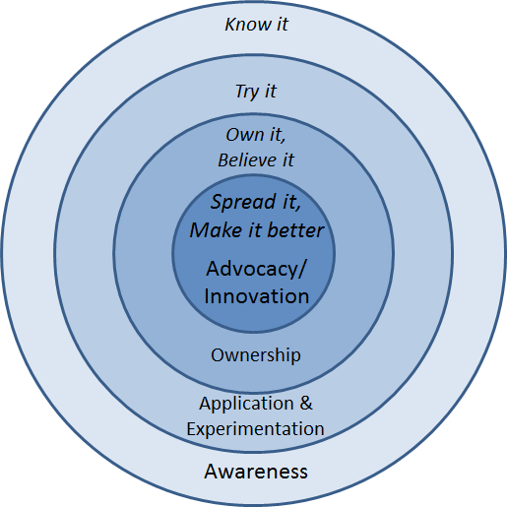
Change Isn’t Easy
Stages of Change
  Achievethecore.org
Notes:
Change Isn’t Easy: Explain to participants that change is often difficult, and full implementation of the new standards cannot and will not happen overnight. It will be a process. In this regard, it is helpful to think about the stages of change and celebrate progress through the stages. Note that the chart on the slide has been provided on page 12.
Review the stages as follows:
Stage 1 is Awareness – simply knowing what is being asked and what it means
Stage 2 is Application and Experimentation – Getting your toes wet, trying out new strategies and perspectives
Stage 3 is Ownership – That’s the moment you get buy-in; you believe in the change and take it on personally
Stage 4 is Advocacy and Innovation – This is the point where you are proficient and can help others and make improvements in the work itself.
Let participants know that, as coaches, they should look for signs of where people are and find appropriate ways to support them where they are, and to leverage current stage. They need to understand that for many teachers the CCS-Math may represent a new way of understanding math themselves.
It’s also important to know where you are as a coach on this road and to keep yourself moving, celebrating the progress you make and simultaneously preparing for the next steps.
After reviewing the stages, ask participants to think about where the teachers in their school are now and how they can help teachers work through these stages of change. Depending on where each school is in their implementation of the CCS, some teachers may only be a the Know It stage, while others may be at the Try It stage or beyond. For those that are at the Know It stage, participants will need to think carefully about the information being presented within each module in order to determine how they will bring the information back to teachers. They will also need to consider how they will help teachers to implement strategies that will be presented in order to help teachers to move to the Try It stage. Knowing where teachers are in the change process will help participants frame their goals for each session in terms of what they need to do to help teachers move forward towards Advocacy and Innovation.
Transition to the next activity by explaining to participants that because teachers are all at a different place with the change process, the environment for change needs to be one that supports each individual. Transition to the next activity by explaining that one way they can begin to shape the environment for change is to have teachers set norms for how they will work together and discuss the changes that are taking place.

Slide 19


How can we work well together?
Creating an Environment for
Personal Change
In a conversation, what is something that encourages you to speak your mind?
What is something that deters you from expressing your ideas?
Notes:
Creating an Environment for Personal Change? Ask participants to silently answer the questions on page 13. Tell them that when everyone at the table has written their answers, they share responses, noting any features of conversation that seem really important in facilitating comfort and productivity. Then ask participants to share one or two important ideas from each table. As they share, chart the responses. Develop a consensus around the list for how participants will try to keep the conversation comfortable and productive for everyone. Hang the completed list on the wall as later, when perseverance and student discourse are addressed, these norms can be referenced. Explain that these norms for working together will be used throughout the work that participants will do within each module and that this is a process that they can use back at their school to help teachers begin to get comfortable with working with each other through the changes required by the CCS.

Slide 20

Let’s Take A Break…
…Be back in 10 minutes
Notes:
The break should be 10 minutes. Remind the participants to try to be timely in their return. When participants return, we will look at Instructional Shifts 2 and 3.

Slide 21
Understanding the Standards for Mathematical Practice: Developing Mathematical Expertise
Section 3
Page 15
Notes:
Section 3: Understanding the Standards for Mathematical Practice: Developing Mathematical Expertise
Section 3 Training Objectives:
To introduce all eight of the Standards for Mathematical Practice and adapting the language of the practices to make each grade level appropriate without reducing rigor.
Section 3 Outline:
Section 3 begins with participants solving problems that are each aligned to one of the Standards for Mathematical Practice.
The facilitator then provides information on each of the eight practices, including information about the standard, what the standard means, instructional supports for helping students to develop the practice, and sample “I Can” statements. Throughout the presentation participants will answer questions and work in groups to determine which of the problems was an example of the Practice, and to create grade level “I Can” statements for each of the practices based on their new understanding of each practice.
3. The section wraps up with teachers discussing how they would pair the practices based on their attributes and then being shown Bill McCallum’s Mathematical Practices Grouping Chart.
Supporting Documents
Problem Set: Practice Standards Alignment
Activity 3: Understanding the Mathematical Practices
Materials
Chart paper, markers
Key Implementation Notes:
In this activity participants will work sample problems that will help them to understand what each of the Standards for Mathematical Practice look like in a classroom situation. Participants will work the problems without knowing the Practice Standard they are most aligned with and the alignment is revealed later during the presentation.
Begin the activity by asking participants to form eight GRADE LEVEL table groups. Once grade level groups have been formed, ask participants to turn to the Problem Set in their Participant Guide on pages 15-16. Number the groups. Teachers should work the problem that coincides with their group number. Participants should work the problem individually and hold off on the group discussion until directed to do so during the presentation of each of the Practice Standards.
While participants are working the problems, hang eight pieces of chart paper around the room. Each piece of chart paper should be labeled with one of the practices. After participants finish working the problems in the Problem Set tell them to move around the room and rate their personal understanding of each of the practices. They should use a rating scale of 1–5 with 1 having little or no understanding and 5 having a deep understanding of the practice. This exercise will allow you to gauge participants’ understanding of the practices and help you to determine the pace of the Practices Presentation.
During the interactive presentation on all eight of the practices, participants will need their copy of the Standards for Mathematical Practice. Suggest that participants use the Understanding the Mathematical Practices to make notes and answer questions in each of the designated areas.
Note: You should spend approximately 5-7 minutes per practice for the first four practices, and then 20-25 minutes on the small group discussions of the last four practices and 5-10 minutes debriefing the small group discussions.

Slide 22
SMP1: Make sense of problems and persevere in solving them
What does it mean to make sense of a problem?
What does it mean to persevere in solving a problem?
Notes:
SMP1: Have participants think for a moment about the questions on the slides. Ask for one or two volunteers to share their answer to the questions. Responses that you want to listen for include points such as:
Making sense of a problem means that students are able to break the problem into usable parts and determine how each part will be used to answer the question.
Making sense of a problem means that students are able to use the information in the problem to determine the final questions to be answered.
Persevering in solving a problem means that students ‘stick with it’ and do not give up when they find themselves challenged.
Persevering in solving a problem means that students are able to ask questions about the problem that will help them clarify points of the problem and make the final problem question make sense rather than wait for someone to tell them how to solve the problem.
These two questions are answered in more depth over the next four slides.

Slide 23
SMP 1: Make sense of problems and persevere in solving them
Mathematically proficient students:
Understand the meaning of the problem
Look for ways to start working on the problem
Analyze the information
Design a plan
Monitor and evaluate their progress
Change course as necessary
Check their answers to problems
Know if their answer makes sense
Notes:
SMP1: Review the check list of attributes on the slide. As you get to the end of the list, ask participants who had a problem that required them to do a number of these things as they came up with a solution. Allow groups a minute to discuss with their group to determine if their problem was the one aligned to this practice.
Note: Participants may say that all of the problems had some element of this practice, however, the problem on the next slide was chosen because it exemplified this practice more than any of the others.

Slide 24

SMP1: Make sense of problems and persevere in solving them
Jack collected hats. He collected
both baseball team and football team hats and he wanted to hang his hat collection on his wall. He started with 16 baseball team hats and some football team hats. In the morning he hung 22 hats. If you knew how many football team hats he started with, how could you figure out how many hats he needed to hang in the afternoon?
Notes:
SMP1: Explain that this problem was chosen as the most closely aligned to this practice. Ask for a volunteer from the group who worked this task to walk through this alignment. Key things to bring out:
There is an amount that is unknown so participants have to understand all of the elements of the problem to determine how that unknown amount would be used.
Students may be uncomfortable thinking about a problem that has this level of ambiguity. They will have to work through this discomfort in order to successfully answer the question in the problem. Note that this means that to be successful, we need to provide frequent opportunities to deal with ambiguous problems as well as strategies for how to approach such problems.

Slide 25
SMP1: Make sense of problems and persevere in solving them
Instructional Supports:
Don’t be afraid to challenge students!
Ask clarifying questions such as:
  What is the problem asking?
  How could you start the problem?
  What tools might be helpful?
  How can you check this?
  Does you answer make sense?
  How could you make this easier?
Notes:
SMP1: Review the instructional supports on the slide. Note that the first support or idea “don’t be afraid to challenge students” will be seen throughout the practices. Ask participants what they think it means to challenge students. As participants discuss, focusing their thinking on how to challenge students by requiring students to really think about the mathematics. The Common Core is not about learning how to get an answer as we heard Phil Daro discuss. The Common Core is about learning to solve problems. Solving problems is much more rigorous than getting answers. Students need to be challenged to gain conceptual understanding of the mathematics being taught to reach a point of being able to recognize, on their own without prompting, when to apply the mathematics that they have learned to solve problems in new situations. This will be challenging and possibly uncomfortable for many students. However students will need to be challenged, and supported, in order to develop their mathematical expertise.

Slide 26
SMP1: Make sense of problems and persevere in solving them
Instructional Supports:
Create ‘I Can’ statements for your students so they know what is expected.
Example 1
I can tell you what the problem is asking me to do.
Example 2
I can solve problems without giving up.
Notes:
SMP1: Review the ‘I Can” statements on the slide. Ask participants if they would add any statements here that would better fit students at their grade level. As volunteers provide their statements, make sure that they align with the practice so that students are receiving the correct information.

Slide 27
SMP2: Reason abstractly and quantitatively
What does it mean to reason
Abstractly?
Quantitatively?
Notes:
SMP2: Review the questions on the slide. Allow participants to think for a moment and then ask for volunteers to share their answers.
As you listen to participants’ answers, listen for things such as:
Reasoning abstractly means to reason within a context or within a situation, form theories, understanding problems on a complex level through analysis and evaluation, and having the ability to know what and when to apply knowledge when solving problems.
Reasoning quantitatively means to apply their mathematical skills to solve a problem. Students understand the values that they are working with and are able to relate those to the problem itself.
Again these questions will be answered in more depth over the next four slides.

Slide 28

SMP2: Reason abstractly and quantitatively
Mathematically proficient students:
Make sense of quantities and relationships
Represent a problem symbolically
Considers the units involved
Understand and use properties
of operations
Decontextualize
Contextualize
Notes:
SMP2: Review the points on the slide. At the end of the list, know that some participants may not understand what it means for students to able to decontextualize and contextualize. To decontextualize means to be able to pull the values out of the problem situation and do the work with them that needs to be done. For example, in the problem Olivia has 4 apples and Sophia has 6 apples. If they both give their apples to Anna, how many apples will Anna have? When decontextualizing students are able to represent the problem as 4+6=10. And then to contextualize they are able to put the final values back in to the problem situation. If students were given the number sentence 4+6=10 and are able to create a problem situation that makes the number sentence, this would be considered contextualizing as well.
Before moving to the next slide ask participants to look at the problems they solved and determine whose problem would be aligned with this practice.

Slide 29

SMP2: Reason abstractly and quantitatively
Fourth graders are going on a field trip. There are 167 students going. How many buses are needed for the trip if each bus can hold 48 students?
Notes:
SMP2: Reveal that the ‘field trip’ problem was chosen as most aligned to this practice because not only do students need to apply the practice when working the problem, but they must also think about their answer within the context of the problem itself. While 167 divided by 48 gives us an answer of 3.47 or 3 with a remainder of 23, a student cannot use their calculated answer to solve the problem because the problem is not asking them to solve 167 divided by 48. The problem is asking them to determine how many buses are needed. Division is one tool that can be used to determine this. Others are estimating, rounding, etc. The final answer is that 4 buses are needed.

Slide 30
SMP2: Reason abstractly and quantitatively
Instructional Supports:
Don’t be afraid to challenge students!
Ask clarifying questions such as:
  What does the number___ represent in the problem?
  How can you represent the problem with symbols and numbers?
  Does your answer fit what the problem is asking?
Notes:
SMP2: Review the instructional supports on the slide.

Slide 31
SMP2: Reason abstractly and quantitatively
Instructional Supports:
Create ‘I Can’ statements for your students so they know what is expected.
Example 1
Example 2
Example 3
I can represent the problem with math symbols and numbers.
I can read the problem and write it as a number sentence.
I can tell if my answer fits the problem.
Notes:
SMP2: Review the ‘I Can” statements on the slide. Ask participants if they would add any statements here that would better fit students at their grade level. As volunteers provide their statements, make sure that they align with the practice so that students are receiving the correct information.

Slide 32
SMP3: Construct viable arguments and critique the reasoning of others
“Elementary students can construct arguments using concrete referents such as objects, drawings, diagrams, and actions. Such arguments can make sense and be correct, even though they are not generalized or made formal until later grades.” CCSS-Math
“Students at all grades can listen or read the arguments of others, decide whether they make sense, and ask useful questions to clarify or improve the arguments.” CCSS-Math
Notes:
SMP3: Ask volunteers to read the two quotes on the slide aloud. Ask participants to tell you some thoughts or key words that jump out at them and to chart their responses so that there is a visual to discuss. Some things to watch and listen for are: construct arguments, arguments of others, decide, ask useful questions, improve arguments. As participants look at the completed list of their responses on the chart paper, have them think about what is not said. After a 30 second wait time, explain that this practice is not just about students just explaining their work. It is about students telling why what they did works, or didn’t work. Remember, it is important for students to know and understand where something went wrong. Not knowing why something did or did not work can lead to misconceptions. Critiquing the reasoning of others does not mean to simply tell if another student got the answer right or wrong. It means that a student has to understand a peer’s approach and be able to tell why the mathematics behind that approach worked or did not work.
Use the next four slides to support these two quotes.

Slide 33
SMP3: Construct viable arguments and critique the reasoning of others
Two more points…
Mathematically proficient students:
Use definitions and previously established results in constructing arguments
Make conjectures and attempts to prove or disprove through examples and counterexamples
Continuous
Notes:
SMP3: Go over the points on the slide and further emphasize to participants that this practice is continuous as in “ongoing.” Constructing viable arguments and critiquing the reasoning of others is something that should be done in small and large group discussions, in students’ own work, etc. This should happen all the time! Before moving on, have participants determine which of the problems best align with this practice.

Slide 34

SMP3: Construct viable arguments and critique the reasoning of others
Using pennies, dimes, and quarters, how many different ways can you make $0.58?
How do you know that there are
no other ways?
Notes:
SMP3: Explain that this problem was chosen because students have to justify their answer using mathematics. In a classroom situation, this would be a good problem to have students compare answers and strategies for answering the question. If different answers are given, have students examine each other’s approach and determine whose was correct and why. Ask participants if anyone currently does this in their classroom and if so, have them describe the strategies that they use. Allow other participants to ask questions. The next two slides provide additional instructional supports.

Slide 35
SMP3: Construct viable arguments and critique the reasoning of others
Instructional Supports:
Don’t be afraid to challenge students!
Create tasks that directly involve argumentation and critique.
Ask questions such as:
  How can you prove that your answer is correct?
  What examples could prove or disprove your argument?
  How is your answer different from _____’s answer?
  What questions do you have for_____?
Notes:
SMP3: Review the instructional supports on the slide

Slide 36
SMP3: Construct viable arguments and critique the reasoning of others
Instructional Supports:
Create ‘I Can’ statements for your students so they know what is expected.
Example 1
Example 2
Example 3
I can use math words to explain my thinking.
I can prove my answer is correct.
I can ask questions about others’ work.
Notes:
SMP3: Go over the ‘I Can’ statements on the slide and ask participants if they would add anything to the list. Allow volunteers to share their ideas and then move to the next Practice.

Slide 37
SMP4: Model with mathematics
What does it mean to model with mathematics?
Notes:
SMP4: Ask participants to think about the question on the slide and explain that Practice 4 is one that tends to be interpreted rather narrowly. Modeling with mathematics is not just about building a concrete model or drawing a picture. It is more about doing those things to diagnose a mathematical problem and, based on the model, develop an equation or number sentence that makes sense for the problem. There is more on this over the next four slides. Before moving on, ask participants which of the problems in the Problem Set best aligns to the Practice of Model with Mathematics.

Slide 38
SMP4: Model with mathematics
Mathematically proficient students:
Apply reasoning to create a plan or analyze a real world problem
Apply formulas/equations
Make assumptions and approximations to make a problem simpler
Check to see if an answer makes sense and changes a model when necessary
Young students may use concrete materials to help them make sense of a problem. With modeling, the expectation is that they will translate what is happening with those concrete materials into a number sentence.
Notes:
SMP4: Review the points on the slide and have participants look hard at the purple text at the bottom of the screen as this is an extremely important point.

Slide 39

SMP4: Model with mathematics
How many students are in your school? You don’t have to tell me the exact number but you should be close.
Notes:
SMP4. Explain that in this problem students will generally have to come up with some type of model that will help them determine how to solve the problem. It also requires them to make assumptions and estimations which are also an important part of this practice.

Slide 40
SMP4: Model with mathematics
Instructional Supports:
Don’t be afraid to challenge students!
Do not interpret the standard too narrowly.
Provide a problem and explicitly ask students to write the equation or number sentence called for in the situation.
Provide a model and ask students to create a situation that matches.
Apply a C-R-A sequence when helping students to progress their thinking.
Notes:
SMP4: Review the instructional supports on the slide. When you get to the last point ask participants if they have heard of a C-R-A approach? If some have, ask them to explain this approach to the others. If no one has, explain that it is a continuum that they should use with students as they work through problems. Start with the concrete (C) such as using counters or cubes, move to the representational (R) such as pictures and drawings (things you have to create on paper that you cannot hold in your hand and physically manipulate), and then to the abstract (A) using mathematical symbols. As students work through problems they can go back and forth on this continuum. For example, if a student is having trouble at the abstract stage, go back a stage until they are successful and then move forward again.

Slide 41
SMP4: Model with mathematics
Instructional Supports:
Create ‘I Can’ statements for your students so they know what is expected.
Example 1
Example 2
I can show my work in many ways.
I can use math symbols and numbers to solve the problem.
Notes:
SMP4: Go over the ‘I Can’ statements on the slide. Ask participants if they would add anything to the list that would make these statements more grade level specific. After volunteers have given their statements, move to the next practice.

Slide 42
Two Sentence Summary
With your grade level team, create a two sentence summary of what the practice will look like in YOUR classroom.
Write your summary on the designated chart paper.
Notes:
Two Sentence Summary: Around the room, hang pieces of chart paper that are labeled with the first four practices. There will need to be three pieces of chart paper per practice. On the first sheet divide the space in half so that K and 1st grade each have half of the piece on which to write their summary, 2nd grade and 3rd grade on the second sheet, and 4th and 5th on the third sheet. Allow participants 10 minutes to complete this portion of the activity and then move on to the last four practices.

Slide 43

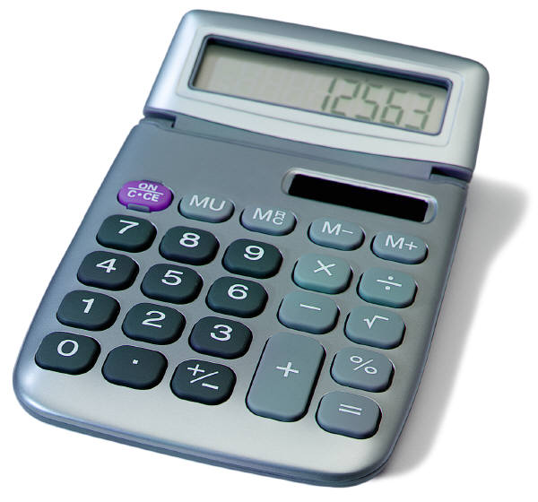
SMP5: Use appropriate tools strategically
What tools do students have available?
Notes:
SMP5: Have participants brainstorm a list of the tools that students have available to them in and out of the classroom and chart their responses. If not brought up by participants, suggest tools such as tens frames, number lines, word walls, multiplication charts, their own previous work (fraction scripts, etc). These are things that we may not normally think of as tools but that can be used strategically when solving problems.

Slide 44
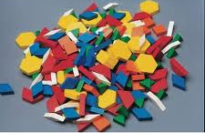
SMP5: Use appropriate tools strategically
Mathematically proficient students:
Identify relevant math resources and use them to pose or solve problems
Make sound decisions about the use of specific tools
Use technological tools to explore and deepen understanding of concepts
Notes:
SMP5: Review the points on the slide and ask participants to determine which problem from the Problem Set most closely aligns with this practice.

Slide 45
SMP5: Use appropriate tools strategically
Arrange the fractions 4/9, 5/8, and 7/12 in order from least to greatest without making common denominators or using decimals.
⁴/₉ ⁵/₈ ⁷/₁₂
Notes:
SMP5: Now that participants have had practice looking at four other problems and determining the alignment to the practices, have them talk for a moment at their tables and determine why this problem was chosen to represent the practice of Use appropriate tools strategically. As participants talk, points that you will want to listen for—and raise if not mentioned—include:
To solve this problem without using common denominators or decimals will require most students to find some sort of tool with which to compare the size of these fractions. This can be in the form of pattern blocks, fraction strips, number lines, etc.
There are those students that may be able to skip the tool by using common numerators or by reasoning about the size of the fractions. However, most will still need a tool at this point in their mathematical development.
Note to facilitator: Some problems, such as this one, have restrictions put in because participants are solving these as adults and they may automatically go straight to an algorithmic solution. Students may not know these ways, thus the need for the restrictions.

Slide 46
SMP5: Use appropriate tools strategically
Instructional Supports:
Don’t be afraid to challenge students!
Have students brainstorm tools that they might use to solve the problem during the problem introduction.
Use students’ prior knowledge about how they used tools to solve other problems.
Make a variety of math tools available.
Have participants evaluate their choice of tool after they have solved to problem.
Notes:
SMP5: Review the instructional supports on the slide.

Slide 47
SMP5: Use appropriate tools strategically
Instructional Supports:
Create ‘I Can’ statements for your students so they know what is expected.
Example 1
Example 2
I can use math tools and explain why I used them.
I can use pictures, drawings, and objects to solve a problem and explain how I used them.
Notes:
SMP5: Review the ‘I Can’ statements on the slide and ask participants if they want to add anything to make these grade level specific. Ask for volunteers to share their thoughts and then move to the next practice.

Slide 48
SMP6: Attend to precision
Two things we know to be true
The study of mathematics entails the use of academic language and the more it is used, the better the communication.
Getting a correct answer is still important.
Notes:
SMP6: Review the two points on the slide. Explain that while we have to focus much of our attention on how students think and reason within mathematics, we do still want them to be precise as well.

Slide 49

SMP6: Attend to precision
Mathematically proficient students:
Communicate precisely using clear definitions
State the meaning of symbols, calculate accurately and efficiently
Provide carefully formulated explanations
Label accurately when measuring and graphing
Notes:
SMP6: Review the points on the slide.

Slide 50
SMP6: Attend to precision
What makes a square a square?
What makes a rectangle a rectangle?
Is a rectangle a square?
Is a square a rectangle?
Notes:
SMP6: Have participants work for 3 minutes in their small group to determine what specific academic language/terms students would need to attend to when answering these questions from the Problem Set.

Slide 51
SMP6: Attend to precision
Instructional Supports:
Don’t be afraid to challenge students!
Be vigilant. Precision should become habit.
Model the standard. Students will speak the language that you speak.
Ask questions such as:
  What does the term/symbol ____ mean?
  What math words can you use?
  What labels will you need to use?
  Have you labeled everything correctly?
Notes:
SMP6: Review the instructional supports on the slide.

Slide 52
SMP6: Attend to precision
Instructional Supports:
Create ‘I Can’ statements for your students so they know what is expected.
Example 1
Example 2
I can work carefully and check my work.
I can use math words to talk about my work.
Example 3
I can use math words, symbols, and notations correctly in all of my work.
Notes:
SMP6: Review the ‘I Can’ statements on the slide and ask participants if they would add any to the slide to make them more grade level specific. After volunteers make suggestions, move to the next practice.

Slide 53
SMP7: Look for and make use of structure
What do they meant by “structure”?
Notes:
SMP7: Ask participants to think about the question on the slide and in their table groups try to come up with an answer to describe structure in mathematics. If participants struggle with this let them know that its ok. Practice 7 and 8 are the two of the most difficult Practices for teachers to visualize. This is due in part to the language that is used within the Practice which doesn’t always align to the language that would be used at the elementary level. An example to give participants of structure is base ten. Ask participants to think about how our number system is built off of base ten and all of the ‘things’ that we can do in mathematics because of our base ten structure. When students look for and make use of structure, they can see the systems of ‘10s’ in place value or understand regrouping based on 10s. The next four slides will help to better describe this Practice. Also note that we will return to these two Practices when we look at the content standards in Module 6.

Slide 54
SMP7: Look for and make use of structure
Mathematically proficient students:
Look for patterns or structure
Recognize the significance in concepts and models and can apply strategies for solving related problems
Look for the big picture or overview
5 x 7 + 3 x 7 = 8 x 7
Notes:
SMP7: Review the points on the slide. Use the example to further describe the idea of using structure. Students use structure when they understand that 8 x 7 is the same as 5 x 7 plus 3 x 7.

Slide 55

SMP7: Look for and make use of structure
Andrea has 280 pieces of candy and wants to create treat bags with 8 pieces of candy in each bag. How many bags will Andrea be able to make?
Notes:
SMP7: Have participants look at their solution to this problem and determine what mathematical structure they used to solve the problem. Most responses will have to do with the use of division.

Slide 56
SMP 7: Look for and make use of structure
Instructional Supports:
Don’t be afraid to challenge students!
Take your time with this–it WILL come.
Ask questions such as:
  Why does this happen?
  How is ___ related to ___?
  What do you know about ___ that can help you figure this out?
  What patterns do you see?
Notes:
SMP7: Review the instructional supports on the slide.

Slide 57
SMP7: Look for and make use of structure
Instructional Supports:
Create ‘I Can’ statements for your students so they know what is expected.
Example
I can use what I know to solve new problems.
Notes:
SMP7: Review the ‘I Can’ statement on the slide. Ask participants to come up with at least one other statement that can be used at their grade level. After volunteers have shared their statements, move on to the final practice.

Slide 58
SMP8: Look for and express regularity in repeated reasoning
What does repeated reasoning look like?
Notes:
SMP8. To introduce this final, and very challenging practice, have participants think about examples they have seen of students using repeated reasoning in their classroom. This can be as simple as knowing which block comes next based on a pattern, or as complex as being able to determine a function based on the pattern seen in a table, chart, or graph. The next four slides will be used to support this practice.

Slide 59
SMP8: Look for and express regularity in repeated reasoning
Mathematically proficient students:
Notice repeated calculations and looks for general methods and shortcuts
Continually evaluate the reasonableness of their results while attending to details and make generalizations based on findings
Solve problems arising in
everyday life
___ | X | ___ | = | ___
8 | X | 10 | = | 80
9 | X | 10 | = | 90
10 | X | 10 | = | 100
11 | X | 10 | = | 110
12 | X | 10 | = | ?
Notes:
SMP8: Review the points on the slide. Ask participants how students can use repeated reasoning to find the missing value in the chart.

Slide 60
SMP8: Look for and express regularity in repeated reasoning
Solve the following division problems. Use a remainder in your answer.
12 ÷ 8 = ___ 36 ÷ 8 = ___ 804 ÷ 8 = ___
What observations can you make about the problem and your answer?
What generalization can you make that involves a decimal?
Notes:
SMP8: Now challenge participants to look at Problem 5 on page 16. Ask for those that worked this problem to share their solution. A generalization to watch for and to bring out, if not raised by participants, is that whenever you have a problem that incorporates the dividend as the divisor times some number plus half of the divisor your answer will always have a .5 in it. Have participants try this for any number they choose and see if it works. Note that problems such as this require the use of repeated reasoning.

Slide 61
SMP8: Look for and express regularity in repeated reasoning
Instructional Supports:
Don’t be afraid to challenge students!
Take your time–it WILL come.
Ask questions such as:
  What generalizations can you make?
  Can you find a short cut to make the problem easier?
  How could this problem help you solve another problem?
Notes:
SMP8: Review the instructional supports on the slide.

Slide 62
SMP8: Look for and express regularity in repeated reasoning
Instructional Supports:
Create ‘I Can’ statements for your students so they know what is expected.
Example 1
Example 2
I can discover and use shortcuts.
I can use a strategy that I used to solve another math problem.
Notes:
SMP8: Review the ‘I Can’ statements on the slide ask participants one last time to modify these to make them grade level specific. Once volunteers have shared, move to the next slide.

Slide 63
Two Sentence Summary
With your grade level team, create a two sentence summary of what the practice will look like in YOUR classroom.
Write your summary on the designated chart paper.
Notes:
Two Sentence Summary: Around the room, hang pieces of chart paper that are labeled with the last four practices. There will need to be three pieces of chart paper per practice. On the first sheet, divide the space in half so that K and 1st grade each have half of the piece on which to write their summary, 2nd grade and 3rd grade on the second sheet, and 4th and 5th on the third sheet. Allow participants 10 minutes to complete this portion of the activity. Once participants have completed their summaries, have them revisit the chart on which they gave their initial rating of understanding and ask them to change the ratings based on the last hour’s worth of work. Discuss with participants changes in their thinking, what they better understand now, and what they want to do back in their classroom.

Slide 64

Pause and Reflect
Look back at all eight practices.
Is there anything that you want to add to your notes?
Do you have additional questions right now?
Notes:
Pause and Reflect: Allow participants two or three minutes to look back over their notes on the practices and make any needed additions. Before moving to the next slide, ask participants how they might group the standards based on the relationships they see and that we have discussed thus far. The next slide will show an example of how the practices have been grouped by some of the writers of the CCSS-Math.

Slide 65
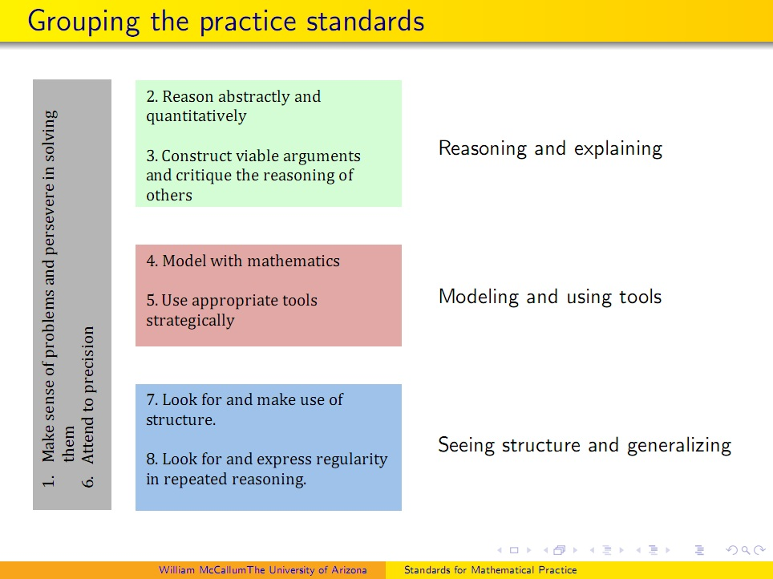
Finding Relationships
Notes:
Finding Relationships: Explain to participants that Bill McCallum, one of the writers of the CCSS-Math, put together this chart to show how the practices can be grouped or organized based on their relationships. Ask participants if they would have grouped them differently and why. If participants are unsure of this grouping, have them look for evidence in the standards themselves that support the organization found here. Further explain that Practice 1: “Make sense of problems and persevere in solving them” and Practice 6: “Attend to precision” are considered the overarching habits of mind of mathematical thinkers. This does not mean that these two practices are somehow more important. It means that these two practices are related to each of the other six practices. If needed, go back and look at the sample problems that were completed for each of the eight practices and have participants find evidence of Practice 1 and Practice 6 in each. When participants are ready to move on, let them know that because of the relationship that Practices 1 and 6 have to the other six practices, we are going to look more in-depth at each of those practices.

Slide 66
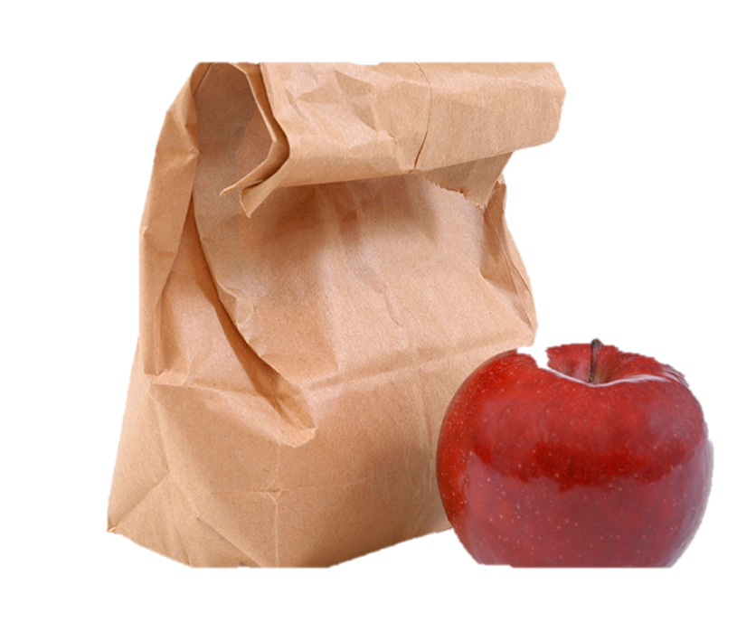
Bon Appétit
Notes:
Remind participants of the need to be timely. Allow 45 minutes. State time to return.

Slide 67
Supporting Students to
"Make sense of problems and persevere in solving them.”
Section 4
Notes:
Section 4: Supporting Students to “Make sense of problems and persevere in solving them.”
Section 4:Training Objectives:
For participants to experience a mathematics task from a students perspective in order to gain a deeper understanding of what it means to make sense of a problem and persevere in solving it.
Section 4 Outline:
1. Participants will begin by working through the Two Machines, One Job task. Participants will debrief the task as a large group and talk about the experience from a personal standpoint. 2. Participants will then work together to discuss what would be needed to help students make sense of this problem and to persevere in solving it. Using this information and the experience of the Two Machines, One Job task, participants will create a description of a classroom environment that is set up to help students “Make sense of problems and persevere in solving them.”
Supporting Documents
Activity 4: Two Machines, One Job
Materials
Chart paper, markers, tape
Key Implementation Notes:
In this activity participants will work a challenging problem and then discuss what information they needed in order to make sense of the problem and how they helped themselves to persevere. Note that this problem is NOT a K-5 problem. However, it was chosen in order to have participants feel, see, and understand what students go through as they work to make sense of problem and persevere in solving them. With that in mind, be sure to move throughout the room as participants work, ask questions that will help participants move forward if they get stuck, and to listen closely as groups work. Make note of interesting comments, ideas, and strategies that you will want to make sure to raise in the large group discussion.

Slide 68
Two Machines, One Job
Ron’s Recycle Shop was started when Ron bought a used paper-shredding machine. Business was good, so Ron bought a new shredding machine. The old machine could shred a truckload of paper in 4 hours. The new machine could shred the same truckload in only 2 hours. How long will it take to shred a truckload of paper if Ron runs both shredders at the same time?
Page 21
Notes:
Two Machines, One Job: Explain to participants that you want to give them an opportunity to see, think, and feel what their students do when solving problems. Have them first read the problem (on the slide and in the Participant Guide on page 26) and take 3 minutes to start working on this lone. When three minutes are up, have participants work in small groups to solve the problem. The first 5 minutes of their group work should entail each group member taking one minute to present their initial thoughts. No one else should talk as they should be in listening mode only. After the 5 minutes of sharing has been completed, have participants work together to expand on those ideas and solve the problem. Give them 20 minutes to work and explain that each group should put their final solution on chart paper. If you see that groups are struggling, stop the work about every 5 minutes and have the whole group discuss where they are, what their thinking is, and strategies that they are trying. This is a good way to help those that are struggling to hear other ideas and perspectives rather than waiting until right at the end. Also, use this time to answer questions that participants might have about the problem. Just be careful not to give away a possible solution with your answers. When time is finally called, have groups share their work and, as a large group, talk about what made this problem challenging, what did they have to do to make sense of the problem, and what it felt like to persevere with this problem. This will give participants a quick look into what we are asking students to do. Also, ask participants to identify specific strategies that you used in order to assist them in persevering with solving this problem. Answers to look for may include strategies such as the following: the questions that were asked, having participants draw a picture, having participants break the problem into smaller parts, and so forth. The goal of this portion of the discussion is to provide examples of instructional strategies that can be used with students to help them persevere when solving challenging problems.

Slide 69
Classroom Environment that Supports Perseverance
Describe the elements of a classroom environment that need to be present in order for students to feel comfortable struggling with problems.
Page 27
Notes:
Classroom Environment that Supports Perseverance. Direct participants attention back to the norms they created for working together as adults and ask them to think about the environment that was created that allowed them to feel comfortable with struggling and persevering with the Two Machines, One Job problem. Now, ask them to think about how those environmental elements translate into the classroom environment. Have participants, on page 27, create a description of a classroom environment that supports perseverance. As time permits, have volunteers share their ideas before moving on to the next activity. Key aspects that need to be brought out in the conversation include, a safe environment for asking questions, an understanding that mistakes are important steps in learning, an understanding that multiple perspectives are helpful in creating a solution strategy, and that there is not always one right way to solve a problem. Transition to the next section by explaining to participants that even though multiple and varied strategies for solving the same problem are promoted within the standards, one thing that must stay constant is students’ attention to the precision of the mathematics.

Slide 70
Attending to Precision in
Every Lesson
Section 5
Page 29
Notes:
Section 5: Attending to Precision in Every Lesson
Section 5 Training Objectives:
To provide participants with a deeper understanding of how to help students attend to precision in classroom lessons.
For participants to begin to identify instructional strategies that can be implemented to help students attend to precision.
Section 5 Outline:
Participants will watch a classroom lesson in which the teacher helps students attend to precision.
In groups, they will then discuss how this teacher gets students to attend to both the precision of the mathematical language and the calculations needed to complete the work.
The facilitator will wrap up Section 5 by charting the instructional strategies identified by the participants and using that list of strategies to transition to Section 6.
Supporting Documents
Video Observations Sheet
Materials
Chart paper, markers
Video
Exploring Math Practice Standard: Precision https://www.teachingchannel.org/videos/exploring-math-practice-standards
Key Implementation Notes:
Explain to participants that when they watch the video of others’ teaching, they need to keep in mind that no one lesson is perfect. The teacher and students sometimes make mistakes, the teacher may do or say something that the participants may find annoying or not in-line with their personal beliefs. However, each video presented as we go forward has been chosen for a distinct purpose and that purpose is the lens through which the video should be observed. For example, in this section the key things for participants to pay attention to are the strategies that the teacher uses to help her students attend to precision within the lesson.

Slide 71
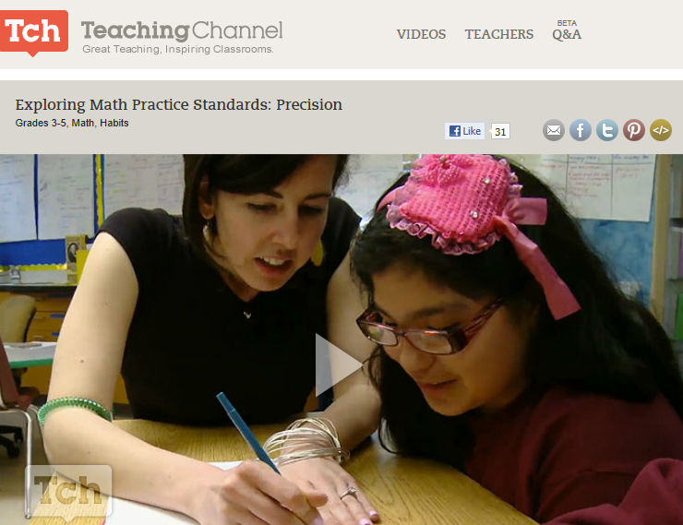
Let’s Observe
Exploring Math Practice Standards: Precision
https://www.teachingchannel.org/videos/exploring-math-practice-standards
Notes:
Let’s Observe: Play the video Exploring the Math Practice Standards: Precision for participants. The video can be found here: https://www.teachingchannel.org/videos/exploring-math-practice-standards on the Teaching Channel website. As they watch, ask participants to use the Video Observation Sheet to record how they observe the teacher helping her students to attend to precision. After the video, debrief the participants’ observations as a large group and chart the strategies identified. Before the break, have participants look back at their questions and fill in any answers that have been found thus far.

Slide 72
Let’s Take A Break…
…Be back in 10 minutes
Notes:
The break should be 10 minutes. Remind the participants to try to be timely in their return. When participants return, we will look at Instructional Shifts 2 and 3.

Slide 73
Teaching with the Standards for Mathematical Practice
Section 6
Page 31
Notes:
Section 6: Teaching with the Standards for Mathematical Practice
Section 6 Training Objectives:
To introduce participants to specific instructional strategies that will promote the development of the mathematics practices.
To help participants plan for the inclusion of the mathematical practices in everyday classroom lessons.
To provide an opportunity for participants to apply the EQuIP Rubric for evaluating lesson plans.
Section 6 Outline:
Participants are first engaged in an exploration of the instructional strategies of asking effective questions, engaging students in mathematical discourse, and teaching and learning mathematics through multiple representations. Through their exploration, participants will engage in a discussion around how these strategies can be used to help students develop the mathematical practices.
Participants will then use this information to assist in an examination of a sample lesson plan through the lens of the EQuIP Rubric. During the lesson examination, participants will focus only on sections of the rubric that specifically discuss the Standards for Mathematical Practice.
Participants will build off of this experience and work within a small group to plan a set of instructional suggestions around a given mathematics task that teachers could use with students and that will meet the expectations set forth in the EQuIP. The facilitator will wrap up Section 6 by having participants discuss their experience and identify possible teacher questions and challenges that they may encounter back at their school.
Note to facilitator: Item #5 on the Asking Effective Questions (page 31) mentions Bloom’s Taxonomy. In Connecticut, and in alignment with the SBAC Content Specifications, we use Hess’ Cognitive Rigor Matrix which expands on the ideas that Bloom’s taxonomy frames for better questioning.

Slide 74

Asking Effective Questions
Well structured questions include three parts:
1. An invitation to think
2. A cognitive process
3. A specific topic
Page 31
Notes:
Asking Effective Questions: Begin the discussion by asking for some examples of questions that were asked in the Two Machines, One Job activity and have participants think about why the those questions were asked. Then, have participants compare the those questions to the list of questions generated during Activity 3 around each of the Practices. Lead participants in a discussion of how the questions were similar and how they were different.
Have participants review the Asking Effective Questions handout. As they review, have them highlight or underline ideas that are new to them that they would like to try or that are important for them personally to remember. Also, have participants consider how they will introduce the strategy of asking effective questions to teachers at their school. If time permits, ask for volunteers to share their thoughts.

Slide 75
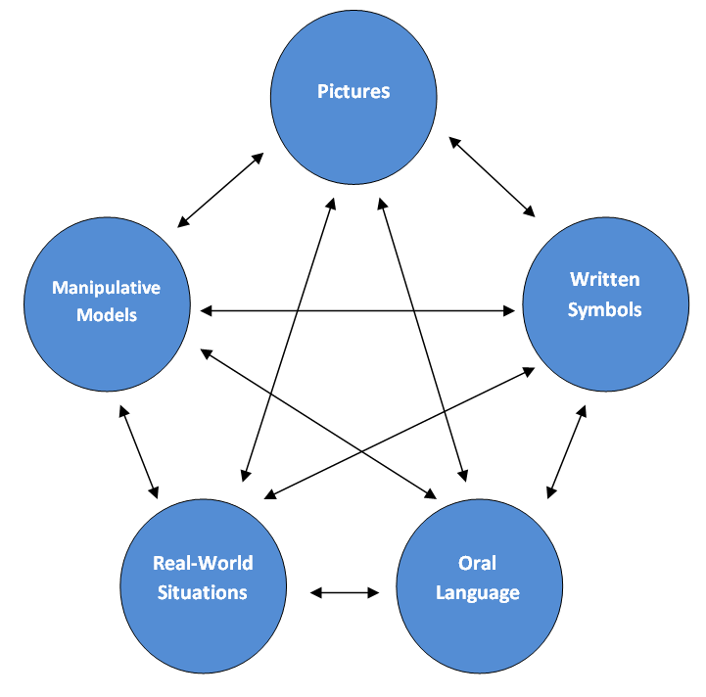
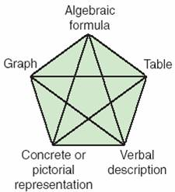
Use of Multiple Representations
NCTM, 2001.
Van de Walle, Karp, & Bay-Williams 2013. 24.
Notes:
Use of Multiple Representations: Have participants look at the two models for using multiple representations on the slide. Explain that the model on the left can be used by younger students to guide their use of multiple representations while the model on the right can be used by older students. Have participants discuss briefly in their groups how the different representations are connected in both models. Have participants discuss how the use of multiple representations were used in solving the Two Machines, One Job problem and have them provide examples of the practices that can be supported by their use. Wrap up the discussion by calling on 5–6 participants in rapid succession and having them give one sentence that summarizes their thinking about the use of multiple representations and one strategy for introducing the importance of multiple representations to their teachers.

Slide 76

Promoting Student Discourse
Review the Steps to Getting K–5 Students Talking handout.
What would you add
to this list?
Page 33
Notes:
Promoting Student Discourse: Have participants look at their copy of the eight practices and identify how many have “communication of ideas” embedded within them. The answer is that all eight say something about communication somewhere in the standard. This just reiterates the importance of having students talk both in small and large groups as this gives them practice with learning to express their mathematical thinking and ideas.
In small groups have participants review the Steps to Get K–5 Students Talking handout (page 33) and ask each group to come up with two more ideas that they got from the video or from the discussion today to add to the list. Wrap up this discussion by having groups share their two ideas.

Slide 77
Examining a Lesson
Part 1: Rate the lesson on the criteria using the following scale:
3: Meets most to all of the criteria.
2: Meets most of the criteria.
1: Meets some of the criteria.
0: Does not meet the criteria.
Part 2: Identify the strengths of the lesson and provide recommendations for strengthening the lesson to meet the criteria.
Notes:
Examining a Lesson. Explain to participants that in this activity, they are going to work together as a group to examine a lesson plan designed to teach the standards. They will examine this lesson by using the EQuIP rubric. Note for participants that every criteria on the rubric WILL NOT be used at this point. Have participants note or underline the following criteria as these are the criteria that they will use in their examination:
I. Alignment to the Depth of the CCS: Bullet 2.
II. Key Shifts in the CCS: Application under Bullet 3.
III. Instructional Supports: Bullets 1-4.
Within their group participants should use the lessons in the Participant Guide to complete both parts of the lesson examination.
Part 1: Rate the lesson on the criteria using the following scale:
3: Meets most to all of the criteria.
2: Meets most of the criteria.
1: Meets some of the criteria.
0: Does not meet the criteria
Part 2: Identify the strengths of the lesson and provide recommendations for strengthening the lesson to meet the criteria.
After groups work, engage participants in a large group discussion on their findings. Transition to the next activity by explaining to participants that they will use their experiences with the practices, solving Two Machines, One Job, and examining the lesson to think through instructional suggestions that they might provide to a teacher around a central mathematics task within a lesson.

Slide 78
Providing Support for Planning Instruction
For Example:
Begin the lesson by explaining or demonstrating...
Have students first think about the problem alone.
Put students in groups and ask them to…
Use the following questions if students are having difficulty with the task…
Think about how the following representations might help students solve the problem…
Notes:
Providing Support for Planning Instruction: Have each group choose one task from those provided. Explain for their lesson they will create several suggestions that they might give a teacher if they were helping them to plan a lesson around the task. For example their list might look something like:
Begin the lesson by explaining or demonstrating…
Have students first think about the problem alone.
Put students in groups and ask them to…
Use the following questions if students are having difficulty with the task…
Think about how the following representations might help students solve the problem…
As time permits have participants share their suggestions with the larger group.

Slide 79
Pause and Reflect
Look back at all of your notes.
Is there anything that you want to add to your notes?
Do you have additional questions right now?
Notes:
Pause and Reflect: Before moving to the next activity allow participants two or three minutes to look back over their questions and fill in any new answers found in the second half of the day.

Slide 80
Planning for Change
Section 7
Notes:
Section 7: Supporting Change
Section 7 Training Objectives:
To have participants create a plan for disseminating big ideas from the session with teachers at their school.
To have participants anticipate specific teacher questions and challenges around implementing lessons that incorporate the Standards for Mathematical Practices.
Section 7 Outline:
Participants will work in grade band groups to reflect on the module activities and discuss how big ideas from each will be shared with teachers back at their school. Facilitator will review module outcomes.

Slide 81
What's Your Plan?
Determine how you will bring what you did today back to your school.
Determine what questions your colleagues may have.
Notes:
What’s Your Plan? Allow participants the remaining time to use the space provided in the Participant Guide to plan for disseminating key learning from each of the module sections back at their school.

Slide 82
Focus on Standards for Mathematical Practice Outcomes
By the end of this session you will have:
Gained an initial understanding of the CCS-Math and the embedded changes and instructional shifts.
Explored all eight of the Standards for Mathematical Practice and identified how they are related.
Explored how practices can be clustered and examine the reasons why Practice 1: Make sense of problems and persevere in solving them and Practice 6: Attend to precision are considered the two “umbrella” standards that describe the habits of mind of successful mathematical thinkers.
Notes:
Review the outcomes for the day.

Slide 83
Focus on Standards for Mathematical Practice Outcomes (cont'd)
By the end of this session you will have:
Identified evidence of the practices in tasks.
Discussed and created grade-level descriptors for all eight practices.
Explored how specific instructional strategies can help students meet major learning goals.
Identified relevant resources for implementing the CCS-Math and created a peer support network.
Identified ways in which you will share information with and provide support for teachers as they make changes to their instructional practice.
Notes:
Review the outcomes for the day (cont’d).

Slide 84
Closing Activities: Post-Assessment–CCS-Math and Session Evaluation

Slide 85


Post Assessment and Session Evaluation
Where Are You Now?
Assessing Your Learning.
Please complete an online Session Evaluation. Your feedback is very important to us!
http://tinyurl.com/K5Mod1MATH
Page 51
Notes:
This Post-Assessment will be the same as the Pre-Assessment they took in the beginning of the session. This assessment is to gauge their learning based on the activities of the full day session. Remind the participants to fill out their Session Evaluation survey online.

Slide 86

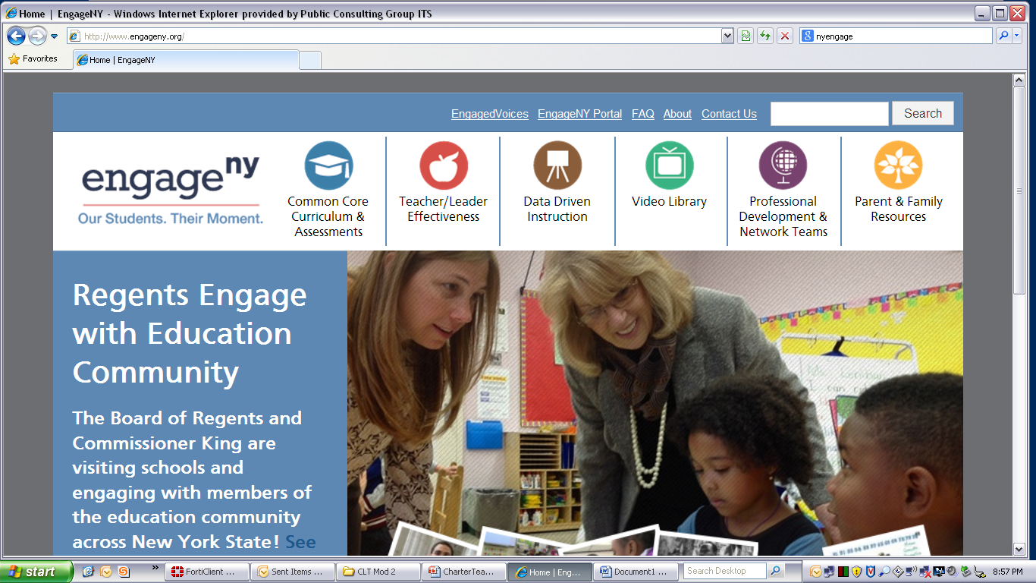


Some Key Resources
ctcorestandards.org
engageny.org
achievethecore.org
americaachieves.org

Slide 87
Thanks and see you next time!
Notes:
If there are dates set for the next professional development session this would be a great time to share that information.

