Slide 1

CONNECTICUT STATE DEPARTMENT OF EDUCATION
Healthy Community Responses to Crises
CRISIS SUPPORTS
FOR THE SCHOOL COMMUNITY
June 5, 2020

Slide 2
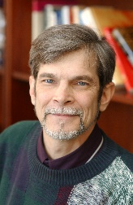
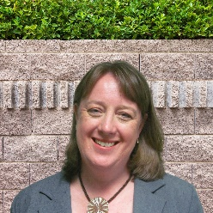
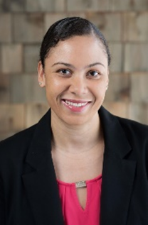
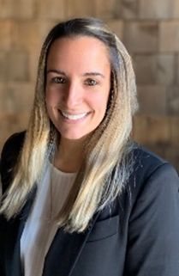
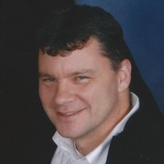


Presenters
Scott Newgass, LCSW
Connecticut State Department of Education
Kristin Pracitto, LCSW
Vice President of Child Services for Wellmore Behavioral Health
Jeana Bracey, PhD
Child Health and Development Institute
Jamie LoCurto, PhD
Child Health and Development Institute
Tim Marshall, LCSW
Director of Community-based Services at the Department of Children and Families
Meagan Rolla, MA
Naugatuck Assistant Principal/district administrator for Project AWARE
CONNECTICUT STATE DEPARTMENT OF EDUCATION

Slide 3
Kristin Pracitto
Vice President of Child Services
Wellmore Behavioral Health
CONNECTICUT STATE DEPARTMENT OF EDUCATION

Slide 4


Jeana Bracey, Ph.D.
Associate Vice President for School and Community Initiatives bracey@uchc.edu
Jamie LoCurto, Ph.D.
Senior Associate
locurto@uchc.edu
CONNECTICUT STATE DEPARTMENT OF EDUCATION

Slide 5
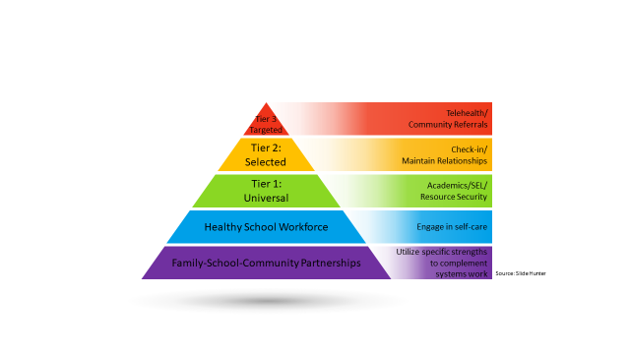
Meeting the Needs of Families—
Individual Level
CONNECTICUT STATE DEPARTMENT OF EDUCATION

Slide 6

Meeting the Needs of Families – Systems Level
Integrate SEL, school climate and culture, suicide prevention, and trauma-informed behavioral health
Adapt regulations, standards and policies with clear expectations
Use data to document innovations and creative approaches
Strengthen communication through empathy and formal supports
CONNECTICUT STATE DEPARTMENT OF EDUCATION

Slide 7

List of Resources
Child Health and Development Institute (CHDI) www.chdi.org
  COVID- related resources
  4-part Newsletter for School Mental Health
  www.kidsmentalhealthinfo.com for parents/caregivers
Trauma-Informed School Mental Health Task Force
  www.plan4children.org
The School Health Assessment and Performance Evaluation (SHAPE) System
  www.theshapesystem.com
CONNECTICUT STATE DEPARTMENT OF EDUCATION

Slide 8
Tim Marshall, LCSW
Director of Community-based Services
Department of Children and Families
CONNECTICUT STATE DEPARTMENT OF EDUCATION

Slide 9
Meagan Rolla
Assistant Principal - Hop Brook Elementary
District Administrator of Project AWARE
CONNECTICUT STATE DEPARTMENT OF EDUCATION

Slide 10
Thank you
Stay Safe
Contact Information:
Scott Newgass, MSW, LCSW
Connecticut State Department of Education
scott.newgass@ct.gov
CONNECTICUT STATE DEPARTMENT OF EDUCATION

