Slide 1

Connecticut Health Care Cabinet
Work Group on
Prescription Drug Cost Determination and Cost Containment
Preliminary Recommendations
November 14, 2017

Slide 2
Work Group Charge
  Develop recommendations to the Health Care Cabinet on ways to lower prescription drug costs for consumers and health care purchasers (e.g., self-insured employers, insurers and government purchasers). Examine policies in the following broad categories:
    Price Transparency
    Price Regulation
    State agency purchasing (other than value based contracts)
      Impact on state agency costs
      State purchasing that can benefit non-state individual or entities in Connecticut
  Work Group Members:
    Cabinet members: Bob Tessier, Marghie Giuiliano, Josh Wojcik, Paul Lombardo & Lena Bachar for Comr. Katie Wade, Comr. Dr. Raul Pino, Ted Doolittle
    Bob Clark (AG’s office), Mark Zatyrka (Consumer Advisory Board), Rob Blundo (APCD), Jill Zorn (UHCF)

Slide 3
Questions to be Explored
Transparency
What are the transparency policies we’re trying to pursue and what public and commercial data are needed to inform them?
How can we best obtain current state agency and commercial data on pharmaceutical costs?
What are the data barriers and how can they be overcome?
How are specialty drugs defined?
How is transparency of drug pricing data useful to consumers? To regulators? To purchasers?
Should there be any categories of data excluded from disclosure requirements?
Regulation
What are the different price regulation strategies?
How do we define “unaffordable”? List price above $x? An increase in price greater than x%
in one or over multiple years?
What is the role of coupons and rebates in drug pricing?
Who are the stakeholders and how are they impacted? Possible list includes: pharmaceutical companies, pharmacy benefit managers (PBMs), insurance companies, providers that prescribe and/or administer medications, pharmacists and consumers.
What are the potential policy pitfalls and/or legal issues associated with any price transparency and/or regulation strategies?
What kind of infrastructure would be needed to monitor and potentially regulate drug prices? What existing agencies could become involved?
State Purchasing Policies
What opportunities exist for leveraging the state’s purchasing power to reduce pharmaceutical costs to the state, other than value-based contracting? To non-state entities?

Slide 5
Many different kinds of information may be relevant in manufacturer price determinations.
Prices offered to other payers
Research and development costs including clinical trial costs
Manufacturing costs
Marketing and advertising costs
Patient financial assistance and rebates
Intellectual property status
Acquisition costs (if relevant)
Pay-for-delay settlements
Regulatory approval costs
State and federal tax benefits
Off-shored profits and jobs
Donations to patient disease advocacy groups
Grants, subsidies, and costs paid with public funds or by third parties.

Slide 6
Two major actors affect employers, payers, pharmacists and consumers most
Manufacturers
Pharmacy Benefit Managers
Consumers
Employers
Pharmacists
Payers

Slide 7
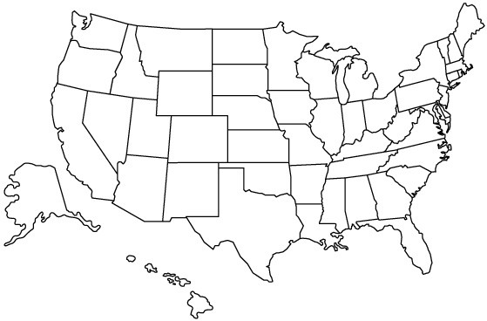
Recommendations are informed by various states’ experience

Slide 8
Preliminary Recommendations:
Create a transparency infrastructure for manufacturer prices
Create a Drug Review Board (DRB) of clinicians, health economists & consumers to analyze & determine whether drug prices & price increases are justified, & result in putting at risk the health of CT patients.
Require insurers to report information to the CID on the impact of prescription drug price increases on premiums.
Require CID to share information with the DRB. Allow the state Medicaid program and the State Employee Health Plan to refer drugs to the DRB for review. Allow the DRB access to de-identified claims data through the APCD to perform their analysis.
Give the DRB authority to request additional information from manufacturers to inform its review process. Exempt information from FOIA, or clarify that existing exemptions apply.
Change CT price gouging statutes to include unjustified pharmaceutical prices or price increases as determined by the DRB. Give the AG authority to pursue price gouging cases against manufacturers of both generic and brand name drugs, as referred by the DRB.
Require manufacturers, PBMs & health insurers to disclose to OSE the funding they provide to nonprofit patient advocacy groups, & post such information on a publicly available website.
Require manufacturers to report to payers 60 days in advance of launch prices and an increase in the price of a drug that exceeds certain thresholds. Require payers to keep such information confidential and that they not share such information with any portion of their company which may take possession of drugs (e.g., pharmacies, including specialty & mail order; or wholesalers).

Slide 9
Preliminary Recommendations:
Increase transparency & accountability of PBMs
Require that all prices negotiated between PBMs, manufacturers and payers pass through to the consumer at point-of-sale, and that consumer co-pays will be based on these negotiated prices.
Define and manage criteria for the “Maximum Allowable Cost” (MAC), which is what pharmacies can charge for generics and for which there is no transparent formula, only directives from the PBMs. The PBM’s MAC to the employer must be the same as the PBM’s pharmacy/retail MAC.
Require that PBMs must provide audit information required within the contractual agreement between the PBM and its insurer or employer client.
Require PBMs to exercise “fiduciary responsibility” (i.e., they must act in their client’s best interest) when contracting in the state of Connecticut.

Slide 10
Preliminary Recommendations:
Promote medication adherence, increase transparency and educate consumers
Set co-pay/deductible/co-insurance maximums per month of $250 for most plans ($500 for bronze ACA plans), per 30-day supply.
Require benefit designs that separate & have much lower deductibles for prescription drugs than medical deductibles.
Require benefit designs that separate & have a lower OOP maximum for prescription drugs vs. medical OOP max.
Eliminate co-pays for asthma, high blood pressure, diabetes & high cholesterol medications.
Adjust fill-dates for newly added meds to synchronize pick-up of all meds at the same time each month
Allow 90-day supplies for chronic disease meds to be filled at local pharmacies not only by mail order
Require on-line availability of price data for drugs covered by co-insurance. This information should be available on the insurer’s website during open enrollment so consumers can make informed choices.
Educate consumers about price variation across pharmacies.
Educate consumers about the different types of patient assistance and coupon programs that may help them afford their meds.
Compile reports from the APCD to illustrate trends in out-of-pocket costs.

Slide 11

Questions?

