Slide 1


Continuous Improvement in
Connecticut State Government
Alison Fisher, Office of Policy and Management
Cheryl Malerba, Department of Transportation
June 14, 2017
Notes:
Cheryl Malerba
Good morning,
Give introduction
You should walk away knowing better what Lean is – how it fits in to our work – and why it is useful to us as managers – maybe even especially now

Slide 2
Let’s Dive In
Why Lean/Continuous Improvement?
What is Lean?
How does it work in CT State Government?
How can State Managers get Involved?
Notes:
Who has been to Lean training?
Been a part of a lean
Initiated a lean for your unit or area of responsibility?
The primary intent of lean = process improvement – which really means eliminating waste – kaizen – take apart and put together in a better state.
They are usually held in 5 continuous days
Day 1 – Overview of Lean/tools & begin current state map
Day 2 – value stream mapping
Day 3 – bring in our customers & start to develop our future state map
Day 4 – finalize future state and develop plan with role & responsibilities
Day 5 – finish power point, practice, present & celebrate

Slide 3
Why Lean?
Improved Quality
Cost effectiveness
Service delivery and responsiveness to the public
Frees up staff time to focus on more important activities
Notes:
By using a tool like Lean/process improvement, we can accomplish all these things and more. Engaging, supporting and empowering our staff fosters productivity, trust and satisfaction.
And, by bringing in our customers we can learn first hand if we are being responsive to the right things. Providing the right service leads to overall satisfaction for the customer and the one providing the services.
It really isn’t good if we are killing ourselves on something that isn’t valued. It’s like writing that comprehensive report that no one reads.

Slide 4
The State of Connecticut Values Lean Because…
As legislation and regulation change, we have more to do within available resources.
Lean provides an opportunity to really invest in our workforce, our partnerships, and the people we serve.
Directive from Governor Malloy, with support from the Office of Policy and Management.
Notes:
There isn't an agency out there that couldn’t use more resources. Lean offers a path forward by helping to justify critical needs with real data.
Collaboration – within an agency (IT, Finance, Data Officer, program staff, executive staff, etc.) and with all stakeholders (other agencies, external partners, etc.) builds enterprise solutions and good will. The Lean philosophy says that the experts are within your organization and that respect for your staff and their work is the most important. These elements allow staff to be a part of the solution which in turn, creates natural buy-in for change.
Lean also says you should review laws that impact our processes to help grow good law.
And, of course, it is a charge of the Governor – who is a strong advocate for maximizing every person and resource under our management to better serve the citizens of Connecticut. But it is bi-partisan – process improvement has followed both republican and democratic leaders and independents too here in CT.

Slide 5
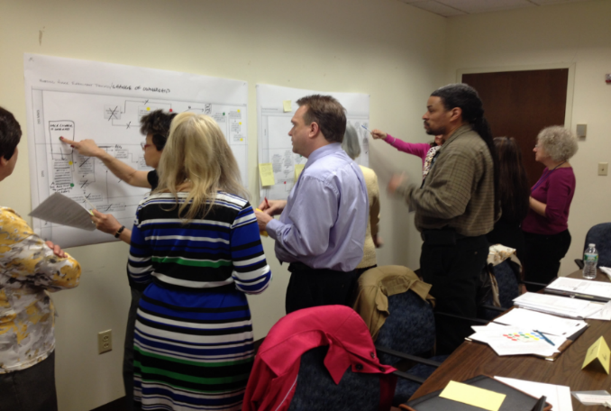
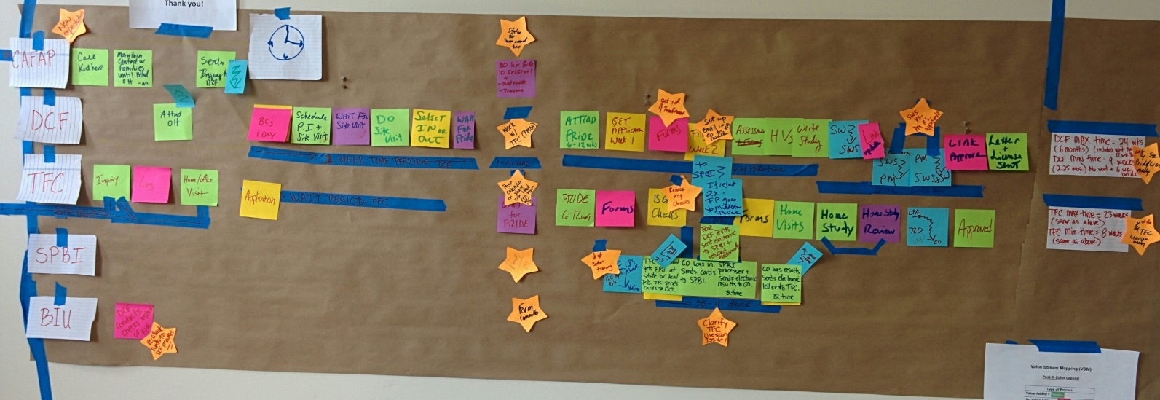
“Lean” in Connecticut State Government is:
A philosophy
A set of tools and templates
A form of communication
Notes:
When an organization embraces and implements Lean, it becomes a growth strategy. By examining a process is detail, eliminating waste, and implementing the changes, you create an opportunity for new or redirected capacity. In many cases it will be that pile of things that needs to get done but there just isn't enough time or people. Lean builds growth through efficiencies.
It builds organizational strength by exposing staff to how things work and engaging them in the exploration of how to make things better. For many including some of us managers, we’ve never examined how everything really works in our offices.
If you are modernizing, rebuilding or recreating a process or a system, now's the time to capture the information and build procedures and manuals for institutional knowledge retention.
Ultimately, it’s all about serving our customers in a smarter and more efficient way. The way that they expect to be served.
We then demonstrate the use of various tools and templates to help make our work more efficient and facilitate teamwork.
Tools: The most common tool we use is value stream mapping. Templates: The most common template we use is the project implementation plan.
In many cases, employees are using these already without realizing the “Lean jargon” that is associated with them. This is common sense approach to make our work a little less frustrating and lot more productive. We are simply trying to “do a better job with the resources we have” because we don’t have the time to do anything different.
Finally, we use Lean as a form of communication, linking line staff with managers, IT, finance, external partners, other branches of government, and even the public. Lean is simple to understand and it enables cross-disciplinary discussion.

Slide 6
Making Government Work: Lean is a key enabler for our transformation efforts
Faster
  Invest in information technology solutions to achieve efficiencies
  Identify statutory and regulatory obstacles to change
  Pursue interagency initiatives or opportunities to continuously improve
  Develop core metrics with measurable data
More effective
More efficient
More responsive
More predictable
More transparent
Notes:
Outcomes from our focus on process improvement (left) allows us to focus and invest in the activities our state government values (right)
We can use Lean Tools to Develop and Inform:
Budget Requests
Resource Allocation
Standard Work/Operating Procedures
Business Requirements for IT solutions
Succession Planning
Professional Development
Our stakeholders and customers
RBA– Is anyone better off?
Performance measures – show us the data really works

Slide 7

Other Benefits of Lean
Standard Operating Procedures
Knowledge Retention
Succession Planning
Staff Development
Team Building
Morale
Customer Trust-Building
Performance Measures
Recognition
Notes:
One of our bigger, yet lesser understood roles as managers is to ensure organizational development. Which is a process of continuous diagnosis, action planning, implementation and evaluation, with the goal of transferring knowledge and skills to to improve organizational capacity for solving problems and managing future change.
We accomplish these things through Diagnosis, action planning, intervention and evaluation. Lean is a natural fit in meeting these goals.
Lean provides an environment rich with change management opportunities….

Slide 8
An Overview of Connecticut’s Lean Journey
The Jobs Bill has sparked State Government to embrace Lean process improvement techniques, with customer service as its focus
Development of Statewide Process Improvement Committee
Assignment of Agency Lean Coordinators
Creation of LeanCT program
Training of state employees and non-profit providers
Process improvement and daily management using Lean tools
Collaboration across agency lines
Notes:
Alison:
Over 40 state agency heads (the 14 on the Steering Committee and another 30) have assigned “Lean Coordinators” to coordinate process improvement efforts and promote a new way of thinking
Over 2,000 state employees (and over 100 non-profit provider staff members) have been trained to use Lean tools and principles
Hundreds of processes have been improved using Lean tools, generating savings and improving service to CT residents
Agencies that have participated in Lean events or project implementation span all functions of government, including regulation and protection, health and human services, corrections, conservation and development, education, enforcement and compliance, housing, transportation, and general oversight.
These events have improved business processes by eliminating waste, removing redundant steps and adding automation across programmatic, functional and agency lines.

Slide 9

Statewide Process Improvement Steering Committee: Member Agencies by Function of Government
General Government
Office of Policy and Management/LeanCT (Chair)
Department of Administrative Services
Department of Revenue Services
Regulation and Protection
Department of Emergency Services and Public Protection
Department of Motor Vehicles
Department of Consumer Protection
Department of Labor
Corrections
Department of Correction
Conservation and Development
Department of Energy and Environmental Protection
Department of Economic and Community Development
CT Housing and Finance Authority
Health and Hospitals
Department of Developmental Services
Human Services
Department of Social Services
Transportation
Department of Transportation
Education
Office of Early Childhood
Notes:
There is a statewide Steering committee made up of 14 agencies which is available to you and can provide support and information for your organization as you engage in process improvement
This Committee sets policy for the statewide effort– making important linkages on common issues and shared goals across agencies.
The Committee determines how to support and promote Lean and other process improvement tools (scorecards, strategic plans, etc.) throughout the state
Engages state staff to work on Lean projects and receive training through statewide contract for Lean services. 5 vendors on current contract who provide an array of services ranging from executive coaching to Kaizen facilitation to Lean leadership certification.

Slide 10
Kaizen Event Results
DDS: Birth to Three
Invoice and Payment Process
DCF: Foster and Adoptive Family Licensing Process
Types of Process Steps | Current Number of Steps | Future Number of Steps | Percent Reduction
No Value Added - Pink | 56 | 7 | -87%
No Value Added but Necessary - Yellow | 19 | 9 | -52%
Value Added - Green | 55 | 21 | -73%
Transport - Blue | 41 | 11 | -72%
Waiting - Purple | 18 | 5 | -72%
Total number of processes | 189 | 53 | -72%
Types of Process Steps | Current | Good | Great
Pink Waste | 45 | 18 | 1
Yellow No Value/But Necessary | 5 | 7 | 8
Green Value Added | 1 | 1 | 1
Blue Transport | 10 | 8 | 4
Purple Waiting | 4 | 6 | 1
Total number of steps in process | 65 | 40 | 15
Processing time reduced by 50% from 6 months to 3 months
Eliminated 70% of the steps!
Reduced reconciliation time by 50%
Eliminated 76% of the steps!
Notes:
These charts illustrate the results from process flow mapping, a common tool used in a Lean event. The colors are used to differentiate between value added (green) vs. non-value added (pink) steps.
Both of these examples highlight work done in the human services area.
Through DCF’s Lean project, foster and adoptive families are now licensed faster than before, which allows for the quicker placement of children in homes.
DDS’ project improved the billing process for Birth to Three services, which led to a quicker payment process for our contracted private provider agencies.

Slide 11
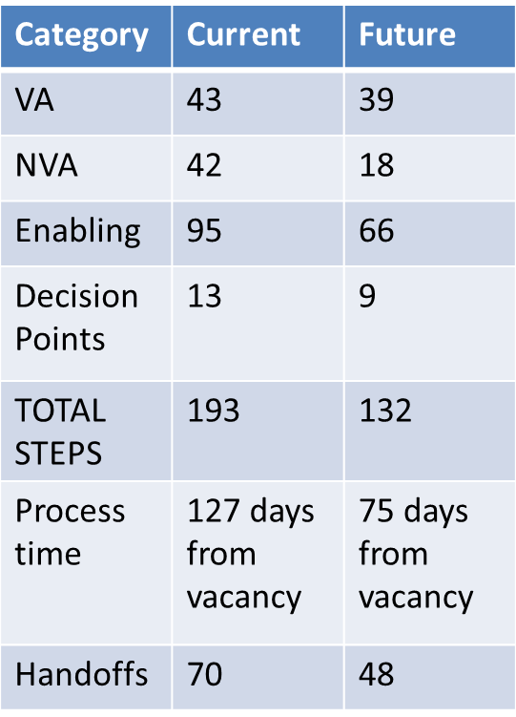
Kaizen Event Results
DEEP: Evaluation of the Storage Tank Compliance Inspection Process
DMV: Human Resources – Hiring Process
Underground Storage Tank Inspection Process | Pre Lean Prior State (Steps) | Post Lean Current State (Steps)
Pre-Inspection Prep | 19 | 3
Post Inspection Processing | 65 | 9
Total Steps | 118 | 47
Total Process Time | 47.6 days | 1.4 hours
Processing time reduced by 56%
Eliminated 69% of the handoffs
60% of process eliminated!
Notes:
Both of these charts highlight results in the regulation and protection area of our state government.
The charts are organized differently than the previous two and depict some Key Performance Indicators that DMV and DEEP use to ensure they are on-target with their expected results.

Slide 12
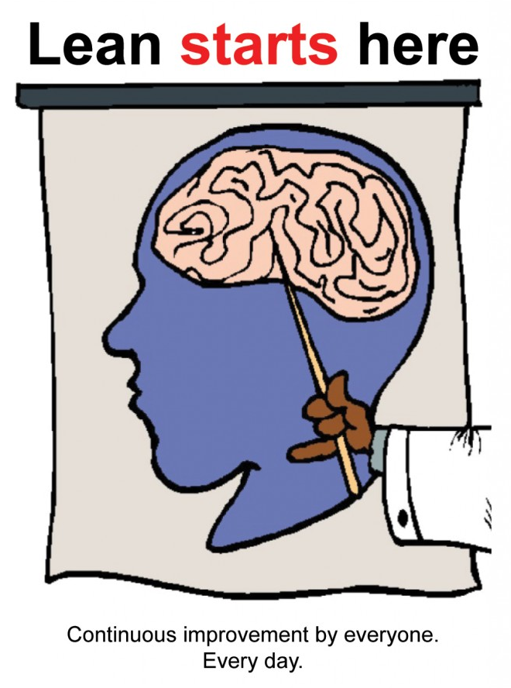
Lean Tools and Strategies
Notes:
Lean can occur within one small area or across a large organization or beyond breaking down silos and barriers for success. For example DOT and DEEP leaned the permitting process for projects together. It helped us understand each others work better while vastly improving the way we work together.
Lean thinking is really the key here – critically thinking about what problem you can solve, what the source of the “problem” is, and figuring how to solve it to benefit not just yourself, your agency, or the state, but the customer as well.
A 3 or 5 day “event” may be appropriate if the problem you want to address is quite large or complex. If it’s a smaller scope issue that is within your control to fix – action that you take to fix it is applying Lean thinking.
Identify – analyze – potential solutions – test your hypothesis – measure outcomes – adjust as necessary

Slide 13
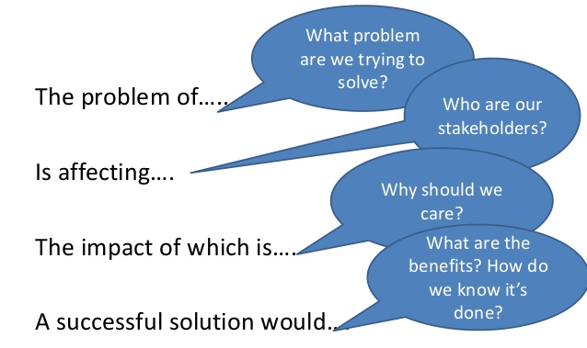
Problem Definition

Slide 14
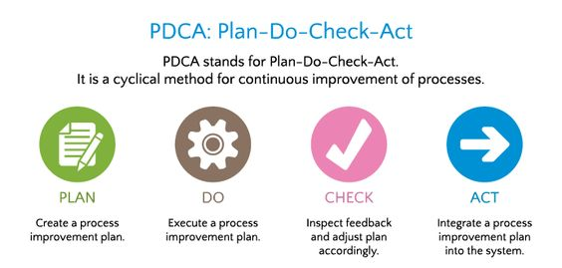
What if I don’t have a big problem to solve?
Notes:
There is no “one-size fits all” improvement technique. However, systematically identifying an issue, solving for its ROOT cause, and testing solutions is a problem-solving approach that can be applied to nearly any issue. Lean thinking is the key.

Slide 15
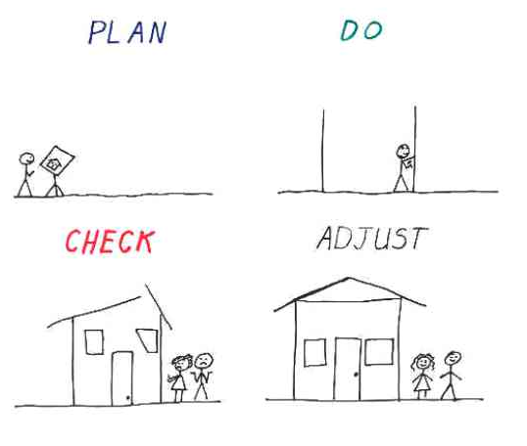
Clear. Predictable. Reliable.
What adds value to our customers?
How does work get done today?
Identify root causes of problems
What does an “ideal” process looks like?
How we can improve performance?
Determine if changes were successful
Take action accordingly
ACT

Slide 16
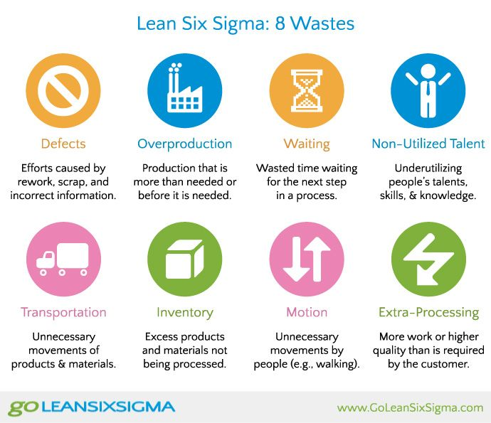
The 8 Wastes of Lean

Slide 17
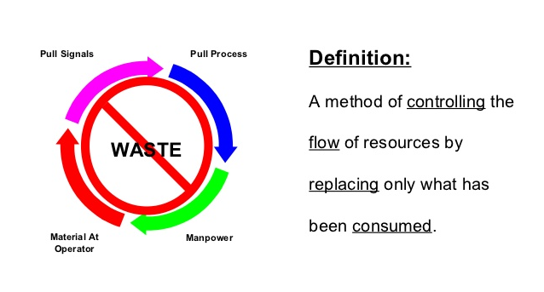
Use a Pull System to Establish Flow
Notes:
All this means better customer service if we kept quality in the mix. Involve your customers in order to understand the pull. What do they want from us?
^{Remove impediments}
^{Silos}
Unnecessary meetings, documents, approvals
^{Error correction loops}
Poor hand off between tasks, waiting time
^{Firefighting}
Improve balancing of priorities

Slide 18

Standard Work
Develop standardized work to reduce variation, eliminate waste, and minimize excessive ^{review.}
  1. Establish routine for work to be performed
  2. Develop baseline for future improvements
  3. Improve quality performance through repetition
  ^{4. Avoid overproduction}
  5. Avoid “reinventing the wheel”
Notes:
If your agency has regional offices or several staff members performing the same, or similar, tasks, you know that a standard among them is rare.
A lot of Lean is common sense. Programmatic agreements, templates, efficiency, creative use of technology, customer focused

Slide 19

Measuring Success and Ensuring Accountability
Establishment of Specific Goals and Key Performance Indicators such as:
  Response Time
  Customer Satisfaction Surveys
  Staff Development/Training
Notes:
Cheryl:
In lean the Primary focus is on the customer – we want to reduce or eliminate process/service that our customers do not want/need, so that we can redirect our resources toward what our customers do want/need.
Lean requires the participants to establish a baseline measurement on how things get done in the current state – (how many resources how much time, how many steps, how many dollars spent, etc.)
It’s preferable to benchmark on productivity with like organizations – typically that means looking at others state’s agencies that provide the same services but, if all else fails – you can measure against yourself.
By capturing an average we can set goals and we can see when we improve.
This grows our vocabulary and skillset for explaining to the public, legislature, etc.
It helps us tell a good story of accountability and good business practices.

Slide 20
Lean and IT: Lessons Learned
Fix the process first!
.
Investing in IT before you streamline and standardize leads to throwing good money at a bad process.
CT OPM requires agencies to improve their processes prior to being approved for larger-scale IT projects through the IT Capital Investment Program.
Notes:
There are pros and cons to how you choose to organizationally establish a Lean program. For both CT and RI, the program resides within the budget arm of the executive branch – an office with management, budget, and policy responsibility. This limits the exposure of the program but also legitimizes it as a core government function. In CT, IT policy is separate from the state CIO, and also resides in the budget agency. This allows for Lean and IT policy to be closely and consistently aligned, with clear and consistent messaging. CT’s Lean program is in no way affiliated with the State budget office, or their work.

Slide 21
Challenges
Gaining and maintaining commitment
  Lean basic training sessions will engage employees, set expectations and foster success in Lean Kaizen events
  Ensuring buy-in from all levels: from the bottom-up and from the top-down
Sustaining Lean over “generations”
  Not “flavor of the month”
Notes:
Do what you can to ensure long-lasting interest in positive change.
Take Lean 101 and allow staff to go too
Sit in on a lean event and ask questions
Talk to your manager – look at your PARS goals – leverage support
Look for low hanging fruit and interest
If you need support, partner with your agency’s Lean Coordinator and reach out to any member of the Statewide Steering Committee for ideas.
Establishing an effective management system is CRITICAL for sustaining your Lean journey. But it absolutely starts with you.

Slide 22
Observations
Management support is critical
Select projects that will result in “quick wins”
Be fully engaged and allow change
Encourage experimentation as much as resources allow
Coordinate efforts with others : other programs, other staff, other agencies
Involve staff at all levels
Acknowledge and support the work of the team members, team leader, stakeholders, and staff
Focus on what you can change
Notes:
Start small and in a manageable way. Get some success and build upon that.
Find your allies – other people who want to make a change – and work together towards your goals.
Build capacity as you go!
Use SWOT’s to brainstorm with staff on areas that would benefit from change/lean
Learn about change management and performance measures so you can be informed and supportive
Model positive energy!

Slide 23
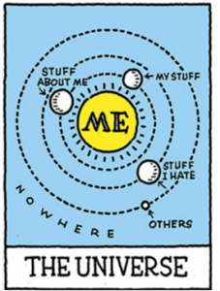
Ok. But what’s in it for me?
Advance your career/professional development
Spend time on what matters
Learning opportunity
Make a difference for the people you serve!
Notes:
Lean doesn’t walk on water – but – it’s not too shabby
It builds communication, team building and trust. It empowers and values staff in a way that may never have happened before.
Ask around the room – what do you think might be in it for you?

Slide 24
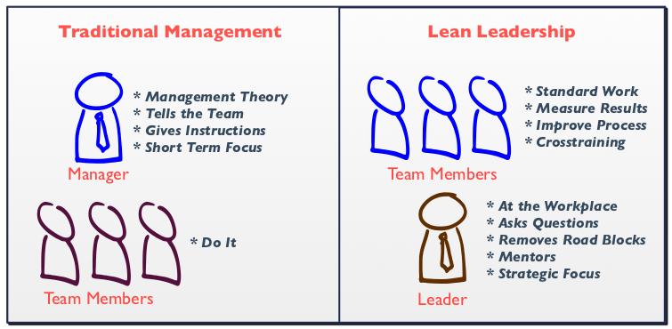
Role of Management
Notes:
What kind of manager do you want to be?
What kind of leader can you be?
How can your organization move towards Lean Leadership?
What is your vision for the kind of work environment you’d like to help create (WHY)?

Slide 25
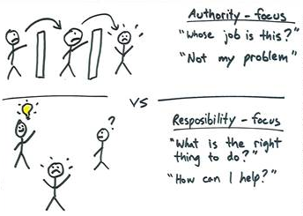

Slide 26
“You Don’t Know What You Don’t Know”: Discovery Through Stakeholder Engagement
IT Staff
Program Staff
HR Staff
External Partners
Fiscal Staff
Customers
Notes:
Alison Fisher
There may be things available to you that you can leverage – relationships, MOUs, technology, examples from other states, examples from other agencies with similar problems – that could give you the data you need to figure out how to make an improvement. You may not find out everything that’s out there, but tapping into your network is the first step.
Step back and ask:
Who in my agency would be able to help me figure this out? Who is affected by this problem? What might they know about this issue, that I don’t?
Are there other agencies that might be addressing the same problem?

Slide 27
Role of Agency Lean Coordinator/Ambassador
Champion of Lean within the agency
Chairperson of Agency Lean Advisory Committee/ participates on Agency Transformation Committee
  Develops agency strategy for Lean implementation
Develops standard work for deployment of Lean events (before, during and after)
    Project solicitation and selection
    Supports Lean teams
    Assists in tracking and reporting results
    Communication and training
Coordinates with agency IT and Finance staff
Communicates with state Lean office about needs for support/coaching

Slide 28

Selection of an Agency Lean Coordinator/Ambassador
Intrinsically motivated employee who is excited about positive change
Rank or job title does not matter, but the person must be a leader (not necessarily someone in a leadership position)
Excellent time management skills
Notes:
Top 10 character traits of a Lean Leader (according to Alison)
Compassionate
Trustworthy
Organized
Curious
Respectful
Inclusive
Flexible
Humble
Approachable
Perceptive

Slide 29

How it Works
Statewide Steering Committee can help!
  Facilitation assistance
  Project scoping
  Coaching/mentoring
DAS state-wide contract for Lean professional services through June 30, 2019
OPM may fund your Lean event if it
    Includes any process which touches two or more agencies
    Impacts internal or external customer service
    Is a project directed by OPM or the Governor’s Office
Notes:
Let us know how we can support your agency. We will come out and meet with your management team, we will facilitate project scope discussions, we will let you place a team at one of our events. We will let you sit in on our events to learn about them. We will coordinate training with you.
DAS contract available for professional Lean training and facilitation.
Application for OPM funding is available on the LeanCT website

Slide 30
How You Can Get Involved…Today!
Agency Lean Coordinator
Lean 101 training
Agency Lean Steering Committee
Visit a Lean team
Get started with a Lean project, large or small
Support your staff in improving a process
Celebrate your agency’s successes
Contact Alison and/or visit www.ct.gov/leanct
Attend the LeanCT conference on September 28th at Rentschler Field!
Notes:
If you haven’t already, find out who your agency Lean Coordinator is. If there isn’t one, talk with your Commissioner.
Send staff, including managers, to Lean 101 training
Establish or work with the Lean Steering Committee within your agency to review projects and measure outcomes
I can let you know where and when
JUST START!
Recognize the effort made by staff who are engaged in process improvement activity. Support staff in their efforts to initiate change in your organization
Meet with staff to receive updates on how things are progressing. Additionally, OPM will request an update on your progress each summer for an annual fall report to the Governor
While executive level support is important for long-term success, the deepest understanding of how to improve a process does not come from management, but from the workers who go through those processes day in and day out. We have made great strides to modernize state government, achieve savings and streamline processes, we still have more work to do.

Slide 31
For more information on
Continuous Improvement in
Connecticut State Government please visit: www.ct.gov/LeanCT

