Slide 1






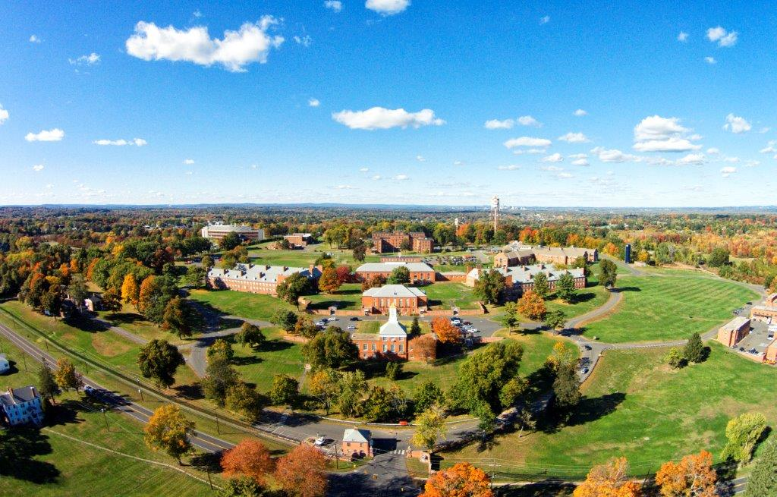
Connecticut Department of Veterans Affairs
Mission: “Serving Those Who Served”

Slide 2

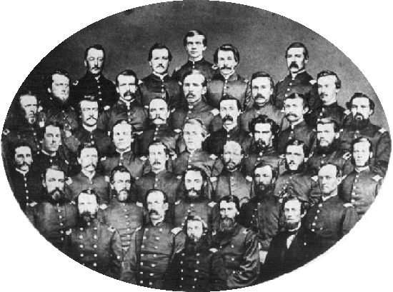
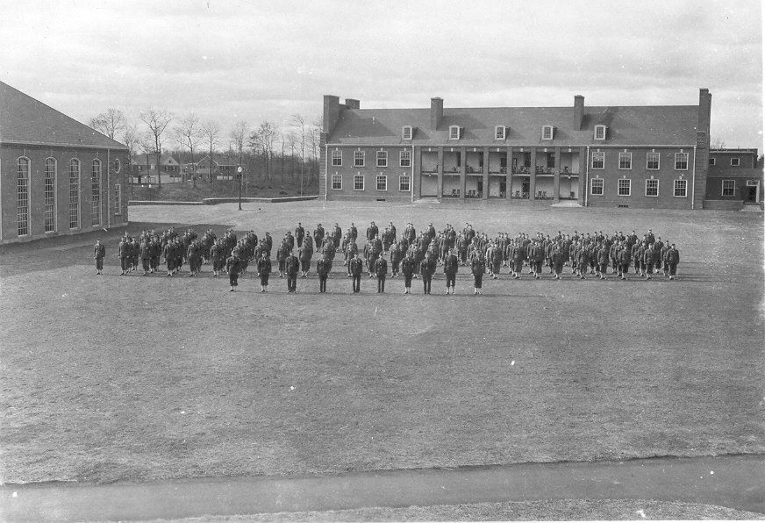
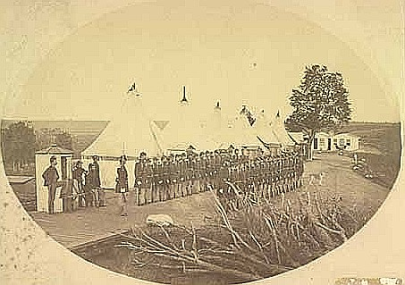
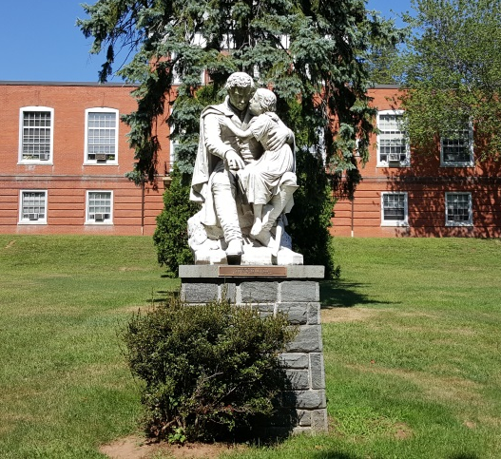
History
Serving Those Who Have Served

Slide 3
Mission: Serving Those Who Served
Serving Those Who Served
Enhance the lives of Connecticut’s Veterans by providing:
Advocacy and assistance to Veterans and their eligible dependents in obtaining benefits to which they may be entitled under Federal, State, and local laws;
Long-term and Chronic disease healthcare;
Residential and rehabilitation services;
Cemetery and memorial services for Veterans and eligible dependents;
Collaborate with Local, State and Federal agencies, Veteran service organizations, community partners, volunteers and Veteran supporters.
Cultivate a work environment of compassion, teamwork, professional development, and employee engagement.
Notes:
3) Domicile houses up to 400 and we have a little over 200 residing there now. We have a secure area for women Veterans there as well as what is called “B Clinic.” We have a population that has aged in place and for some of those in need of more care than the dom provides but less than the Health Care Center, we place those Veterans in the same hallway as B Clinic where there is a medicine dispensary and nurses station.
4) The Sgt John Levitow Health Care Center is a Chronic Disease Center and cares for Veterans who need 24 hour care. This is also where we have revamped our respite care program that I will get to later in the presentation. Currently there are just over 100 Veterans who reside there.

Slide 4
Vision
Serving Those Who Served
Provide Connecticut’s Veterans and their eligible dependents proactive, world-class, and values-based service excellence.
Notes:
3) Domicile houses up to 400 and we have a little over 200 residing there now. We have a secure area for women Veterans there as well as what is called “B Clinic.” We have a population that has aged in place and for some of those in need of more care than the dom provides but less than the Health Care Center, we place those Veterans in the same hallway as B Clinic where there is a medicine dispensary and nurses station.
4) The Sgt John Levitow Health Care Center is a Chronic Disease Center and cares for Veterans who need 24 hour care. This is also where we have revamped our respite care program that I will get to later in the presentation. Currently there are just over 100 Veterans who reside there.

Slide 5
Core Functions
Serving Those Who Served
Advocacy and Assistance
Cemeteries and Memorials
Residential Facility
Health Care Center (Long-Term/Chronic Disease Care)

Slide 6
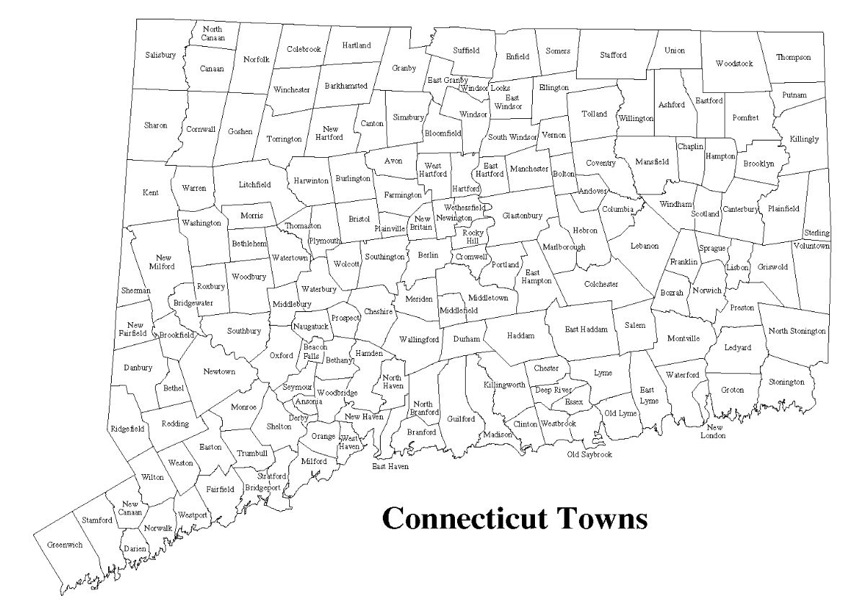
“Serving Those Who Served”
Serving Those Who Served
Dist 1: Newington Dist 4: Bridgeport State Vet Cemetery
Dist 2: Norwich Dist 5: Waterbury VSO office
Dist 3: Milford HQ: Rocky Hill

Slide 7
Office of Advocacy and Assistance
Serving Those Who Served
Assist qualified Veterans and family members with state and federal benefits:
- Education and Training
- Health and Housing Services
- Employment Services
- Presenting Claims Under Federal Law (Disability/Compensation/Pension)
- Conducting Training for local Veterans’ Representatives

Slide 8

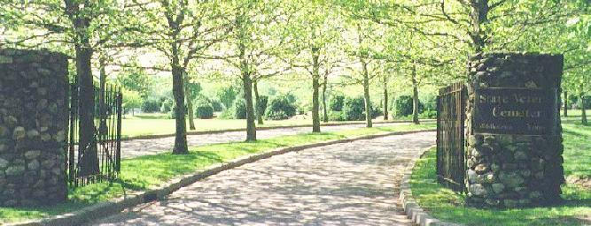
Cemetery and Memorial Services
Serving Those Who Served

Slide 9
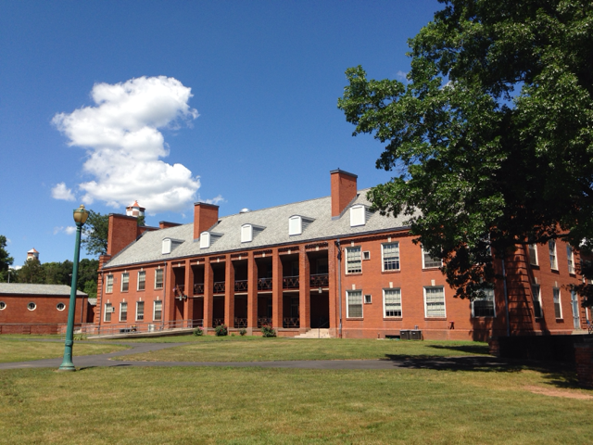
Residential Facilities
Serving Those Who Served
Rehabilitation services & programs designed to return Veterans to independent living in the community.
Residential Staff assists each Veteran in developing an individualized rehabilitative plan.
Meals and medical care are provided to residents.

Slide 10
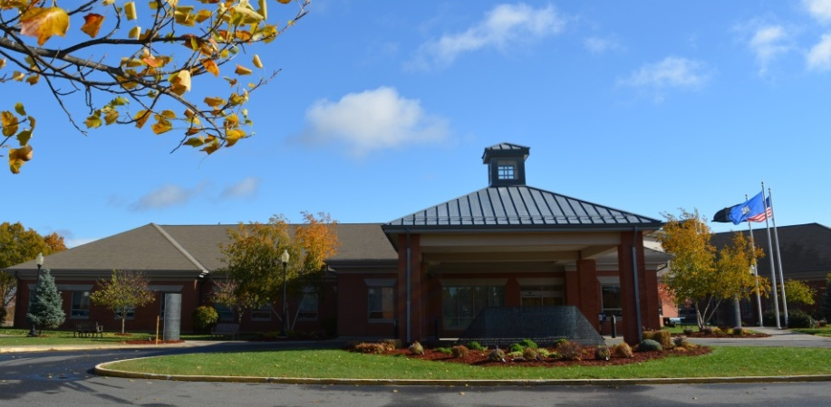
Healthcare Center
Serving Those Who Served
DPH-licensed as Chronic Disease Hospital and Fed VA regulated for long term care
24-hour long-term care for Veterans with chronic and disabling medical conditions
Sub-acute care and medical resources beyond a skilled nursing facility
Outpatient clinic in the Residential Facility to provide Veterans with medical care, medication, exams, treatments, wellness and sick visits, rehabilitative services and support
Respite Care Program for caregivers of Veterans for up to 28 days per year

Slide 11

Achievements
Serving Those Who Served
OAA Enhancements (Veterans Express, Laptops, Mobile Phones, CVLC Training, VIMS Training)
Communications (Social Media, Website Updates, and Donation Application)
Center of Excellence Partnerships – CVLC, The WorkPlace, DOL, Chrysalis)
Municipal Veterans Representatives Training
Missing in America Project Funeral Honors
Middletown State Veterans Cemetery Expansion
Healthcare Center Respite Program
Patriot’s Landing
Expanded Internships with CT Colleges and Universities (UCONN, USJ, MCC, Quinnipiac, Yale, Northeastern)
Electronic Healthcare Records Launch
MOAs (Federal VA Pilot Program, DMHAS, Colleges and Universities)
Veterans Day Ceremony at Rocky Hill Campus
Connecticut State Veterans Memorial Dedication
Hall of Fame Inductions Ceremony with Permanent Plaque
CT Wartime Service Medal Ceremonies
Notes:
2015
AUGUST:
Secretary of the VA Visit: Secretary McDonald toured the campus and our facilities
Ground Breaking at the State Veterans Cemetery: 3,000 niche columbarium set to be completed by July
SEPTEMBER:
Electronic Healthcare Records: September we saw the initial rollout of the EHR that I know several of you have been in training for in March as we get closer to integrating this important system.
OCTOBER:
Missing in America Project: August and October we joined with the Missing in America Project to honor a total of 12 unclaimed cremains of Soldiers and Sailors with full military honors at the State Veterans Cemetery in Middletown.
Federal VA Pilot Program on our Campus: Strengthening Federal VA relationship through collaborative efforts to offer services here at the Rocky Hill campus. The week of Thanksgiving we signed an MOA with the Federal VA for a pilot program based here at the Rocky Hill for temporary emergency housing for pre-certified Veterans referred by the Federal VA.
MOU with DMHAS: Fellowship House – the substance abuse recovery program on campus, now falls under the Department of Mental Health and Addiction Services. We had the Lieutenant Governor and their Commissioner, Commissioner Dr. Delphin-Rittmon, here to officially sign an agreement with our department.
NOVEMBER:
Veterans Month: Throughout the month of November, I was out visiting Veterans OASIS centers at all the state colleges and universities.. We had a great turn out for the Veterans Parade with breakfast here at the main dining room. We had a incredible Veterans Day Ceremony here for the Veterans on campus. We had musical entertainment, a program the Governor, Senators Blumenthal and Murphy attended as well as Veterans from our health care center and domicile, and a wonderful guest speaker and Vietnam Veteran, Allan Yanaros.
Connecticut State Veterans Memorial Dedication: Incredible turnout and we were lucky to have the weather cooperating with us!
Hall of Fame Inductions Ceremony with permanent display plaque revealed: 11 new inductees were honored and we also unveiled a plaque will all current and past recipients names on it. It took ten years but it was one of the first things I set my mind to getting done for our Veterans.
CT Wartime Service Medal Ceremonies: Throughout the fall and early winter, more than 2,000 Veterans have received their medal in the various ceremonies throughout the state. It’s a highlight and an honor to shake a Veteran’s hand, thank them for their service and pin that medal on them.
2016
FEBRUARY:
MOU with Quinnipiac
Significantly increased communications: via our social media sites with our Facebook hitting 1,000 likes in February (began the page in June 2015).
MARCH:
Website Updates for more user-friendly interface-working with DAS/BEST
Donation Application Launch- working with DAS/BEST
Inviting partners on to campus – DMHAS (on-site)/DOL (Tues. & Thurs.)/DSS (2x week)/VSO(TBD)/Chrysalis (2-5 personnel until June)/CT Veteran Legal Center (TBD)/ The WorkPlace’s Platform to Employment 5 week course held at our campus.

Slide 12
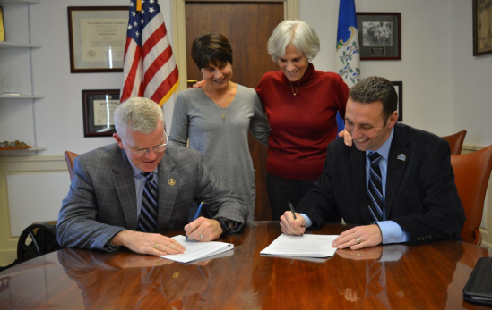
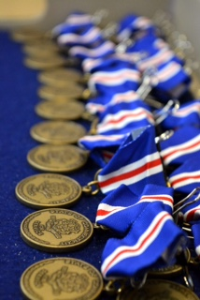
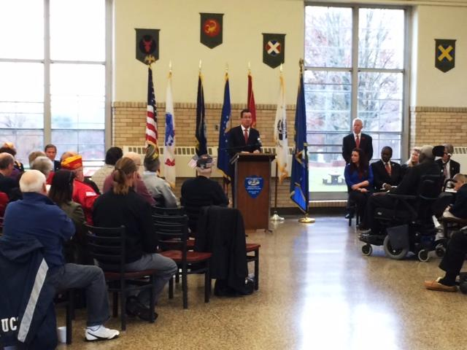
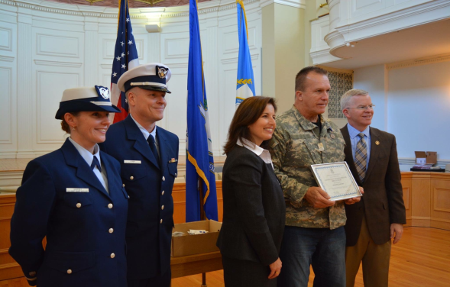
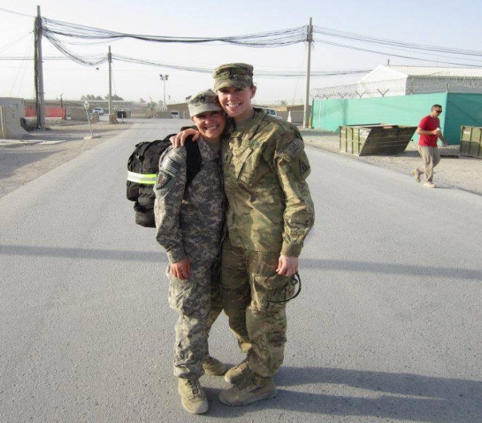
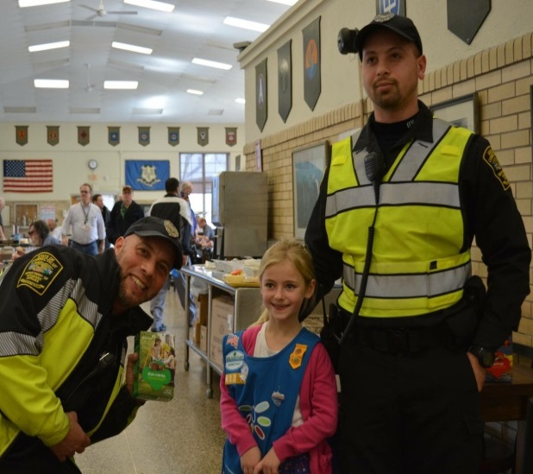
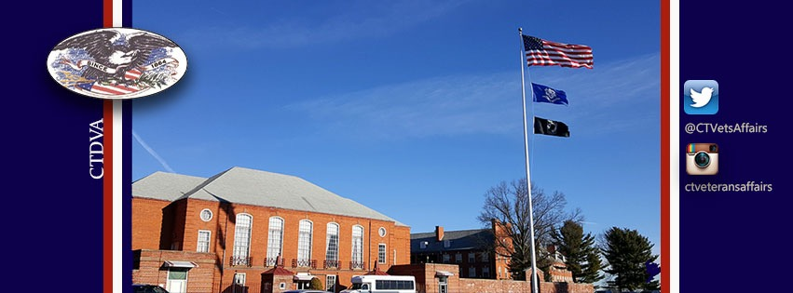
Serving Those Who Served

Slide 13
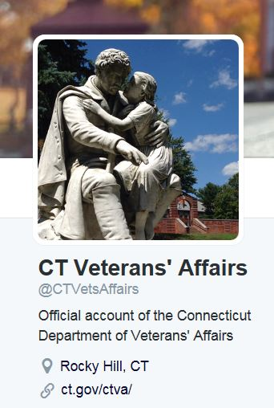
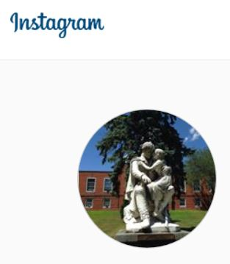


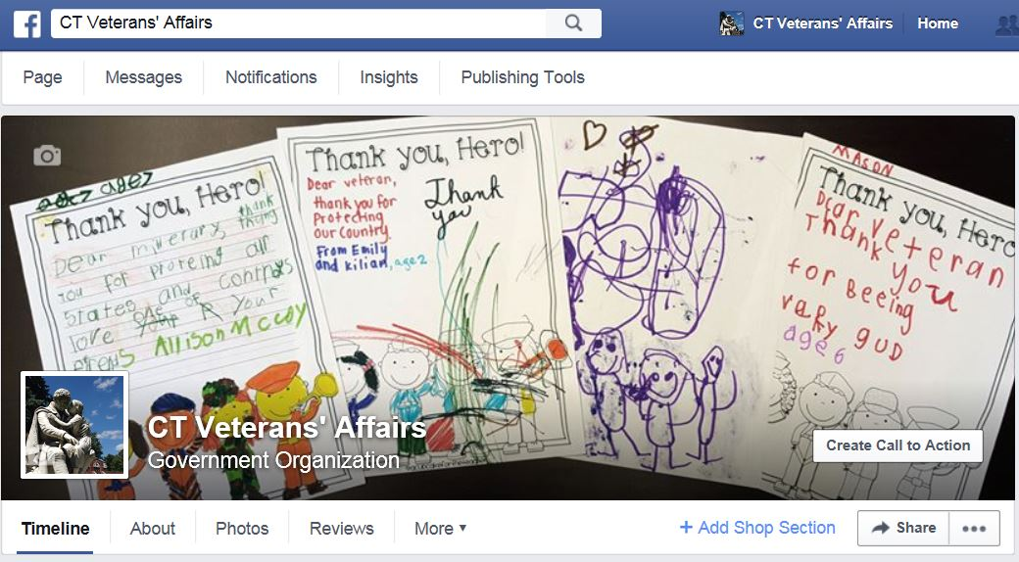

Serving Those Who Have Served
@CTVetsAffairs
ctvetsaffairs
CT Veterans’ Affairs

