Slide 1

Social Security
www.socialsecurity.gov

Slide 2
History of
Social Security Programs
1935 – Retirement Insurance
1939 – Survivors Insurance
1956 – Disability Insurance
Notes:
Social Security legislation was passed in 1935. At that time, the program was solely a retirement program. The basic tenets of this social insurance program have been to provide:
Individual Equity – You earn the benefits you receive. The more you earn, the higher your benefit will be.
Social Adequacy – Social Security provides a financial foundation which protects all workers.
In 1939, a year before Social Security began paying monthly retirement benefits, the social safety net expanded with the Survivors Insurance program. Again during difficult economic times, the vulnerability of widows and children became even more apparent.
In 1956, the Social Security Disability Insurance Program became law. Then, as now, for most workers in America, Social Security is the only comprehensive disability insurance policy they have.

Slide 3
Other Programs
1965 – Medicare Program
1972 – Supplemental Security Income
2003 – Medicare Prescription
Drug Coverage
2010 – Patient Protection and
Affordable Care Act
Notes:
The Medicare program was enacted in 1965. This program is the medical coverage you get when you turn 65 or become disabled.
The Supplemental Security Income (SSI) program was enacted in 1972. SSI is a program based on need for those who are 65 or older, blind, or disabled. Although SSI is administered by Social Security, the cost of running the program and the SSI benefit payments come from general tax revenue and not Social Security taxes.
The Medicare Modernization Act was enacted in 2003. It added a prescription drug benefit to the Medicare program. Prescription drug coverage went into effect in 2006; helping to meet drug cost needs for millions of Medicare beneficiaries.
In 2010, the Patient Protection and Affordable Care Act (commonly called Affordable Care Act or Federal health care) was signed into law. It reduces the number of uninsured Americans and the costs of health care.

Slide 4
Save for a Secure Future
Social Security is the foundation for a
secure retirement, but you also will need
other savings and investments. If you want to
learn more about how and why to save,
visit www.mymoney.gov

Slide 5
A Foundation for Planning Your Future
OTHER INCOME
SAVINGS & INVESTMENTS
PENSION
SOCIAL SECURITY
Notes:
Social Security provides a foundation on which to build
retirement security.

Slide 6
Who Gets Benefits from Social Security?
58 million people
Notes:
This graph is an overview of the number of beneficiaries we pay. Currently, about one in every six people in America is receiving a Social Security benefit. The majority of our beneficiaries are retired.
But Social Security is more than retirement...it is a family protection plan (almost 1/3 of the beneficiaries are disabled, dependants of disabled, or survivors).

Slide 7
Who Pays for Social Security?
Today’s Workers
&
Employers
Today’s
Beneficiaries
Notes:
The basic concept of Social Security is an intergenerational transfer system: the workers of today pay the benefits of current retirees and other beneficiaries.
Currently, an estimated 156 million workers are paying Social Security taxes.

Slide 8

U.S. Birth Rate 1920-2020
Children Per Woman
est.
Notes:
As the chart shows, the fertility rate in 1920 was about 3.2 children for all women of childbearing age. During the depression the rate declined dramatically. After World War II a major increase in the fertility rate took place – the baby boom generation. Since 1960, there has been a major decline in the rate. This means there will be fewer future workers to support this large generation of baby
boomer retirees.

Slide 9
America is Getting Older
(21% of total population)
(15% of total population)
(7% of total population)
Million
Notes:
The combined pressures of a massive baby boom generation
and increasing life expectancy will result in an American population
with almost 20% of our projected population over the age of 65 by
the year 2035.

Slide 10
Life Expectancy
for Those Age 65 Today
Men Women
U.S. Population 82 85
White 82 85
African American 79 83
Hispanic 85 89
Asian 85 88
American Indian 84 88
Notes:
This slide provides a comparative chart of life expectancy.

Slide 11
Social Security Trust Funds Will Be Able to
Pay Only About 77 Cents for Each Dollar
of Scheduled Benefits after 2033
Calendar Year
Notes:
In 2033, only about 75% of benefits could be paid if no changes are made.

Slide 12
Social Security Cost-of-Living Adjustments
Effective Date Amount June 1975 8.0%
June 1976 6.4%
June 1977 5.9%
June 1978 6.5%
June 1979 9.9%
June 1980 14.3% June 1981 11.2%
June 1982 7.4%
Dec 1983 3.5%
Dec 1984 3.5%
Dec 1985 3.1%
Dec 1986 1.3%
Dec 1987 4.2%
Dec 1988 4.0%
Dec 1989 4.7%
Dec 1990 5.4%
Dec 1991 3.7%
Dec 1992 3.0%
Dec 1993 2.6%
Dec 1994 2.8%
Effective Date Amount
Dec 1995 2.6%
Dec 1996 2.9%
Dec 1997 2.1%
Dec 1998 1.3%
Dec 1999 2.5%
Dec 2000 3.5%
Dec 2001 2.6%
Dec 2002 1.4%
Dec 2003 2.1%
Dec 2004 2.7%
Dec 2005 4.1%
Dec 2006 3.3%
Dec 2007 2.3%
Dec 2008 5.8%
Dec 2009 0%
Dec 2010 0%
Dec 2011 3.6%
Dec 2012 1.7%
Dec 2013 1.5% Dec 2014 1.7%
Notes:
Another economic factor that can affect Social Security is the rate of inflation. Social Security will probably be the only source of your retirement income that is tied directly to the Consumer Price Index. This is important information for your pre-retirement planning.

Slide 13
Value of Inflation Protection
Example: Worker with average
pre-retirement income of $30,000
(Retiring at age 66 in 2015)
1st Year of Retirement
Pension $13,000/50%
Social Security $13,000/50%
Inflation 3% per year
Notes:
This slide is an example of how Social Security benefits being directly tied to the Consumer Price Index (CPI) offers incredible long-term protection. (This slide provides the “givens” for use with the next slide.)
Percentages refer to percentage of combined retirement income.
This assumes an annual inflation rate of 3% per year, as measured by the CPI.

Slide 14

Value of Inflation Protection
example continued:
Worker with average
pre-retirement
income of $30,000
5th Year of Retirement
Pension $13,000/47%
Social Security $14,632/53%
10th Year of Retirement
Pension $13,000/43%
Social Security $16,962/57%
20th Year of Retirement
Pension $13,000/36%
Social Security $22,796/64%

Slide 15

How Do You Qualify for
Retirement Benefits?
You need to work to earn
Social Security “credits”
Each $1,220 in earnings
gives you one credit
You can earn a maximum
of 4 credits per year
Example: To earn 4 credits in 2015, you must earn at least $4,880. Earning 40 credits (10 years of work) throughout
your working life will qualify you for a retirement benefit.

Slide 16
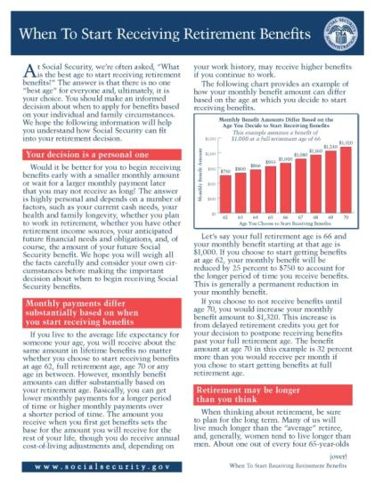
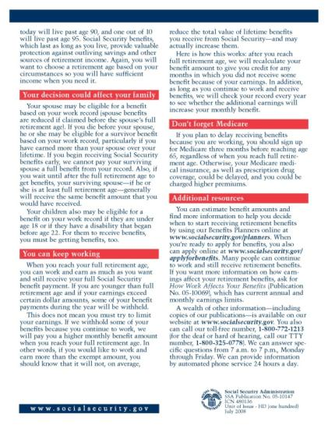
Thinking of Retiring?
Deciding what is the ‘right’
age to retire
Check online
Social Security Statement
How working after
retirement can
affect benefits
Medicare considerations
Online retirement estimator
How to apply online
for benefits

Slide 17

Your Age at the Time You Elect
Retirement Benefits Affects the Amount
If You’re a Worker and Retire
At age 62, you get a lower monthly payment
At your full retirement age,
you get your full benefit
You get an even higher monthly
payment if you work past your
full retirement age

Slide 18

Your Age at the Time You Elect
Retirement Benefits Affects the Amount
For example, if you were born from 1943 through 1954:
Age 62 75% of benefit
Age 66 100% of benefit
Age 70 132% of benefit
Notes:
The reduction for early retirement is:
20% if you were born before 1938
25% if you were born between 1943 and 1954
30% if you were born 1960 or later

Slide 19

In Addition to the Retiree,
Who Else Can Get Benefits?
Your Child
Not married under 18
(under 19 if still in high school)
Not married and disabled
before age 22
Your Spouse
Age 62 or older
At any age, if caring for a child under age 16 or disabled
Notes:
The worker and his or her spouse must be married for one year (continuously) immediately before the day on which the application is filed.
(Note: The one-year requirement can be waived if the spouse is the natural mother or father of the worker’s biological child or if the spouse was entitled or potentially entitled to certain auxiliary or survivor’s benefits in the month before the month of marriage to the worker.)
If a spouse is caring for a child under age 16 of the worker, the spouse could qualify regardless of age. When the youngest child turns 16, the spouse’s benefit will stop, even though the child’s benefit will continue. However, if the child is disabled, the spouse’s benefits will continue as long as the child is under his or her care.

Slide 20
In Addition to the Retiree,
Who Else Can Get Benefits?
Your Ex-Spouse
Marriage lasted at least 10 years
Ex-spouse 62 or older
Divorced at least two years and you and your
ex-spouse are at least 62, he or she can get benefits
even if you are not retired
Ex-spouse’s benefit amount has no effect on the
amount you or your current spouse can get
Notes:
Your divorced spouse can get benefits on your Social Security record if the marriage lasted at least 10 years. Your divorced spouse must be 62 or older and unmarried.
Also, if you and your ex-spouse have been divorced for at least two years and you and your ex-spouse are at least 62, he or she can get benefits even if you are not retired. Your current spouse cannot receive spouse’s benefits until you file for retirement benefits.
The amount of benefits your divorced spouse gets has no effect on the amount of benefits you or your current spouse can get.

Slide 21
Spouse’s Benefit Computation
Benefit is 50% of worker’s unreduced benefit
Reduction for early retirement
If spouse’s own benefit is less than 50% of the worker’s, the benefits are combined
Does not reduce payment to worker
Notes:
A spouse who has not worked or who has low earnings can be entitled to as much as one-half of the retired worker’s full benefit. If you are eligible for both your own retirement benefits and for benefits as a spouse, we always pay your own benefits first. If your benefits as a spouse are higher than your retirement benefits, you will get a combination of benefits equaling the higher spouse benefit. If spouses want to get Social Security retirement benefits before they reach full retirement age, the amount of the benefit is reduced. The amount of reduction depends on when the person reaches full retirement age.
For example:
If full retirement age is 65, a spouse can get 37.5 percent of the worker’s unreduced
benefit at age 62;
If full retirement age is 66, a spouse can get 35 percent of the worker’s unreduced
benefit at age 62;
If full retirement age is 67, a spouse can get 32.5 percent of the worker’s unreduced
benefit at age 62.
The amount of the benefit increases at later ages up to the maximum of 50 percent at full retirement age. If full retirement age is other than those shown in our example, the amount of the benefit will fall between 32.5 percent and 37.5 percent at age 62.
However, if a spouse is caring for a child under age 16 or disabled, who gets Social Security benefits on the worker’s record, the spouse gets full benefits, regardless
of age.

Slide 22
Full Retirement Age
Year of Birth Full Retirement Age
1937 or earlier 65
1938 65 & 2 months
1939 65 & 4 months
1940 65 & 6 months
1941 65 & 8 months
1942 65 & 10 months
1943 – 1954 66
1955 66 & 2 months
1956 66 & 4 months
1957 66 & 6 months
1958 66 & 8 months
1959 66 & 10 months
1960 or later 67
Notes:
The increase in full retirement age was the result of the 1983 Amendments. Full retirement age increases apply to all Retirement Benefits and to Survivors Benefits. Although, we at Social Security have always used the term “full” retirement age, you may find that some people now refer to “full retirement age” as “Normal Retirement Age”.
Regardless of your full retirement age, reduced benefits can still be paid as early as age 62.
In addition, the Medicare eligibility age of 65 has not changed. You should apply for Medicare 3 months before your 65th birthday, even when you plan to apply for your retirement or spouse’s benefits later.

Slide 23

How Social Security
Determines Your Benefit
Social Security benefits are based on earnings
Step 1 -Your wages are adjusted for changes in wage levels over time
Step 2 -Find the monthly average of your 35 highest
earnings years
Step 3 -Result is “average indexed monthly earnings”
23
Notes:
This slide provides an overview of the first step that we use in computing a benefit. We are looking for the highest 35 years during a worker's lifetime of earnings, regardless of when earned.
This formula also makes clear how a worker who qualifies for a retirement benefit with just 10 years of work would have a low benefit payment. Since we are looking for his or her highest 35 years, in this example, we would be adding in 25 zero years. Needless to say, this worker would be receiving a lower benefit. There is, however, no such thing as a minimum benefit.

Slide 24

Use the Retirement Estimator
Convenient, secure, and
quick financial planning tool
Immediate and accurate
benefit estimates
Lets you create “What if”
scenarios based on different ages and earnings
www.socialsecurity.gov/estimator
Notes:
You can get estimates of your future Social Security
retirement benefits using our online Retirement Estimator.
You must enter certain ID information about yourself to use, such as your name, date of birth, Social Security number, place of birth and mother’s maiden name. This service is drawing high favorability ratings from users.

Slide 25
What You Can Expect at Full Retirement Age
55%
41%
34%

Slide 26
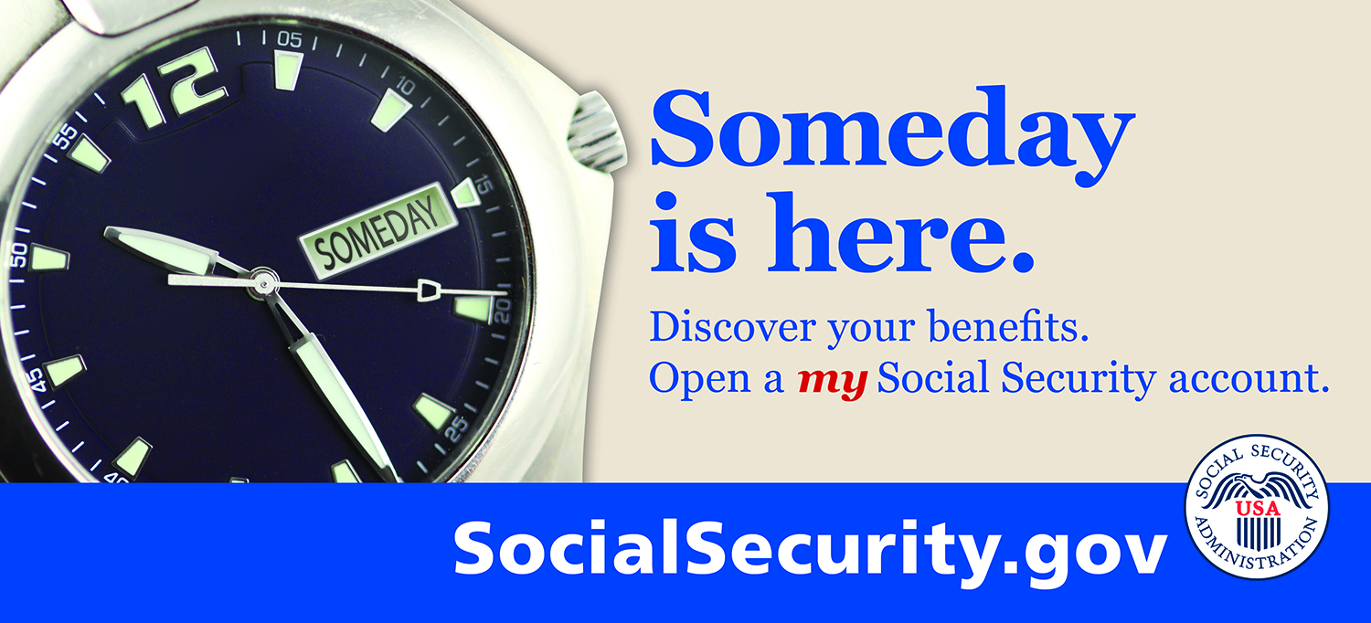
my Social Security
  Your Online Account ... Your Control ... socialsecurity.gov/myaccount
my Social Security is an easy-to-access,
easy-to-use portal to view and update some
of your own Social Security information.
Notes:
my Social Security is a convenient way to access valuable, personal Social Security information, whether you’ve been working and paying Social Security taxes or are receiving Social Security benefits. And you can check your online account just about whenever you want at socialsecurity.gov/myaccount.

Slide 27

Who Can Open a
my Social Security Account?
You must be at least 18 years old and have a:
Valid E-mail address;
Social Security number; and
U.S. mailing address.
Notes:
Almost anyone can open a my Social Security account. You must be at least 18 years of age, have a valid e-mail address, a Social Security number, and a U.S. mailing address (includes military addresses, APO/FPO/DPO AE, AP or AA).
There are many options available to set up an email address and it can be done in as little as five minutes. Each email provider has its own criteria for setting up an account and you must accept the provider’s terms of use agreement. Some examples of free email providers include:
AOL: aolmail.com
Gmail: gmail.com
iCloud Mail (Apple): icloud.com
Outlook: outlook.com
Yahoo: yahoo.com
*This is not a complete list of email providers. Social Security is not endorsing any of these particular email account provider(s), as you may use other email account providers as appropriate.
Even if you do not use email on the computer, if you have a smart phone it is likely that you already have an email account. Contact your cell phone service provider to find out.
You can only open a my Social Security account for yourself. You cannot open a my Social Security account for another person, even if you have his or her written consent. This also applies to an appointed representative or someone who is in business with the number holder.
You may be unable to open a my Social Security account if you:
• Blocked electronic access to your personal Social Security information;
• Recently moved or changed your name; or
• Placed a freeze on your credit report.

Slide 28
my Social Security Services
If you don’t get benefits, you can—
Review estimates of your future retirement and
disability benefits;
Review estimates of the benefits your family may get when you receive Social Security or die;
Verify your lifetime earnings according to Social
Security’s records;
Review the estimated Social Security and Medicare taxes you’ve paid;
Learn about qualifying and signing up for Medicare; and
View, save, and print your Social Security Statement.
Notes:
Your online my Social Security account provides a wealth of information to help you and your family. (Walk through the bullets in the slide.)
(Note to presenter: Services are available and presented to registered users based on the type of benefits they receive.
If the user does not receive benefits:
Access online Social Security Statement
If the user only receives Social Security benefits:
Access online Social Security Statement
Get benefit verification letter
Change address and telephone number
Start or change direct deposit
If the user only receives SSI benefits:
Access online Social Security Statement
Get benefit verification letter
If the user receives both Social Security and SSI benefits:
Access online Social Security Statement
Get benefit verification letter
If the user only receives Medicare:
Access online Social Security Statement
Get benefit verification letter
Change address and telephone number)

Slide 29
my Social Security Services
If you do get benefits you can—
  Check your benefit and payment information
  and verify your earnings record;
  Change your address and phone number; and
  Start or change your direct deposit.
  Get a replacement SSA-1099 or SSA 1042S for tax season.

Slide 30

Online Benefit Verification Letter
With my Social Security you can get your benefit verification letter online and use it
as official proof of:
Your income when you apply for a loan or mortgage, assisted housing
or other state or local benefits;
Your current Medicare health insurance coverage;
Your retirement or disability status; and
Your age.
Notes:
(Note to presenter: Read from slide.)

Slide 31
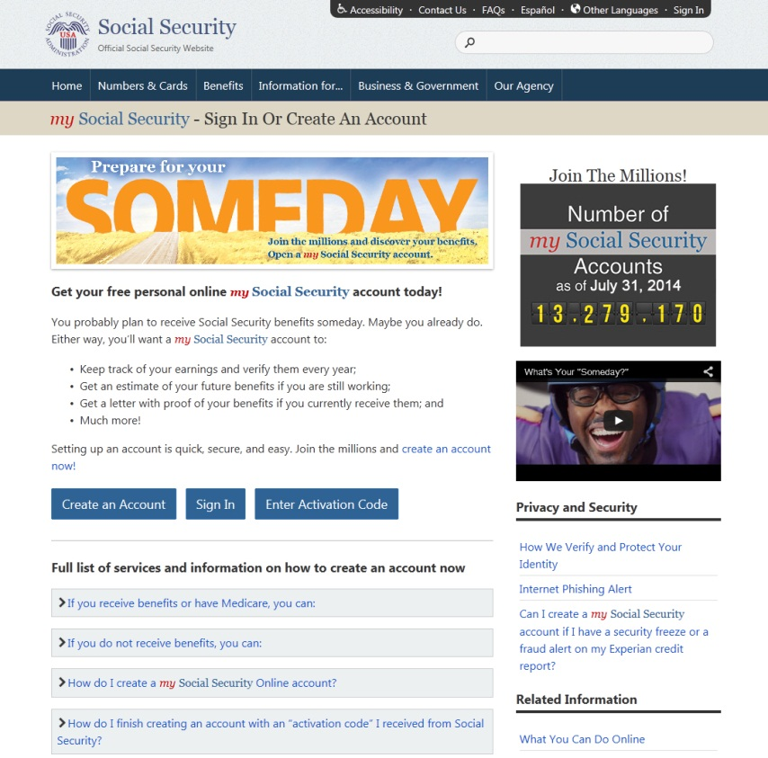
my Social Security
Getting Started
How to open a my Social Security account
1
Visit socialsecurity.gov/myaccount
2
Select: Create an Account
Notes:
After you have a valid email address, you are ready to open your own
my Social Security account.
To start, go to socialsecurity.gov/myaccount and select “Create an Account”.
This will bring you to our Terms of Service page. After reading this information, select the box that displays, “I agree to the Terms of Service” and select “Next” to continue.

Slide 32
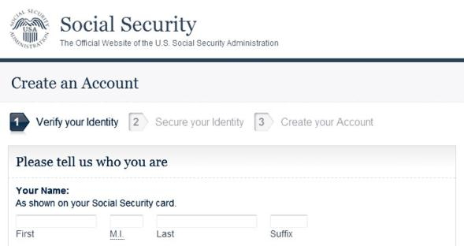
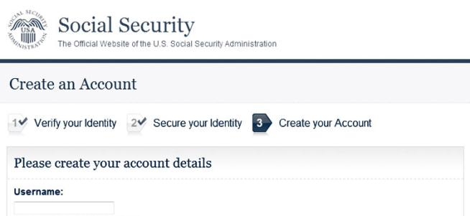
my Social Security
Getting Started
How to open a my Social Security account
Provide some personal information to verify
your identity.
3
Choose a username and password to create
your account.
4
Notes:
To secure your identity, we ask a few personal questions to which only you will likely know the answer.

Slide 33
my Social Security
You May Choose to Add Extra Security
You will need to enter a unique code we will send to your
text-enabled cell phone each time you want to sign in, in addition to your username and password. Your text message rates still apply.
To add this feature, you will first have to provide us with one of the following to verify your identity:
The last eight digits of your Visa, MasterCard,
or Discover credit card;
Information from your W-2 tax form;
Information from your 1040 Schedule SE
(self-employment) tax form; or
Your direct deposit amount, if you receive
Social Security benefits.
Notes:
You will also notice the option of adding an extra level of security to your account. By selecting “Yes, let’s start now” you are prompted to select an additional question to answer. With this feature, you will receive a temporary code via text message each time you attempt to log in. And you will use this code with your account password. Keep in mind that your cell phone provider’s message rates may apply.
To add this feature, you will first have to provide us with one of the following to verify your identity:
The last eight digits of your Visa, MasterCard, or Discover credit card;
Information from your W-2 tax form;
Information from a 1040 Schedule SE (self-employment) tax form; or
Your direct deposit amount, if you receive Social Security benefits.
In the past, we told you Social Security would never ask for your credit card number or other financial information. We have changed our policy for this one service. Now, we may ask you for the last eight digits of your Visa, MasterCard, or Discover credit card or some other financial information. Our new security process and federal guidelines require that we do this so we can be sure that you are who you say you are when you conduct online business with us.
This information provides extra security because even if someone gets your username and password, he or she will not be able to access your personal information.
Once you give us this additional information, we will send you a letter in the mail in five to 10 business days. You will need this letter to complete the process to add extra security.
You can upgrade to extra security or disable it at any time.

