Slide 1





VOICES UNITED

Slide 2

Pledge of Allegiance
I pledge allegiance to the flag of the United States of America and to the Republic for which it stands; one Nation under God, indivisible with Liberty and Justice for ALL.

Slide 3
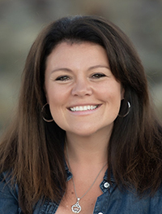
Welcome
Mairead Painter
State Long-Term Care Ombudsman

Slide 4

Beginning October 23, 2019, the new alert icon will be added to the Nursing Home Compare website.
It will be present for facilities cited on inspection reports for one or both of the following:
1) abuse that led to harm of a resident within the past year; and
2) abuse that could have potentially led to harm of a resident in each of the last two years.
To ensure CMS is providing the latest information, the icon will be updated monthly, at the same time CMS inspection results are updated.

Slide 5
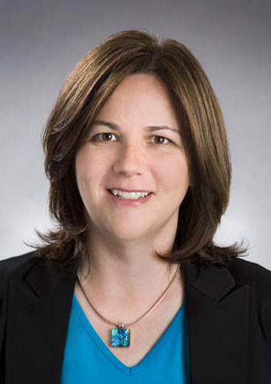
Opening Remarks
Commissioner Amy Porter
Department of Aging
and
Disability Services

Slide 6
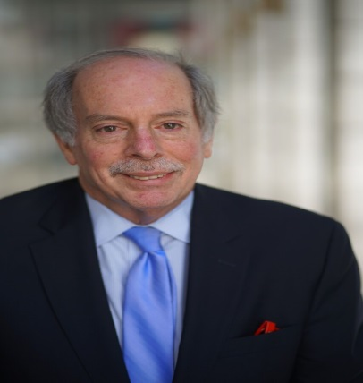
Keynote Speaker
Bob Blancato
National Elder Justice Coalition
Voices United for Justice

Slide 7

Elder Justice Advocacy: Connecticut and the U.S.
Bob Blancato
National Coordinator, Elder Justice Coalition
bob@elderjusticecoalition.com

Slide 8
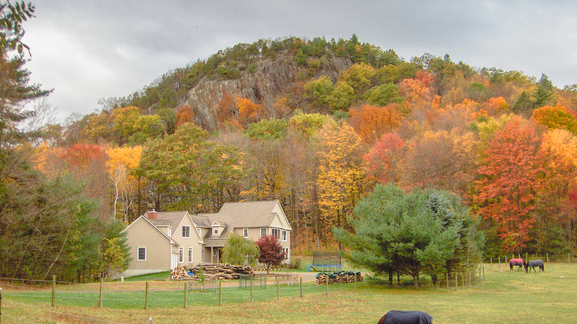

Slide 9

FY 2020 Funding: Getting There?
We are essentially halfway home with decisions on funding for the fiscal year which began last week
But one important intervening step
Required passage of a Continuing Resolution to keep the government open and funded through Nov 21
That was done
Even before that was agreement on a bipartisan budget agreement which will prevent any return to sequestration and will allow increases for some programs

Slide 10
Program | FY19 Final | FY20 House | FY20 Senate
Social Services Block Grant | $1.7 billion | $1.7 billion | $1.7 billion
Elder Justice Initiative | $12 million | $17 million | $12 million
OAA Title VII Ombudsman | $21.7 million | $23.7 million | $21.7 million
OAA Title VII MDTs | $3.9 million | $3.9 million | $3.9 million
VOCA - Crime Victims Fund | $3.353 billion | $2.838 billion | $3.177 billion
VAWA Elder Abuse Grants | $5 million | $9 million | $5 million
Notes:
Senate Labor-HHS has been held up by “poison pills” – so these numbers are proposal-only for Senate
FY20 House EJI funding includes $3 million increase for APS data collection/analysis and $2 million increase for screening related to opioid abuse
FY20 House Ombudsman funding includes $2 million increase to address assisted living facilities
10% of Crime Victims Fund is set aside for underserved populations, including victims of elder abuse

Slide 11

FY 2020 Funding (cont.)
Senate Labor-HHS will be complicated to resolve
May get more complicated because of the CR, because you can defer items and then face another deadline
Sen. Murphy is on Appropriations Committee
Our message to both Sens. Murphy and Blumenthal: support the House bill or do better!

Slide 12

Elder Justice Act—Getting There?
Hard to believe that in less than 6 months we will observe the 10th anniversary of the enactment into law of the EJA as part of ACA
A landmark law which has both made a difference but also has not realized its full potential
It set out the most comprehensive federal response to elder abuse ever
It has resulted in some $50 million in funds never previously spent on elder abuse
  Mostly in the APS space—grants and a new data collection system

Slide 13

Elder Justice Coordinating Council
It led to the formation of the Elder Justice Coordinating Council
  Connects all the federal agencies doing work and spending money on elder abuse to work in a more coordinated fashion with existing dollars
Today we find 14 different agencies working within EJCC to address the myriad number of issues in elder abuse from robocalls to the sad and growing link between elder abuse and misuse of opioids

Slide 14

EJA: Realizing Its Full Potential
Two areas
Funding—what has been achieved represents about 8% of what was authorized by the EJA—because the authority to spend is not the same as getting actual funds into the street
But the fact that we have any funding is a direct result of the leadership of Rep. Rosa DeLauro who now chairs the important Labor-HHS Subcommittee of the House Appropriations Committee
Next time out, the advocacy work must be two-fold—getting a new law passed—and a more aggressive appropriations strategy to secure needed funds
This Photo by Unknown Author is licensed under CC BY

Slide 15
EJA: Realizing Its Full Potential (cont.)
Second, nursing home reform space
EJA has provision calling for immediate reporting of crimes in nursing homes
  Section 1150B of the Social Security Act
  Reasonable suspicion of a crime must be reported within 24 hours (or two hours if serious bodily injury) to law enforcement and to HHS
  Penalties for not reporting: up to $200,000 for individuals
  Penalties for crimes: up to $21k per day
  Penalties for retaliation for reporting as well

Slide 16
Implementation of Protections
But prior Administration slow to implement
Now, current Administration wants to reduce enforcement and penalties, making this even harder to accomplish
Criminal background checks—while not technically part of EJA, much work from EJC went into it
  Yet, less than half of states participated, and a recent OIG report said those who did varied widely in rates of disqualification or did not fully implement the program

Slide 17
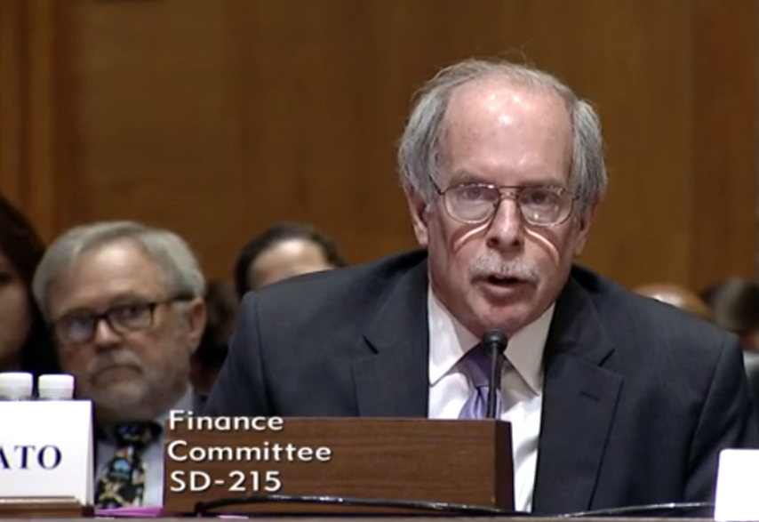
New Elder Justice Act
So now we are on the threshold of seeing a new Elder Justice Act
Process kicked off at Senate Finance Committee hearing on July 23 where I had privilege to testify (link to testimony in resources)
The new Elder Justice Act, when finalized:
  Like the previous one, it will be bipartisan
  Like the previous one, it will work to provide dedicated and increased funding for APS
  More training and funding for LTCOP
  Continue the work of the EJCC
  Possible set-aside of Crime Victims Fund $$ for APS’s activities

Slide 18

New EJA: Nursing Home Reforms
Much more emphasis on the nursing home reform side
Expect changes to Nursing Home Compare after the testimony in March provided by daughter of woman who died in nursing home due to dehydration and neglect—and the home had a five-star rating from the government
Stronger provisions on reporting of crimes
Emergency preparedness in nursing homes
And a revamped criminal background check program

Slide 19

New EJA: Timetable?
Timetable not totally clear, but I think it gets introduced this month in Senate
  House picture not as clear
Sure that Sen. Blumenthal, a strong advocate for elder justice, will join as a co-sponsor and likely Sen. Murphy too
  Sen. Murphy becomes important as a member of Senate Appropriations Committee to get any new law funded, working with Rosa DeLauro
Would expect that once introduced, it should move quickly, especially in Senate
It will be our top priority and I hope yours too

Slide 20
Other Relevant Advocacy Issues
Two other relevant advocacy issues
First is the need to push back on efforts by current Administration to roll back rules aimed at protecting nursing home residents
Binding arbitration ban rolled back
  Reverses the Obama admin’s ban on having nursing home residents sign a contract waiving their rights to sue the facility in cases of neglect and abuse—as a condition to admission to the facility

Slide 21
Other Relevant Advocacy Issues (cont.)
And, as mentioned previously, fines being levied are much lower, lessening the incentives for nursing homes to prevent/report abuse
  Many nursing homes now being charged on a per-incident basis rather than a per-day basis – and cap is the same, so many facilities only paying equivalent of one day of fines even if incident happened on more than one day

Slide 22

New OIG Report
A June report from the US Department of Health and Human Services Office of Inspector General (OIG) shows a disturbingly high level of potential abuse and neglect not being reported
  Incidents of Potential Abuse and Neglect at Skilled Nursing Facilities Were Not Always Reported and Investigated
1 in 5 high-risk hospital ER Medicare claims for treatment in 2016 were the result of potential abuse or neglect of residents

Slide 23

New OIG Report (cont.)
Facilities failed to report 84% of these claims to state survey agencies as required by federal law and regulation
State survey agencies then failed to report 67 of 69 claims to local law enforcement as required
Thus, the Centers for Medicare and Medicaid Services (CMS) could not track these incidents

Slide 24

The Report’s Recommendations
Training of nursing home staff
Clarification of guidance on definitions of abuse and neglect
Requiring state survey agencies to record and track all potential abuse/neglect and referrals to local law enforcement
Monitoring those referrals

Slide 25
Would This Help?
However, advocacy groups like Consumer Voice feel like this doesn’t go far enough since many of these things are already required (recording/tracking, monitoring) and they still aren’t happening
CV suggests fixes such as whenever a nursing home fails to report abuse/neglect, the survey agency also should impose a significant monetary penalty

Slide 26

Other Relevant Advocacy Issues (cont.)
Second is the need to reauthorize the Older Americans Act
Currently contains the following key elder justice provisions:
  Title VII, Allotments for Vulnerable Elder Rights Protection Activities, provides funding for the ombudsman program as well as community-based elder abuse prevention programs
  ACL, which administers OAA, is federal home for APS and funds the APS resource center, Natl. Center on Elder Abuse, Natl. Indigenous Elder Justice Initiative, and LTCOP resource center
House has a bill which is on its way to floor
It’s a good bill and the Senate needs to catch up

Slide 27


Getting Along Locally
Appears that there is a lot of interaction already between your organizations
Your Coalition partners cover the waterfront of who should be involved in this area
If a priority issue develops within the state, you should have the capacity to address
But it’s up to each member of the coalition to determine how they can help

Slide 28
Getting Along Locally (cont.)
Most importantly, a coalition by its very nature is a stronger voice because of its members – when it speaks, it speaks on behalf of its membership and the community at large
But it should be nimble enough to respond quickly, to prioritize issues, and to do “temperature checks” on how members feel they are doing as a louder/stronger voice

Slide 29

Getting Along Nationally
We ask that you continue to strengthen your relationship with your federal congressional delegation so they are constantly aware of your views
And we ask that you stay engaged with us to be aware of what the important federal issues are

Slide 30
Getting Along Nationally (cont.)
Understand significance of Committee/Subcommittee assignments of federal delegation
  Sen. Murphy/Rep. DeLauro on Appropriations
  Sen. Blumenthal on Judiciary and Aging
  Reps. Courtney and Hayes on Education and Labor (OAA jurisdiction)
And, we look forward to building closer relationships with your organizations
  Hope you continue to engage closely with the National Network of State Elder Justice Coalitions, an EJC leadership member

Slide 31

Conclusions
Leave with one main message
Continued advocacy will mean continued progress
VOICES United, the theme of your conference, is the key to this issue
We must all work together with a unified voice to prevent and combat elder abuse: local, state, national organizations
Or, quoting from a sign I found in a senior center in Torrington, Wyoming recently:
“We may not have it all together, but together we have it all!”

Slide 32

Resources
Elder Justice Finance Testimony: http://bit.ly/EJC-SenFinance
Elder Justice Coalition: http://elderjusticecoalition.com
EJC sign-up: http://bit.ly/EJClist
EJC Twitter: @elderjustice; EJC Facebook: http://facebook.com/elderjustice
DOJ Elder Justice: http://justice.gov/elderjustice
bob@elderjusticecoalition.com

Slide 33
Awards

Slide 34
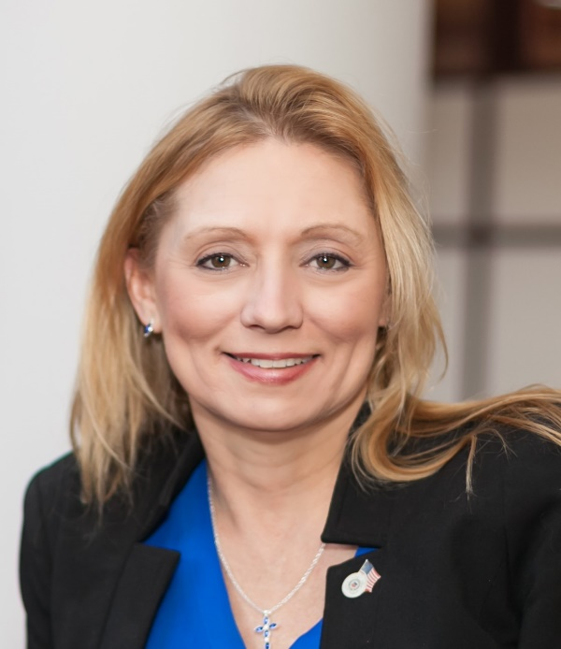
This year we are pleased to award the
Carol Rosenwald Spirit of Advocacy Award
to
Representative Michelle Cook

Slide 35
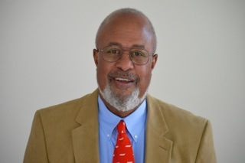
This year we are
pleased to award the
4th annual
Brian Capshaw
Rock Star Award
to
Byron D. Peterson

Slide 36
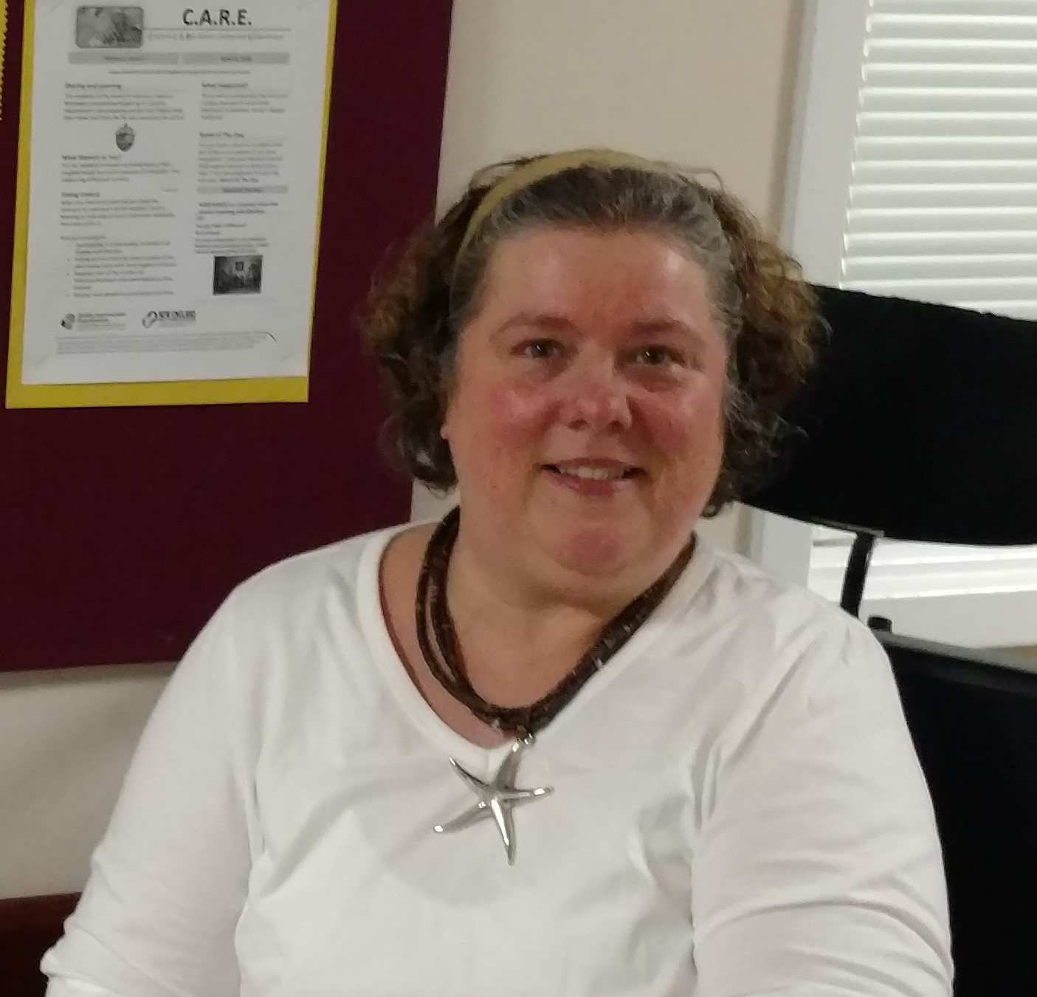
Legislative Update
&
Executive Board Advocacy
Jeannette Sullivan-Martinez
Executive Board Member
Pendleton HC

Slide 37
E-Board 2019 Advocacy Ideas
Personal needs allowance
  Increase
Staffing
  Staffing to provide quality care for needs of Residents in the home
Transportation
  Nonmedical – personal
  Affordable
Camera use

Slide 38
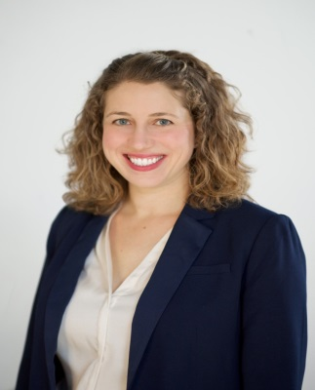
Effective Advocacy
Messaging for Change
Anna Doroghazi
Associate State Director for Advocacy and
Outreach AARP CT

Slide 39


Using Stories for Advocacy
Anna Doroghazi
Associate State Director – Advocacy and Outreach, AARP Connecticut

Slide 40
What is Advocacy?
Advocacy is an activity by an individual or group that aims to influence decisions within political, economic, and social systems and institutions.

Slide 41
What is Power?
“There is nothing wrong with power if used correctly…What we need to realize is that power without love is reckless and abusive, and love without power is sentimental and anemic. Power at its best is love implementing the demands of justice, and justice at its best is power correcting everything that stands against love.”
– Dr. Martin Luther King, Jr.

Slide 42
How can I have influence?
Individuals and groups can influence policies and systems by understanding who makes decisions, when decisions are made, and what goals decision-makers have.

Slide 43
Elements of Persuasion
Logos (logic) – the logic or reasoning behind an argument
Ethos (ethics) – the character and believability of the speaker
Pathos (emotion) – the emotional content that makes a connection to people and motivates them to take action

Slide 44
Developing and Sharing Stories
Know your goal
  Why are you telling this story?
  Can multiple stories deliver a single message?
Lion’s Share Family Services
Get to the point
  Call your BLUF – Bottom Line Up Front
  Develop a 27-9-3 story

Slide 45

    Open Microphone
    & Panel Discussion
Kim Hriceniak, DPH
Dorian Long, DSS-Protective Services
Jeanette Sullivan-Martinez, E-Board/RC Pres. – Pendleton HC
Anna Doroghazi - Associate State Director for Advocacy and Outreach AARP
Laura Snow-Robinson – CEJC -Program Director, Home Together AFLH

Slide 46

    Closing
Mairead Painter
State Long-Term Care Ombudsman

