Slide 1


TPA User Guide

Slide 2
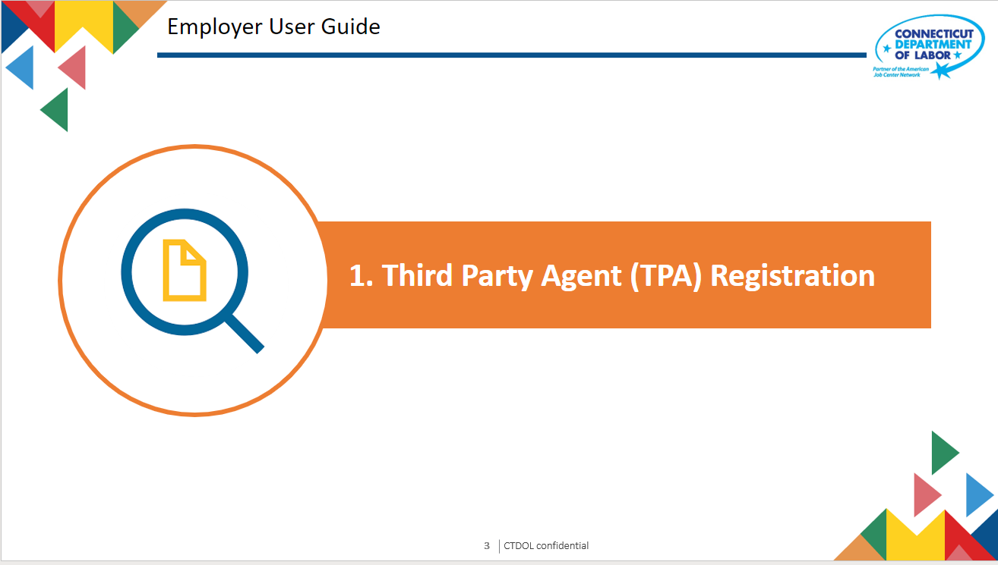
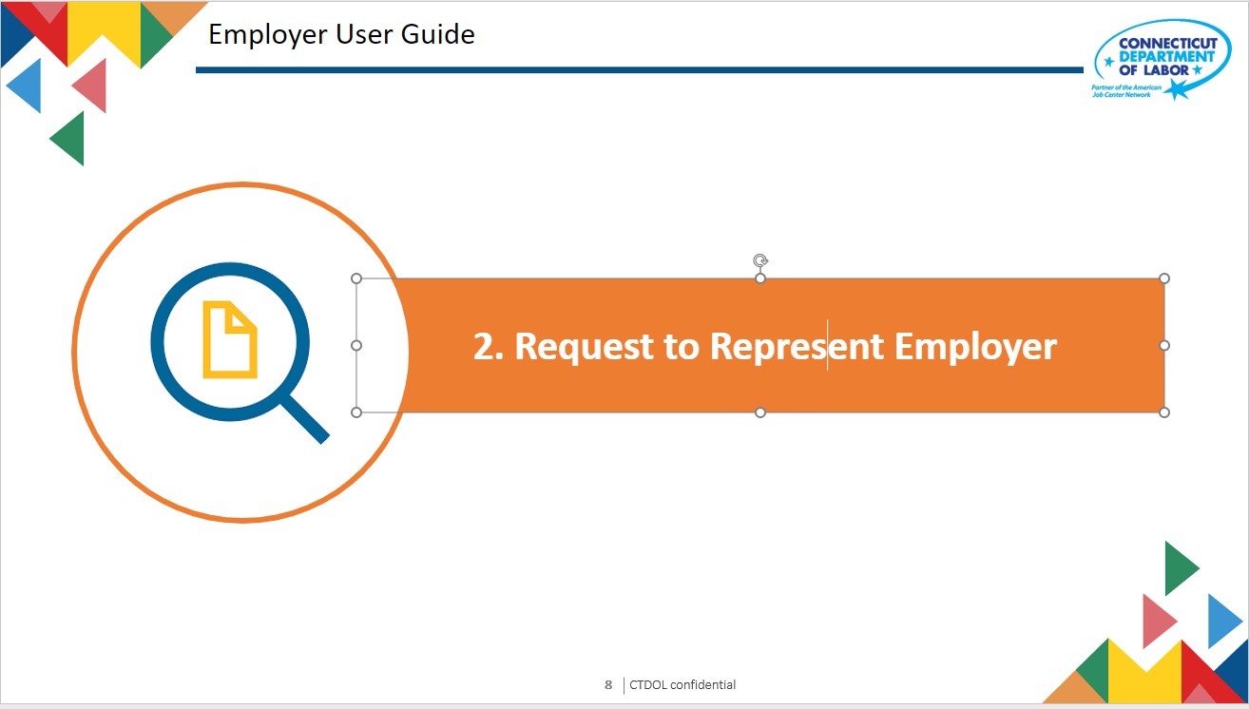
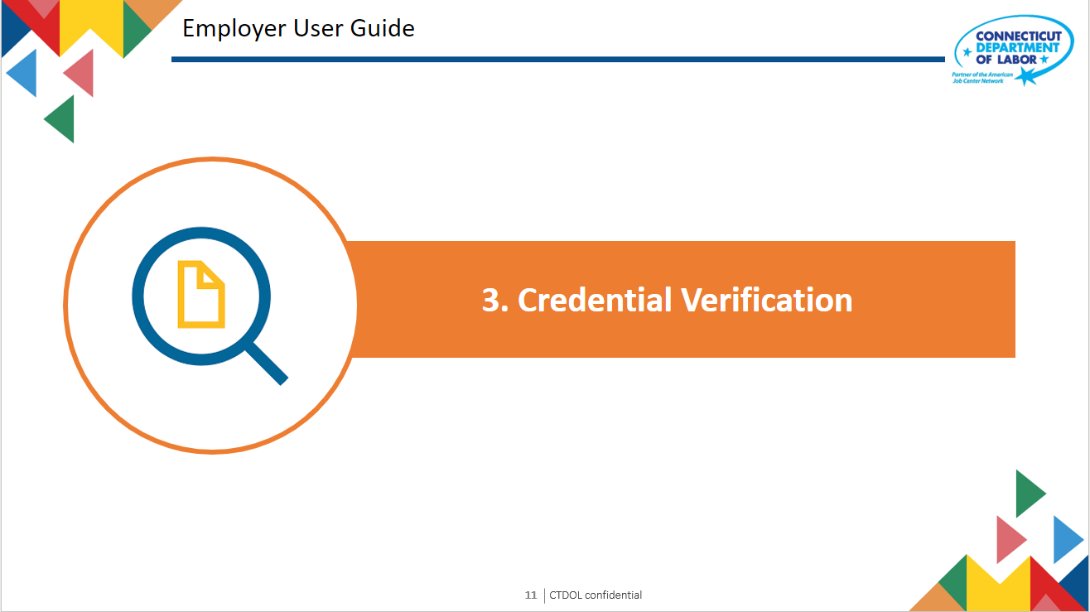


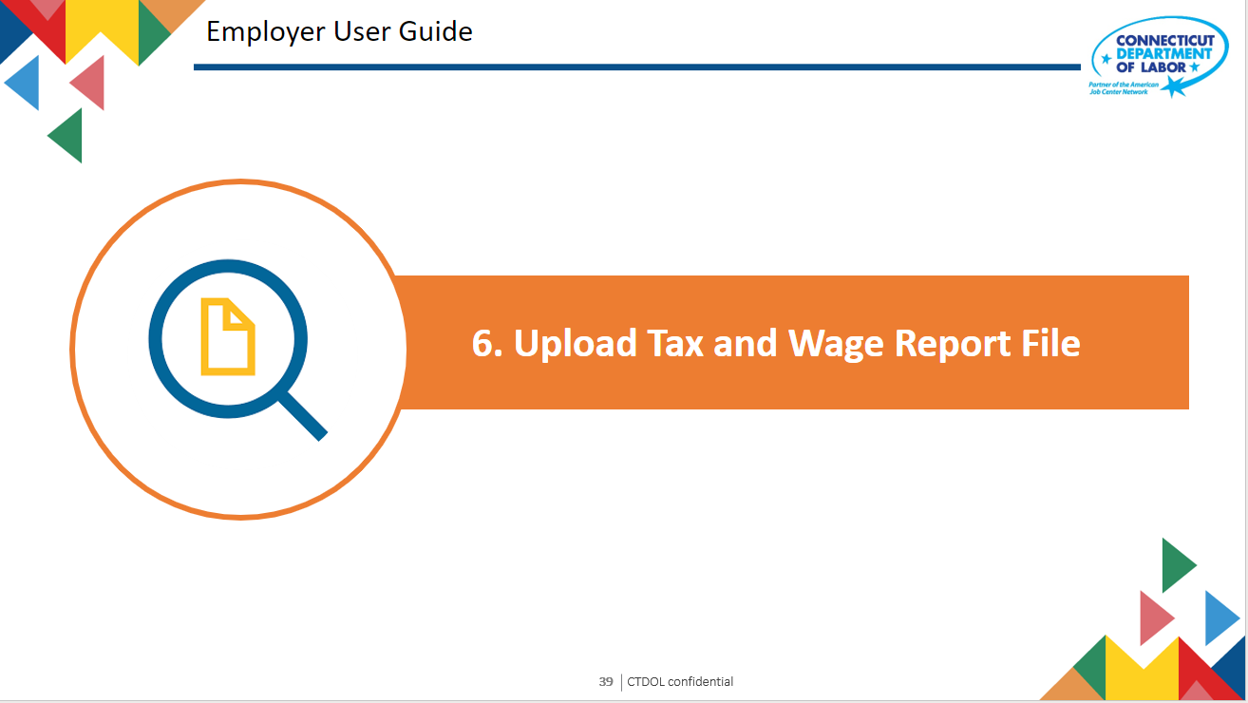
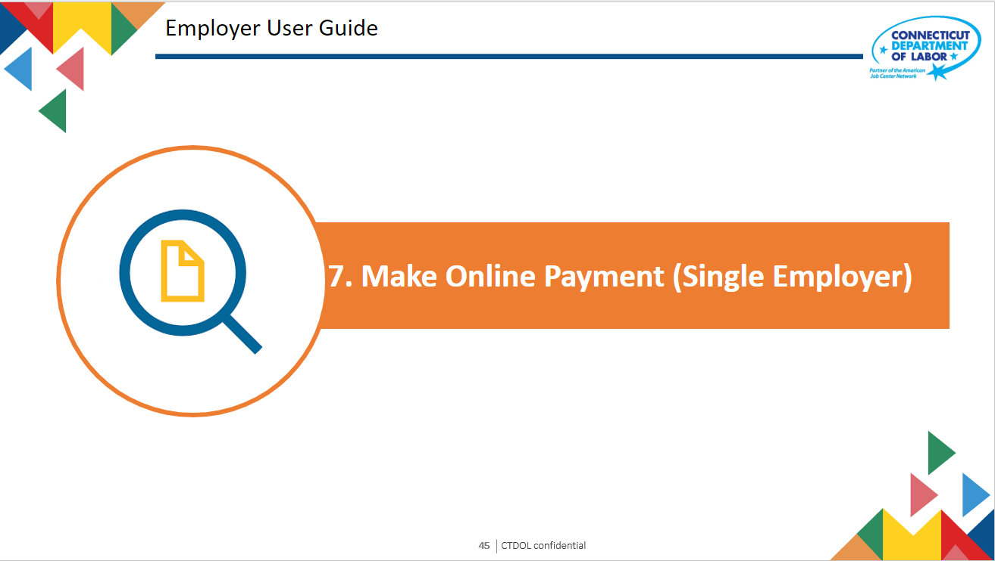
TPA User Guide
Table of Contents

Slide 3
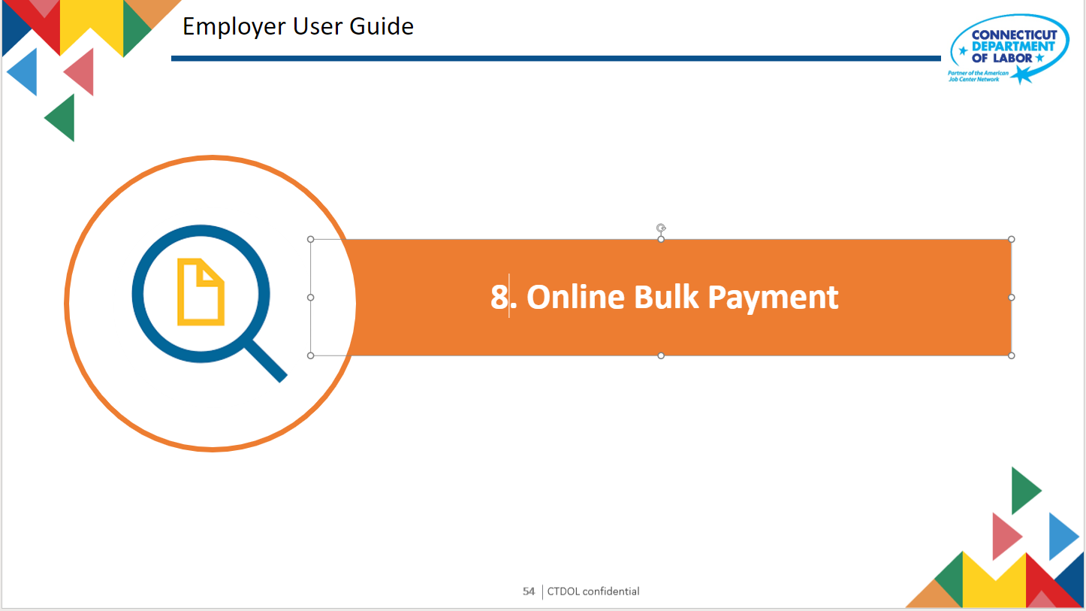


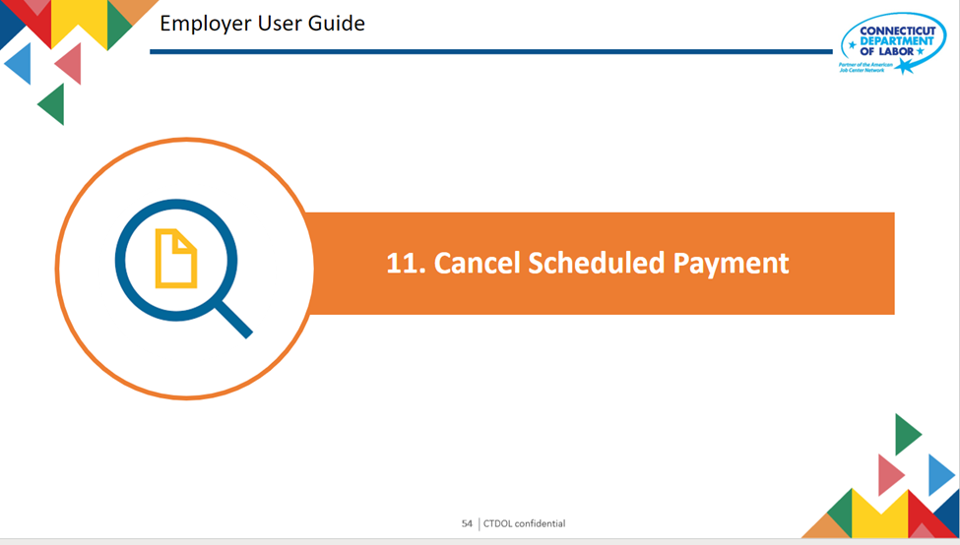
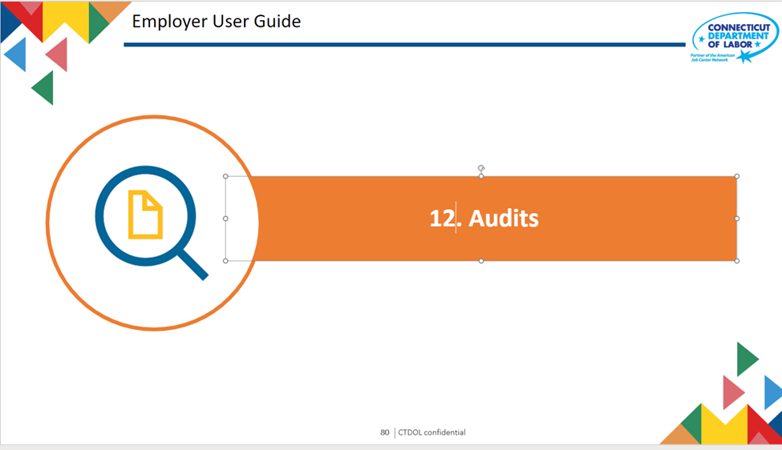
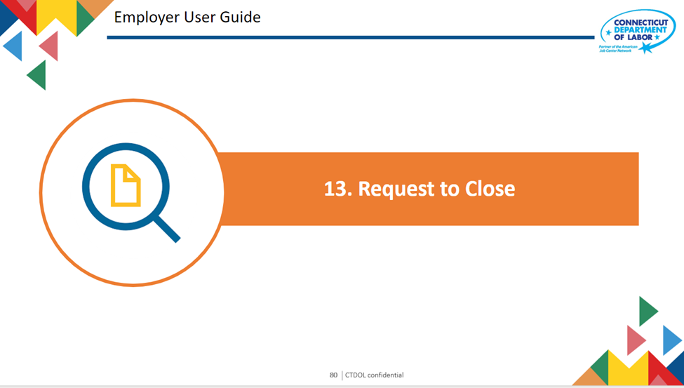

TPA User Guide
Table of Contents

Slide 4

Employer User Guide
1. Third Party Agent (TPA) Registration
Text 03

Slide 5
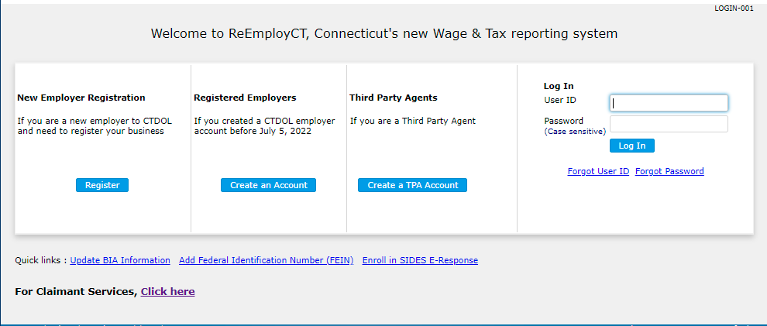
TPA Registration
Click Create a TPA Account

Slide 6
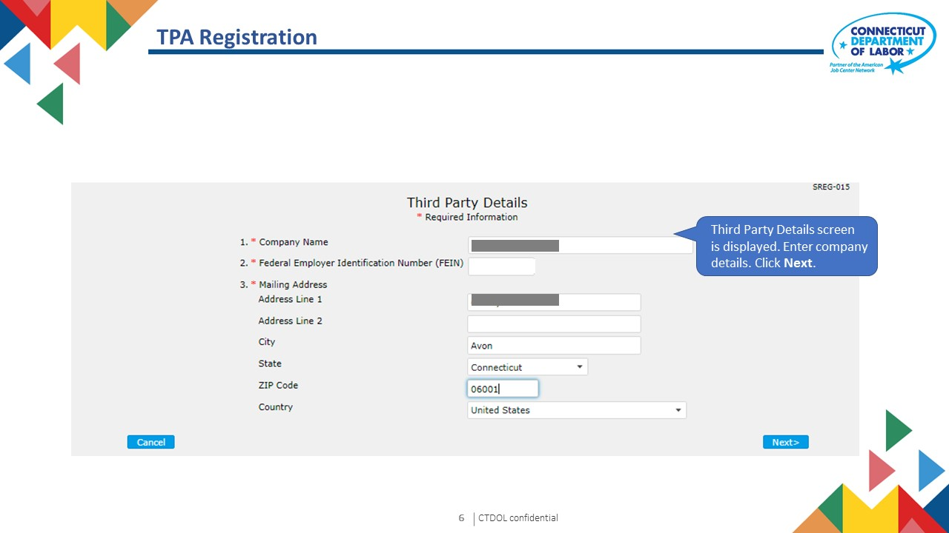

Slide 7
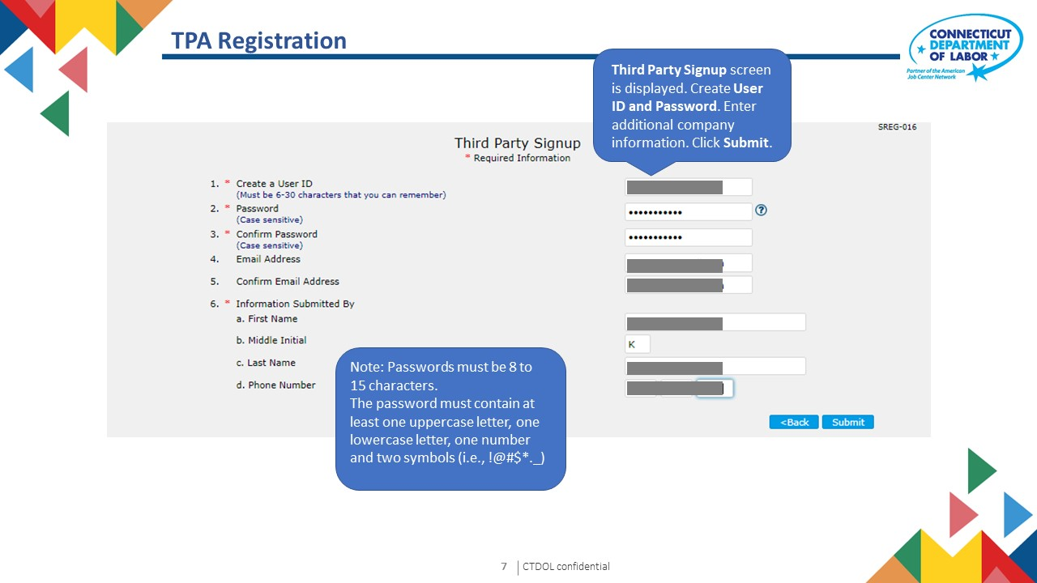

Slide 8
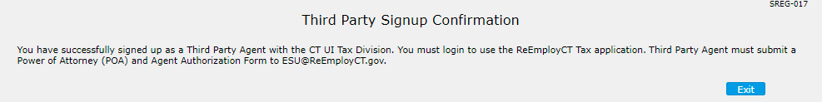

TPA Registration - Confirmation
Third Party Online Signup Confirmation screen is displayed. Registration is complete. Manual process must be completed. See Section 2.

Slide 10
Employer User Guide
2. Request to Represent Employer
Text 03

Slide 11
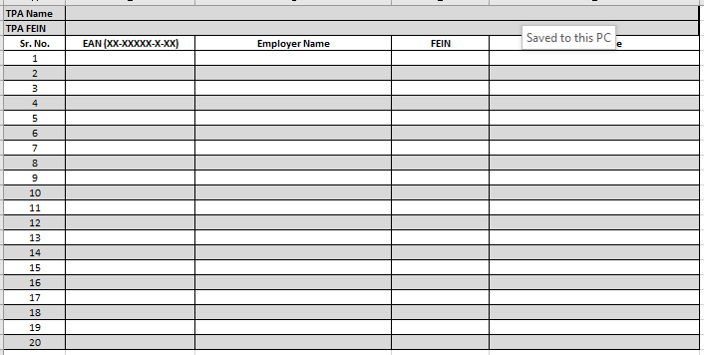
Request to Represent Employer – Previously Registered TPAs
For TPAs previously registered with CTDOL, please complete the Employer Linking Form and submit to dol.sos@ct.gov.

Slide 12
Request to Represent Employer – Newly Registered TPAs
Complete and submit Power of Attorney and Agent Authorization Form to dol.sos@ct.gov.

Slide 13
Employer User Guide
3. Credential Verification
Text 03

Slide 14
Forgot User ID
If user forgets User ID, click Forgot User ID.

Slide 15
Forgot User ID
The following message appears:
If you forgot your User ID:
•Claimants may complete this lockout form
•Employers or Third-Party Agents may contact us by clicking on the following link: ReEmployCT User ID/Password Resets (jotform.com)
•State or Federal Agencies or Housing Authorities may contact us via email at: DOL.ReEmpPartnerReset@ct.gov

Slide 16
Forgot Password
If user forgets password, enter User ID and click Forgot Password.

Slide 17
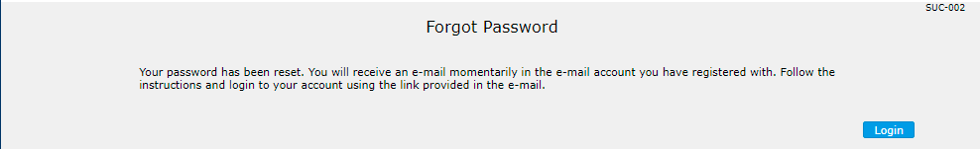
Forgot Password
Message populates to inform user to check their email for instructions on resetting their password.

Slide 18
Employer User Guide
4. File Tax and Wage Report
Text 03

Slide 19
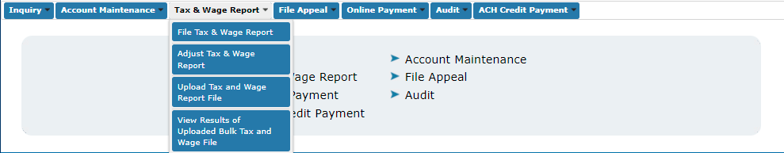
File Tax & Wage Report – Single Employer
Select Tax & Wage Report then File Tax & Wage Report.

Slide 20
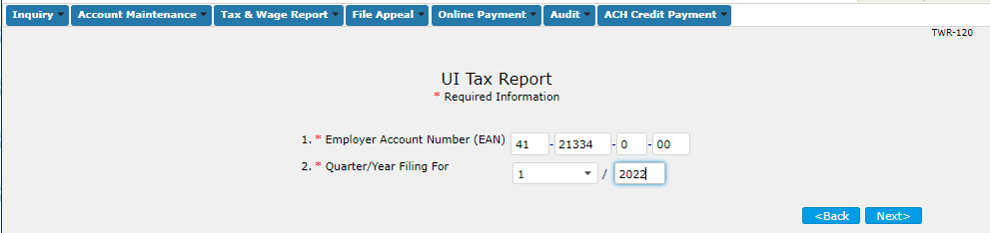
File Tax & Wage Report – Single Employer
The UI Tax Report screen displays. Enter the Employer Account Number (EAN) and select mandatory dropdown field from Quarter/Year Filing for and click the Next button.

Slide 21
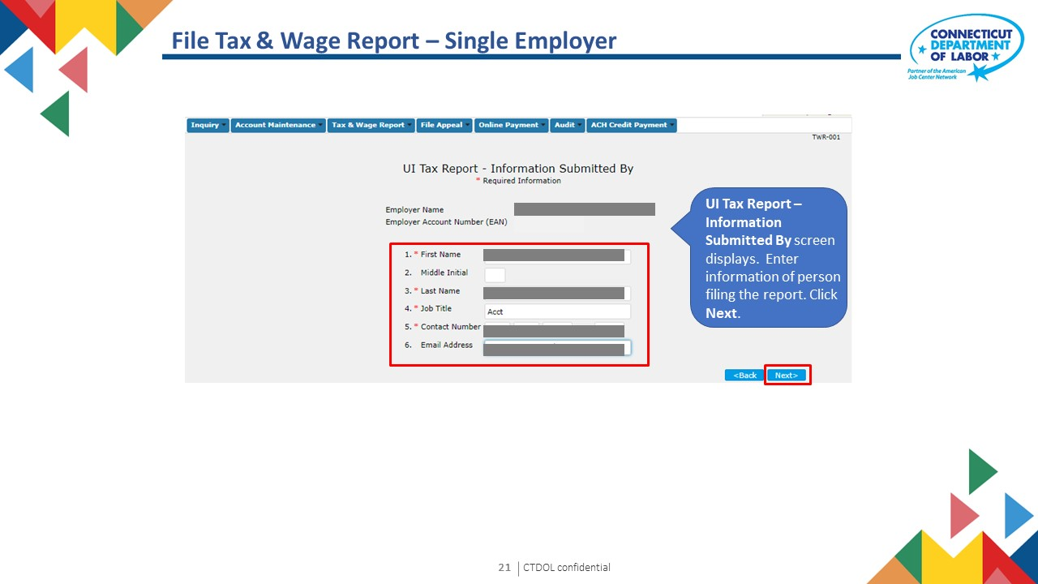

Slide 22
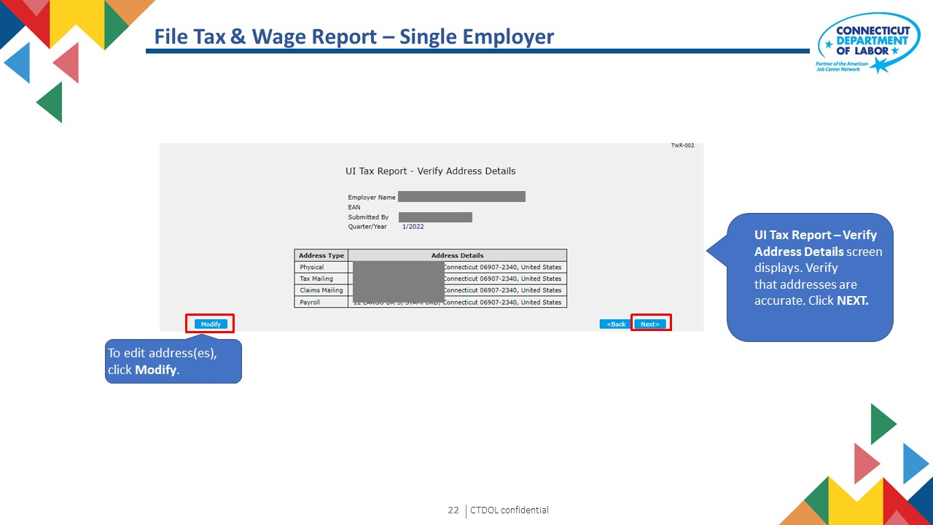

Slide 23
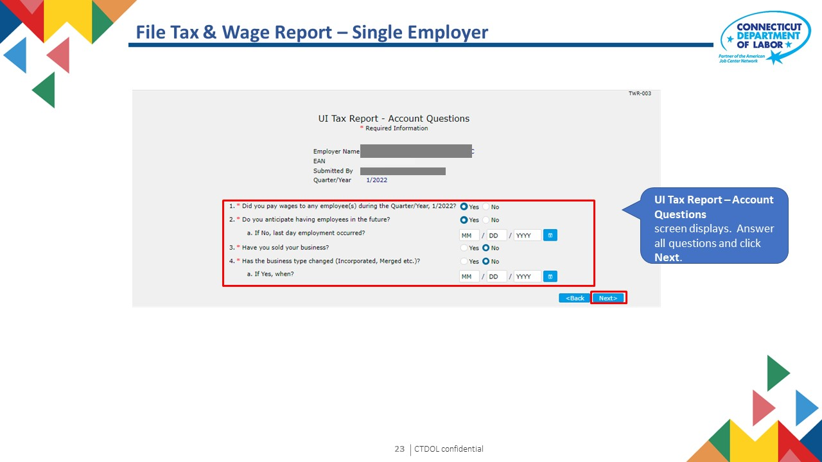

Slide 24
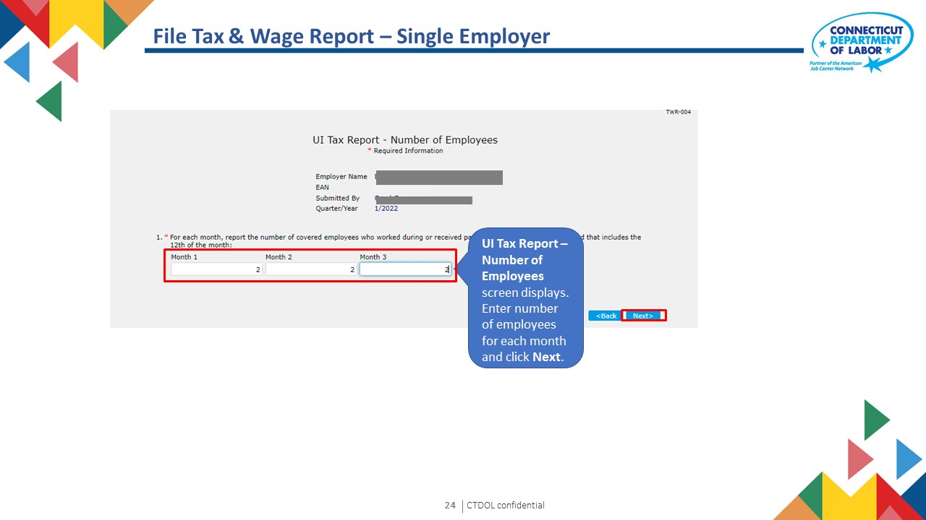

Slide 25
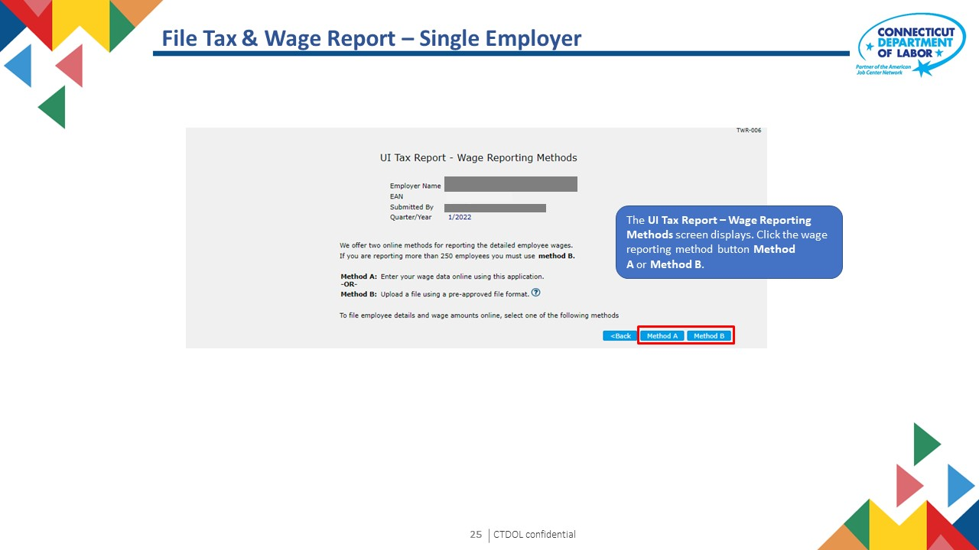

Slide 26
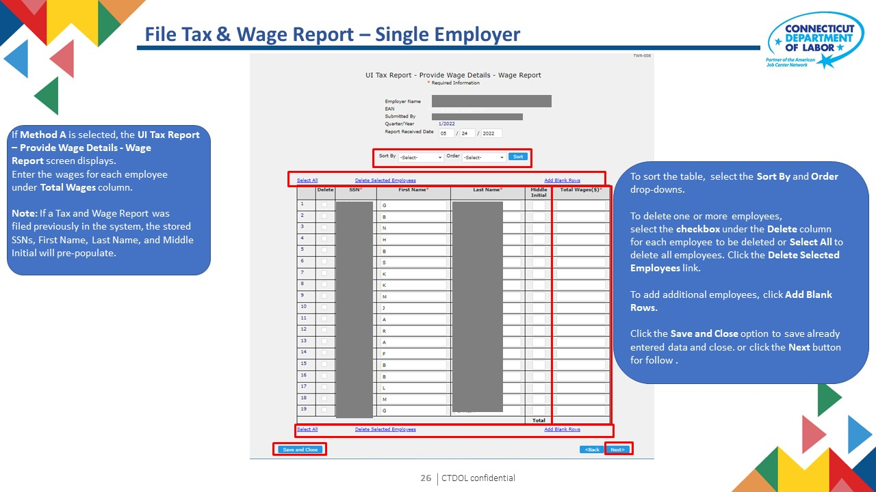

Slide 27
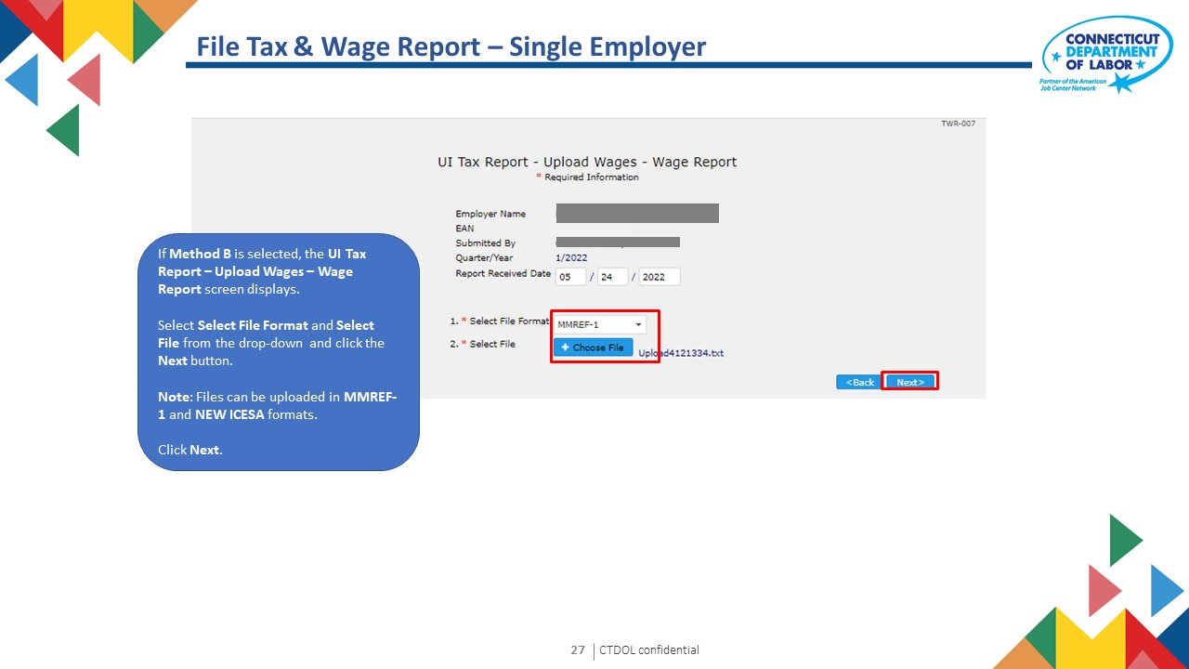

Slide 28
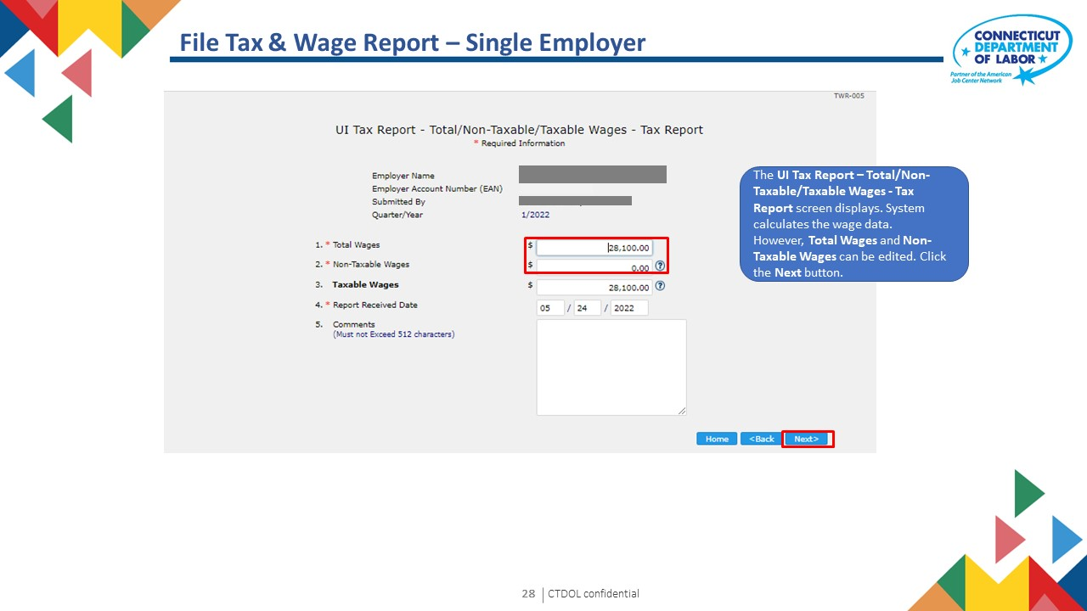

Slide 29
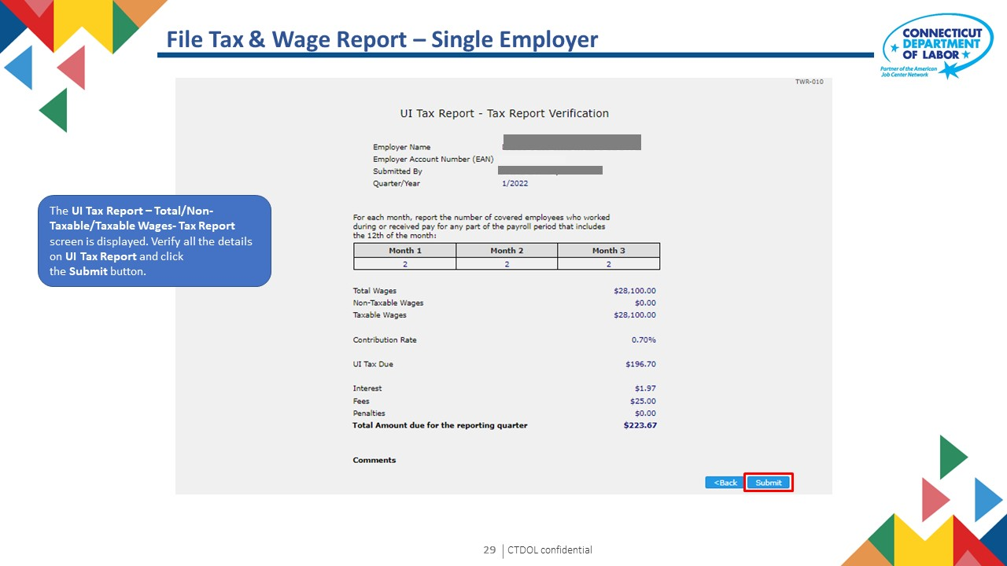

Slide 30
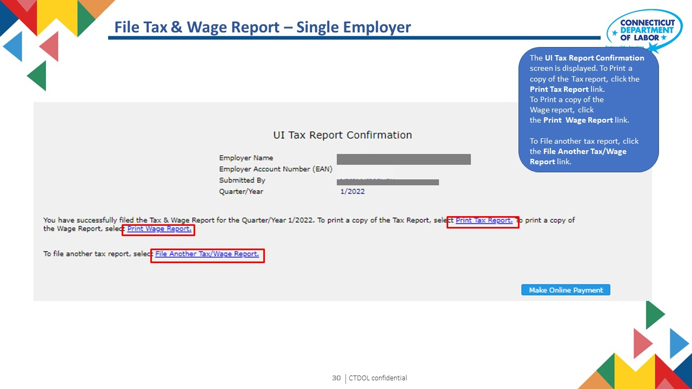

Slide 31
Employer User Guide
5. Adjust Tax and Wage Report
Text 03

Slide 32
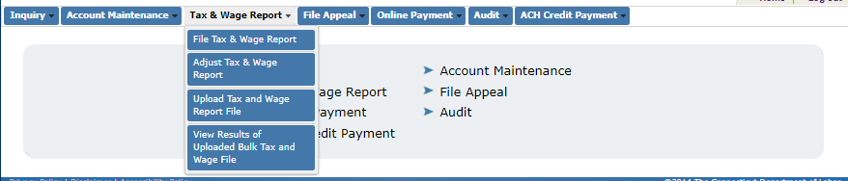
Adjust Tax & Wage Report

Slide 33
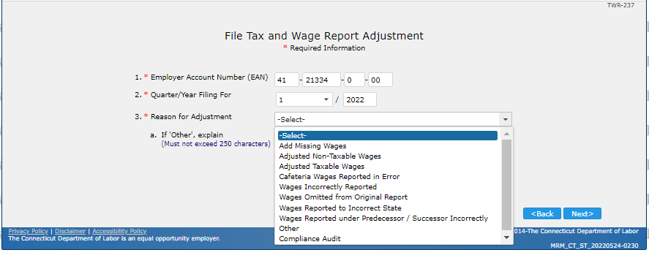
Adjust Tax & Wage Report
The File Tax and Wage Report Adjustment screen is displayed. Enter the information in the mandatory fields click the Next button.

Slide 34
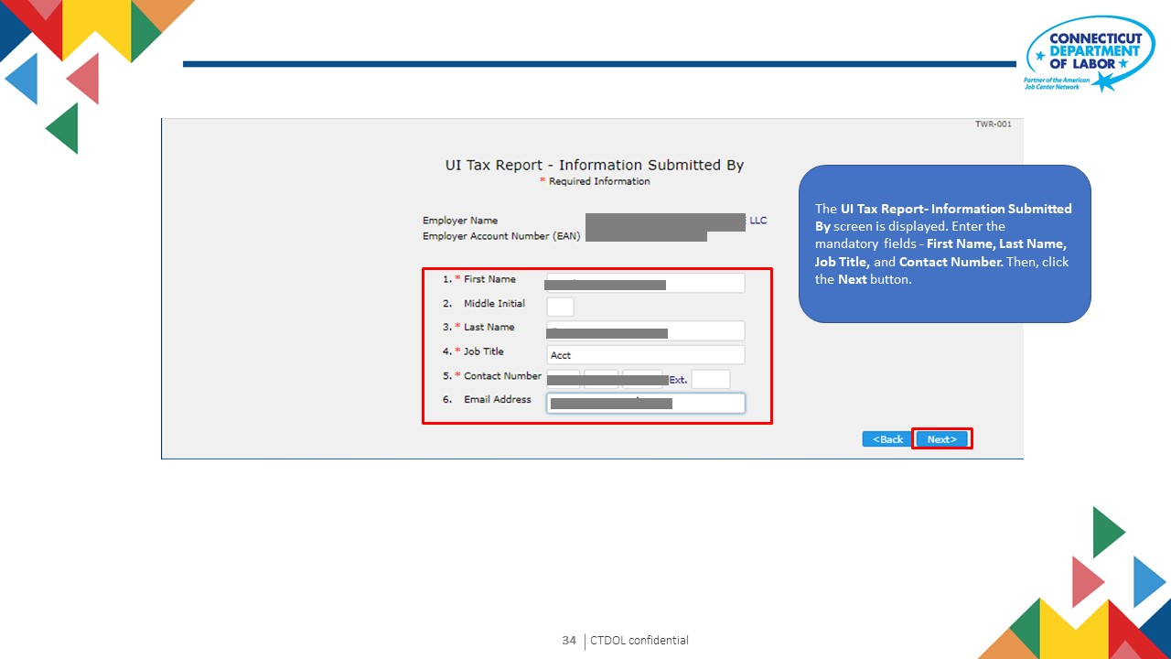

Slide 35
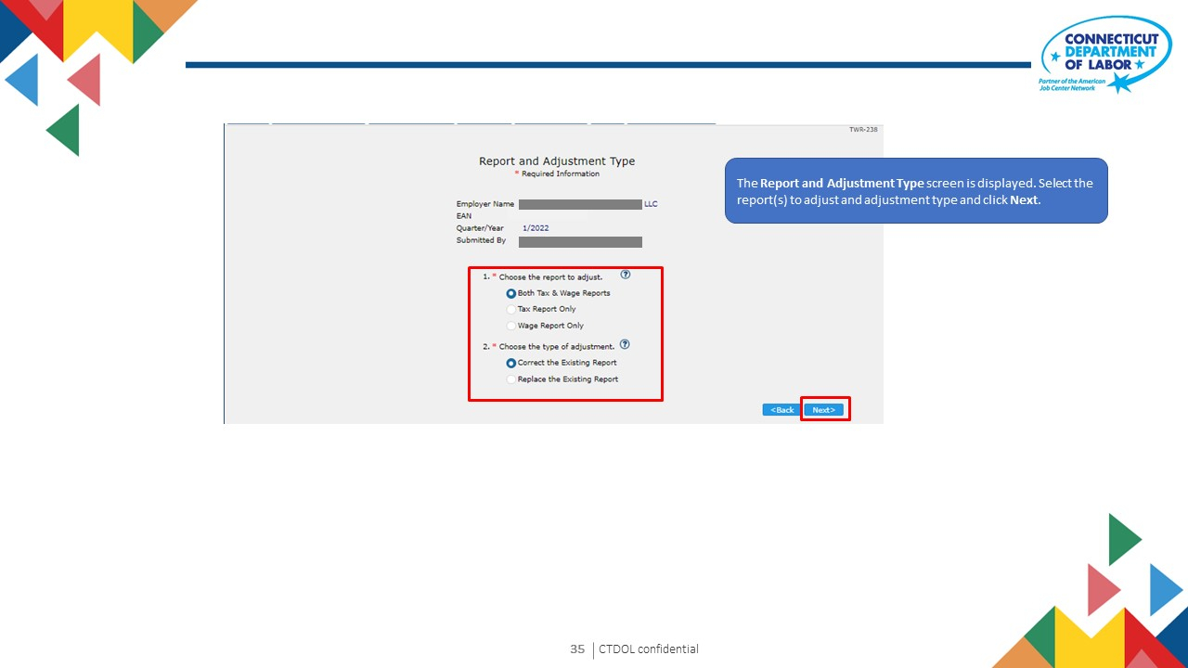

Slide 36
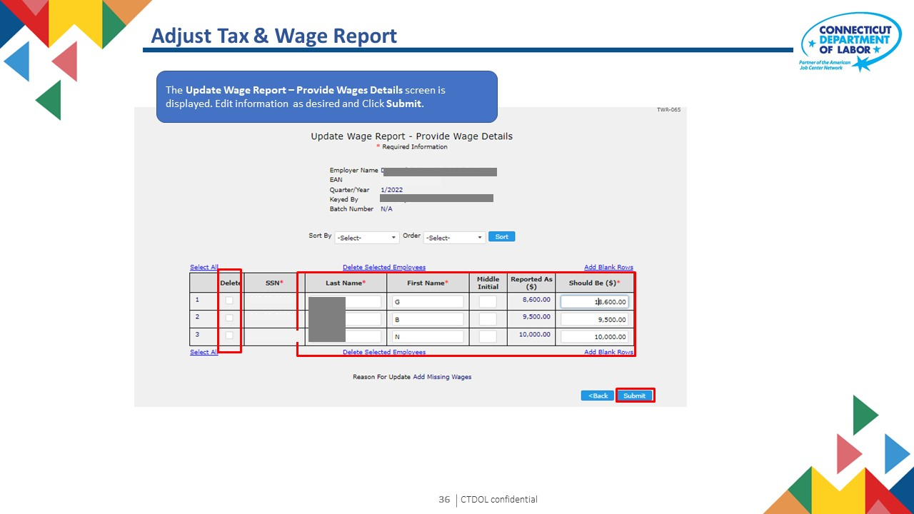

Slide 37
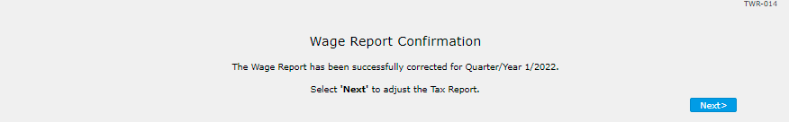
Adjust Tax & Wage Report
The Wage Report Confirmation screen is displayed. This screen confirms that the wage report has been successfully corrected. Click Next.

Slide 38
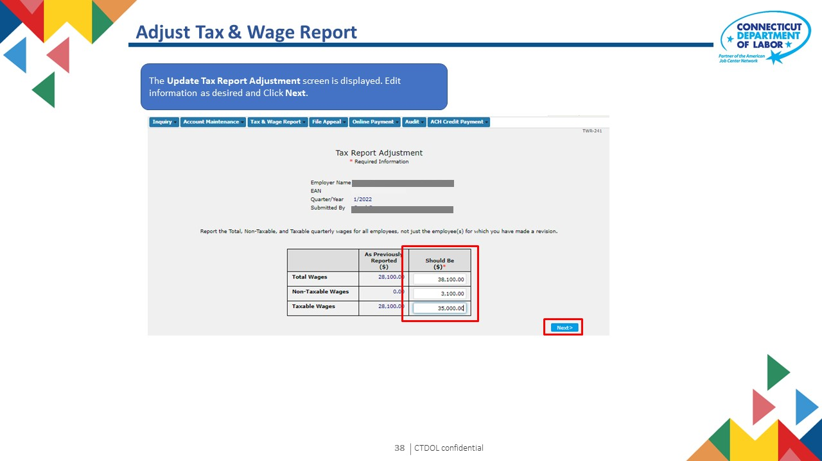

Slide 39
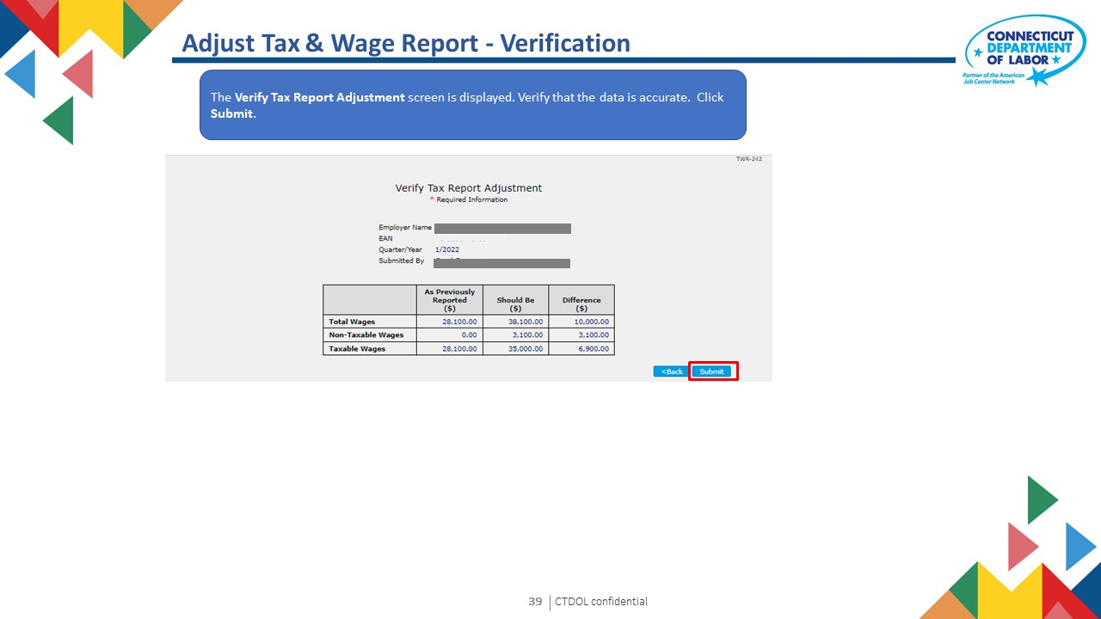

Slide 40
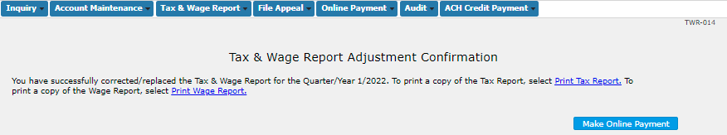
Adjust Tax & Wage Report - Confirmation
The Tax & Wage Report Adjustment Confirmation screen is displayed. This screen confirms that the Tax and Wage Report has been successfully corrected. Click Next.
To Print a copy of the Tax Report, click the Print Tax Report link.
To Print a copy of the Wage Report, click the Print Wage Report link.
To make an Online Payment, click the Make Online Payment button.

Slide 41
Employer User Guide
6. Upload Tax and Wage Report File
Text 03

Slide 42
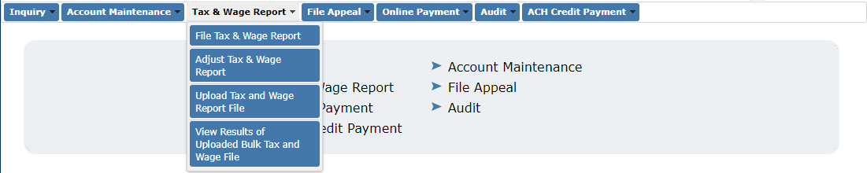
Upload Tax & Wage Report File
A third-party agent can file tax and wage report files for multiple employers that they represent by filing a bulk file. The user selects the highlighted menu option.

Slide 43
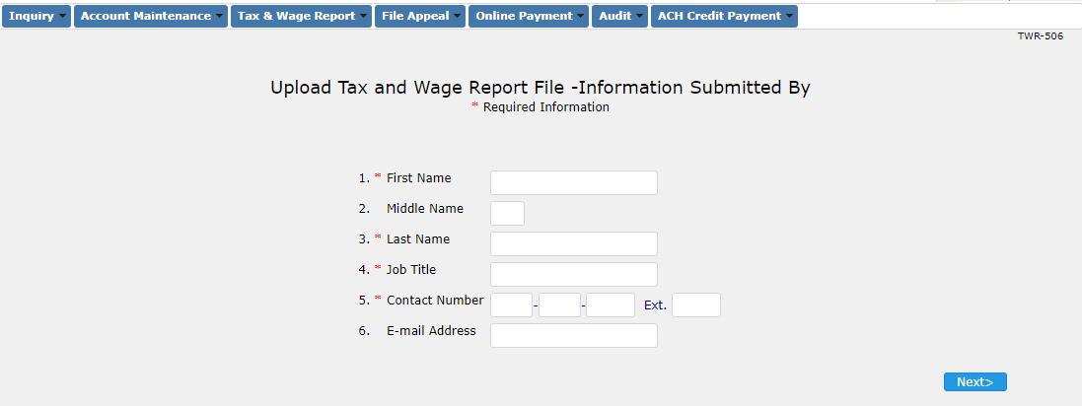
Upload Tax & Wage Report File
The user enters information of the person submitting the file.

Slide 44
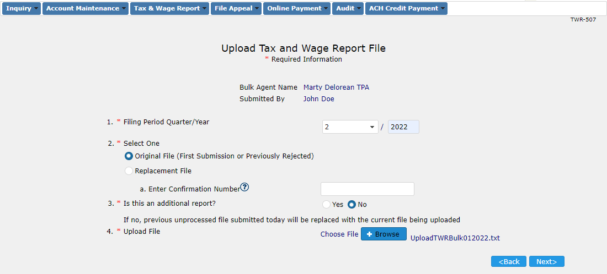
Upload Tax & Wage Report File
The user enters the information:
The quarter-year
Original / replacement file. If replacement, confirmation number should be entered
Additional reports can be added to already uploaded file.
The user uploads the file and selects "Next"

Slide 45
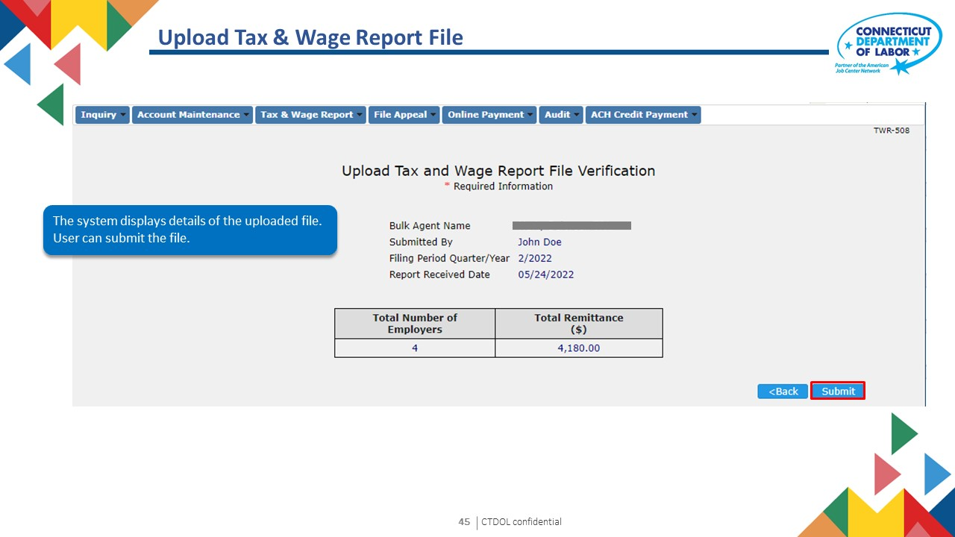

Slide 46
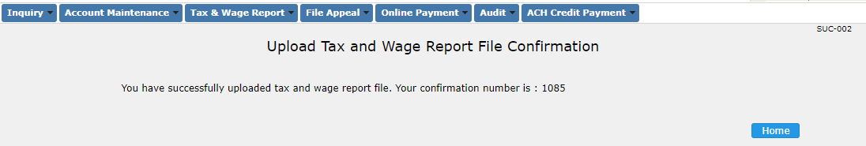
Upload Tax & Wage Report File
The file is submitted and a confirmation number is generated. The confirmation number can be used to make a bulk online payment or resubmit the tax and wage report file.

Slide 47
Employer User Guide
7. Make Online Payment (Single Employer)
Text 03

Slide 48
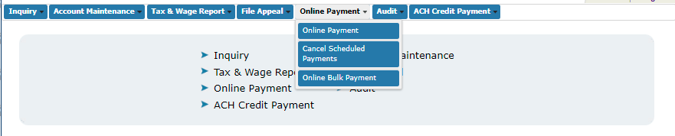
Make Online Payment – Single Employer
Click Online Payment

Slide 49
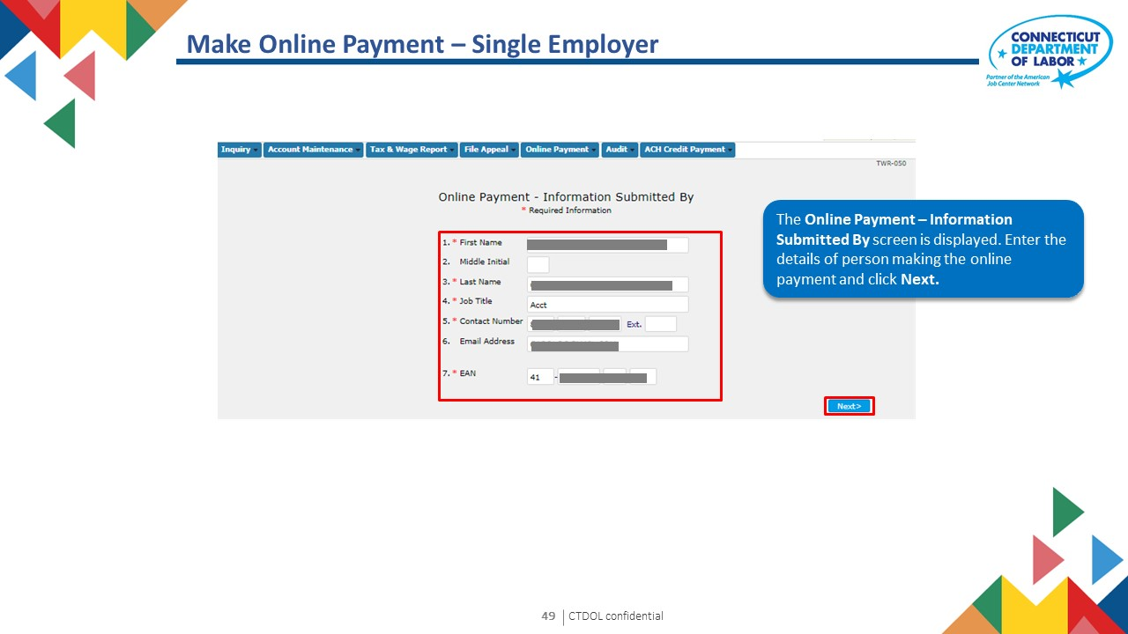

Slide 50
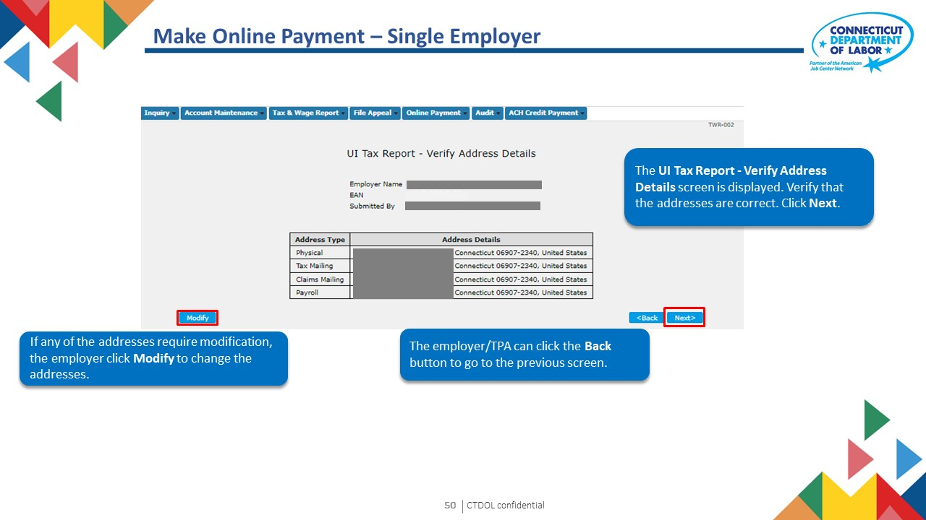

Slide 51
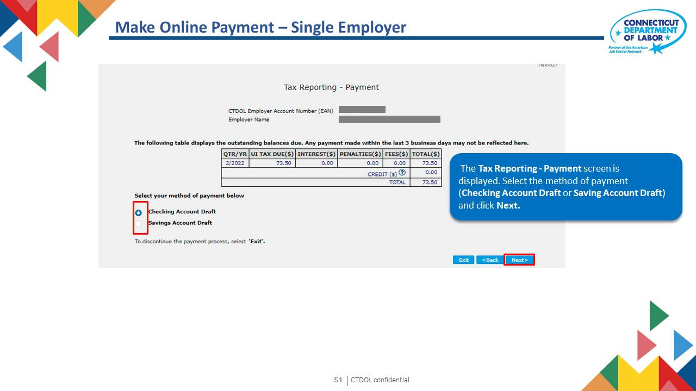

Slide 52
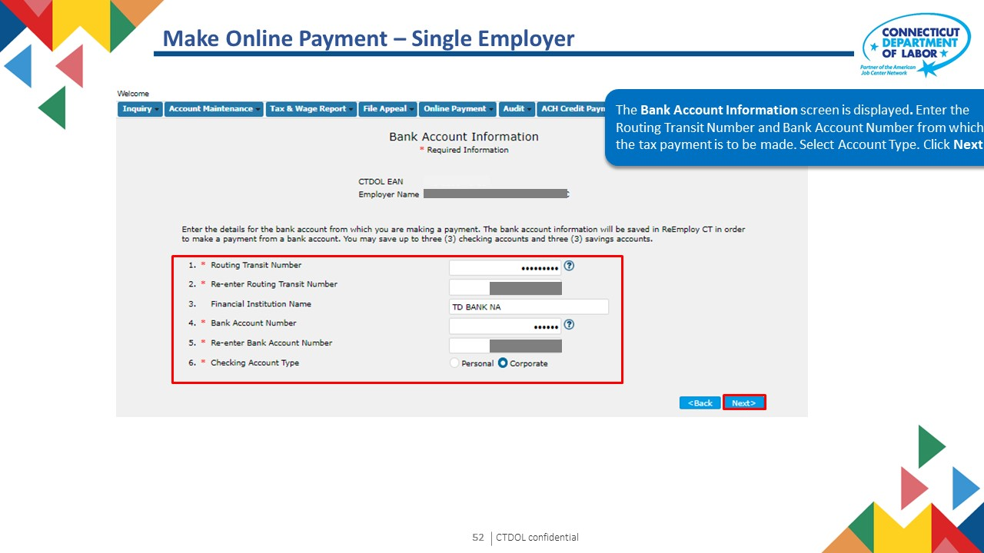

Slide 53
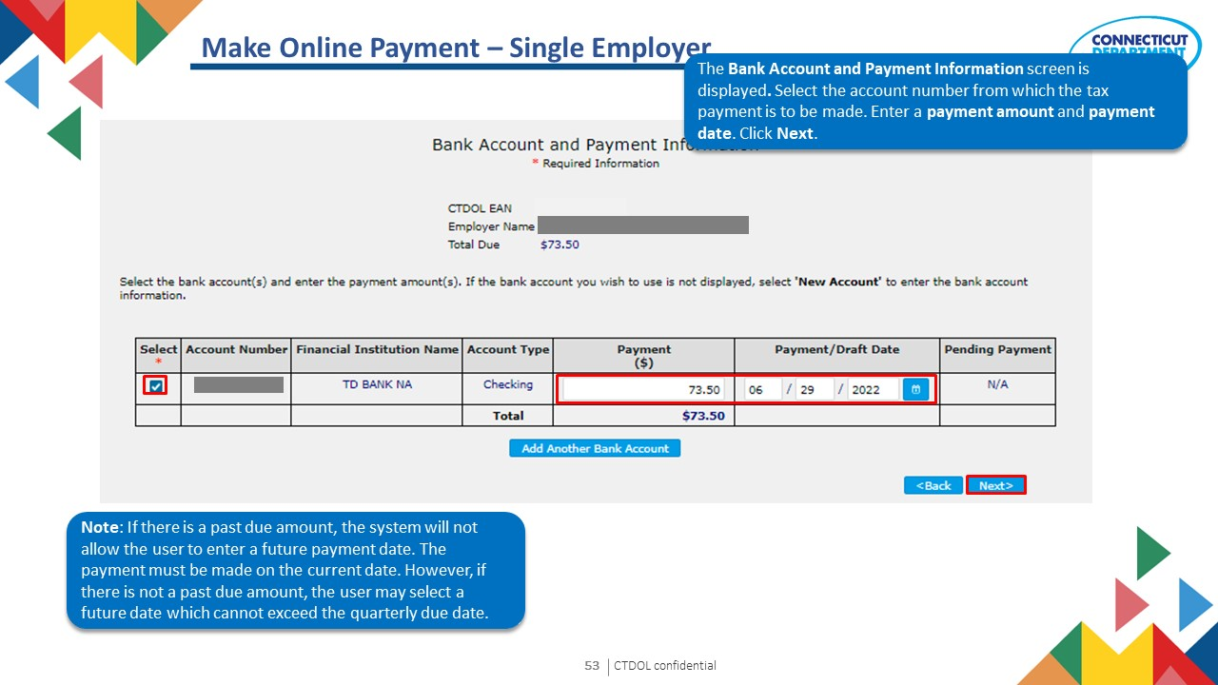

Slide 54
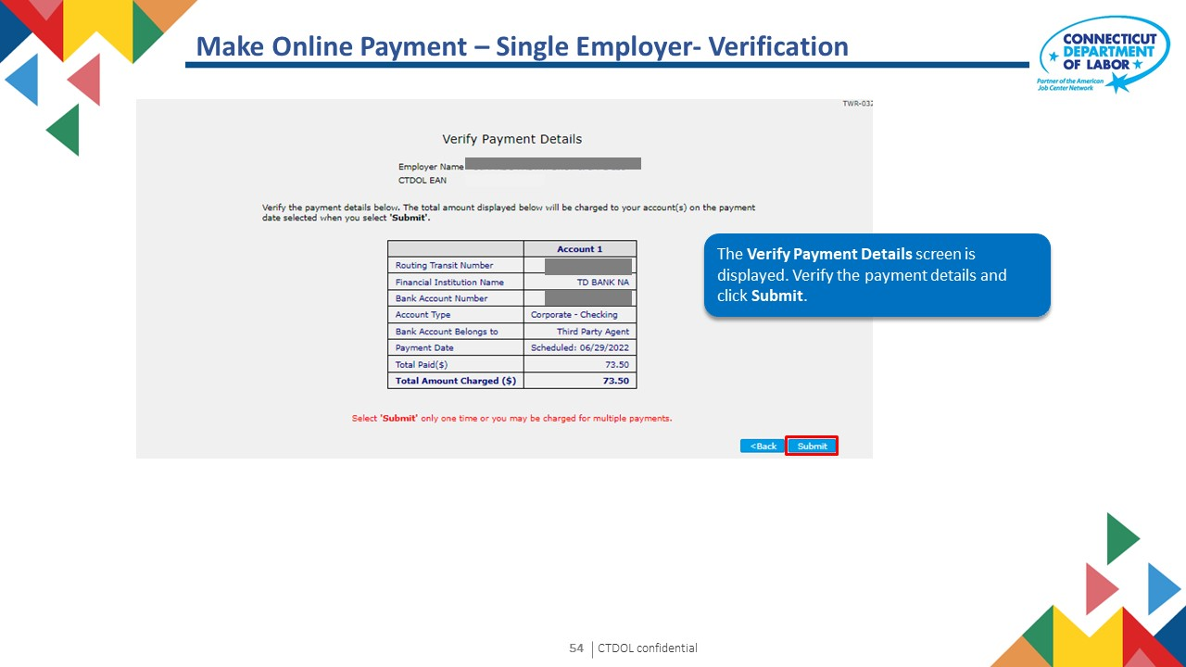

Slide 55
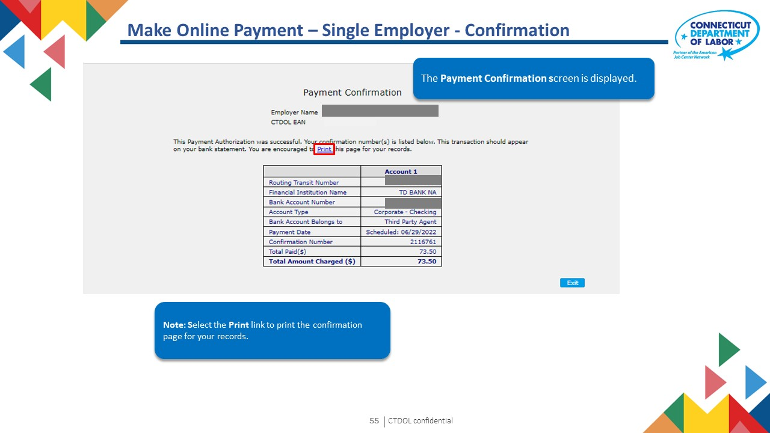

Slide 56
Employer User Guide
8. Online Bulk Payment
Text 03

Slide 57
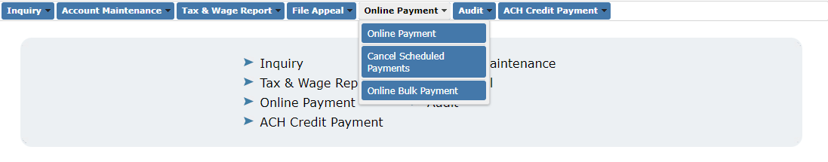
Online Bulk Payment
Click Online Bulk Payment

Slide 58

Online Bulk Payment
Enter information of the user entering the data

Slide 59

Online Bulk Payment
Enter the confirmation number generated when bulk tax and wage file was submitted. Payment amount will be auto-populated.

Slide 60


Slide 61


Slide 62


Slide 63
Employer User Guide
9. View ACH Credit Payment
Text 03

Slide 64

View ACH Credit Payment
To view ACH credit payment, the user selects on the menu option

Slide 65

View ACH Credit Payment
The payments made will be listed on the screen by payment date. The user selects a payment record and clicks on "Next".

Slide 66

View ACH Credit Payment – No Pending Payments
The payment results are displayed. "No records found indicates that there are no error records.

Slide 67

View ACH Credit Payment – Pending Payments
This screen is shown when there are errors in the ach payment data. User can download an excel file to see the data.

Slide 68
Employer User Guide
10. Update ACH Credit Payment
Text 03

Slide 69

Update ACH Credit Payment
This process is used to update any error records in the ACH credit payment so that the payment can be applied. The user starts this process by selecting the highlighted menu option

Slide 70

Update ACH Credit Payment
The payments made will be listed on the screen by payment date. The user selects a payment record and clicks on "Next".

Slide 71


Slide 72


Slide 73


Slide 74

Update ACH Credit Payment - Confirmation
The user can select another payment record to update by selecting on the highlighted button.

Slide 75
Employer User Guide
11. Cancel Scheduled Payment
Text 03

Slide 76

Cancel Scheduled Payment
Click Cancel Scheduled Payments

Slide 77


Slide 78


Slide 79


Slide 80


Slide 81


Slide 82
Employer User Guide
12. Audits
Text 03

Slide 83

Audits
Third party agents can respond to audit questionnaires on behalf of the employer they represent. To enter a questionnaire the user clicks on the highlighted menu option.

Slide 84


Slide 85


Slide 86

Audits
The user enters all the questionnaire responses.

Slide 87

Audits
The user enters all the questionnaire responses.

Slide 88

Audits
The user enters all the questionnaire responses and selects submit.

Slide 89


Slide 90

Audits - Verification
The user submits the questionnaire responses.

Slide 91

Audits - Confirmation
The questionnaire responses and saved successfully.

Slide 92
Employer User Guide
13. Request to Close
Text 03

Slide 93

Request to Close Account
From the home screen, select Account Maintenance tab then click the Request to Close Account option from the menu.

Slide 94

Request to Close Account
The Request to Cancel Account screen is displayed. Enter EAN to request an account closure and click Next.

Slide 95


Slide 96


Slide 97


Slide 98

Request to Close Account
Enter the Termination details of registration. Click Next.

Slide 99


Slide 100


Slide 101

Request to Close Account - Confirmation
The Request to Close Account Confirmation screen is displayed.

Slide 102
Employer User Guide
14. Maintain Address
Text 03

Slide 103

Maintain Address
From the home screen, select Account Maintenance tab then click the Maintain Account option from the menu.

Slide 104

Maintain Address
The Maintain Address screen is displayed. Enter EAN and click Next.

Slide 105


Slide 106


Slide 107

Maintain Address - Confirmation
The Employer Contact Maintenance Confirmation screen is displayed.

Slide 108
Employer User Guide
15. Inquiry
Text 03

Slide 109

The third-party agent has access to inquiry screen which allow the user to see specific information for each employer they represent. To access the information, the user can select the menu options below

Slide 110

For example, the use can select "Employer Tax Payment" menu option to see payment information. The user enters employer EAN.

Slide 111


Slide 112


THANK YOU!

